Slide 1
Mayoral elections in Germany Candidates, election results and the role of incumbents
Dr. David H. Gehne

Slide 2
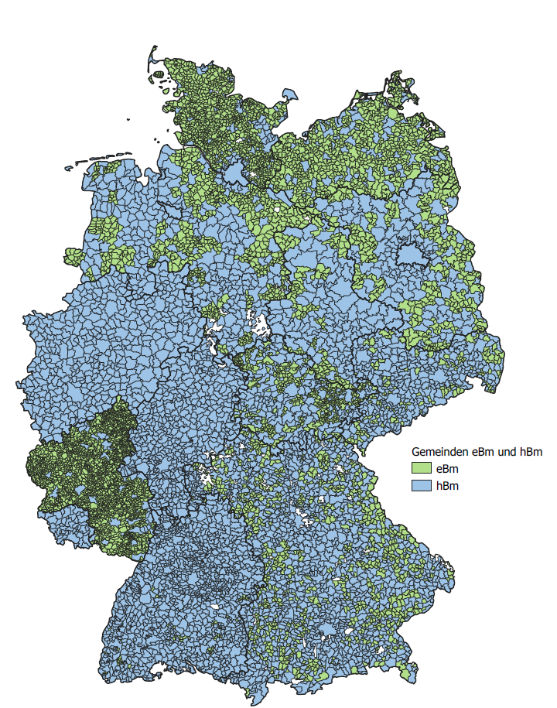
Mayors in Germany

Slide 3
Outline
Legal framework
Current state of research and dataset
Mayoral elections – range of candidate and election results
Conclusion: Two worlds of personal party politicisation
Notes:
Let`s have a look at our data on direct elections

Slide 4
1. Legal framework of mayoral elections
Election period: 5 – 10 years
Passive suffrage: EU citizenship, 18 – 23 years, primary residence
Active suffrage: EU citizenship, 16 – 18 years, primary residence
Nomination: by parties or voters‘ associations; individual by endorsement signatures
Winning rule: First ballot absolute majority, second ballot / run-off (2 best candidates) relative majority
Vote out: by council vote or public petition

Slide 5
2. Current state of research and dataset

Slide 6
Current state of research
Some research of Direct Elections of Mayors in Ländern: Mielke/Benzner 2000 Rhl.Pf., Gehne 2008 NRW, Klein 2014 BW, Klein/Lüdecke 2018 Hessen. For lager cities in Germany Holtkamp/Garske 2020
Current state of research is fragmented, databases are not comparable or homogeneous. Different timelines are covered. Candidate offer ist not often controlled in a an adaequate way.
Incumbent candidates are included as an important factor for election results. Their rate of election victories is very high.
Mayors can use their term to dominate in the local arena because of their high degreee of popularity.

Slide 7
Dataset mayoral elections in Germany
The data set "Mayoral elections in Germany" comprises 3,209 direct elections from 11 of the 13 federal states. Hesse and Baden-Württemberg could not be included.
Of the states included, 42% of the direct elections could therefore be taken into account.
Municipalities with fewer than 20,000 inhabitants were included in the data collection to a greater extent for the first time.

Slide 8
Dataset mayoral elections in Germany
Federal State | Number of elections | Elections included | Share
Schleswig-Holstein | 86 | 61 | 70,9
Lower Saxony | 291 | 182 | 62,5
North Rhine-Westphalia | 396 | 396 | 100,0
Rhineland-Palatinate | 2.301 | 273 | 11,9
Bavaria | 2.056 | 500 | 24,3
Saarland | 52 | 44 | 84,6
Brandenburg | 416 | 402 | 96,6
Mecklenburg-West. Pomerania | 726 | 427 | 58,8
Saxony | 419 | 208 | 49,6
Saxony-Anhalt | 218 | 218 | 100,0
Thuringia | 631 | 500 | 79,2
Total | 7.592 | 3.209 | 42,3

Slide 9
3. Mayoral elections – range of candidates and election results

Slide 10
Range of candidates
Federal state | n | Ø Number of candidates | Share of one candidate | Proportion of party candidates
Schleswig-Holstein | 59 | 3,2 | 20,3 | 47,3
Lower Saxony | 182 | 3,0 | 18,1 | 54,4
North Rhine-Westphalia | 396 | 3,5 | 10,9 | 72,5
Rhineland-Palatinate | 273 | 1,7 | 60,4 | 31,1
Bavaria | 500 | 2,6 | 31,8 | 62,5
Saarland | 44 | 3,2 | 6,8 | 83,3
Brandenburg | 402 | 2,3 | 38,3 | 35,3
Mecklenburg-West. Pomerania | 427 | 1,8 | 49,2 | 27,5
Saxony | 208 | 2,2 | 38,0 | 35,9
Saxony-Anhalt | 218 | 2,9 | 28,0 | 26,5
Thuringia | 500 | 1,8 | 55,8 | 28,3
Total | 3.209 | 2,4 | 37,3 | 43,1
Notes:
The average proportion of party candidates varies greatly

Slide 11
Degree of coverage

Slide 12
Incumbent mayors

Slide 13
Elected mayors and nomination groups

Slide 14
Direct Election of Mayors: Share of Successful Incumbents
Notes:
A lead that is very difficult to catch up with in the race

Slide 15
Concordance index and personal party politicisation

Slide 16
Conclusion: Regional profiles are different
World of villages: Small municipalities with fewer than 1,000 inhabitants without competition with only one candidate, often the non-partisan mayor, and without personal party politicization at all.
World of large cities: Municipalities with more than 50,000 inhabitants with intense competition (5 candidates and more) and a range of candidates strongly characterised by parties.
Incumbent Mayors are important and have a high success rate, but they are not unbeatable.

Slide 17
Contact Details:
Dr. David H. Gehne: david.gehne@rub.de
ZEFIR / RUB
Project on honorary mayors in rural Germany:
http://www.zefir.ruhr-uni-bochum.de/2021_ehrenamtliche_buergermeister_ebmland.html.de

Slide 18
Municipal concordant and competitive democracy
The design of municipal decision-making processes depends on various independent explanatory factors, including municipality size, the institutional arrangement of municipal constitutions, local political and cultural factors, and personal constellations
To describe the municipal decision-making structures, which vary greatly between the federal states, and the degree of party politicization, the pair of terms “municipal concordant and competitive democracy” is used as two different extreme types of representative democracy (Holtkamp 2008).

Slide 19
1. Personal party politicization - municipal concordant and competitive democracy

Slide 20
Concordance index (Holtkamp)
20

Slide 21
Personal party politicization
“The municipal concordant democracy is characterized by a low degree of party politicization of the council and mayors in the nomination, election campaign, election and government phases, while at the same time the mayor is strongly dominant. In contrast, competitive local democracy is characterized by strong party politicization in all phases and a less influential mayor.” (Holtkamp 2008)
The degree of party politicization can be described as the extent to which local political parties succeed in monopolizing local politics and elections in terms of personnel, content and procedures (Hans Georg Wehling).

