Slide 1
SOCIALIZATION

Slide 2
Definition
By socialization we mean:
the gradual growth of an individual into society,
adaptation to society,
acquiring desirable forms of behaviour,
adapting to social roles,
and internalizing the values and opinions of society.
Notes:
Positive: Optimism, confidence, self-esteem, extraversion, emotional strength, friendliness, creativity. Negative: Irrationality, fear, emotional fragility, depression, anxiety, suicide.

Slide 3
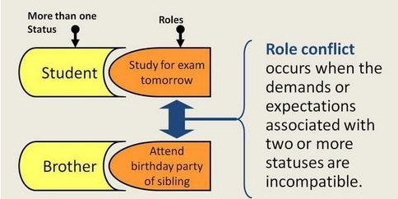
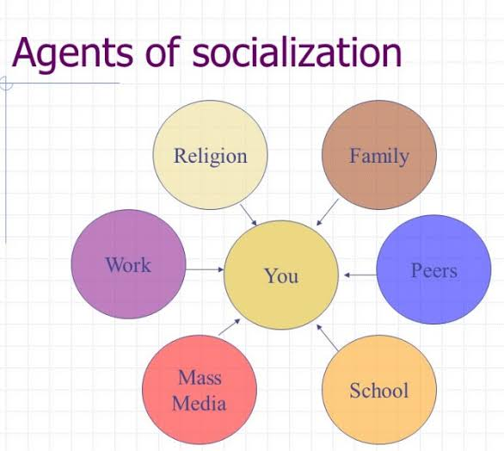
Social roles; role conflict

Slide 4
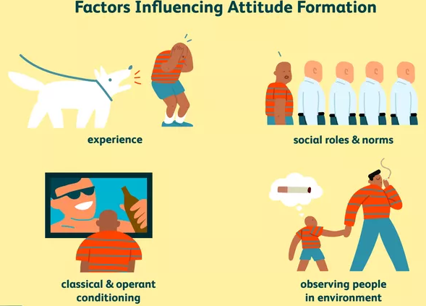
Attitude formation
Social roles and social norms can have a strong influence on attitudes. Social roles relate to how people are expected to behave in a particular role or context. Social norms involve society's rules for what behaviours are considered appropriate.

Slide 5
Socialization
Socialization is a process of learning
Socialization is not only term but a full process of learning of individuals how to conduct their life, morals and values.
Converts Individual from bio-logical being to social being
Socialization converts individual from a biological bearing to social being and social entity.
Personality Development
Socialization play a vital role in personality and self-development as self is not inherited but acquired from the society by individual.

Slide 6
Social process
During social processes, children acquire social values and norms,
socialization has been going on for life.
The goal is to form a person that will behave as if it were under the constant supervision of other members of the group.

Slide 7
Without socialization
the individual is unable to enter into normal interactions with the other members of the group - the socially disturbed individuals;
the society is not able to pass on values and standards to the next generation and is falling apart.

Slide 8
Internalization
Socialization can be described as any integration into a new social group, as long as it is connected with internalisation;
Internalization - full acceptance of the values and standards that the social system represents.

Slide 9
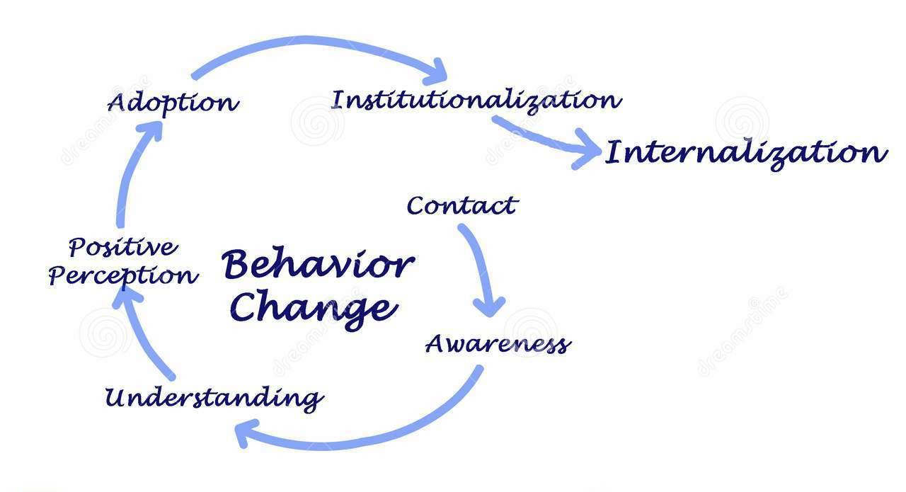
Internalization in graphs
Performance/Motivation graph : from denial to internalization
Behavior Changes leading to internationalization

Slide 10
Introjection and internalization are used interchangeably
An example of introjection might be a dad telling his son “boys don’t cry”- this is an idea that a person might take in from their environment and internalize into their way of thinking.
The child isn’t necessarily identifying with the person who said this (their dad), but they take it in and it becomes part of how they see the world (and consequently, how they believe they should behave).
Over time, this might lead to identification with the individual (father) who said it. This would look like the son following in their dad’s footsteps and becoming like their dad in more ways than just this belief.

Slide 11
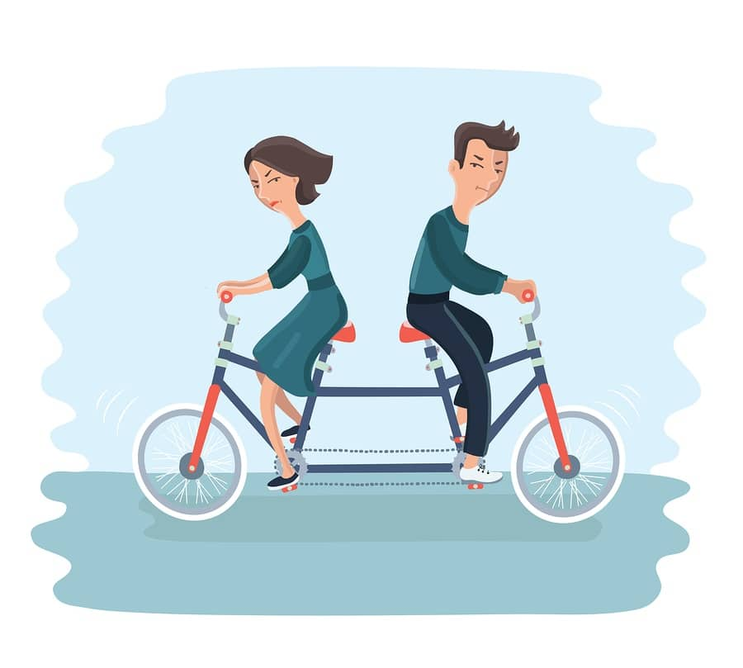
Example:
The correct answer is C, identification.
Introjection (A) occurs when a person internalizes an idea or voice of another person-often an authority figure. So if it said the husband just internalized his father’s idea that “women do the housework” this would be introjection. While this has occurred, more than this has occurred. Remember, introjection and identification are very similar and on a continuum; introjection often leads to identification (as has happened in this scenario).
Intellectualization (B) is when a person removes themselves emotionally from something stressful by focusing on reasoning/thinking to avoid feeling. This is not occuring in the scenario above.
Identification (C) occurs when a person not only takes on a belief or voice of another person, but also begins to identify with that individual. In this case, the husband has not merely taken on the idea that women should do the housework; rather, he sees himself as the head of his household, like his father. He is identifying with his father. Because of this identification, he expects to be treated like his father, with his wife respecting him and treating him as his mom treated his dad.
Reaction formation (D) is when a person acts opposite to their unacceptable thoughts and emotions. We do not see the husband acting opposite to his thoughts or emotions in this scenario.
A young married couple presents for counselling due to ongoing disagreements about roles within their marriage. The wife explains that she “never signed up to be his mom” and resents being expected to do all of the cooking and cleaning. The husband states, “I’m not asking for anything different than what my parents had. As the head of the house, I expect to be respected like my mother respected my father.” What defence mechanism is the husband using?
Introjection
Intellectualization
Identification
Reaction Formation
Correct Answer

Slide 12
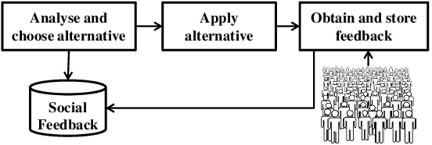
Social adaptation
As far as external adaptation is concerned, we are talking about adaptation.
Social interaction and communication with other people are a necessary condition for socialization.
adaptation

Slide 13
Resocialization
The disintegration of values and behavioural patterns adopted so far is followed by the adoption of new, radically different ones (e.g. new image).
In certain circumstances, even in adults e.g.:
psychiatric hospital,
prison,
barracks,
concentration camp.

Slide 15
Conformity I.
Compliance with standards and rules of the society - giving life a certain order in society; distinguish us from animals.
Conformity
Zimbardo prison experiment

Slide 16
Conformity II.
Socialization is not conformism - a degree of individuality is applied, yet a well socialized person behaves in a conformist way.
Conformism is actually relative and which is thought to be a conventional way of living at one place, might seem like a rebellious act in some other part of the world.
Conformity

Slide 17
Deviant behavior
Behaviour that does not conform with respect to some standard or set of standards accepted by most people in a given society.

Slide 18
Devience_explanation

Slide 19
Cultural differences
Standards and values vary from one culture to another (e.g. view of homosexuality, polygamy, polyandry, etc.);
each of us sometimes breaks the norm, followed by sanctions (legislative, social convictions).
Cultural diversity

Slide 20
Thank you for your attention

