Slide 1
Contemporary Theories of Consciousness
5
Non-Reductive Biological Theory

Slide 3
1992

Slide 4
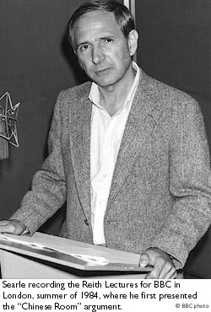
John Searle: Critique of AI
1. Chinese Room
2. Observer-relative

Slide 5
Today
What is consciousness according to John Searle?
Is a physicalist reduction possible?
Questions

Slide 6
1. What is Consciousness According to John Searle?

Slide 8
Consciousness
Objective (epistemically speaking)

Slide 9
Consciousness
Objective (epistemically speaking)
Subjective (ontologically speaking)

Slide 10
Consciousness
Objective (epistemically speaking)
Subjective (ontologically speaking)
‘Ontological subjectivity’

Slide 11
Consciousness
Objective (epistemically speaking)
Subjective (ontologically speaking)
‘Ontological subjectivity’
Property of systems

Slide 12
Consciousness
Objective (epistemically speaking)
Subjective (ontologically speaking)
‘Ontological subjectivity’
Property of systems
Emergent property of systems

Slide 13
2. Is a Physical Reduction Possible?

Slide 14
Reductions
Ontological Reduction: Identity of composition (chairs are collections of molecules; genes are DNA).
Causal Reduction: Causal power of one entity are nothing more than the causal powers of another entity (heat is the kinetic energy of molecular movement; colour is reflectance of surfaces).

Slide 15
As a rule:
Causal Reduction → Ontological Reduction

Slide 16
But consciousness is different (and unique)
“But where the phenomena that interest us most are the subjective experiences themselves, there is no way to carve anything off. Part of the point of the reduction in the case of heat was to distinguish between the subjective appearance on the one hand and the underlying physical reality on the other. Indeed, it is a general feature of such reductions that the phenomenon is defined in terms of the “reality” and not in terms of the “appearance”. But we can’t make that sort of appearance-reality distinction for consciousness because consciousness consists in the appearances themselves. Where appearance is concerned we cannot make the appearance-reality distinction because the appearance is the reality.”
Searle, p. 122

Slide 17
“Where appearance is concerned we cannot make the appearance-reality distinction because the appearance is the reality.”

Slide 18
Causal emergentism
“… consciousness is a causally emergent property of systems. It is an emergent feature of certain systems of neurons in the same way that solidity and liquidity are emergent features of systems of molecules. The existence of consciousness can be explained by the causal interactions between elements of the brain at the micro level, but consciousness cannot itself be deduced or calculated from the sheer physical structure of the neurons without some additional account of the causal relations between them.”
Searle, p. 112

Slide 19
Causal efficiency
“There is nothing mysterious about such bottom-up causation; it is quite common in the physical world. Furthermore, the fact that the mental features are supervenient on neuronal features in no way diminishes their causal efficiency. The solidity of the piston is causally supervenient on its molecular structure, but this does not make solidity epiphenomenal; and similarly, the causal supervenience of my present back pain on micro events in my brain does not make the pain epiphenomenal.”
Searle, p. 126

Slide 20
Searle’s Non-Reductive Biological Theory
“Consciousness is a feature of the brain”
It is a feature of the system.
Causally reducible to the brain
Biological emergentism

Slide 21
Searle’s Non-Reductive Biological Theory
“Consciousness is a feature of the brain”
It is a feature of the system.
Causally reducible to the brain
Biological emergentism
BUT
Consciousness is not identical to neurological activity.
Consciousness is ontologically irreducible

Slide 22
3. Questions

Slide 23
Questions
(i) Epiphenomenalism?
(ii) Property dualism?
(iii) Can we really distinguish between causal power and the real nature of a thing?

Slide 24
Questions
(i) Epiphenomenalism? No, because consciousness is a systems property
(ii) Property dualism?
(iii) Can we really distinguish between causal power and the real nature of a thing?

Slide 25
Questions
(i) Epiphenomenalism? No, because consciousness is a systems property
(ii) Property dualism? Possibly.
(iii) Can we really distinguish between causal power and the real nature of a thing?

Slide 26
Questions
(i) Epiphenomenalism? No, because consciousness is a systems property
(ii) Property dualism? Possibly.
(iii) Can we really distinguish between causal power and the real nature of a thing? What is left when causal reduction is complete?

Slide 27
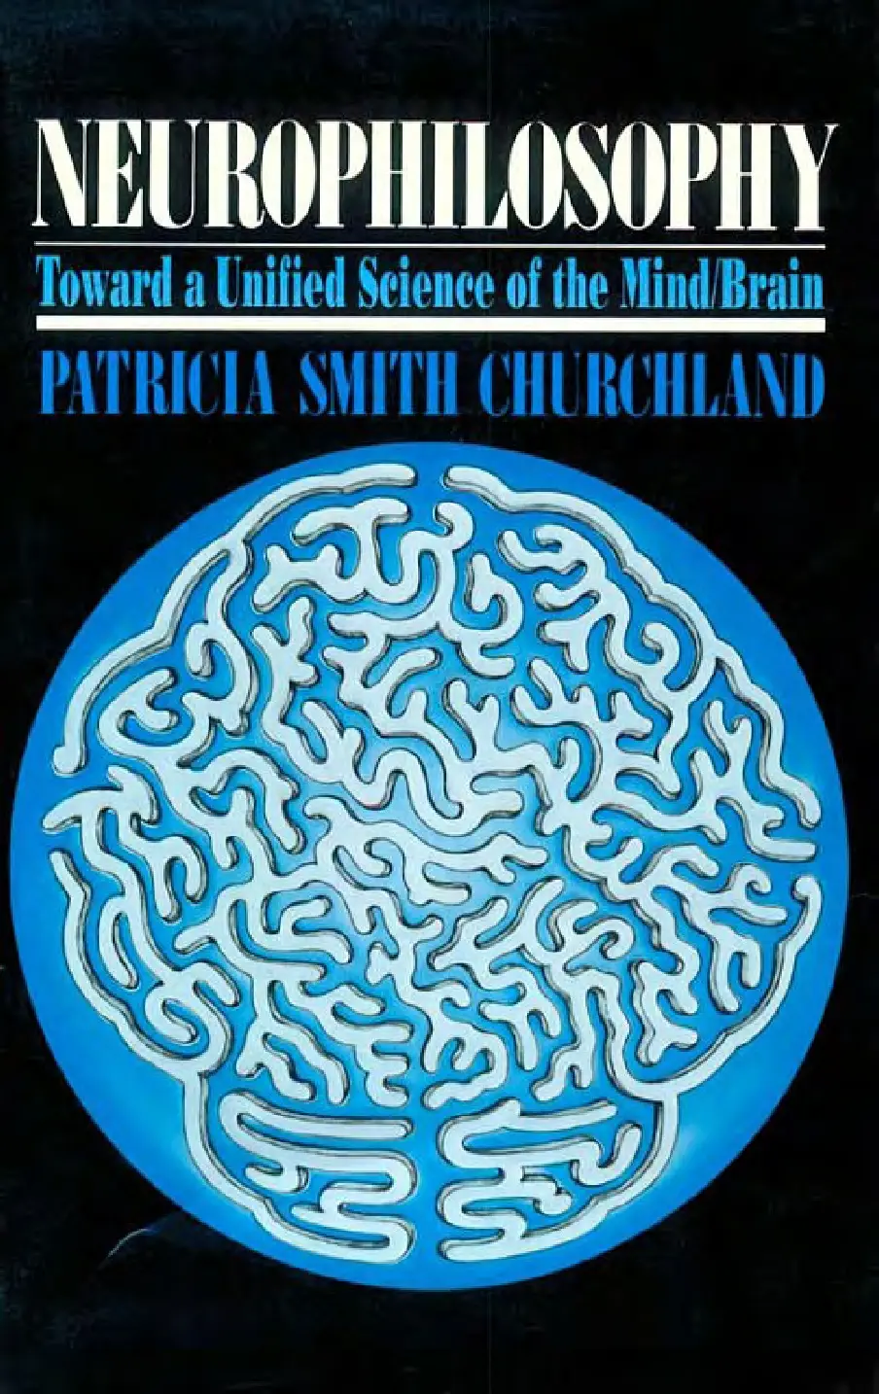
1. Reductive biological theory
Patricia Churchland

Slide 28
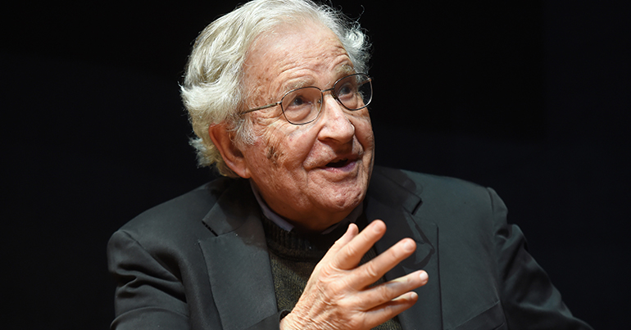
Next Week
Noam Chomsky, ‘The Mysteries of Nature: How Deeply Hidden?’
The Journal of Philosophy, 106 (4), April 2009

