Slide 1
Maps as Visual Sources
Davi Costa da Silva

Slide 2
Contents
Map Wars
THE History of Cartography?
Practical tips: J. B. Harley’s “DOs”
Digital maps and the mediated experience
References

Slide 3
1. Maps wars: Positivism x Culturalism
Positivism: cartography as “Science”
Claim of being an objective representation of the real world (space shapes maps)
Claim of constant progress towards greater precision
Teleology: was precision that important for early Western peoples?
Culturalism: cartography as encoded social practice in space
As language: one of the earliest forms of human communication
“Memory banks for spatial data and as mnemonics in societies without printing” (Harley …).
“Real” world questioned: cosmologic maps, utopias
Maps (culture) shapes space: we know the world via maps; open spaces

Slide 4
1.1 A little ice-breaker

Slide 5
2. Historiography of Cartography
Is there such a thing as THE history of cartography?
It usually falls on traps like:
Eurocentric evolutionism
Disenchantment (M. Weber): Magic – Religion - Science
Missing the negotiated character of cartographic conventions
Staying as a collection of poorly related picture album of regional histories.

Slide 6
2.1 What about non-Western maps?
Issues of definition: umbrella terms like “document” and “picture”
Arabic:
Chinese:

Slide 7
3. Harley’s “DOs” for pre-modern and modern maps
Panofsky’s layers of meaning with special attention to:
Size
The larger, the more significant
Centrality
Tendency of putting one’s ethnic group at the center*
Colour
Expression of emotions towards a given space. Pink as indicator of imperialism*
Script
Size, colour, shape… place names
Silence
Omissions (dominated peoples), intentional blank spaces
Accuracy (modern maps)

Slide 8
3.1 What else to notice?
Source
Survey(s) date(s)
Is it a copy?
Printing date
Internal evidence (style, elements represented)
External evidence (watermark, type of material or printing)
Why was it made?
Audience

Slide 9
A few examples

Slide 10
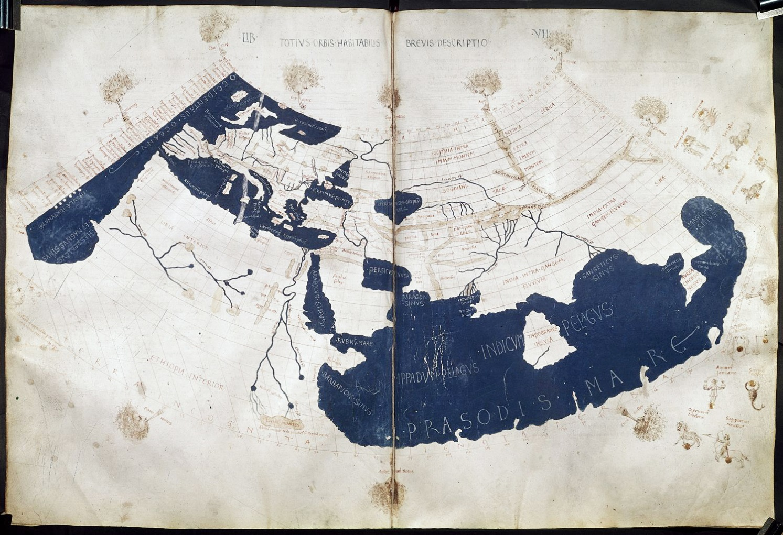
Ptolemy’s Geographia and Cosmographia
c. AD 150
Compilation of the know world
Influenced European Renaissance maps and medieval Caliphate maps
1 world map and 60+ regional maps
Re-entered Europe in 1301 by the Byzantine Maximus Planudes (translation to Latin)

Slide 12
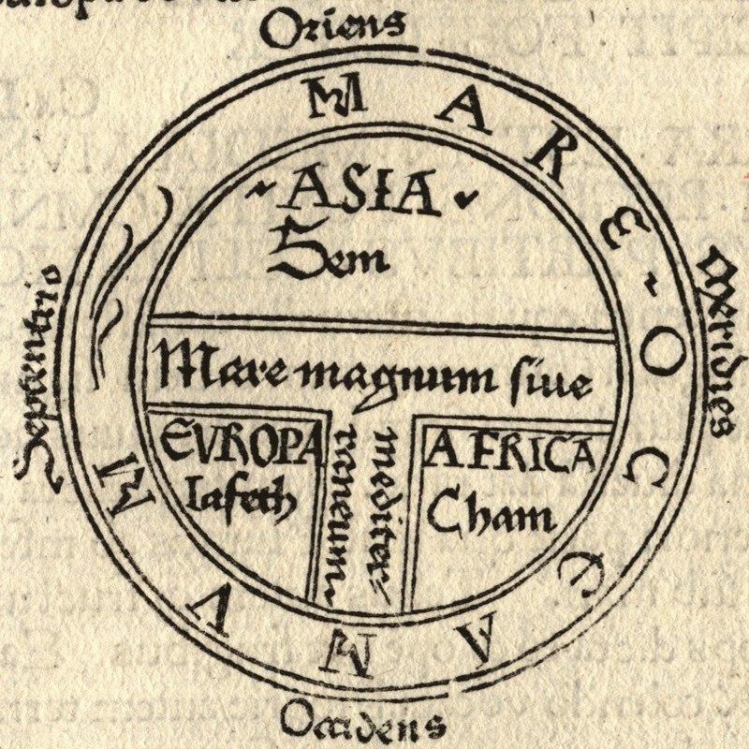
Orbis terrarium (O-T map)
The [inhabited] mass of solid land is called round after the roundness of a circle, because it is like a wheel [...] Because of this, the Ocean flowing around it is contained in a circular limit, and it is divided in three parts, one part being called Asia, the second Europe, and the third Africa.
- St. Isidore of Seville, Etymologie, c. 630
“Oriented” map: Garden of Eden in the East
Medieval Europe

Slide 13
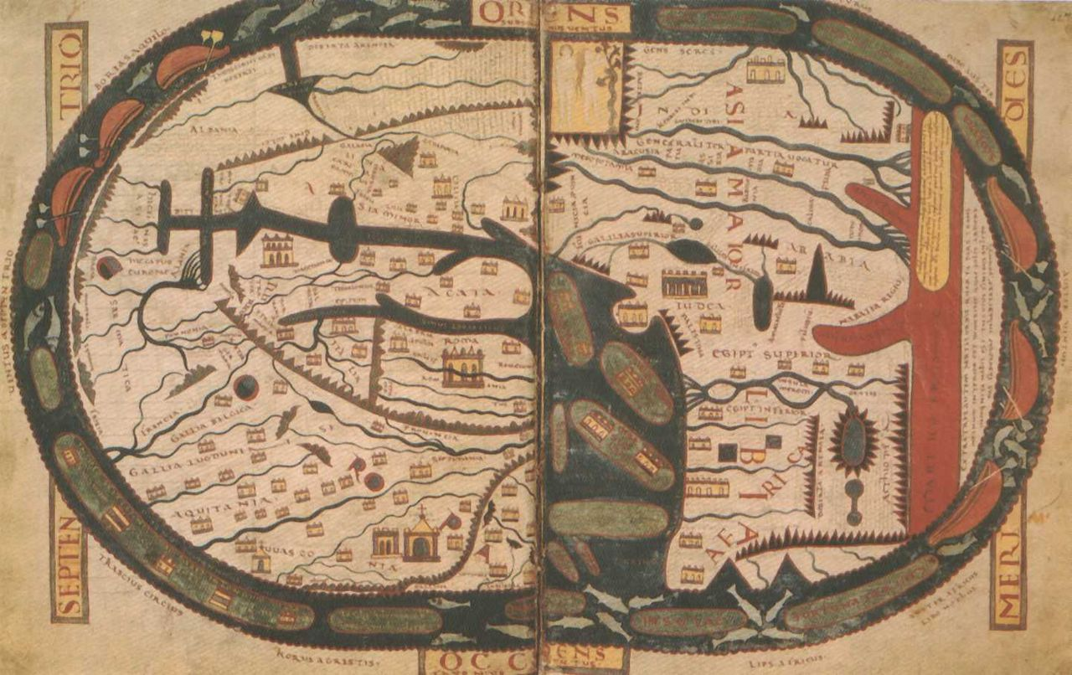
Beatus O-T map
Beatus of Liébana, 8th Century
Oldest manuscripts date from 11th Century
Oriented: Garden of Eden with the four rives flowing from it
Rome and Jerusalem as centres
Intention was to show the Diaspora of the Apostles

Slide 14
Beatus O-T map
The [inhabited] mass of solid land is called round after the roundness of a circle, because it is like a wheel [...] Because of this, the Ocean flowing around it is contained in a circular limit, and it is divided in three parts, one part being called Asia, the second Europe, and the third Africa.
- St. Isidore of Seville, Etymologie, c. 630

Slide 15
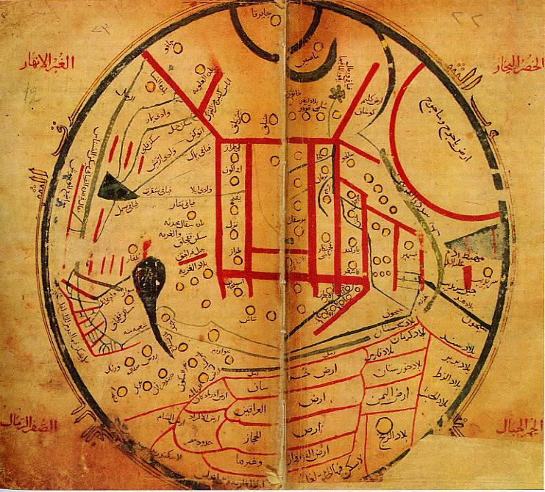
Islamic maps
Mahmud al-Kashgari (Mahmud from Kashgar), Diwan Lugat at-Turk (The Compendium of the Turk Dialects), 1072-74
Illustrate Turkic world in relation to the known world
Center at Turkish speaking areas of Central Asia, Balasaghun City (Turkish Khans)
Blue: rivers
Green: seas
Yellow: deserts and cities
Red: mountains

Slide 16
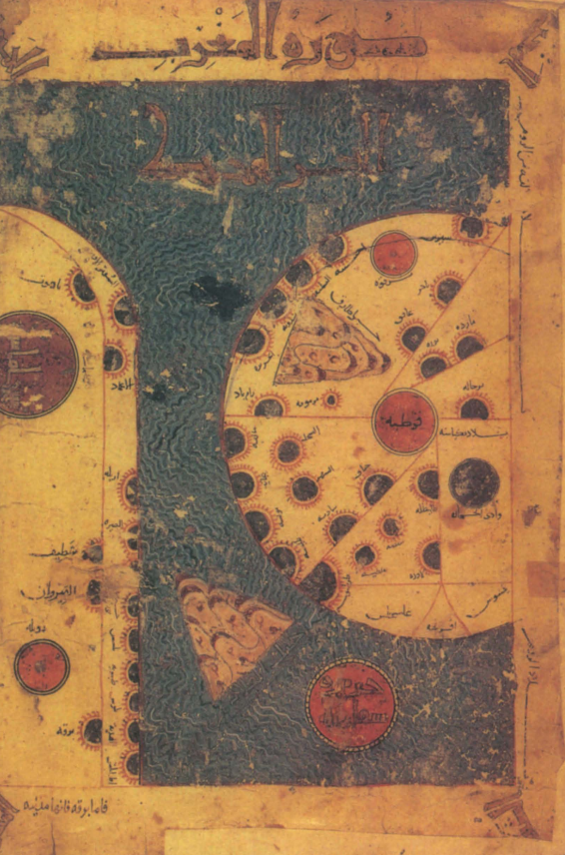
Istakhri I manuscript
Abu Ishaq Ibrahim ibn Muhammad al Farisi al Istakhri (“Abu Ishaq Ibrahim son of Muhammad from Persia’s Estakhr”)
569 (1173)
Persian traveler and “geographer”

Slide 18
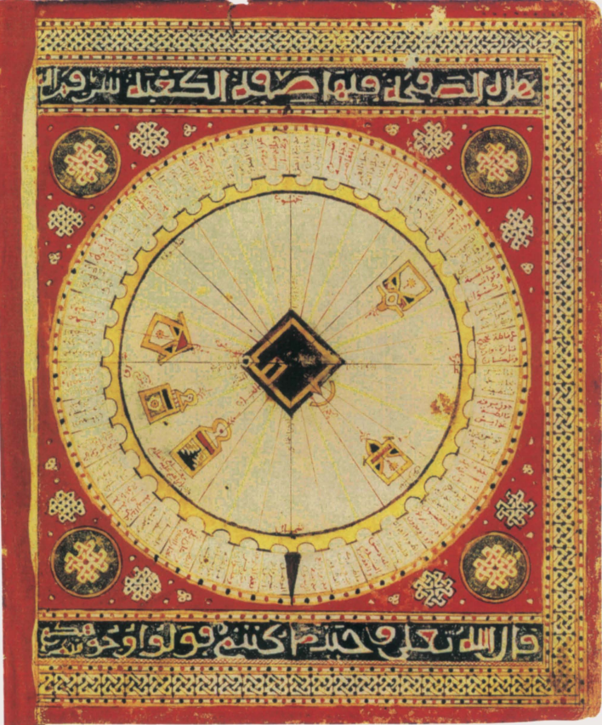
Islamic maps
Qibla diagram (‘Ali ibn Muhammad al Sharaft al-Sifaqsi, 958 (1551)
32-point wind rose (Mecca)

Slide 19
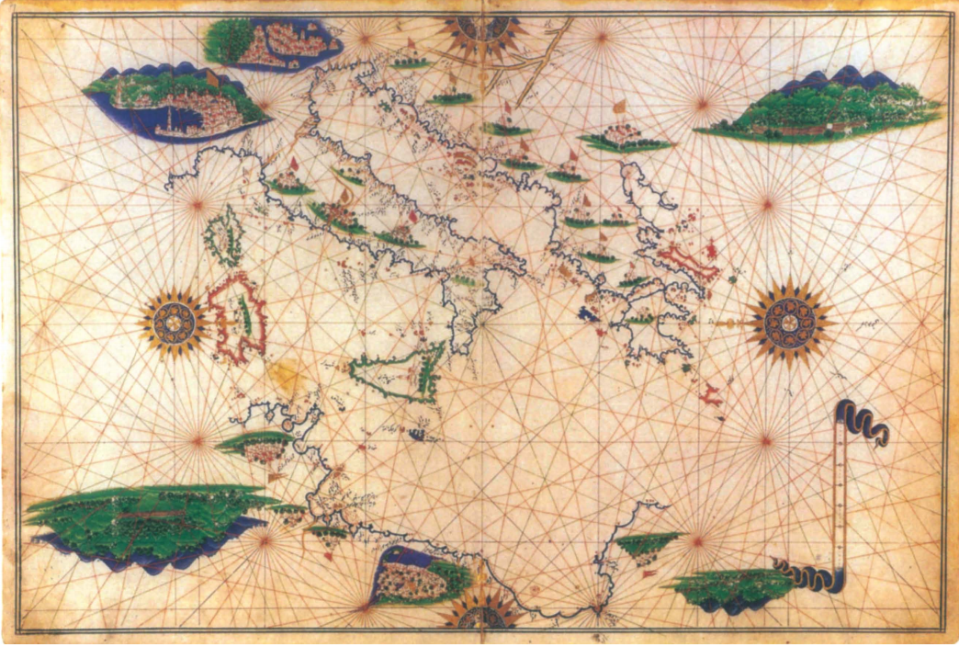
The Walters Deniz atlasi
Ottoman atlas from the 16th-C.
82 double pages
Italy and the Mediterranean
Compilation of Italian and Ottoman charts
Names along the costs and Danube
Portolan map (navigation) - Islamic 32-point rose wind

Slide 21
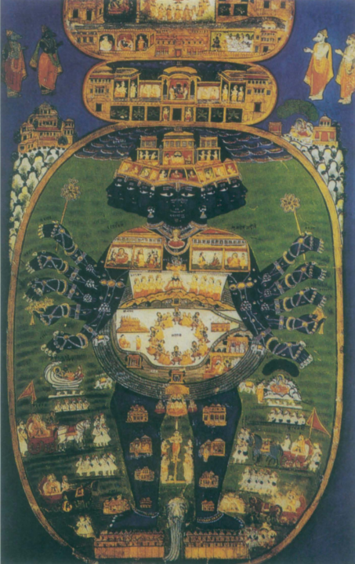
Cosmographic maps
18th Century depiction of Vishnarupa
Bhagavad Gita passage, Vishna/Krishna showed the entire universe on his body
War between two armies from the entire world
Yamuna river in the center
Stands on a serpent (sustains the universe)

Slide 23
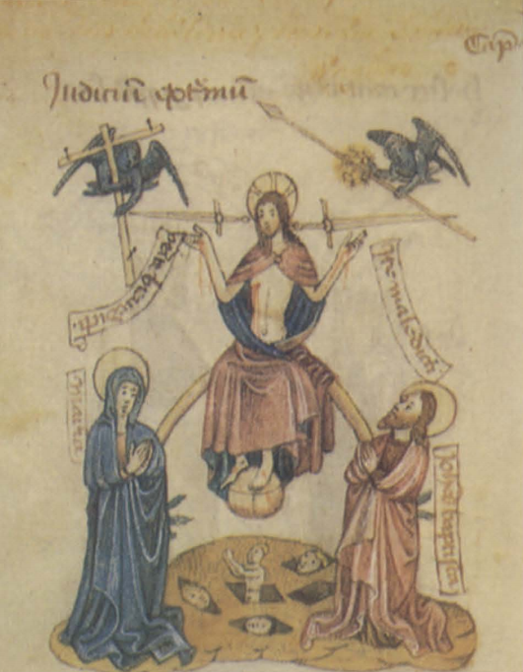
Cosmographic maps
Europe:
O-T maps and Judaic-Christian depiction of the cosmos

Slide 24
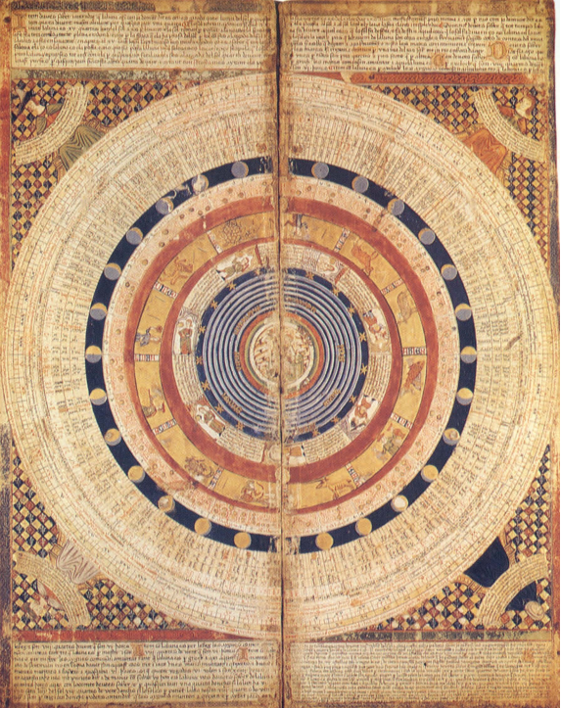
Cosmographic maps
Enlightenment Mechanical concept:
God as the Clockmaker
The Catalan Atlas, 1375

Slide 25
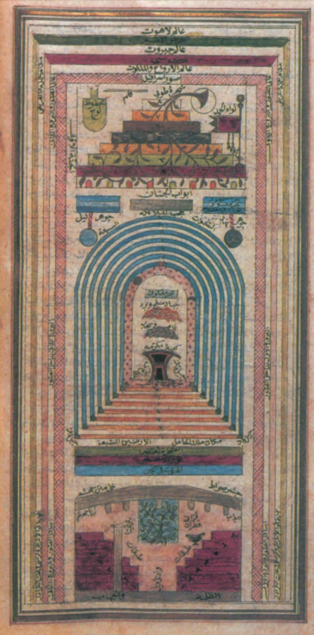
Cosmographic maps
Ibrahim Hakki Erzurumi (sufi saint and philosopher), Marifetname (Book of Gnosis), 1756.
Cosmos evolved by three divine layers (transcendence, omnipotence, and sovereignty)
Heaven (8 gates/layers), Earth (surrounded by 7 heavenly spheres), Hell (7 layers), each one having its tree

Slide 26
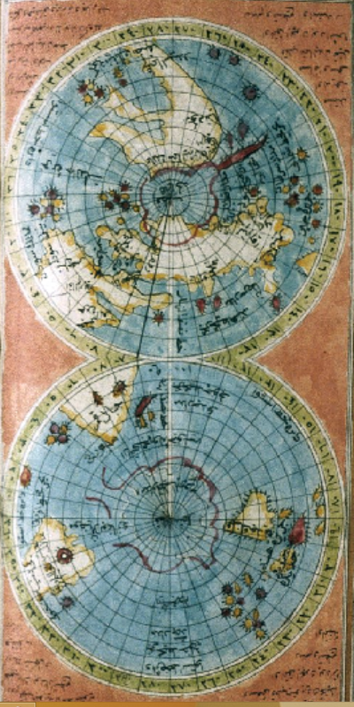
Something extra!
Size of America

Slide 27
Conventions: North on the top
Europe O-T maps: Orient on the top
Earlier European maps: South at the top based on Arabic tradition
16th Century: navigation and European association of North with Northen Star
Ptolemy is rediscovered in Europe and became an obsession

Slide 28
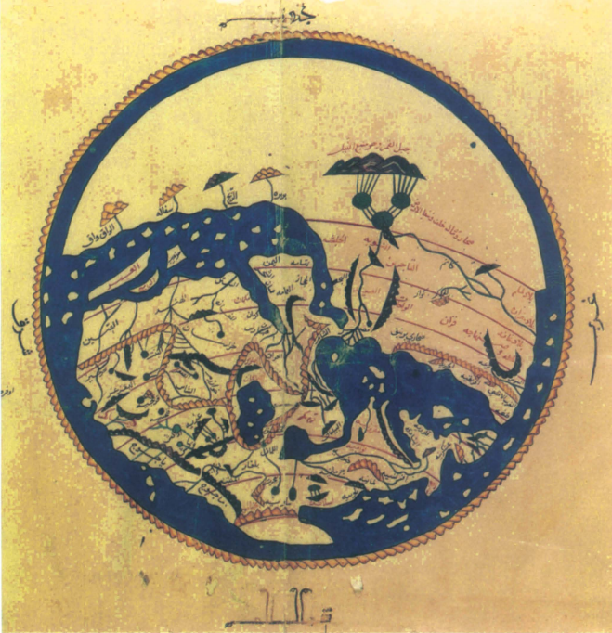
Muhammad al-Idrisi
1154

Slide 29
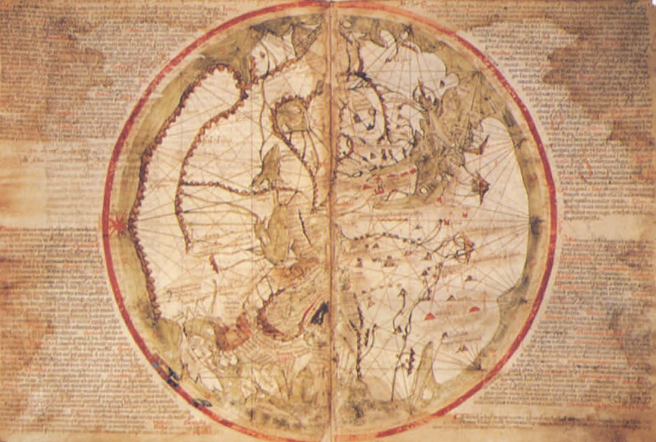
Pietro Vesconte
Mappamundi
1321

Slide 30
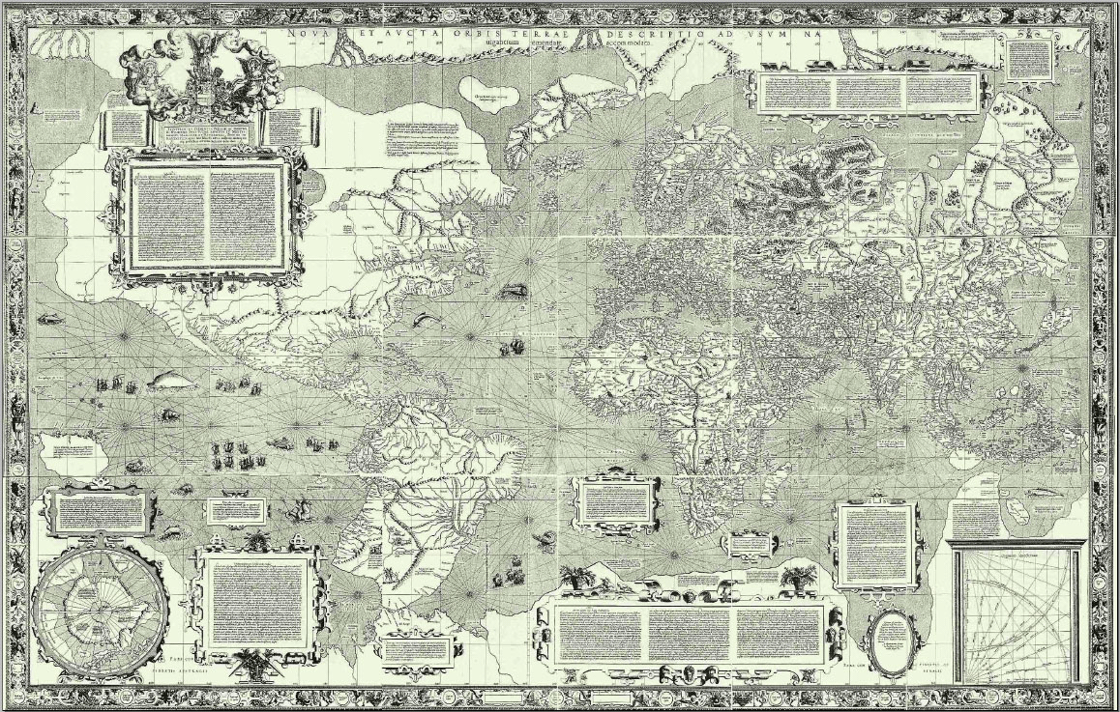
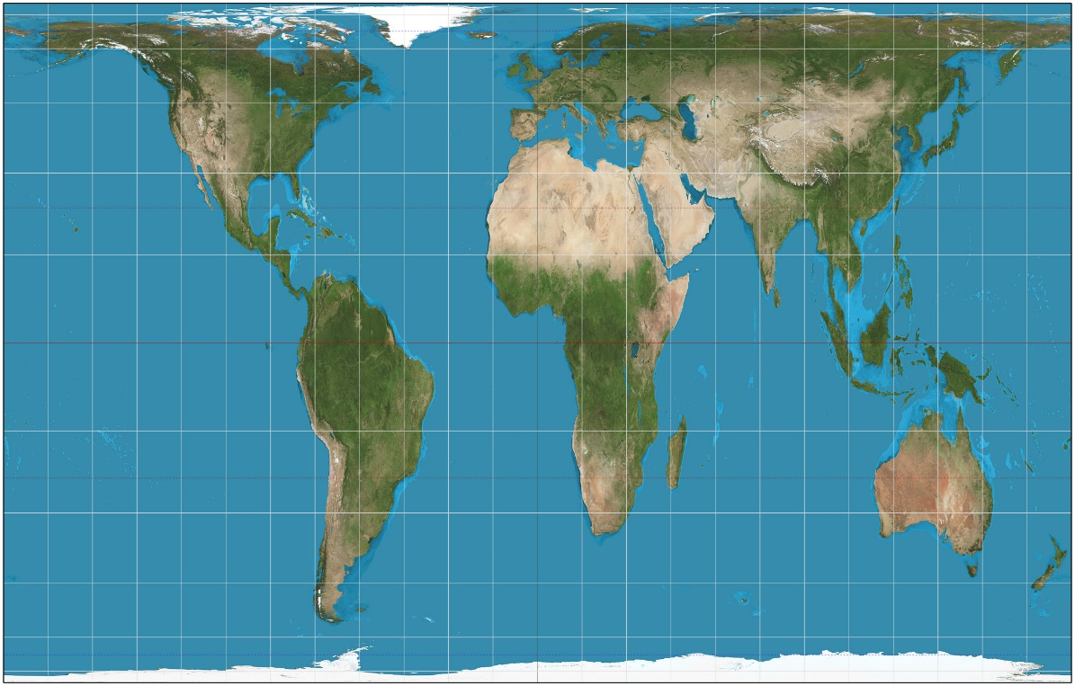
Conventions: Mercartor vs Gall-Peters
Gerardus Mercator, 1569
Navigation, Shape
James Gall and Arno Peters, 1885/1970
Criticism of Eurocentrism, Area

Slide 31
4. Digital maps and the mediated experience
Digital satellite image as the end of the history of cartography?
Apotheosis of objectivism: perfect accuracy
Politics: shadowed or pixled areas (e.g. Google Maps: Israel, Western nuclear/military facilities)
Mediated experience
Your or my map? Customization, Social Media bubble and public space
Maps are social practices in space -> Tech Giants as a intermediate visibility layer
Market forces: promotion or exclusion of partners or concurrence

Slide 32
5. References
Harley, John Brian and Woodward, David. The History of Cartography. Volumes 1-2. Chicago and London: The University of Chicago Press. 1987-1994.
Andrews, J. H. “Introduction: Meaning, Knowledge, and Power in the Map Philosophy of J. B. Harvey”. In Harley, J. B., The New Nature of Maps: Essays in the History of Cartography, edited by Paul Laxton. Baltimore: The John Hopkins University Press. 2001.
Hobsbawm, Eric J. “The World Unified”. In The Age of Capital: 1848 – 1875, 64 – 87. London: Abacus. 1977.
Mozorov, Evgeny. “My Map or Yours?: Google’s plan to personalize maps could end public space as we know it”. Future Tense, May 28, 2013, http://www.slate.com/articles/technology/future_tense/2013/05/google_maps_personalization_will_hurt_public_space_and_engagement.html.

Slide 33
(OMG Time’s over)
Thank you! :)

Slide 34
Title and Content Layout with Chart

Slide 35
Two Content Layout with Table
First bullet point here
Second bullet point here
Third bullet point here
Class | Group A | Group B
Class 1 | 82 | 95
Class 2 | 76 | 88
Class 3 | 84 | 90

Slide 36
Two Content Layout with SmartArt
Task 1
Task 2
Task 3
Task 4
Task 5
First bullet point here
Second bullet point here
Third bullet point here

Slide 37
Add a Slide Title - 1

Slide 38
Add a Slide Title - 2

Slide 39
Add a Slide Title - 3

Slide 41
Add a Slide Title - 4

Slide 42
Add a Slide Title - 5

