Slide 1
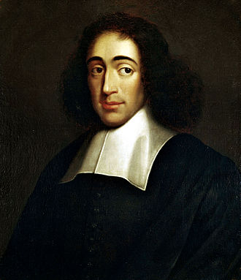
Baruch Spinoza
And
The Critique of rabbinic judaism
In the Tractatus theologico politicus

Slide 2
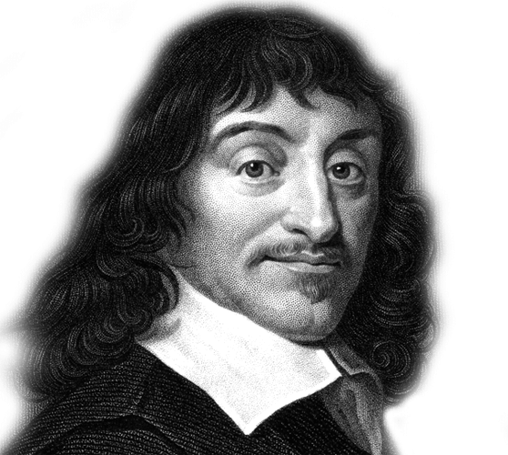
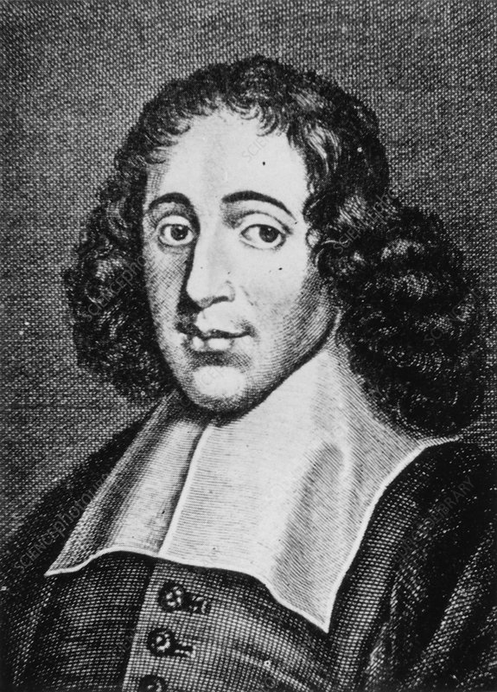
The essential question of metaphysics:
WHAT IS?
René Descartes
Baruch Spinoza
DEUS
RES EXTENSA
RES COGITANS
SUBSTANCE, ITS ATTRIBUTES AND MODES
dr. Arthur Holmes, Professor of philosophy at Wheaton College, lecture on Spinoza´metaphysics
https://www.youtube.com/watch?v=x7qmv1HTE4I

Slide 3
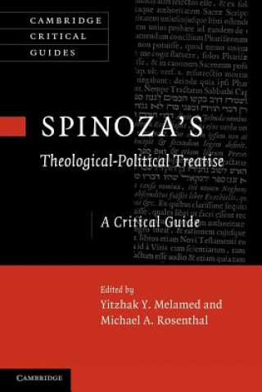
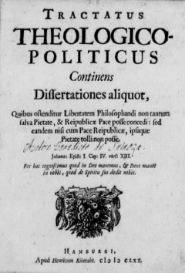
Published in
1670

Slide 4
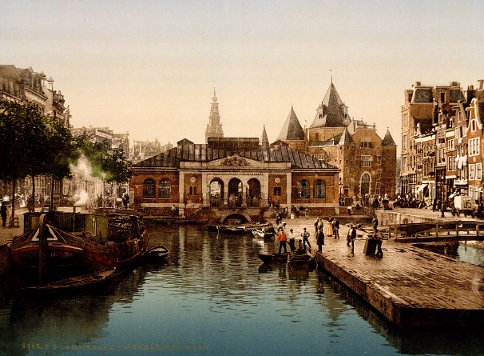
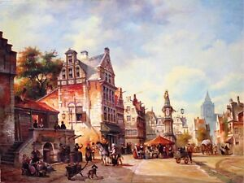
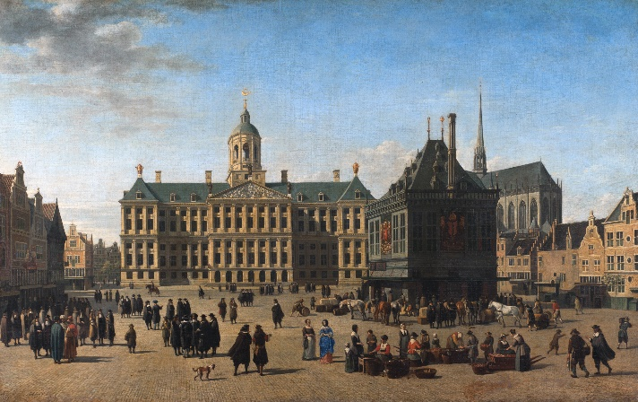
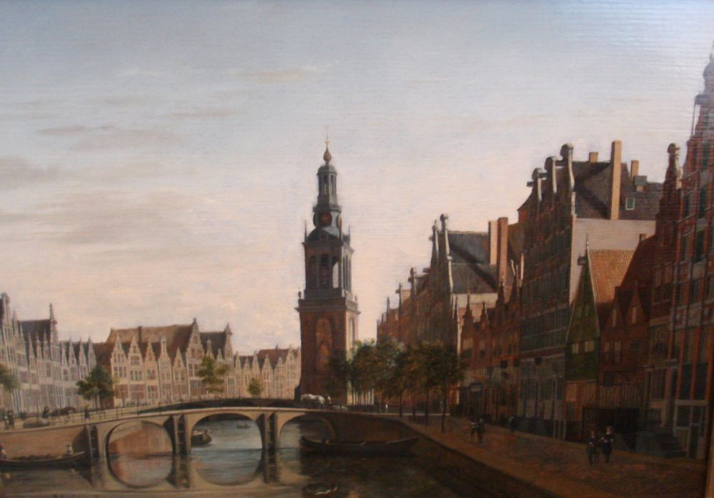
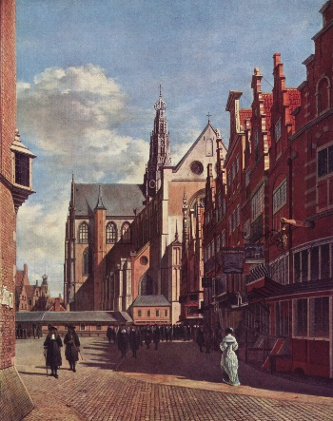
Baruch (Benedictus, Bento) Spinoza
- born in 1632 in Amsterdam
- second son of Miguel d´Espinoza; Sephardic origin
- traditional Jewish upbringing - predestinated for a career as a rabbi
- after 1649, helps run the family’s importing business

Slide 5
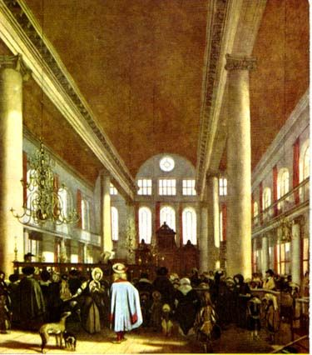
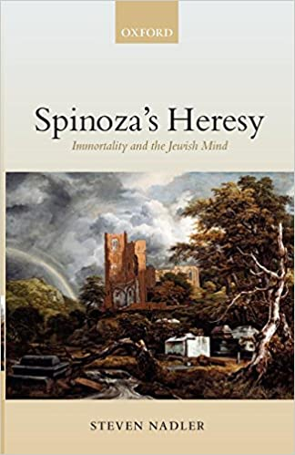
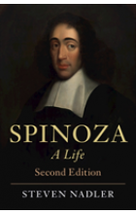
- after 1650, studies with Franciscus van den Enden, the probable author of two anonymous pamphlets: Brief Account of New Netherland and Free Political Proposals; introduction to scholastic philosophy and texts of Descartes
- 27th July 1656: excommunication (cherem) from the Sephardic community of Amsterdam
the reasons of excommunication: “monstrous deeds” and “abominable heresies”
Two of Steven Nadler´s books related to the life of Spinoza
Emanuel De Witte's painting of the interior of the Sephardic Synagogue in Amsterdam founded in 1675

Slide 6
“Abominable heresies”
in later works of Spinoza
- denies the immortality of the soul;
- rejects the notion of a transcendent God, the God of Abraham, Isaac and Jacob;
- the Tora is not literally the word of God but rather a work of human literature;
- the “true religion” has nothing to do with theology and liturgical ceremonies but it consists only in a simple moral rule: love your neighbour;
- ecclesiastic authorities should have no role in the governance of a modern state;
- Divine providence is nothing but the laws of nature;
- miracles, understood as violations of the natural order of things, are impossible.

Slide 7
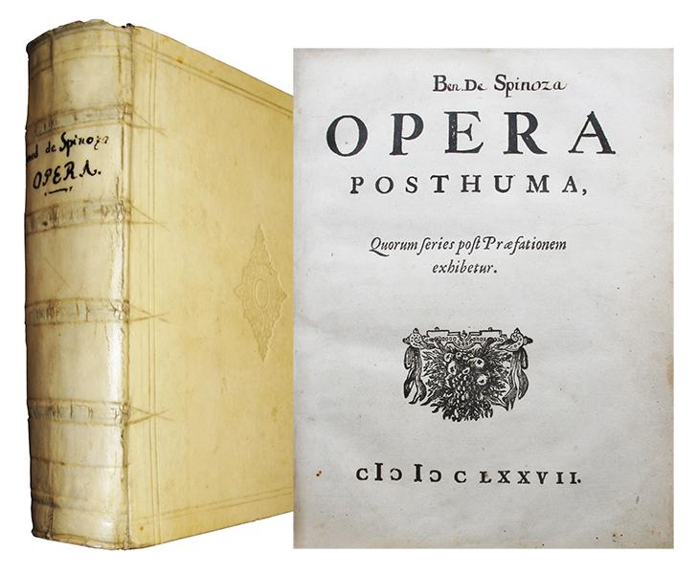
lived in Rijnsburg
Treatise on the Emendation of the Intellect
Short Treatise on God, Man and His Well-Being
moved to The Haag
Descartes’s Principles of Philosophy.
Ethics
Theological-Political Treatise
died in 1677 in The Hague
Opera posthuma
Ethics, Political treatise, Compendium to Hebrew Grammar, letters

Slide 8
Theological-Political Treatise
- published anonymously in 1670
- “a book forged in hell by the devil himself”
Spinoza targets standard religious ways of thinking about:
prophecy
miracles
God´s “election” of the Jewish people
the Tora
role of religion in the modern state

Slide 9
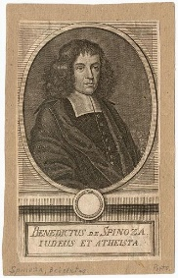
Title page
Theological political treatise
containing several discourses which demostrate
that freedom to philosophize
may not only be allowed without danger to piety
and the stability of the republic but cannot be refused without destroying the peace of the republic
and piety itself.
Chapter 1, On prophecy
Paragraph 1: prophet = orator, interpreter
Paragraph 2: prophetic knowledge vs. natural knowledge (?)
natural → prophetic → divine
Paragraph 3: prophets grasp the divine knowledge → men grasp with
the certainty natural phenomena.
Paragraph 4: light of reason enables men to understand natural =
divine phenomena

Slide 10
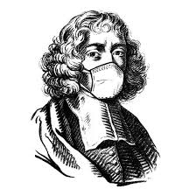
A homework:
Read the chapter about Spinoza in Leaman´s History of Jewish Philosophy, p. 246 – 265.
Choose one of Spinoza´s critical objections against traditional rabbinic Judaism and explain it in your own words.
Send me your paper via e-mail before 15th May.
For more information on Tractatus Theologico Politicus, see:
https://plato.stanford.edu/entries/spinoza-political/

