Slide 1
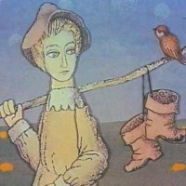
The Sorcerer´s Apprentice Analysis Concept of the Other Side

Slide 2
The Sorcerer´s Apprentice Analysis Concept of the Other Side Where is the other side?

Slide 3
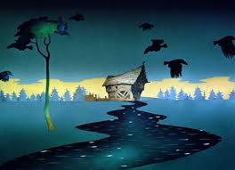
The Sorcerer´s Apprentice Analysis
The Black Mill = the world of
magic

Slide 4
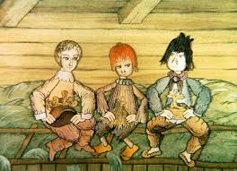
The Sorcerer´s Apprentice Analysis
the world of
everyday life
The Black Mill = the world of
magic

Slide 5
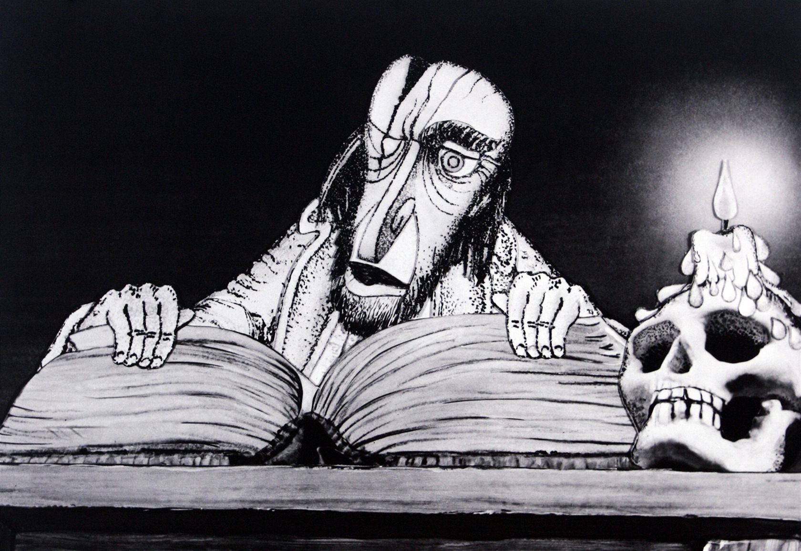
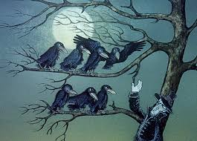
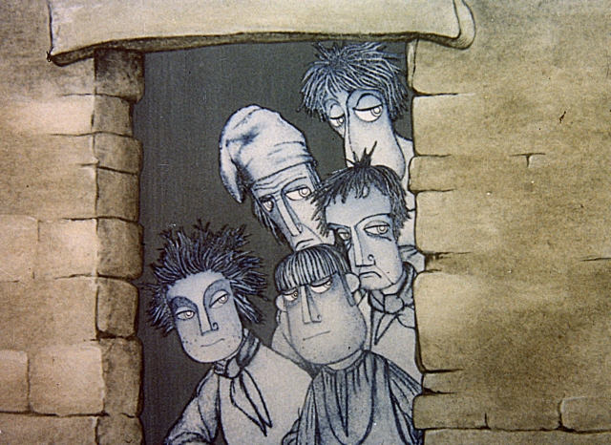
The Sorcerer´s Apprentice Analysis
the world of
everyday life
The Black Mill = the world of
magic
the Sorcerer = Master
crows
anxiety, fear, terror
grey, dark colours

Slide 6
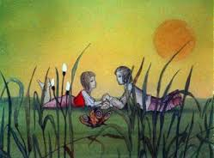
The Sorcerer´s Apprentice Analysis
the world of
everyday life
ordinary people
colours
The Black Mill = the world of
magic
the Sorcerer = Master
crows
anxiety, fear, terror
grey, dark colours

Slide 7
The Sorcerer´s Apprentice Analysis
the world of everyday life
the world of magic
Where is the boundary?

Slide 8
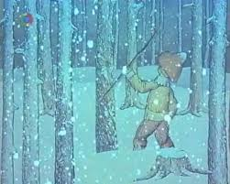
The Sorcerer´s Apprentice Analysis
the world of everyday life
the world of magic
Where is the boundary?

Slide 9
The Sorcerer´s Apprentice Analysis
the world of everyday life
the world of magic
Where is the boundary?
1. Scene in the forest: raging snowstorm, a man warning him…

Slide 10
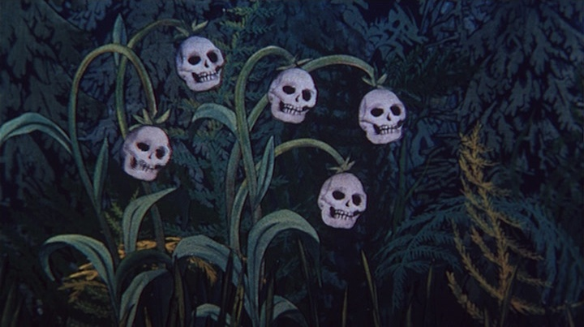
The Sorcerer´s Apprentice Analysis
the world of everyday life
the world of magic
Where is the boundary?
1. Scene in the forest: raging snowstorm, a man warning him…

Slide 11
The Sorcerer´s Apprentice Analysis
the world of everyday life
the world of magic
Where is the boundary?
1. Scene in the forest: raging snowstorm, a man warning him…
2. First attempt to escape, everything drawing him back: snowflakes=skulls, animals = wild beasts…

Slide 12
The Sorcerer´s Apprentice Analysis
the world of everyday life
the world of magic
Other „border moments“

Slide 13
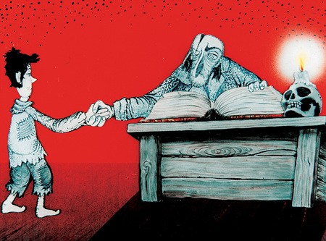
The Sorcerer´s Apprentice Analysis
the world of everyday life
the world of magic
Other „border moments“

Slide 14
The Sorcerer´s Apprentice Analysis
the world of everyday life
the world of magic
Other „border moments“
3. Making the contract with the Sorcerer

Slide 15
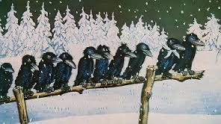
The Sorcerer´s Apprentice Analysis
the world of everyday life
the world of magic
Other „border moments“
3. Making the contract with the Sorcerer
4. Apprenticeship itself

Slide 16
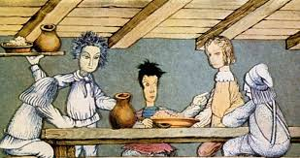
The Sorcerer´s Apprentice Analysis
the world of everyday life
the world of magic

Slide 17
The Sorcerer´s Apprentice Analysis
the world of everyday life
the world of magic
5. Colour differences

Slide 18
The Sorcerer´s Apprentice Analysis
the world of everyday life
the world of magic

Slide 19
The Sorcerer´s Apprentice Analysis
the world of everyday life
the world of magic
5. Meeting the girl

Slide 20
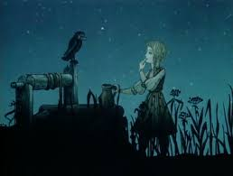
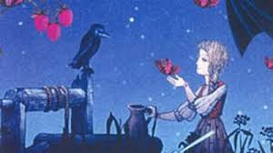
The Sorcerer´s Apprentice Analysis
the world of everyday life
the world of magic
5. Meeting the girl

Slide 21
The Sorcerer´s Apprentice Analysis
the world of everyday life
the world of magic
5. Meeting the girl

Slide 22
The Sorcerer´s Apprentice Analysis
the world of everyday life
the world of magic
5. Meeting the girl
Christian symbolism???

Slide 23
The Sorcerer´s Apprentice Analysis
the world of everyday life
the world of magic
5. Meeting the girl
Christian symbolism???
Good Friday+place where someone died violently (Jesus), a girl bringing water, singing about water, daybreak (ressurection)

Slide 24
The Sorcerer´s Apprentice Analysis
Rite of passage?

Slide 25
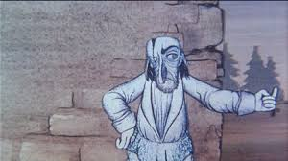
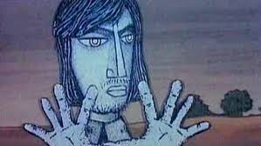
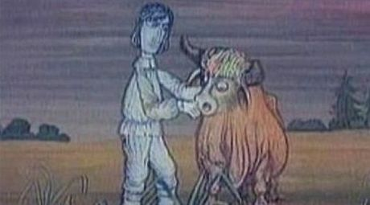
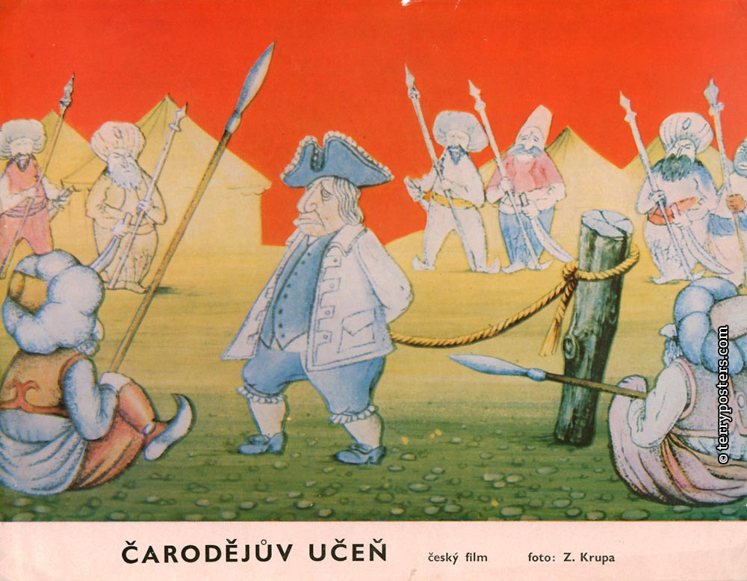
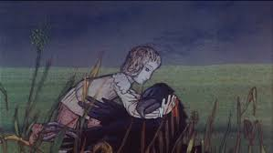
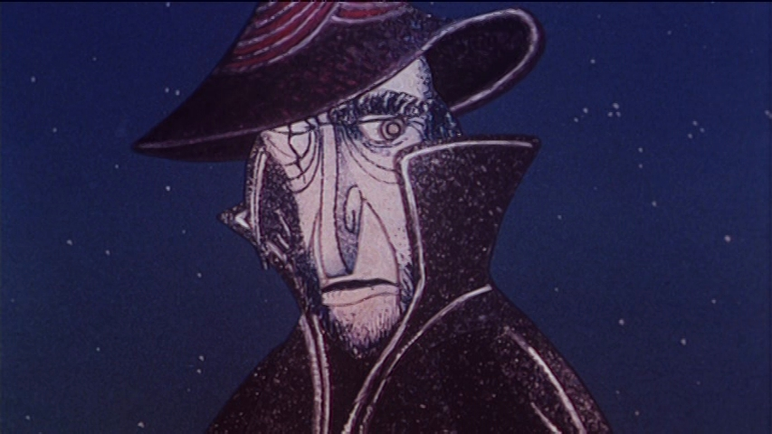
The Sorcerer´s Apprentice Analysis
Rite of passage?

Slide 26
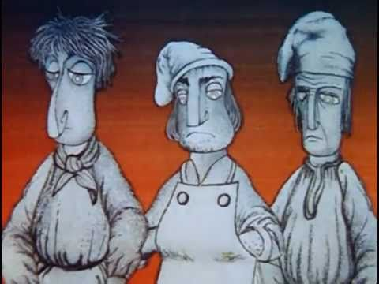
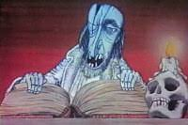
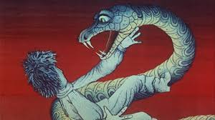
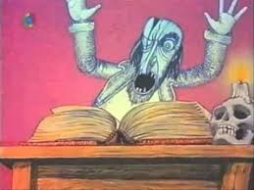
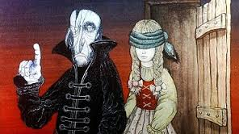
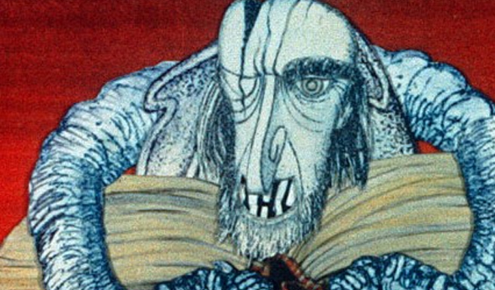
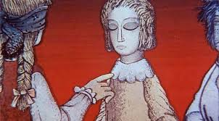
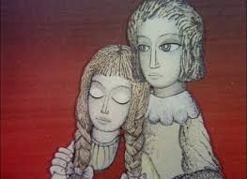
The Sorcerer´s Apprentice Analysis
Rite of passage?

Slide 27
The Sorcerer´s Apprentice Analysis
Concept of Other Side (Religious Study Analysis)
Our world vs. magic world, good forces vs. evil forces, life side vs. death side,
rite of passage, hero´s journey, initiation…
g

Slide 28
What about other stories?

Slide 29
The Twins
What about other stories?
The Golden Hill

Slide 30
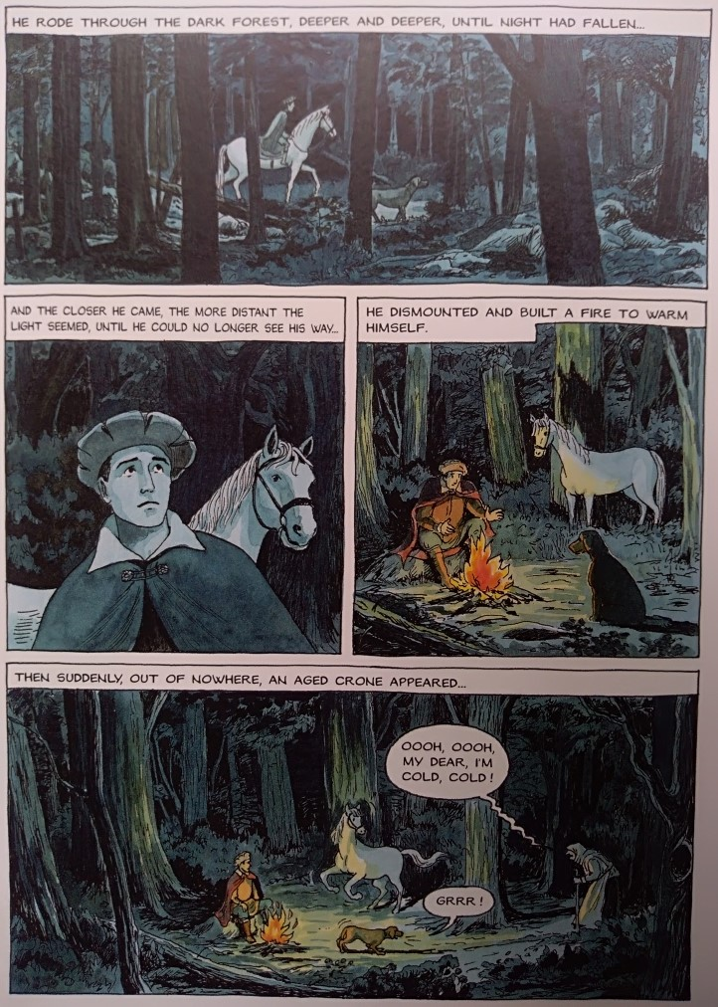
The Twins
What about other stories?
The Golden Hill

Slide 31
The Twins
What about other stories?
The Golden Hill
„…If you fail, you must die…“

Slide 32
The Twins
What about other stories?
The Golden Hill
„…If you fail, you must die…“
Long, Wide and Sharpeyes The Three Golden Hairs The Firebird and the Red Fox…?

