Slide 1
Corpus-informed pedagogical materials
& data-driven learnng
Dr hab. Agnieszka Leńko-Szymańska

Slide 2
OALD 1974

Slide 3
Electronic dictionaries
https://www.oxfordlearnersdictionaries.com/definition/english/force_1?q=force
https://www.ldoceonline.com/dictionary/force
https://dictionary.cambridge.org/dictionary/english/force

Slide 4
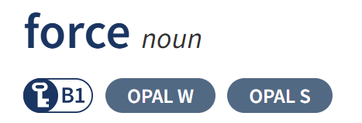

Slide 6
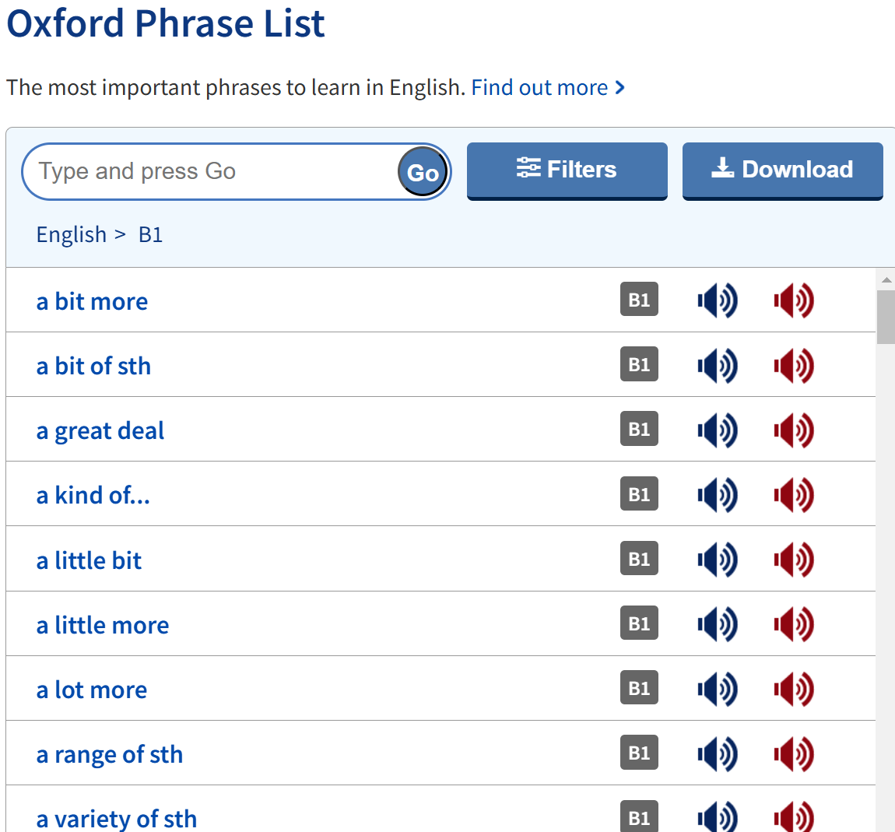

Slide 7
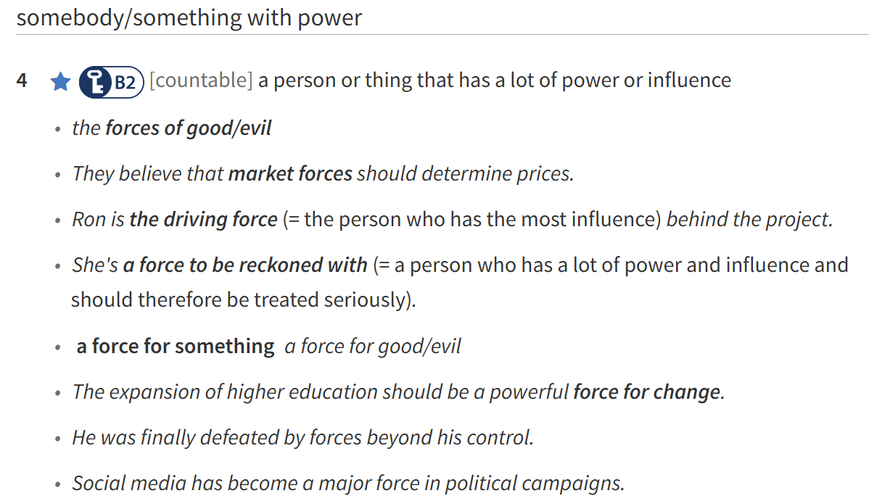

Slide 8
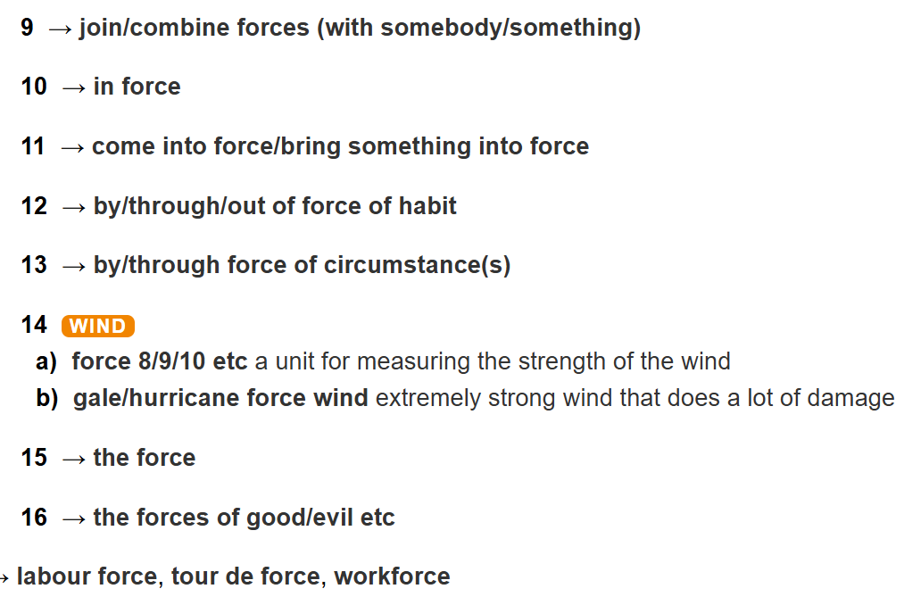

Slide 9
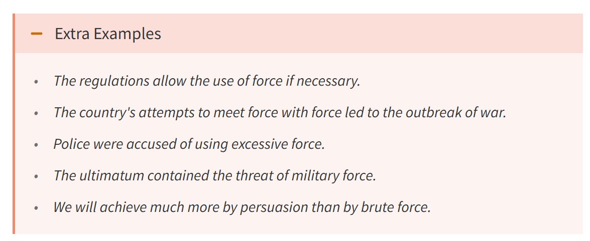
Notes:
oxford

Slide 10
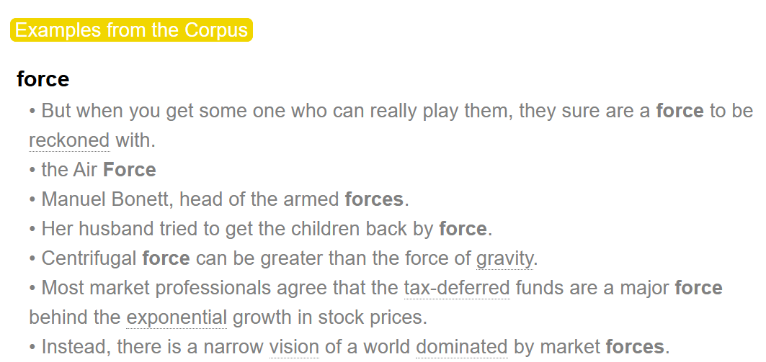

Slide 13
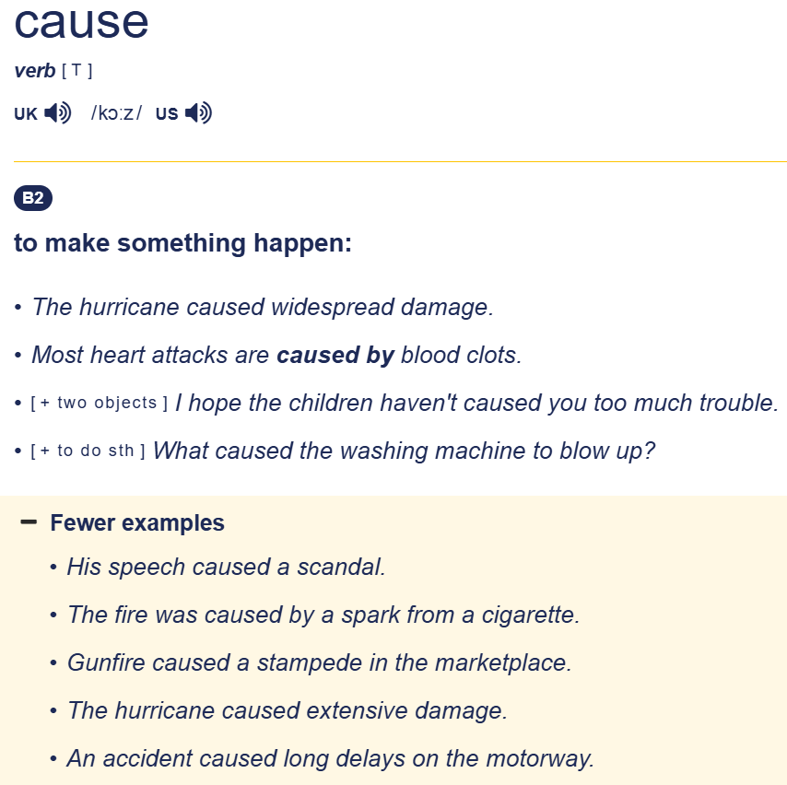
Notes:
https://dictionary.cambridge.org/dictionary/learner-english/cause

Slide 14
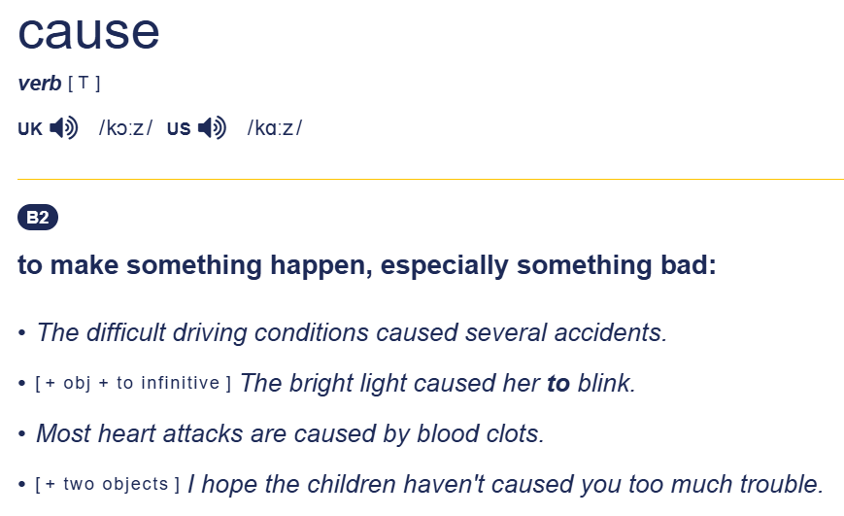
Cambridge Advanced Learner’s Dictionary
Notes:
https://dictionary.cambridge.org/dictionary/english/cause

Slide 15
COBUILD project
Collins Birmingham University International Language Database
lexicographical project
the 1980s
led by Professor John Sinclair
Collins Corpus -> Bank of English
Collins COBUILD English Language Dictionary published in 1987

Slide 16
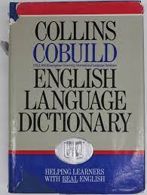
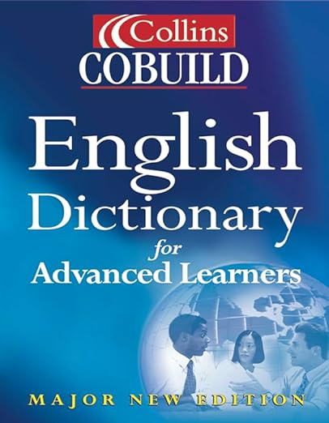

Slide 17
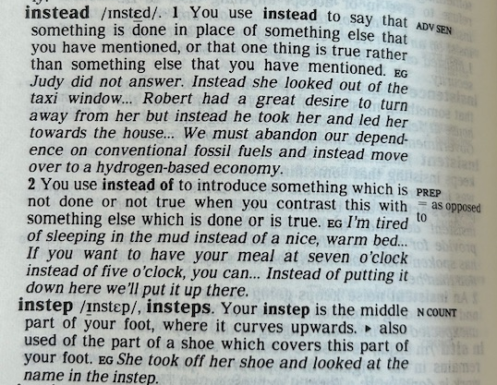
Example of an entry

Slide 18
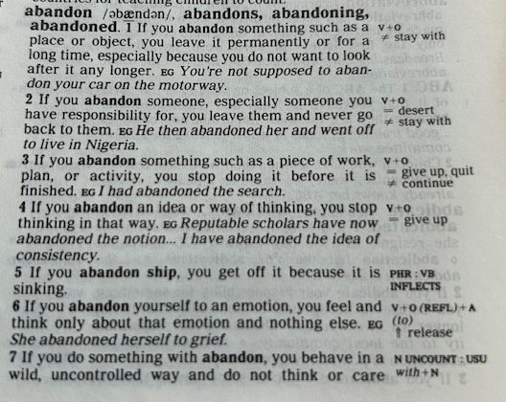

Slide 19
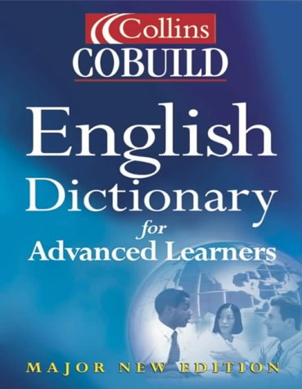
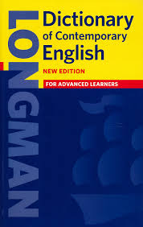
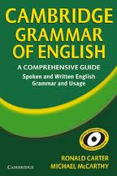
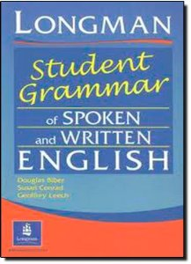
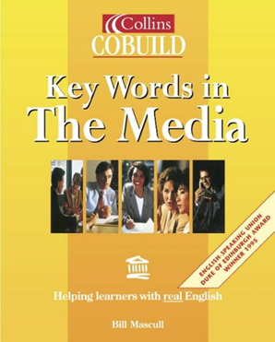
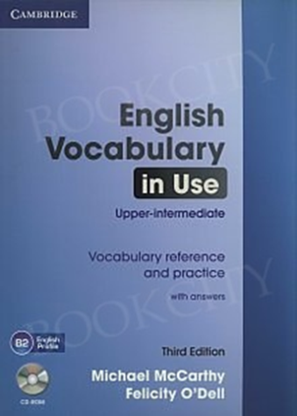
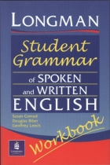
Corpus-based materials for EFL learners

Slide 20
Coursebooks

Slide 21
Corpora in language teaching
indirect uses
learners’ contact with corpus data through the mediation of reference works and teaching materials
traditional (deductive) approach to learning
direct uses
learners consult corpora or corpus data in the form of printout of concordance lines
inductive approach
(Leech, 1997)

Slide 22
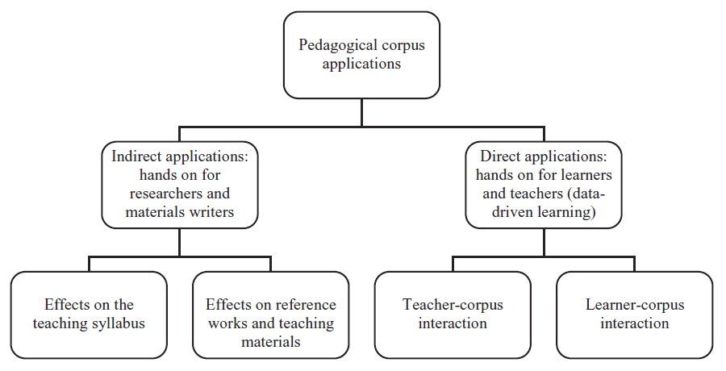
Römer (2011: 207)

Slide 23
Corpora in language teaching
indirect uses
learners’ contact with corpus data through the mediation of reference works and teaching materials
traditional (deductive) approach to learning
direct uses
learners consult corpora or corpus data in the form of printout of concordance lines
inductive approach
(Leech, 1997)

Slide 24
(?) in the form of vs. in form of (?)

Slide 25
Context

Slide 26
Classroom corncordancing / data-driven learning
Tim Johns, University of Birmingham
late 1980s, 1990s
Johns, T. (1991). “Should you be persuaded”: Two samples of data-driven learning materials. In: T. Johns & P. King (Eds.), Classroom Concordancing. English Language Research Journal, 4: 1-16
Johns, T. (1991). From printout to handout: grammar and vocabulary teaching in the context of data-driven learning. In: T. Johns & P. King (Eds.), Classroom Concordancing. English Language Research Journal, 4: 27-45
“cut out the middleman as far as possible and … to give the learner direct access to the data” (Johns, 1991: 30)

Slide 27
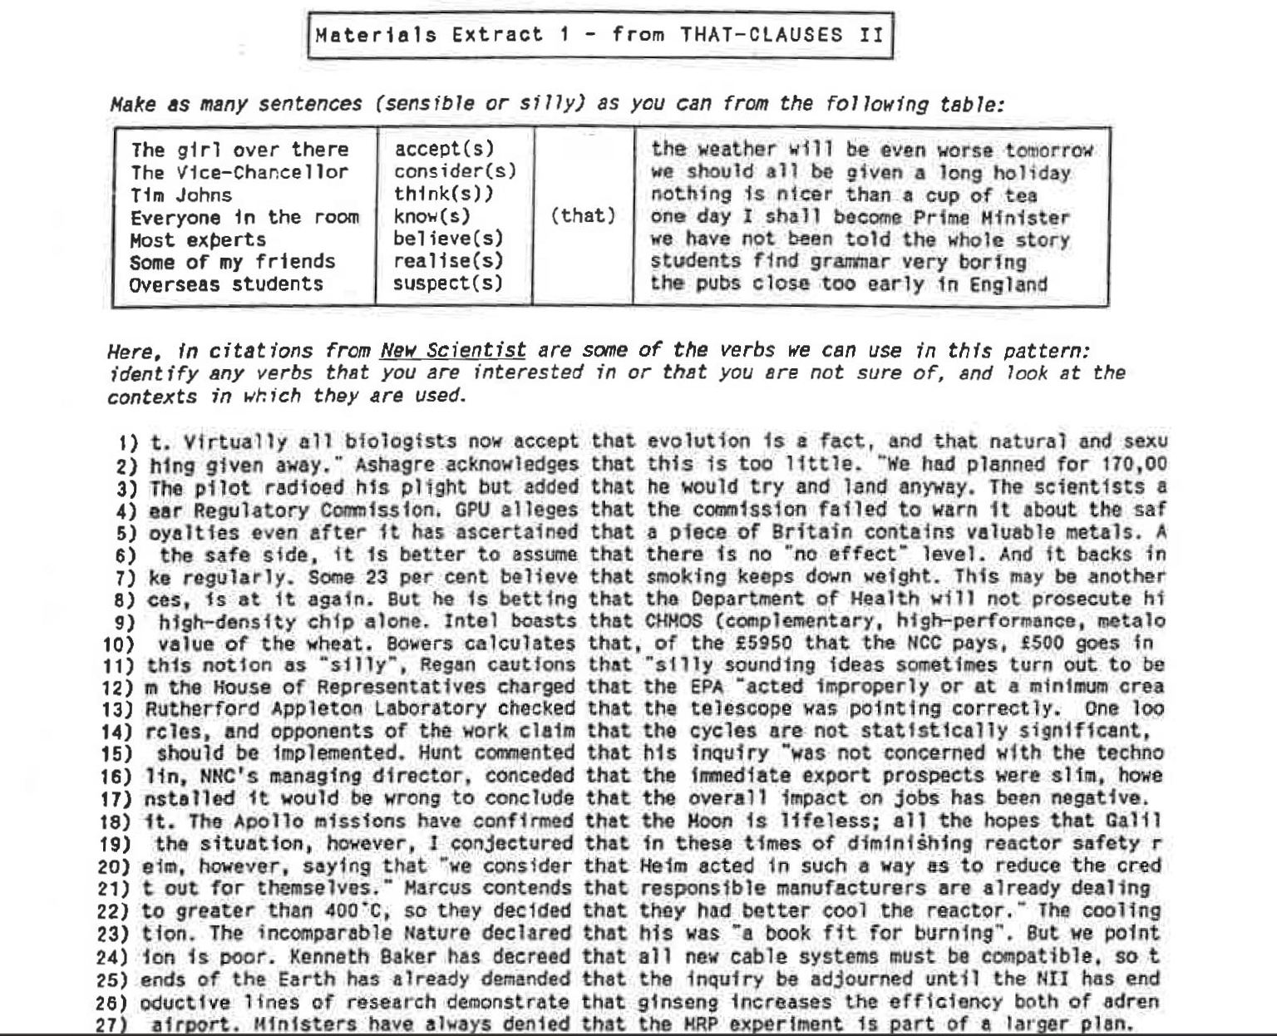

Slide 28
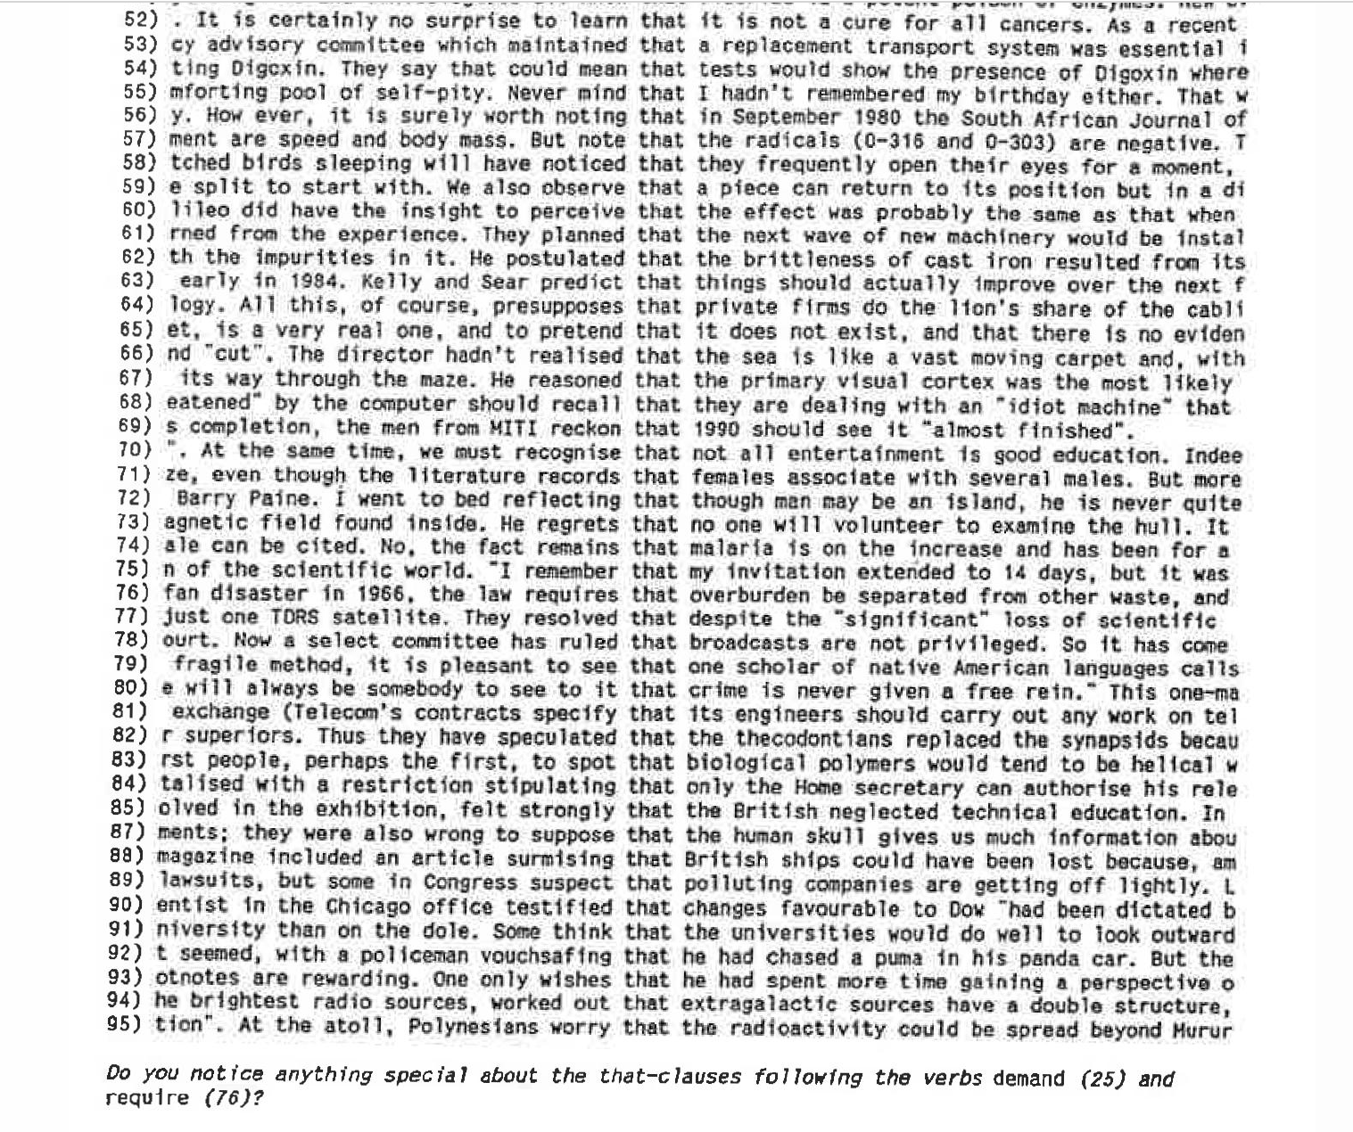

Slide 29
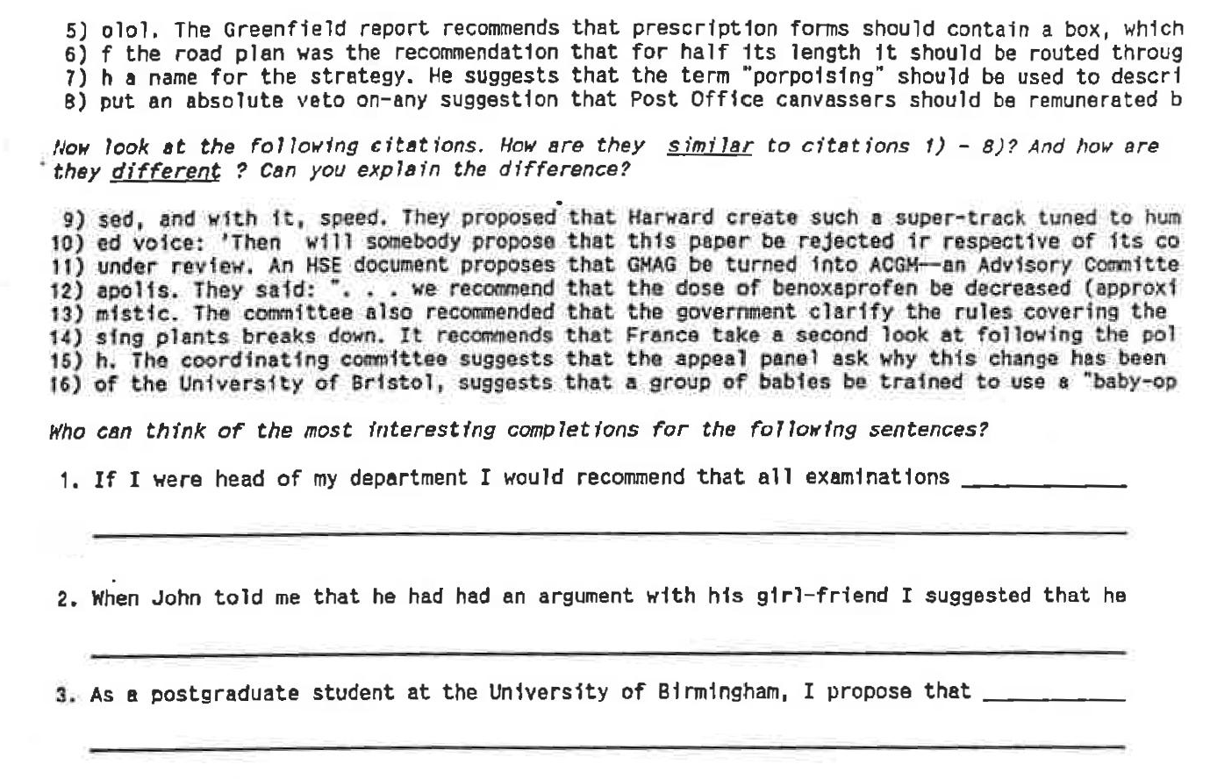
Johns (1991: 38-40

Slide 30
Tim Johns' Kibbitzers
https://lexically.net/TimJohns/

Slide 31
TaLC conferences
TaLC: Teaching and Language Corpora
1994 –
1994 TALC Lancaster
2012 TaLC10 Warsaw
2024 TaLC16 Manchester

Slide 32
Theoretical background
Communicative Language Teaching
authnentic language, language in context
focus on form
usage-based grammar
frequency, lexicogrammar, collocation, language patterns
constructivism
inductive learning, guided discovery
learner-centredness
autonomy
language awareness

Slide 33
Limitations
for learners
difficult and messy langugage
(?)contextualised language, (?)authentic langauage
cognitive challanges (building appropriate queries, analysing large amounts of data, reading concordance lines noticing patterns, interpretation of results)
for teachers
corpus literacy required
labour-intensive and time consuming
dependance on technology
advanced adult learners
corpus researchers, academic teachers

Slide 34
Current situation
teacher education
corpus-based language pedagogy
resource teaching materials
dedicated corpus resources and tools
e.g., SKELL

Slide 35
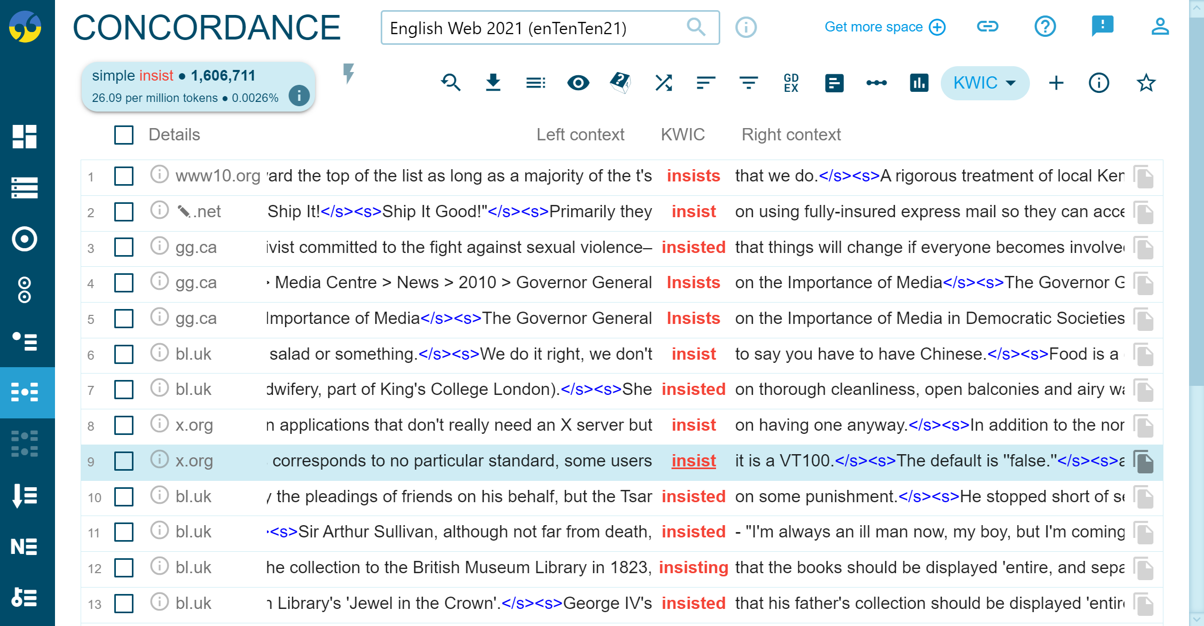

Slide 36
