Slide 1
Public Management for 21st Century
Vladimír Kváča, Ph.D. October 2022 – January 2023
#6 December 14, 2022

Slide 2
Outline for today:
Conclusion Topic 5: Human Learning Systems – The Learning element
Reading reflection
Recap of the key ideas
Q&A
Short break
Intro to Topic 6: New Synthesis, Metagovernance and conclusions
Q&A

Slide 3
Public Management for 21st Century
Human Learning Systems

Slide 4
Human Learning Systems
Public service should be a process of ongoing exploration and learning: workers, clients and other actors exploring and learning together. Learning is the management strategy - the primary task of public managers and leaders is to create effective learning environments.

Slide 5
Reading reflections
Split into groups
Do exercise 5-1, first individually and then discuss within groups

Slide 6
Four ways to change behaviour
Note that this is a slightly different typology than described in your reading (instead of transforming/self-transcedent strategy I have environmental/adaptive way)
Coersion | Rational
Normative | Environmental/Adaptive

Slide 7
Four ways to change behaviour
In a group discuss:
What can coersive/power-coersive way of management to change human behaviour look like. (Example)
What are the pros, what are the cons?
When would you apply it?
Coersion | Rational
Normative | Environmental/Adaptive

Slide 8
Four ways to change behaviour
Orders, prohibitions…
Sometimes necessary.
Works well in „simple“ conditions.
Often back-fires (mainly in more complex situations)
Could serve well as (rarely used and well justified) tactics but not as a default strategy.
Coersion | Rational
Normative | Environmental/Adaptive

Slide 9
Four ways to change behaviour
In a group discuss:
What can empirical-rational way of management to change human behaviour look like. (Example)
What are the pros, what are the cons?
When would you apply it?
Coersion | Rational
Normative | Environmental/Adaptive

Slide 10
Four ways to change behaviour
Explaining others using evidence why the change is good.
Works great, but only with curious people. Most people are not curious.
If you try to explain to someone what he doesn‘t want to hear, he experiences cognitive dissonance, confirmation and other biases apply…
I don‘t like what you say => you are an idiot (or other reason why you are irrelevant) => I don‘t need to take you seriously…
Deep crisis sometimes triggers curiosity…
Coersion | Rational
Normative | Environmental/Adaptive
Never try to explain things to people who are not interested. First you need to make them curious.

Slide 11
Four ways to change behaviour
In a group discuss:
What can normative-reeducative way of management to change human behaviour look like. (Example)
What are the pros, what are the cons?
When would you apply it?
Coersion | Rational
Normative | Environmental/Adaptive

Slide 12
Four ways to change behaviour
„Shaking someones reality“ – kind of artificial crisis.
Includes emotional experience when someone is confronted with own assumptions or mental models and concludes that these need to be updated.
This creates curiosity that enables also rational strategy.
Most effective when working with managers, difficult to arrange.
Double-loop learning. Remember?
Coersion | Rational
Normative | Environmental/Adaptive

Slide 13
Four ways to change behaviour
Most people tend to conformity with the system – their behaviour will adapt when you change their environment.
In a good system, most people will do decent work, in a bad system, most people‘s performance will be poor.
For this you need managers to cooperate, as the working environment is their job…
(Ethical) nudging also fits here.
Coersion | Rational
Normative | Environmental/Adaptive

Slide 14
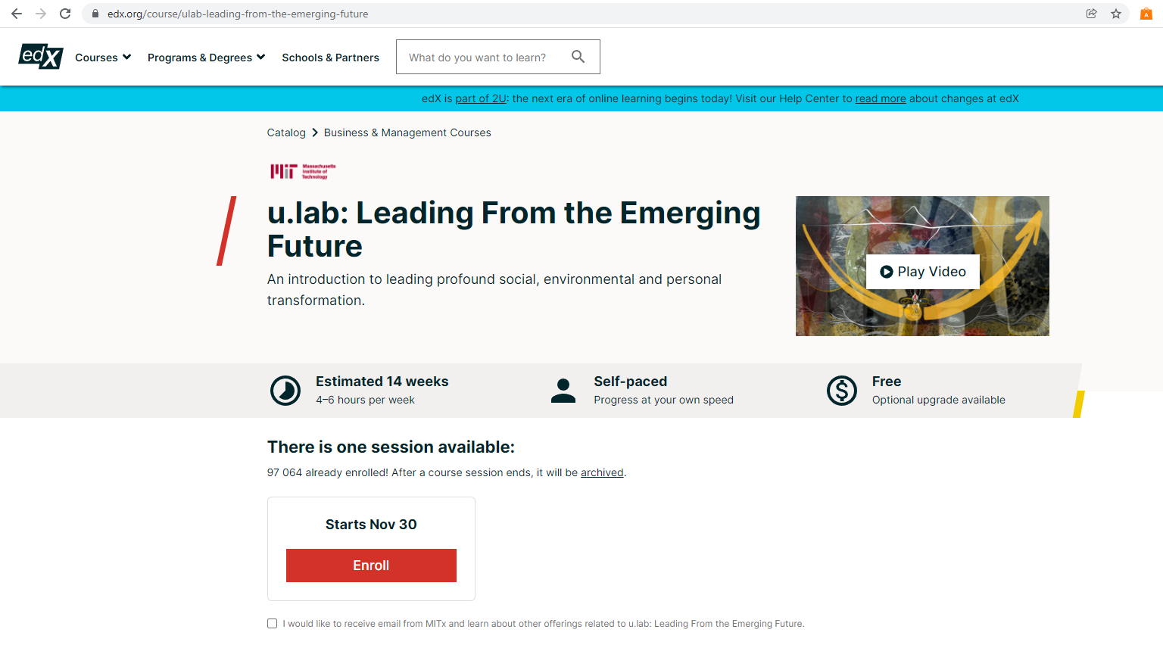
Transforming/self-transcedent strategy
In my understanding this strategy is available only for yourself.
But you can help others to embrace this strategy.
To know more, I recommend Otto Scharmer (MIT)

Slide 15
Homework #5
As an HLS expert and consultant you have been just hired to help a local Public Employment Service in one of the Prague districts to improve their services. You can work on it on average 2 days per week for 2 years. PES agenda is mainly to (i) provide various social benefits (unemployment, housing, child care, care for elderly…), (ii) help job seeker to find a suitable jobs, (iii) requalify them if considered necessary. The structure of the organisation is: Director, 3 heads of unit (Benefits, Labour market, Requalification), 30 of staff in functionally specialized units (8-12 in each).
Alternatively, think about a similar public organisation in your country.
Write a short (2 pages = 550 - 650 words) essay following this outline:
What would you do in the first steps? (Say in the first month.)
Why would you do that?
How would you do that?

Slide 16
HW feedback
This one was difficult one, wasn‘t it
You all tried hard
My frequent comments were:
Not focused on the first month (or very over-optimistic about what can be achieved)
Too focused on technical part and not paying enough attention to social part of the change (trust, understanding, relations…) – start with social, then go to technical…
Usualy not thinking about creating the environment for psychological safety

Slide 17
Social and technical aspect of change
Social
Technical
Change starts with RELATIONAL work, before TECHNICAL work
The bridge from relational to technical work is shared sense-making, the strategy for change is LEARNING

Slide 18
Social and technical aspect of change
LEARNING
HUMAN
SYSTEMS
Change starts with HUMAN work, before SYSTEMS work
The bridge from relational to technical work is shared sense-making, the strategy for change is LEARNING

Slide 19
Learning within the systems

Slide 20
The caretaker of four dialogues
What experiments to run?
Service design
(subsystem)
System design (system)
Innovation – conscious experimenting
Shared sensemaking on what does it mean
How to change the system to enable more of what is good? How to enable more learning within the system?

Slide 21
The caretaker of four dialogues
Psychologically safe environment
What experiments to run?
Service design
(subsystem)
System design (system)
Innovation – conscious experimenting
Shared sensemaking on what does it mean
How to change the system to enable more of what is good? How to enable more learning within the system?

Slide 22
The caretaker of four dialogues

Slide 23
^{Reflection}
What are you thinking about in relation to what we have discussed so far?
Photo by Luke Leung on Unsplash

Slide 24
Break - be back at 15:30

Slide 25
Public Management for 21st Century
Topic 6: New Synthesis, Metagovernance and conclusions

Slide 26
Public administration evolution
Weberian Bureaucracy
Public Administration
New Public Management
Post-NPM debate
* Very simplified, reflects mainly the reality of „the West“.

Slide 27
Post-NPM debate
Post-NPM debate
Human Learning Systems
Other concepts…
New Public Governance
New Synthesis of Public Administration
Metagovernance
Similar solutions to similar problems,
overlapping, not mutually exclusive…

Slide 28
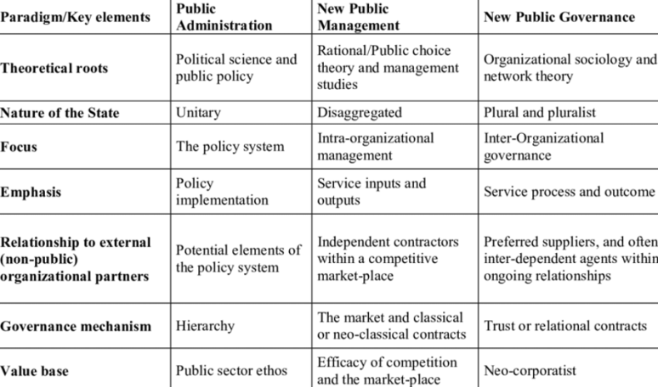
New Public Governance
Key author – Stephen Osborne

Slide 29
New Synthesis of Public Administration
Key author – Jocelyne Bourgon (Canada)
Similar methodology to HLS (practice-based Framework, Singapore prison case is one of the famous case-studies)
Focus on Government perspective – need to expand the roles of government
(HLS is more focused on public services perspective)

Slide 30
New Synthesis of Public Administration

Slide 31
New Synthesis of Public Administration
Complementarity with HLS:
NS provides good explanations WHAT and WHY the governments should do differently in the 21st century
HLS is maybe more useful in understanding HOW to do it (and expands the view that eg. the system stewardship is not necessarly only the role of government)

Slide 32
Metagovernance
Part of post-NPM debate
Solution to failure of governance and its rootcauses
Group task – 5 min
How would you define governance? What types of governance do you know? Can you name any failure?

Slide 33
Metagovernance – governance
Governance = “the sum of interactions in which public actors (such government and other public bodies) and private actors (such as private sector and civil society) participate, aiming at solving societal problems or creating societal opportunities, taking into account the institutions within which these governance activities take place.”
(Kooiman, 2003; Meuleman, 2008)
Notes:
“has become a rather fuzzy term that can be applied to almost everything and therefore describes and explains nothing” (Jessop, 2002: 4)

Slide 34
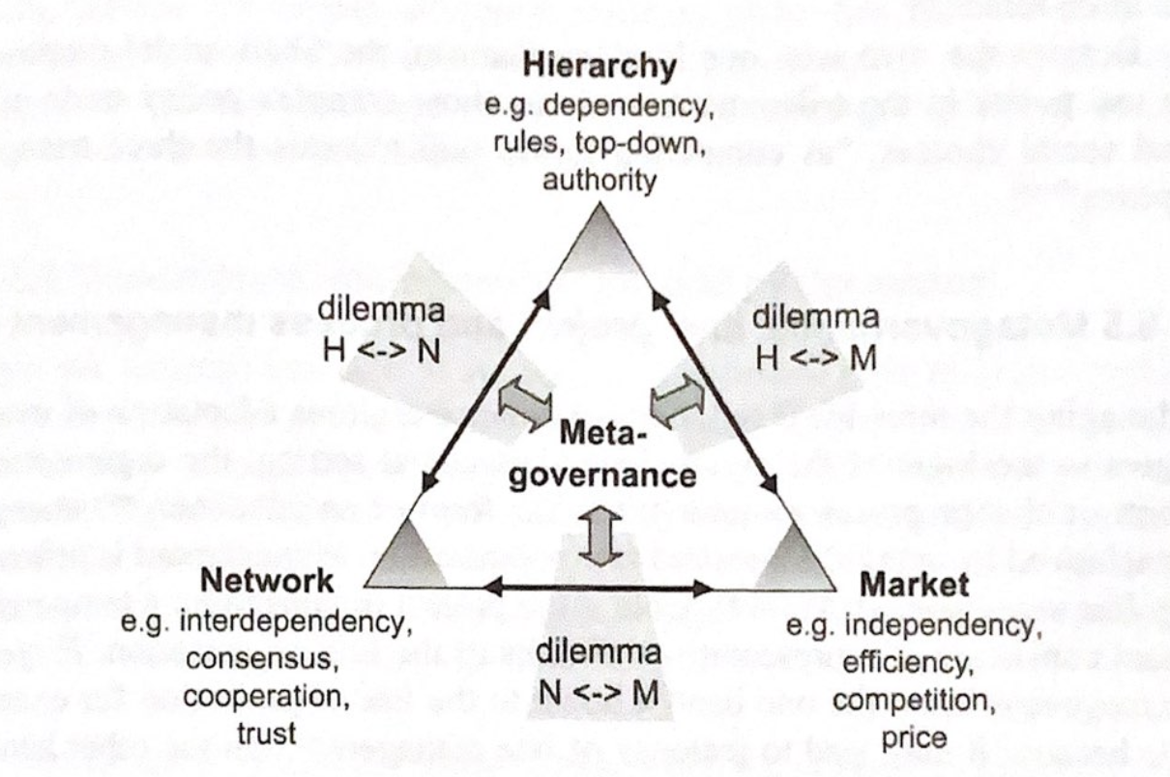
Metagovernance – types of governance
3 ideal types/modes of governance
Hierarchy governance
Market governance
Network governance
Failures of governance
Governance design failure
Governance capacity failure
Governance management failure
L. Meuleman: Public Management and the Matagovernance of Hierarchies, Networks and Markets, 2008
Notes:
These styles are seldomly found in a ‘pure’ form, but usually appear in combinations. The design and management of such combinations is called metagovernance

Slide 35
Metagovernance – definition
Metagovernance = “means by which some degree of coordinated governance is produced, by designing and managing sound combinations of hierarchical, market and network governance, to achieve the best possible outcomes from the viewpoint of those responsible for the performance of public-sector organizations: public managers as metagovernors” (Meuleman, 2018)
How to use the benefits of each governance mode + minimalize negative consequences of each mode? How to design and manage the combination?
Concept positioned above the three main governance styles, “helicopter view” approach
Situational and flexible approach – mixing and combining, need to fit into the context and time (no best practice, no “blue prints”)

Slide 36
Metagovernace – history
Firstly mentioned by Jessop (1997) “coordinating different forms of governance and ensuring a coherence among them” or “rebalancing market, hierarchy and networks”
Rhodes (2005) “The future will not lie with markets, or hierarchies or networks but with all three and the trick will not be to manage contracts of steer networks but to mix the three systems effectively when they conflict with one another.”
First-order-metagovernance vs. second-order-metagovernance
Internal vs. external metagovernance
Notes:
Networks – best ways to solve societal problems

Slide 37
Metagovernance – Dr. Meuleman
Louis Meuleman (The Netherlands / Belgium)
Policy and governance advisor, public manager
40 year experience in public sector management (international, national, regional levels), in field of the environment and sustainable development
Member (and former vice-chair) of the UN Committee of Experts on Public Administration
senior researcher/visiting professor
Notes:
European Commission – DG Environment
Visiting professor at the Public Governance Institute of the University of Leuven (Belgium), senior fellow at the Center for Governance and Sustainability of the University of Massachusetts Boston (USA) and research associate at the Public Administration & Policy Group of Wageningen University & Research (Netherlands), and member of Scientific Committee of the European Environment Agency EEA

Slide 38
Course overview - Structure
Paradigm shifts 1: The Environment, The People we Serve, The Way of Management
Paradigm shifts 2: The Nature of Public Organisations, Motivation of Staff, Accountability
Human Learning Systems 1: Introduction and Human element
Human Learning Systems 2: Systems element
Human Learning Systems 3: Learning element
New Synthesis, Metagovernance and conclusions
Questions
(Tentative) answers

Slide 39
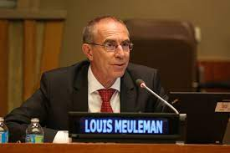
Your companions for the next few days
Jocelyne Bourgon
Louis Meuleman

Slide 40
Reading and watching list

Slide 41
Final group discussion: save your dates
Wednesday, January 11th 2023
Online (zoom) 10:30
Offline (Pekařská 212) 14:00
Offline (Pekařská 212) 14:45
Wednesday, January 25th 2023
Online (zoom) 10:30
Offline (Pekařská 212) 14:00
Max. 3 students per session. Please register in moodle!
Content: You are presented a case study and you are suppossed to suggest possible solutions based on HLS
(Similar to assignment #5)

Slide 42
Homework #6
Feedback of the Public Management using Human Learning Systems as a framework
Different tasks for different students, 400-800 words:
A) If you are an incoming student (just for a term or two – Erasmus…) or based at different faculty:
Use Human Learning Systems as a Framework for your feedback to this course:
Did you feel psychological safety and good relations? (Human)
Were individual topics well interlinked? (Systems)
What was helpful / useless in your learning, in what circumstances you could learn even more? (Learning)
Anything else you want to share – what to keep, what to change, what to improve...
B) If you study a program where Dept. of Public and Social Policy (KVSP) plays a role (PASP, VERASP):
Same as A) but for Systems element think about the wider system – your study programme:
Where do you see overlaps/repetitions with other courses?
Where do you see complementarity/synergies with other courses?
Where do you see contradictions/discrepancies to other courses?
This time Czech version is welcomed.
Deadline: Thursday, January 6, 23:59 CEST
10/10 automatically for all serious submissions (challenger safety ☺ )

Slide 43
Thank you and
see you next week.

