Slide 1
Medieval Philosophy Proseminář – High Scholasticism and what is this about
Fall Term – Charles University Prague
17.12.2020
Anna Tropia, PhD

Slide 2
1) What is “High Scholasticism”?
2) Who are its main representatives?
3) What kind of themes you are going to study?

Slide 3
1) High Scholasticism
By “High Scholasticism” one usually refers to the thought developed in schools (universities, but also the studia of different religious orders—e.g. Dominican, Franciscan, etc.) after the 13th century in the Latin Western world
Characteristic features of this period:
conflicts between universities and papal/religious authority
Aristotelianism as “common language”;
Increasing refinement of logics and metaphysics in the wake of the new Aristotelian sources at disposal

Slide 4
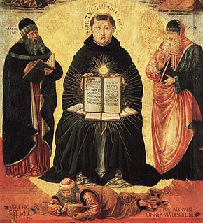
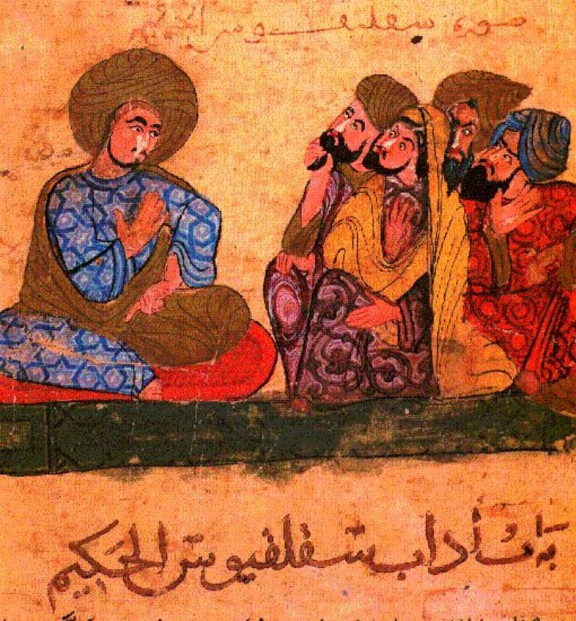
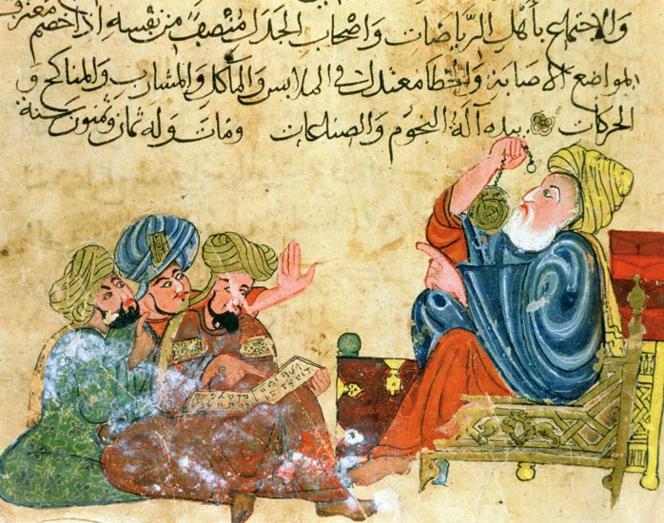
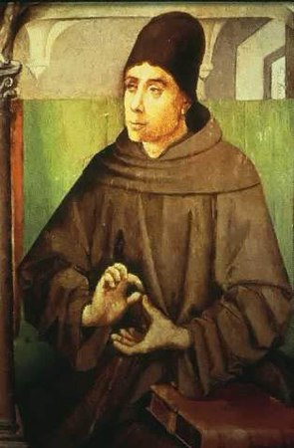
Aristotelianism (and Aristotelianisms)
Thomas Aquinas
(1225-1274)
Averroes, aka the Commentator (1126-1198)
Moses Maimonides (1138-1204)
Avicenna (980-1037)
John Duns Scotus (1266-1308)

Slide 5
2) The Latin “three ways” (tres viae) into philosophy
Ockham
Aquinas
Scotus

Slide 6
What Aquinas and Scotus have in common (some ex.)
According to both, sense-perception is the base of all human cognition
Both believe that human beings can obtain naturally true science of this world
They’re good readers of Aristotle
Naturally = outside Revelation

Slide 7
Where they (mainly) disagree:
According to Scotus, the human intellect has a broader capacity (e.g. the distinction between an angel’s and human’s mind is not as strict as is according to Aquinas)
The language human beings use to talk about God is exactly the same we employ to talk about us (univocity vs analogy);
What individuates human being is not quantified matter (materia quantitae signata), but their own uniqueness (haecceitas)

Slide 8
In the intellect of the wayfarer a real concept is caused naturally only by things that are naturally capable of moving our intellect. Such things are a phantasm (or the object shining out in the phantasm) and the agent intellect. Hence, no simple concept arises naturally in our intellect in its present state if not by virtue of these factors. But a concept that is not univocal to the object shining out in the phantasm, but entirely different and prior and related to it by analogy, cannot arise by virtue of the agent intellect and the phantasms. Therefore, such a different concept, which is supposed to be analogous, will never occur naturally in the intellect of the wayfarer. And so it will be impossible to have some concept of God in a natural way, which is false.
[John Duns Scotus, Ordinatio I, d. 3, q. 1, §35, Eng. tr. By J. van der Bercken, Fordham 2016, p. 53-4]

Slide 9
What unifies Aquinas’ and Scotus’ projects, is the conception of human being’s ability of having true science of this world
Whatever is known for certain is known in the light of the eternal reasons (…) I say that divine light invests the knower with infallibility and what is knowable with immutability.
Bonaventure of Bagnoreggio, Quaestiones disputatae de scientia Christi, q. 4
They are wrong, those who claim that human being can grasp any kind of cognition in a completely natural way, without any divine and special illuminations and outside a special light infused supernaturally.
Henry of Ghent, Summa ordinaria, I q. 2

Slide 10
3) What are the main themes you going to study?
Theories of cognition
Metaphysics
Doctrines of the soul
Relation between faith and reason, philosophy and theology
Representations of God

Slide 11
Goals of the course:
Providing you with an introduction to High Scholasticism’s main concepts
Providing you with instruments to access the texts directly and orient yourself in the studied period
The acquisition of a major awareness concerning themes and problems, that will remain crucial in history of philosophy even after the 14th century

Slide 12
Assignment
Reading: Selection from Avicenna’s On the Soul, I.1 (Moodle)
Questions:
Following all the qualifications Avicenna attributes to the soul, describe the activities the soul can perform
At the end of the selected passage from On the Soul (I.1, §7), Avicenna makes up a mental experiment usually referred to as “the flying man”. According to you, what Avicenna aims to prove by it?
You can answer in Czech or in English and send them (even contact me if need be) at my address: anna.tropia@ff.cuni.cz.
All the information are also on Moodle

