Slide 1
War on Drugs
Mexico and the US

Slide 2
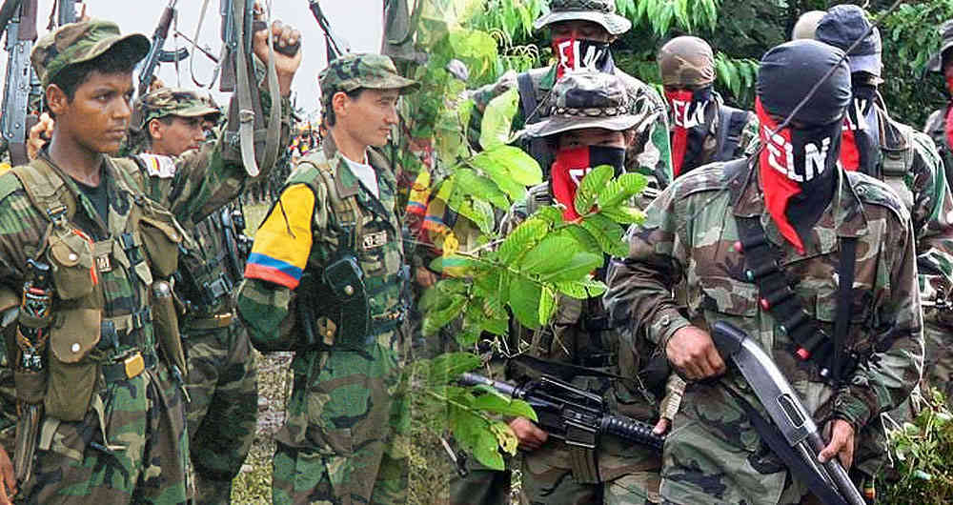
History
Vietnam
Operation Intercept – 1969
Operation Just Cause – 1989
Plan Colombia – 1999 and 9/11

Slide 3
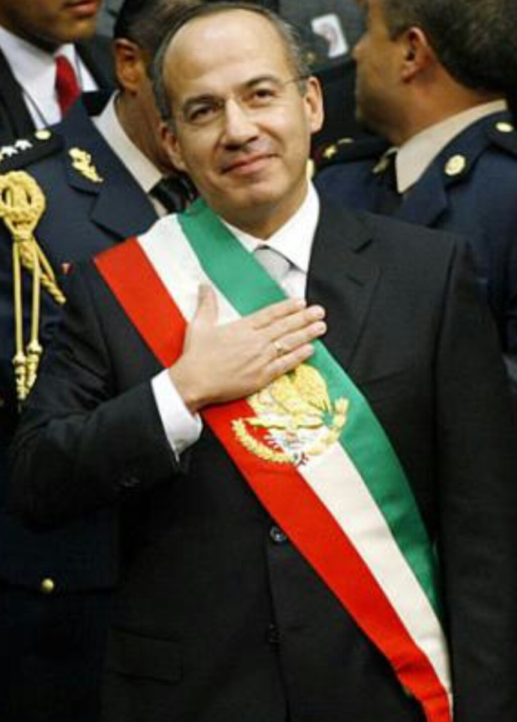
Mexico
After the intervention in Colombia and a bloc in Caribbean the trade and production moved to Mexico
NAFTA and small farmers
End of ties PRI-cartels
Calderón „declares war“ 2006
Nieto did not finish it
AMLO plans to use force

Slide 4
Routes
Marihuana – local
Methamphetamines – China, Asia
Cocaine – local, Colombia

Slide 6
Cartels and what they do
Conquest of new routes and territory
Control of these areas
Delivery from Alpha to Omega
Mexican Amazon of Joaquín Chapo Guzmán
Human trafficking
Smuggling of all sorts
Weapons
Petrol and oil

Slide 7
Cartels – important ones
Sinaloa – Joaquin Chapo Guzman
Gulf – Tamaulipas – in decline recently
Jalisco New Generation + Knights Templar
Los Zetas – paramilitary
Beltran-Leyva – from Sinaloa
Juarez – in Chihuahua
Tijuana - California

Slide 9
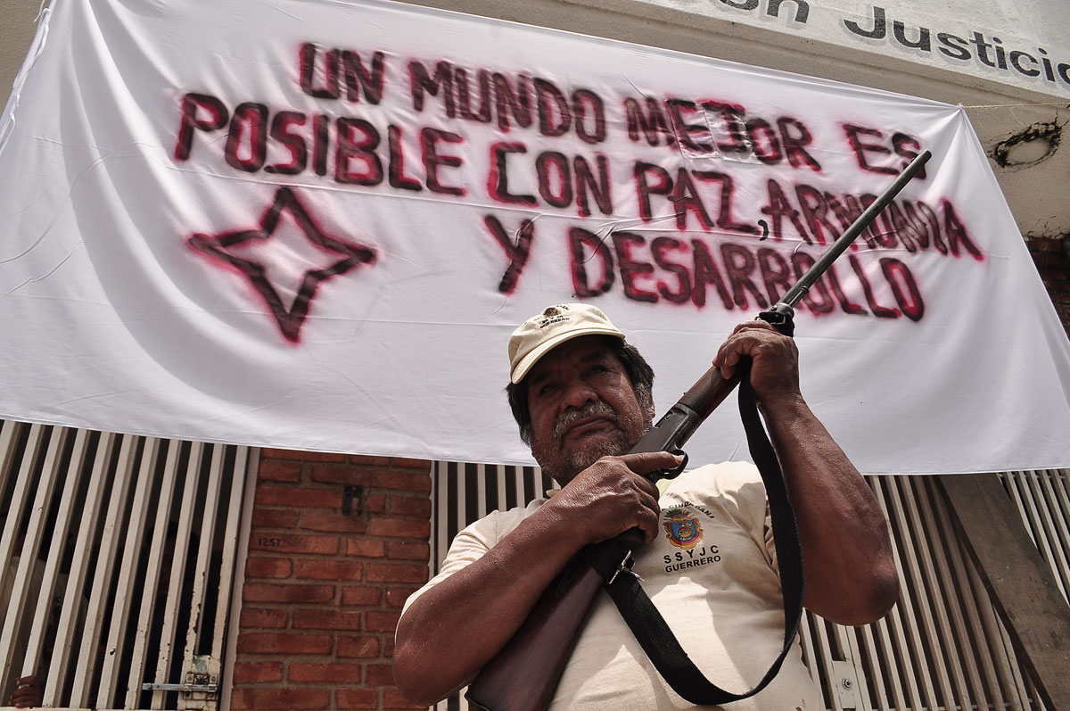
Who fights them
Police – federal mostly
Army – not corrupted
Local militias – Autodefensa
USA – agens DEA
Colombia

Slide 10
International scale
Italian mafia – Sicily, 'Ndrangheta
Move to Cetral America – Guatemala, Salvador, Honduras
Venezuela recently
Canada
Iran
Hezbollah

Slide 11
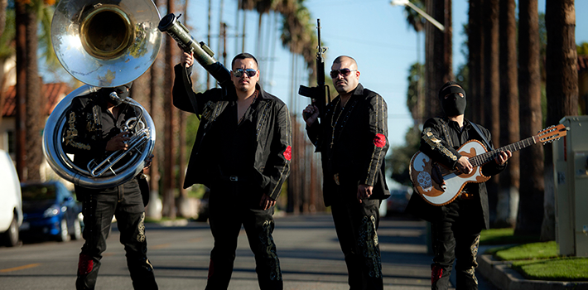
Impacts
Violence – Iguala, 200k+, 1,5 million dissplaced
Corruption
Murders of journalists and politicians
Human rights
Migrants abuses
Narcoculture
Sean Penn
Allergy

Slide 13
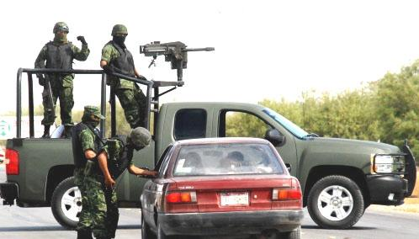
Personal experience
First shock – press info
Building of walls – segregation
Bad neighbourhoods
Checkpoints and road blocks
Drug tourism

