Slide 1
ZEZENGORRi
Basque mythology
Lenka Mošnerová

Slide 2
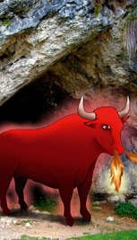
description
Red bull
He throws fire through his nostrils and mouth
Shining with horns and tail on fire
Usually lives in cave (protector)
If someone disturbs him and disrespects his peace ➔ he gets angry
Able to transform into man → use for punishing those who offended him

Slide 3
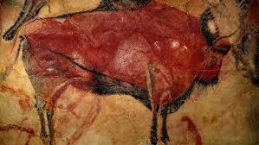
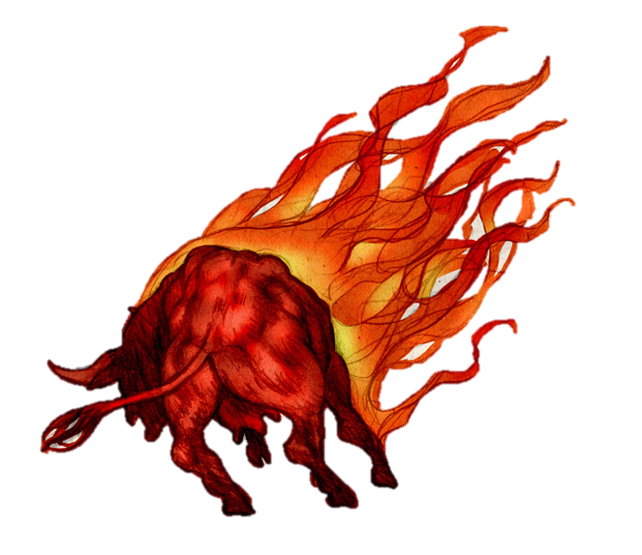
He may symbolize a bad sign or just frighten pedestrians
Other names: Etsai (= enemy), Txahalgorri, Behigorri, Ahatxe, Zezensuzko,…

Slide 4
Legend from orozco (biskay province)
Thief that lived in the Atxulaur Cave in Mount Itzina
He possessed a huge amount of gold → was storing in the cave
During one theft → passed away
One day some foreigners went to the cave where the treasure was → when they approached the red bull came out of the cave, throwing fire from his mouth and nostrils
Red bull = spirit of the thief
Foreigners brought the dead thief‘s bones to the cave → after that, they were allowed to take the treasure because the thief‘s body was already in peace

Slide 5
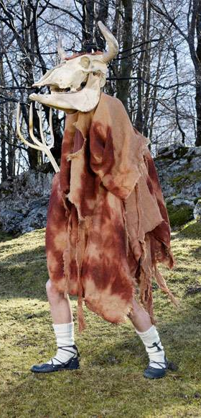
Zezengorri in the basque culture
People dress up as Zezengorri for the carnival in Pamplona which is being held in February

Slide 6
Thank you for your attention !

Slide 7
Sources
https://lh6.googleusercontent.com/Btzns_tLUfWGcRu4z3t0BOxyTntM_EmedpBQvtPJUrbE1bDs5mr3XVW6w6c0z4o7IgpkGrQF3Kk45m-Se1AUE8SR5lHPZmR_4l14kC_BkbIFXWN6=w1280
https://euskalmitologia.com/wp-content/uploads/2017/01/zezengorri.jpg
Basque Mythology - ZEZENGORRI ‘red bull’ (google.com)
https://media.wired.com/photos/5b45048b3808c83da3503d0d/master/w_1600,c_limit/WM3-zezengorri.jpg
Aatxe | Myths and Folklore Wiki | Fandom
Zezengorri | Wiki Mitología Ibérica | Fandom
https://arjungwriter.files.wordpress.com/2018/04/aatxe.jpg
Mythical Creature, ‘Aatxe or Etsai,’ an ancient Basque (Spanish and French) shapeshifting bull spirit with writing prompt – ARJung (arjungwriter.com)
Aatxe | Brickthology
Book Extract #3 – Carnival in the Pyrenees – Perennial Pyrenees
https://flashbak.com/wp-content/uploads/2016/01/SPAIN-Zezengorri-at-Carnival.jpg
¨

