Slide 1
European Commission Policy Proposal
Knut Øye Brandsås
Kevin Curran
Tatevik Vantsyan

Slide 2
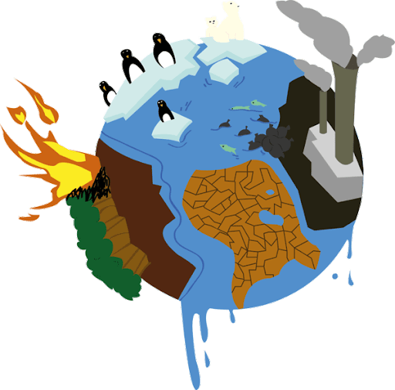
Problem statement
Global rather than local problems
Natural disasters
Migration
Threatened ecosystems
Impact on diverse spheres
economic
political
public health
ecological

Slide 3
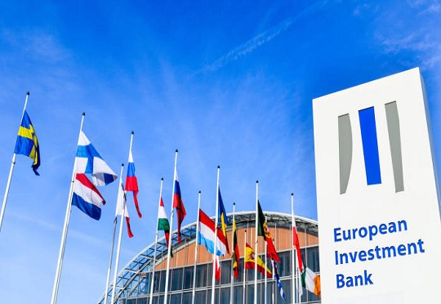
Action
Quick and comprehensive
Enactment of significant policies
Europe has become a torch-bearer
EIB stops lending to fossil industry projects from 2021
Imperative for EU nations to act together
Fairness in the distribution of burdens is essential

Slide 4
Proposed solution
Carbon neutrality by 2050
crucial, but not sufficient
55% emissions cut by 2030
faster transition – less economic and ecological costs
reduced crises
1.3 % of GNI contributions
Ensure the funding of Just Transition Fund, the European Regional Development Fund, etc.
Contributions according financial abilities
Rich countries should assist those with less capabilities

Slide 5
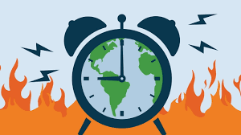
Distributional and revenue neutral carbon tax
Effective elimination of emissions while taxing the small proportion of population (Metcalf & Weisbach, 2009)
Formation of a “Club” (Nordhaus, 2020)
Higher tariffs for countries outside the EU
Encouraging other countries to adopt the same measures

Slide 6
Obstacles to implementation
Budgetary commitments to MFF
GER and SWD consciousness of EU-level projects’ increased spending
Aggressiveness of 2030 target setting
The progress and ideological stances of GER and SWD
EP constituency and POL concerns on moving too quickly on climate policy changes without proper funding

Slide 7
The European Commission is both cognizant and sensitive to each pole of these negotiations. As such, we hope to act as an arbiter and offer a compromise position wherein both sides of these contentious issues can achieve a level of satisfaction commensurate with our stated goal of a fair and just transition made in the best interest of all nations now coming to the table together.

Slide 8
References
Ambrose, J. & Henley, J. (2019). European Investment Bank to phase out fossil fuel financing. The Guardian. Retrieved from https://www.theguardian.com/environment/2019/nov/15/european-investment-bank-to-phase-out-fossil-fuels-financing
European Commission. (Unknown). Paris Agreement. Retrieved from https://ec.europa.eu/clima/policies/international/negotiations/paris_en
Metcalf, G. E. & Weisbach, D. (2009). The design of a carbon tax. Harv. Envtl. L. Rev., 33, 499.
Nature. (2018). The costs of climate inaction. Nature, 561, 433. DOI: 10.1038/d41586-018-06827-x
Nordhaus, W. (2020). The Climate Club. How to Fix a Failing Global Effort. Foreign Affairs. Retrieved from https://www.foreignaffairs.com/articles/united-states/2020-04-10/climate-club
Courchene, T. J., & Allan, J. R. (2008). Climate change: the case for a carbon tariff/tax. POLICY OPTIONS-MONTREAL-, 29(3), 59.
MacCracken, M. C. (2008). Prospects for future climate change and the reasons for early action. Journal of the Air & Waste Management Association, 58(6), 735-786.
Hutter, S., Altiparmakis, A., & Vidal, G. (2019). 15 Diverging Europe: The Political Consequences of the Crises in a Comparative Perspective. European Party Politics in Times of Crisis, 329.
Hoffman, M. T., & Todd, S. W. (2013). Impact of Environmental Change on Ecosystem Services and Human Well-being in Africa.

Slide 9
Thank You!

