Slide 1
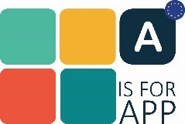
The adaptation of a reading app into a different language, culture, and education system
Lenka Krejčová
lenka.krejcova@dyscentrum.org

Slide 2
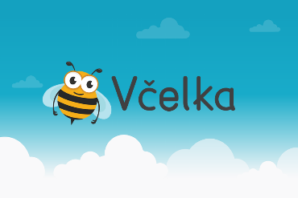
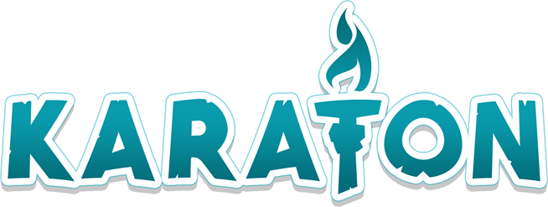
The situation in the Czech Republic at the beginning of our project
Small target group
Complicated language
One app to support reading

Slide 3
The process of adaptation
Notes:
Academy: principles, vocabulary, structure relevant to Czech users X game: game vocabulary, list of words and distractors, categorization of the words according to their structure (syllables, clusters of vowels…)

Slide 4
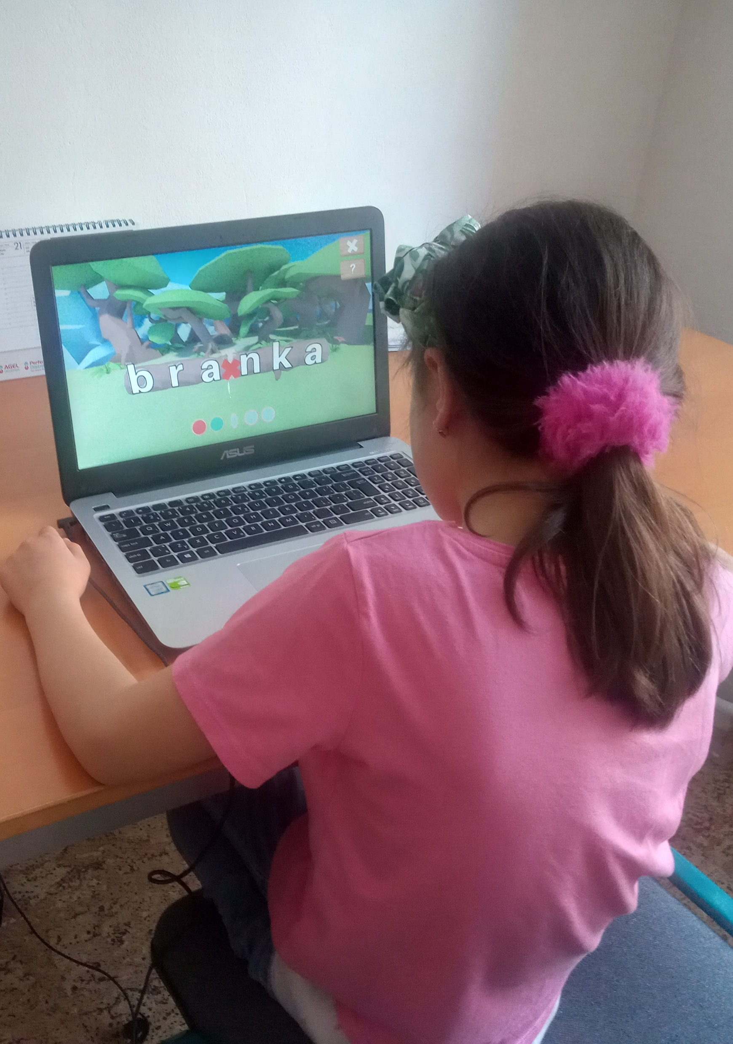
Challenges
Successes
from Flemish to English to Czech
translation without knowing the context
adjusting the training games to the Czech language
creating the list of words
list of several hundreds of words
useful distractors
system of continuous update and corrections

Slide 5
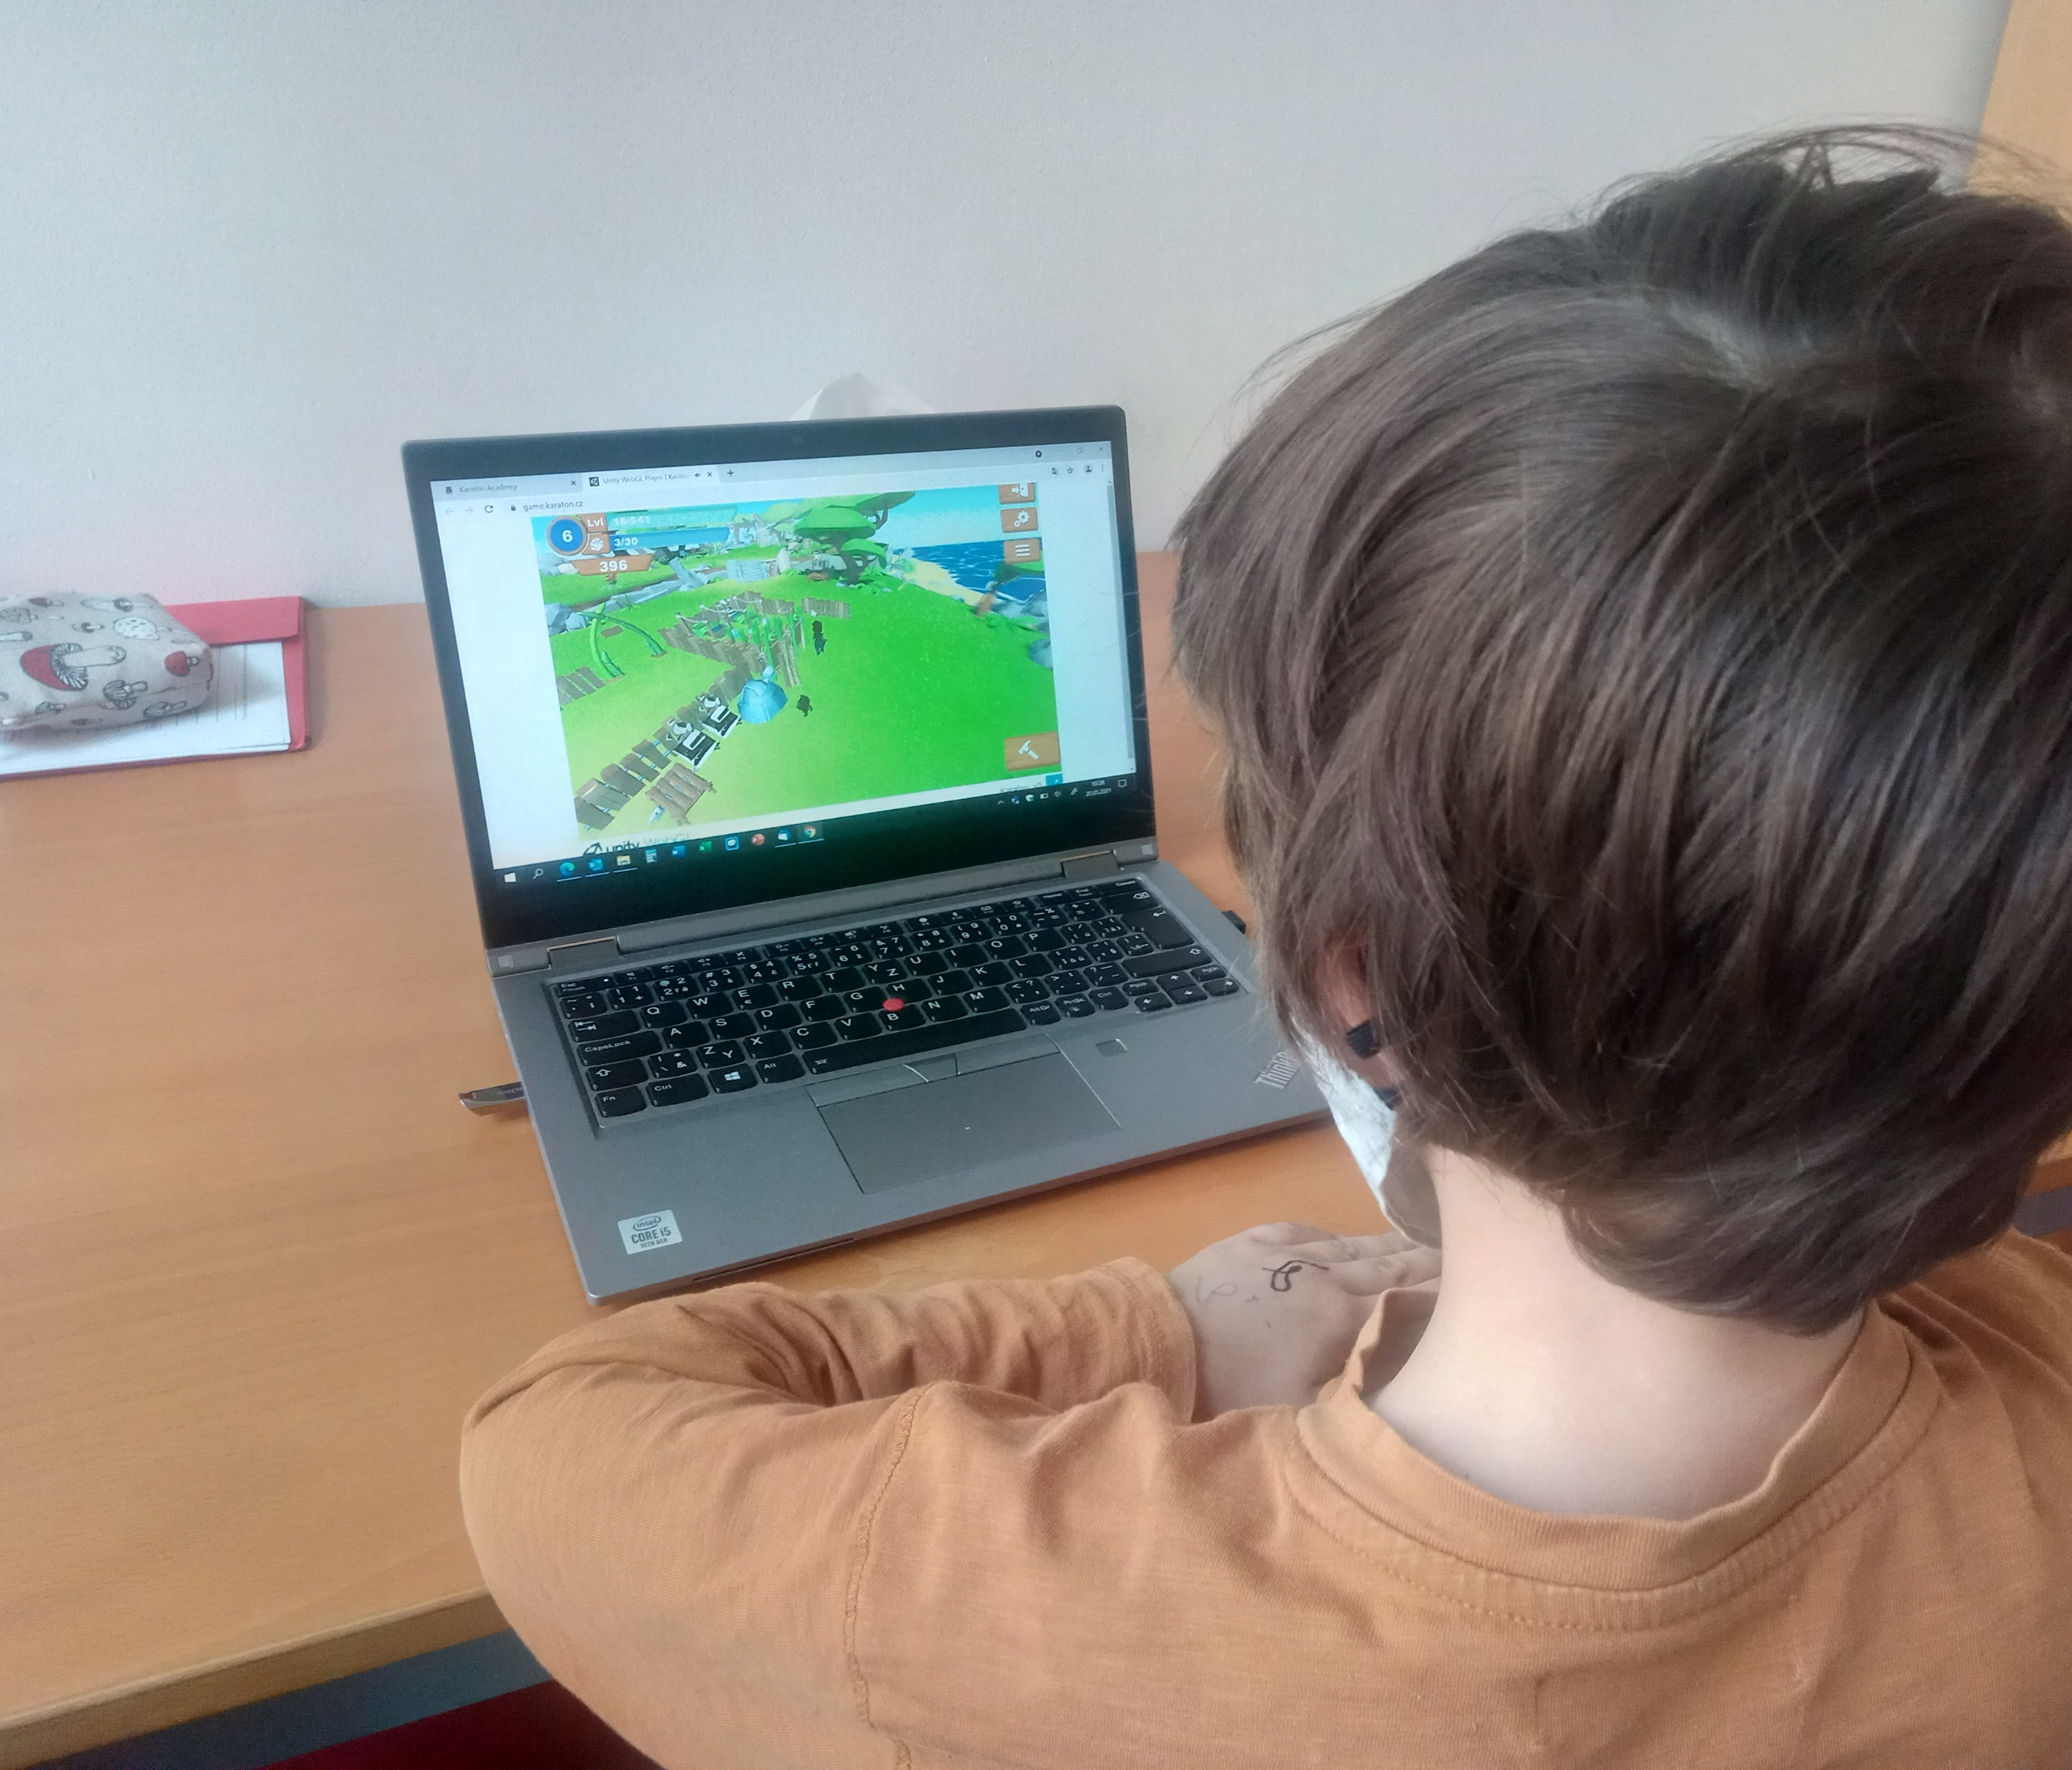
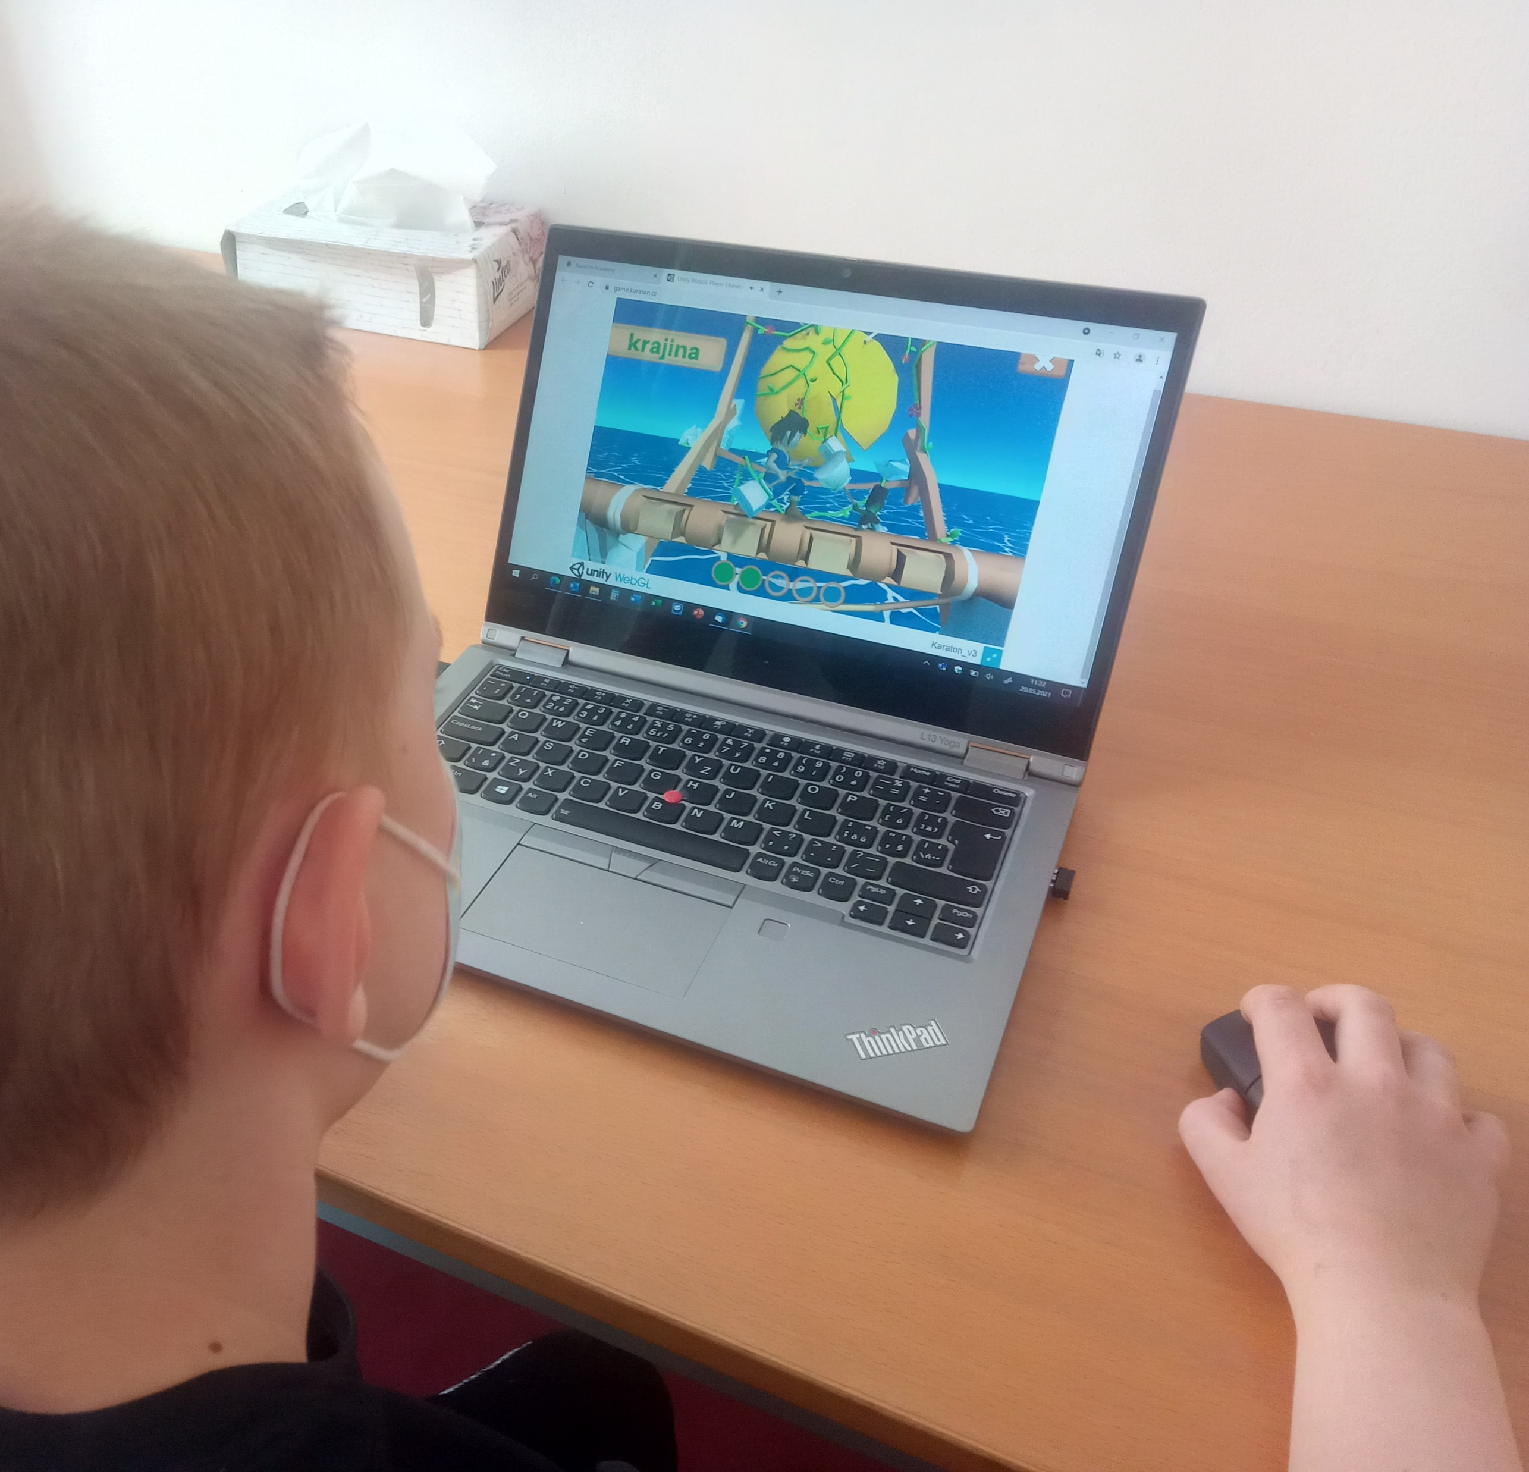
Implementation at schools
second-graders – either group of pupils with reading difficulties or two equal comparative groups of pupils
pretest – training – posttest – collection of quantitative data
observations and interviews during and after each training – collection of qualitative data
training – 2-3 times per week; 20-30 minutes
Notes:
According to Czech curriculum and Czech language characteristics the app appears for younger pupils than in its original version in Belgium.

Slide 6
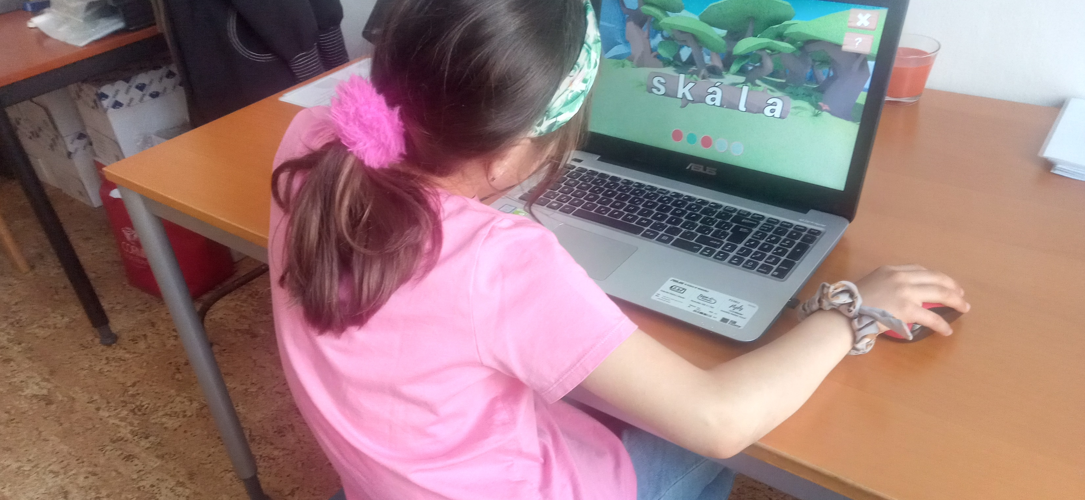
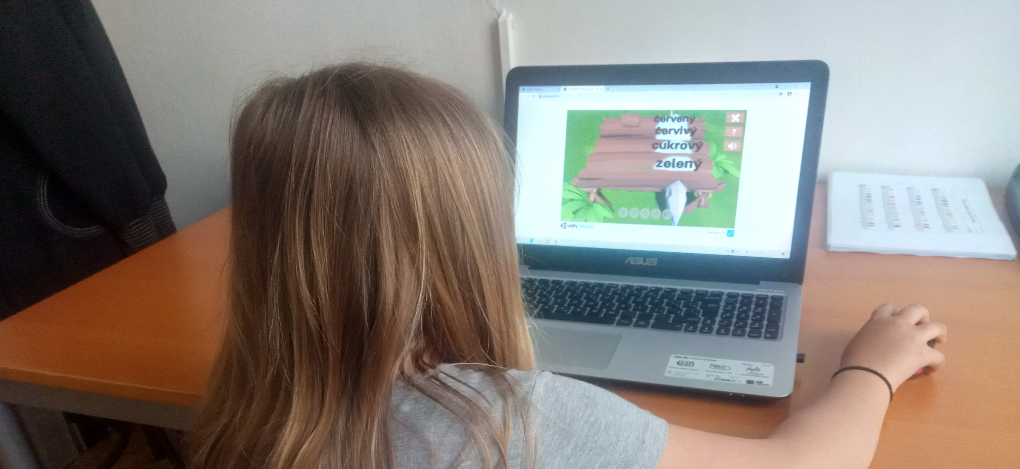
Preliminary outcomes I.
The gamification principle confirmed its functionality.
The pupils had to read to collect material to build their islands.
They never complained about training and reading. They only were anxious when the game did not work properly.

Slide 7
Preliminary outcomes II.

Slide 8
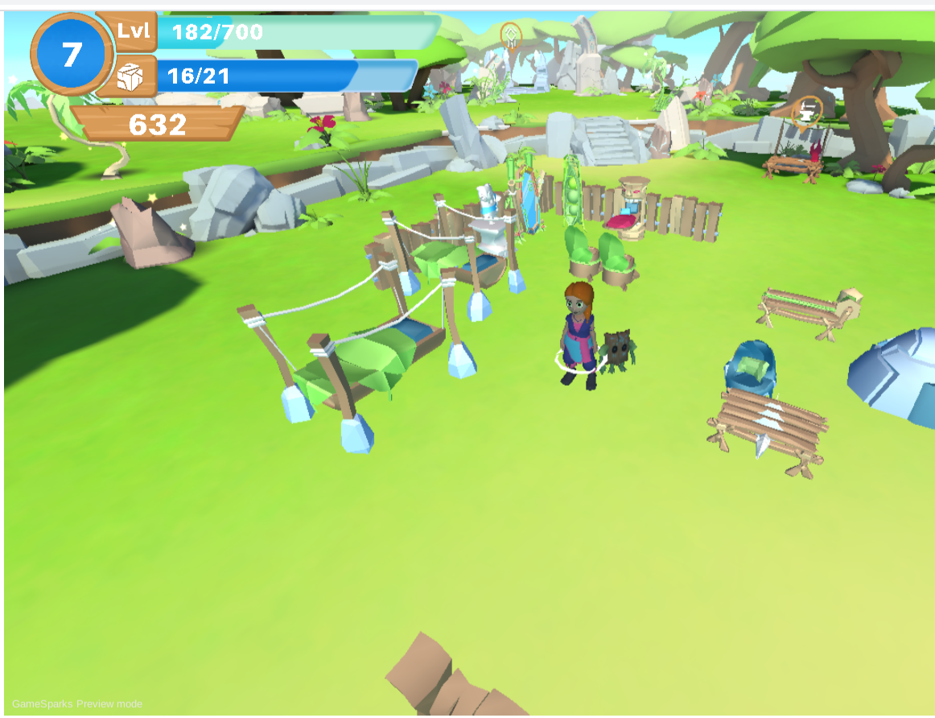
Further steps
further translations and corrections are needed
more data to validate the Karaton are needed
however, we are convinced the app is a useful tool applicable within the education and/or individual training

