Slide 1
Course description
The aim is to review the basic grammatical structures and develop vocabulary which is common for the academic environment. This blended learning course introduces students to academic skills and critical thinking skills via 1 contact lesson (in case of distance learning via ZOOM) and a set of autonomous online activities provided by the Moodle platform.
https://dl1.cuni.cz/course/view.php?id=6424#section-2
Textbook: Brook-Hart, G., Jakeman, V. Complete IELTS Bands 4 -5 (Students' Book), CUP, 2012.
Units 1-10

Slide 2
Credit requirements
The course is assigned 3 credits after completion of the following conditions.
Attendance (50% of all contact sessions)
Active work during sessions
Submitting an essay + 100% of the assigned coursework
Passing the final course test (min. 60% of the total score). Test date January 6, 2021

Slide 3
The difference between academic and general English
What is IELTS?

Slide 5
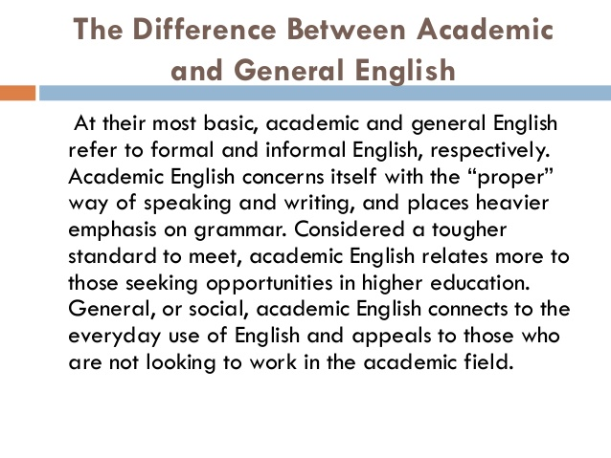

Slide 6
Facts about English
Did you know that English is the most widespread language in the world and is more widely spoken and written than any other language?
Did you know that over 400 million people use the English vocabulary as a mother tongue, only surpassed in numbers, but not in distribution by speakers of the many varieties of Chinese?
Did you know that over 700 million people speak English as a foreign language?
Did you know that of all the world's languages (over 2,700) English is arguably the richest in vocabulary; and that the Oxford English Dictionary lists about 500,000 words, and a further half-million technical and scientific terms remain uncatalogued?
Did you know that three-quarters of the world's mail, telexes and cables are in English?
Did you know that the main language used throughout the world on the internet is English?
Did you know that more than half of the world's technical and scientific periodicals are in English?
Did you know that English is the medium for 80% of the information stored in the world's computers?
Did you know that English is the language of navigation, aviation and of Christianity; it is the ecumenical language of the World Council of Churches?
Did you know that 5 of the largest broadcasting companies in the world (CBS, NBC, ABC, BBC and CBC) transmit in English, reaching millions and millions of people all over the world?
Did you know that the oldest word in English is “town.”?

