Slide 1
Nations and Nationalism: An Advanced Course on Politics and culture
Zdeněk Uherek
zdenek.uherek@fsv.cuni.cz
Charles University, Faculty of Social Sciences Institute of Sociological Studies
U Kříže 8, 158 00 Prague 5 / iss.fsv.cuni.cz / iss@fsv.cuni.cz / +420 251 080 216
www.fsv.cuni.cz
1/1

Slide 2
Community building and nationalism in Indonesia

Slide 3
Politics can be defined many ways:
the activities associated with the governance of a country or area, especially the debate between parties being in power
activities aimed at improving someone's status or increasing power within an organization
the art to negotiate
the total complex of relations between people living in society
competition between different interest groups

Slide 4
From the definitions of politics sometimes is aparent that there are some groups of people and politicians that work with them – negotiate, rule, compete, set power relations etc.
But the situation is dialectical politicians at the same time create these groups. Politicians do not create power relations or any other relationship only in just existing groups but create groups by setting power relations too.
A wide range of views on how politics can be defined also encompass the concept of politics as a community building.

Slide 5
What is community?
It is an aggregate of people with some kind of sociability
Or people in interaction
Or people of face to face relations.
Stress can be put to:
interaction with others (Barth)
routinization, habitual behaviour (Bourdieu, Giddens)
need to belong somewhere (Tönnies)
necessity for survival (Engels) etc.
My interpretation today focuses on space and kinship.

Slide 6
Naturally, the oldest groups will be considered as groups of relatives or ancestral coalitions who are aware of their affinity through distant ancestors.
These groups perceive a strong territorial consciousness, and besides the ideology of internal ties, they create an ideology about why to protect their territory.
My examples will be today from the Indonesian environment.

Slide 7
Let us see Indonesia and here the Siberut

Slide 8
Indonesia is an archipelagic country of about 18,000, out of 8,844 in named and 922 permanently inhabited.
The country´s position is enourmosly important in international navy trade and the trade formed also the Indonesian history.
From 17thCentury, Indonesia was a target of European expansion. It was a sphere of Portugal interests and from 1610 it was under the domination of the Dutch state. Its rule ended during the WWII by the Japanese invasion and then formally in 1949.
In August 1945 nationalist leader Sukarno declared the Indonesia and in 1949 Dutch definitively withdraw. Independent state under the Sukarno (1901 – 1967) – presidentship: 1949 – 1967. In 1967 he was replaced by the General Suharto (1921 – 2008) – presidentship: 1968 – 1998.
In the post-Suharto era, democratic processes have been strengthened by enhancing regional autonomy and instituting the country‘s first direct presidential election
The todays day president is Joko Widodo

Slide 9
Nationalism in Indonesia:
- the state nationalism
- the local nationalism – or patritism
- the ethnicity and national sentiment are divided and are not in congruence
Nationalism is derived from political endeavours of several big national groupings
But there is many other ethnic or national groupings out of power.
Sukarno and Suharto were a Javanese Muslims living far from the Mentawai archipelago.

Slide 10
Besides nations there are many indigenous groups in Indonesia.
They are not involved in the state politics and aside political decisions.
Indigenous people are groups who are the original settlers of a given region, in contrast to groups that have settled, occupied or colonized the area more recently. Groups are usually described as indigenous when they maintain traditions or other aspects of an early culture that is associated with a given region.

Slide 11
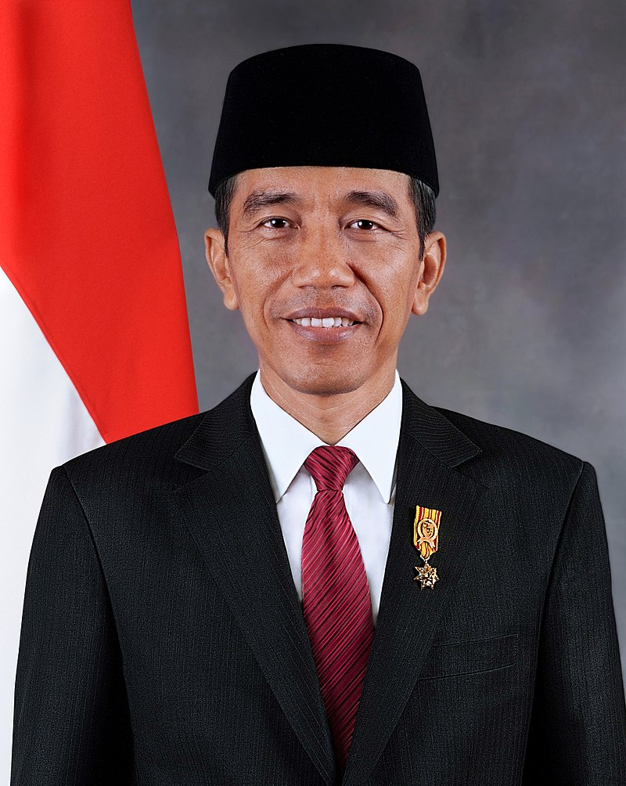
Joko Widodo
First president not to come from an elite political or military background, he was previously the Mayor of Surakarta from 2005 to 2012, and the Governor of Jakarta from 2012 to 2014.
He also introduced years-late programs to improve quality of life, including universal healthcare, dredging the city's main river to reduce flooding, and inaugurating the construction of the city's subway system.

Slide 12
He is a symbol of democratization processes and he is a member of democratic party an a symbol of democratization processes.
What is quite important, he came from the poor backgroud and was able
achieve a strong position due to his clever decisions and good city politics. From a little trademan he became a mayor of the city where he was born and then Mayor of Jakarta.
What was helpful for him: support of masses, Javanese and Muslim background.
Before Joko Widodo, all of the presitdents originated in Indonesian military circles:

Slide 13
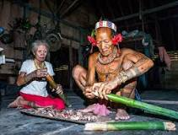
In Siberut the indigenous people are the Mentawai people, who lived in the rain forest and did not care very much whether or not are the members of Portugal, British, Dutch or Indonesian state.

Slide 14
Mentawai: concept of UMA:
At the same time house and the broader space around the house.
What UMA means is given by how people move around in the landscape and how they use it.
Siberut for instance covered by a rain forest 85 % humidity 23 – 40 C
Amount of rainfall about 4,000 mm. – very wet climate.
In the forest, there is very damp, slippery, sprouted soil.

Slide 15
In the immediate vicinity of the house the soil is trampled and because there is little shade, it quickly dries out. The round along the house, this is an intimate, private space owned by a family living in the house.

Slide 16
Frequent walks for a day-to-day operations (such as a dock, a garden where a sago is being handled, or where bananas, or banboos are harvested regularly). For these walks the artificial paths are made by defeating a tree and walking on the logs.

Slide 17
overgrown and obnoxious.
overgrown and obnoxious.
Long journeys are exceeded. Houses are part of a village, or rather scattered settlement. Among single houses are intersections and little paths full of mud. At longer distances than are necessary for operational reasons, Mentawais do not go or only exceptionally. Where the path ends and there are no relatives, UMA ends and is mostly unpermeable terrain.
You can see here three or four intimity territories that creates the UMA space. House, its immediate vicinity, frequent everyday paths and little paths to the edge of UMA used occasionally. The rest is unused and not very important because it is overgrown and obnoxious.
However, a connection to the rest of the world may be a river.

Slide 18
The remote UMAs has rarely been contacted by the other Mentawais groups, due to distance and also because peacekeeping contacts were rarely needed. However, missionaries and other officials who also tried to control the island politically contacted also the forest people.
In particular, the movement of the Dutch, who controlled a large part of Indonesia until 1949, also caused the movement of the local population who accompanied them and exercised some of the less important administrative functions. For example, Zane Goebelg of Tilburg University believes that in this way ethnicization of the local population in the 19th century was especially among the most technologically advanced inhabitants of large islands.
She described encounters between Minankabau people with Javanese.

Slide 19
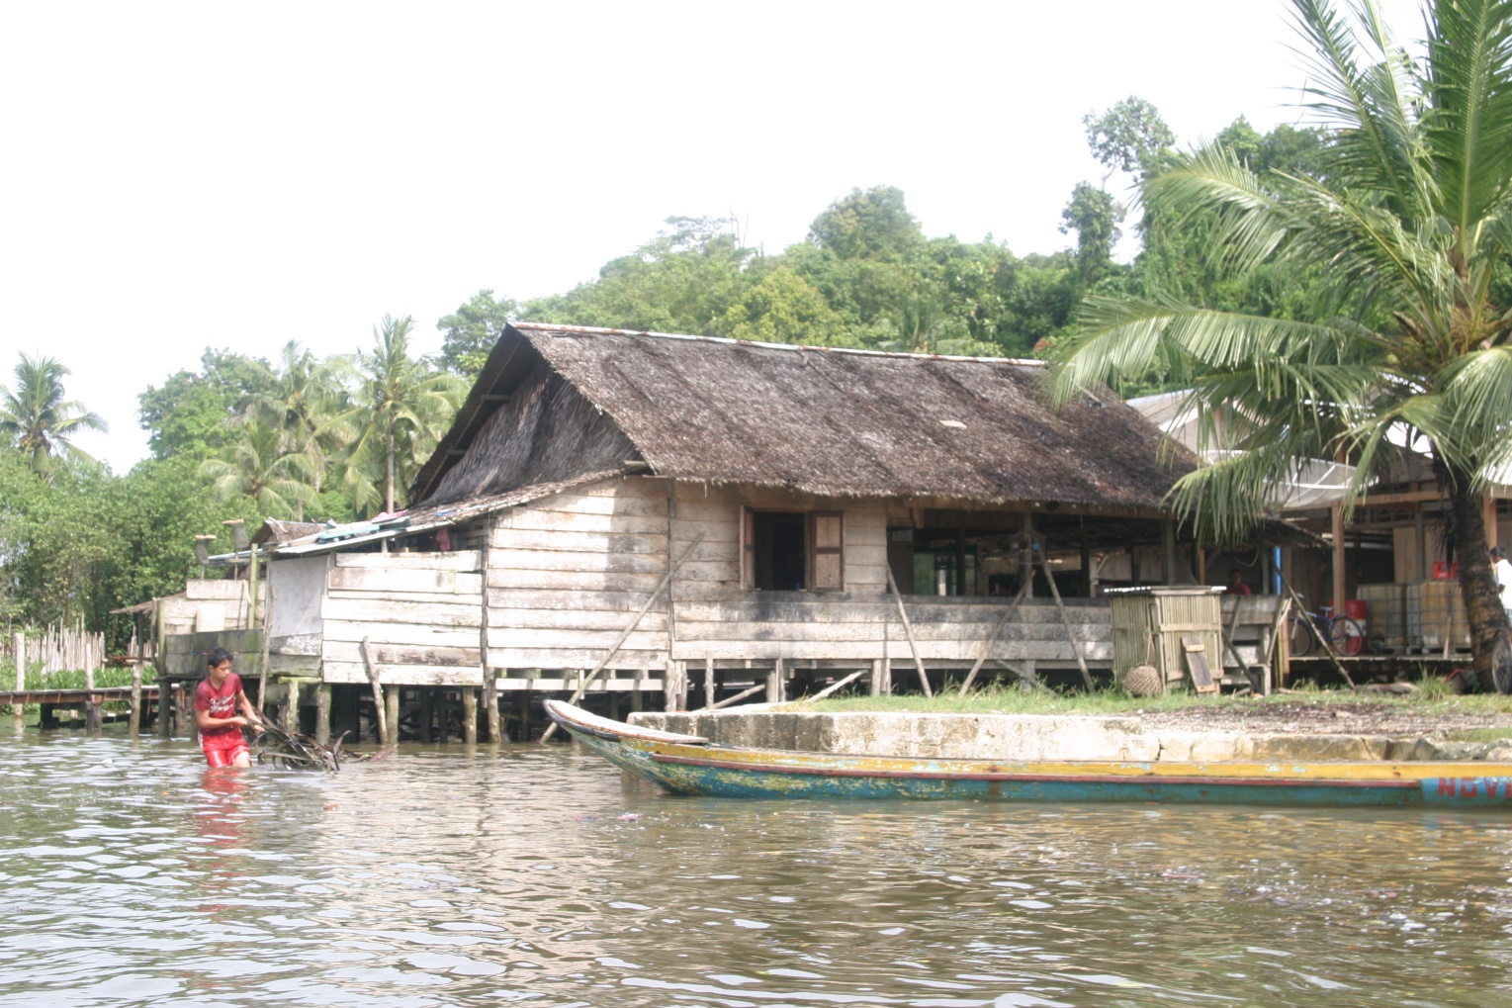
Minankabau also populated the Siberutian coastal areas and pushed local residents into the forest.

Slide 20
In Idonesian environment, a specific situation arose. The hostility to life and death between the various factions of the people from the same space (Siberut, for instance) was complemented by processes of dichotomization and complementarization with other groups: the Dutch and local remote Indonesians who were more different than their traditional enemies, but closer to them than the Dutch as a colonizing power.
Common enemy joined the most powerful groups in the big islands and during the blody anticolonial war they won and established their own state.

Slide 21
Of course, not all of groups particitated in. I do not know about a revolt in Siberut.
In 1945 Indonesia claimed indipendence and 1949 achieved it also thanks to president Sukarno, left wing politician who tried to eradicate the powerty in the country and enhance democratial development.
Eradication of underdevelopment was also applied in Siberut. The Mentawaians were forcibly forced into school, driven out of the forests and settled as a workforce on the coast.

Slide 22
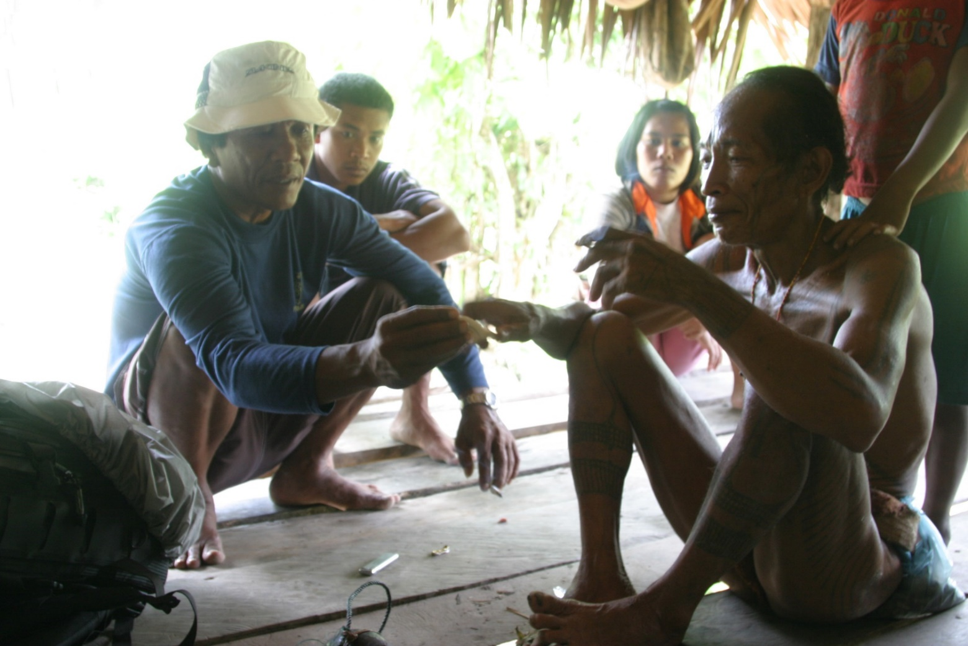
On the coast, however, there are only inferior jobs among the more educated and busy minkanbauks who even physiognomically look different than the Mentawai. They are large, robust rounds against them, while the Mentawians are much more subtle and subtle.

Slide 24
Therefore, as soon as he released the external pressure for General Suharta, much of it returned with the original houses in the jungle (some never left), but part lives on the shore and occasionally goes to help his relatives. These created a group of people who have rain forest as a weekend space, as in the Czech Republic weekend housing with relatives in the villages. This sort of people is not numeroud but exists – the first little village is about 6 – 7 hour by the river.
The movement of the inhabitants in the area is well visible for clothing. Some go with a penis pouch and tattoo, others use a more regular outfit. In particular, women have switched to European clothing and use their own clothing for example when collecting shells in water.

Slide 25
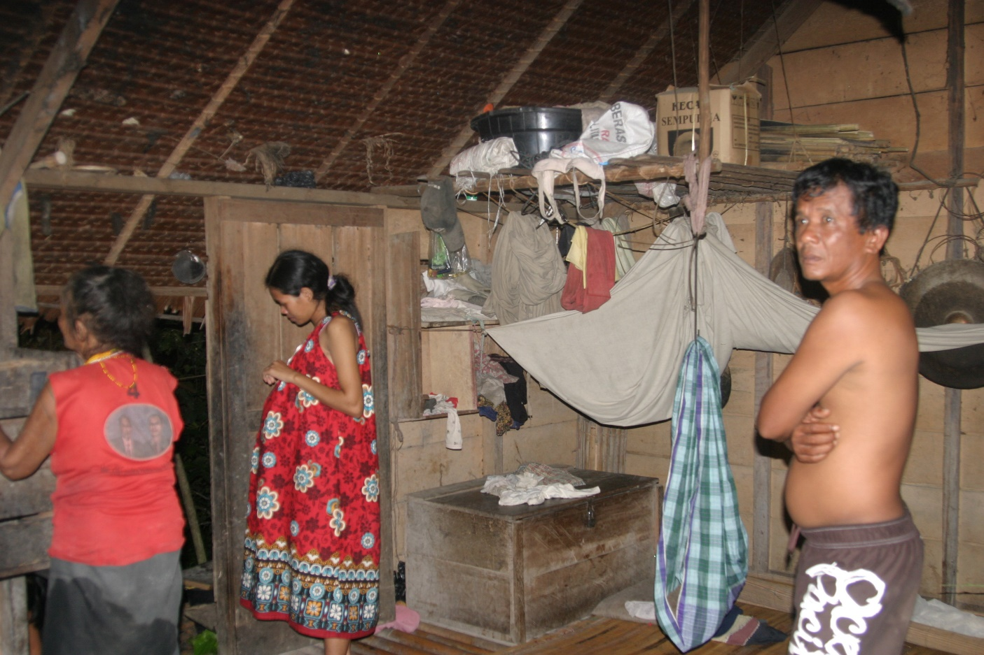

Slide 26
Obviously the loyalty of these people to the ruling regime, the attitude towards Minankabau and the Europeans should be borne out by other connotations. In particular, the Dutch are Mentawai people rather a legend, but they have some knowledge because they have tried to convert them to Christianity. However, they are aware of them. One of the locals told me that his grandfather was in Holland. But that could not be verified.

Slide 27
Obviously the loyalty of these people to the ruling regime, the attitude towards Minankabau and the Europeans should be borne out by other connotations. In particular, the Dutch are Mentawai people rather a legend, but they have some knowledge because they have tried to convert them to Christianity. However, they are aware of them. One of the locals told me that his grandfather was in Holland. But that could not be verified.

Slide 28
Because of the great diversity of the population, it is very lively and clearly ethnocultural. Ethnicity has nothing to do with nationalism. It is perceived as a group phenomenon, while nationalism is perceived as nationalist nationalism, apparently taken from the Dutch tradition. The nation-building nation is in this sense Indonesian, while individual groups of specific language and customs are declared as ethnic groups and some are experiencing their national revival. The extent to which a joint national declaration is acceptable to them is, of course, a question.

Slide 29
This is also the case of Minankabau, which vehemently revitalize now their traditions and traditional houses not regard that they do not live in them.

Slide 30
Indonesian Nationalism Today and in the FutureAuthor(s): Benedict R. O'G. AndersonSource: Indonesia, No. 67 (Apr., 1999), pp. 1-11Published by: Cornell University Press; Southeast Asia Program Publications at CornellUniversity
Indonesia – the name from 1920s: the very first organization to use the word in its name was the Communist Party of Indonesia and it was pread in 1930s
After WWII the only unifying power was Indipendence Army
And Indonesia was a concept of future:
„One can see how much nationalism is tied to visions and hopes for the future“

Slide 31
The wager is that the idea "the future of Indonesia" will be sufficiently rooted in the spirit of the country's legal citizens that each new candidate-member of the nation will be ready to set aside where necessary personal ambitions and loyalties for that grand idea. This wager is winnable in the long run only if the Indonesian nation, like other nations, is large-hearted and broad minded enough to accept the real variety and complexity of the national society (which in Indonesia's case numbers two hundred million people). The modern world has shown us sufficient examples of nations that have broken up because too many of its citizens have had shriveled hearts and dwarfish minds-to say nothing of excessive lust for domination over their fellows.

