Slide 1
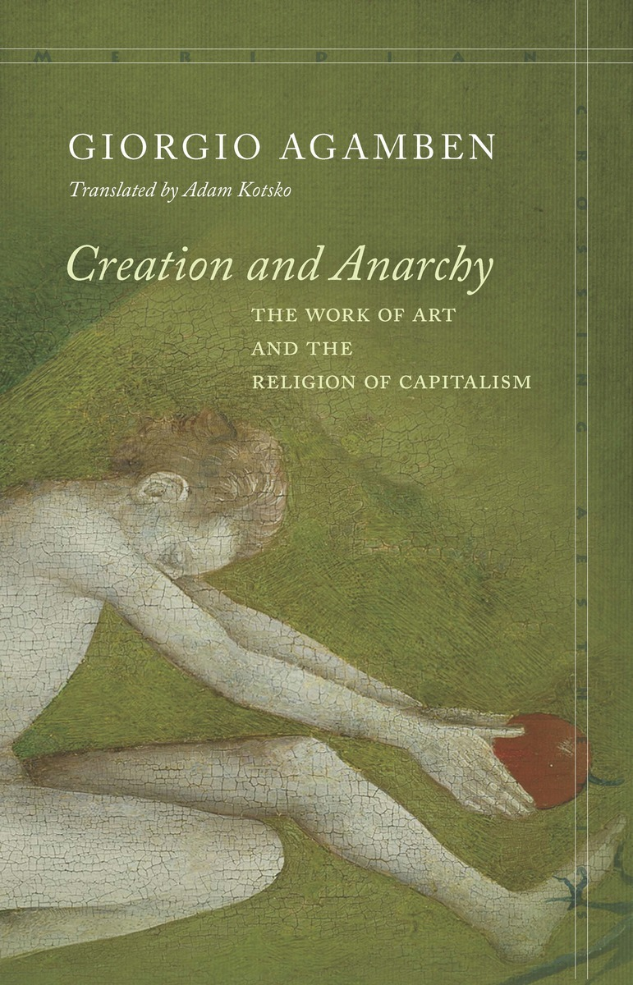
Kapitalismus jako náboženství
Giorgio Agamben

Slide 2
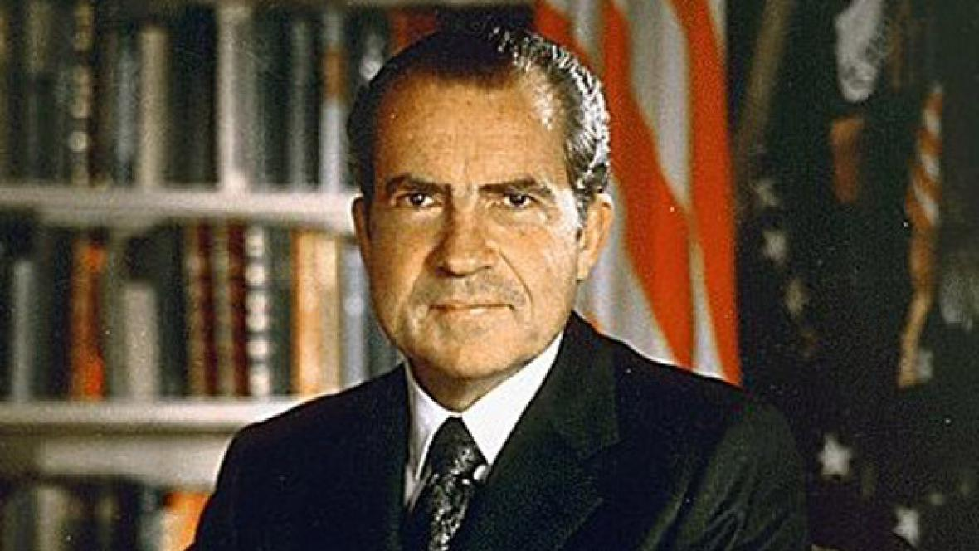
„After August 15, 1971, one should add that money is a credit that is founded solely on itself and that does not correspond to anything but itself.“

Slide 3
„According to Benjamin, capitalism does not represent only, as in Weber, a secularization of the Protestant faith, but is itself esentially a religious phenomenon, which developed in a parasitical way from Christianity.“

Slide 4
„Let us attempt to take Benjamin’s hypothesis seriously and develop it. If capitalism is a religion, how can we define it in terms of faith? What does capitalism believe in? And what, with respect to this faith, does Nixon´s decision imply?“

Slide 5
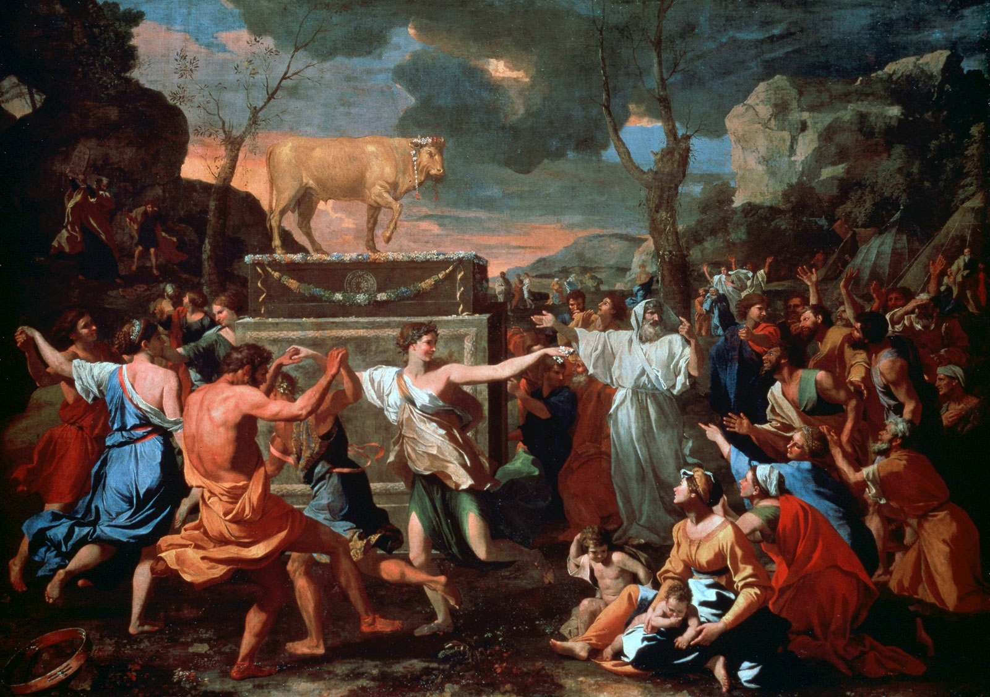
„The „thing hoped for“ is no more; it has been annihilated and has to be, because money is the very essence of the thing, its ousia in a technical sense.

Slide 6
„The capitalist religion, consistent with Benjamin’s thesis, lives in a continual indebtedness, which neither can nor should be paid off.“

Slide 7
„Separated from things, language communicates nothing and in this way celebrates its ephemeral triumph over the world; detached from gold, money exhibits its own nothingness as absolute measure – and, at the same time, absolute commodity.“

Slide 8
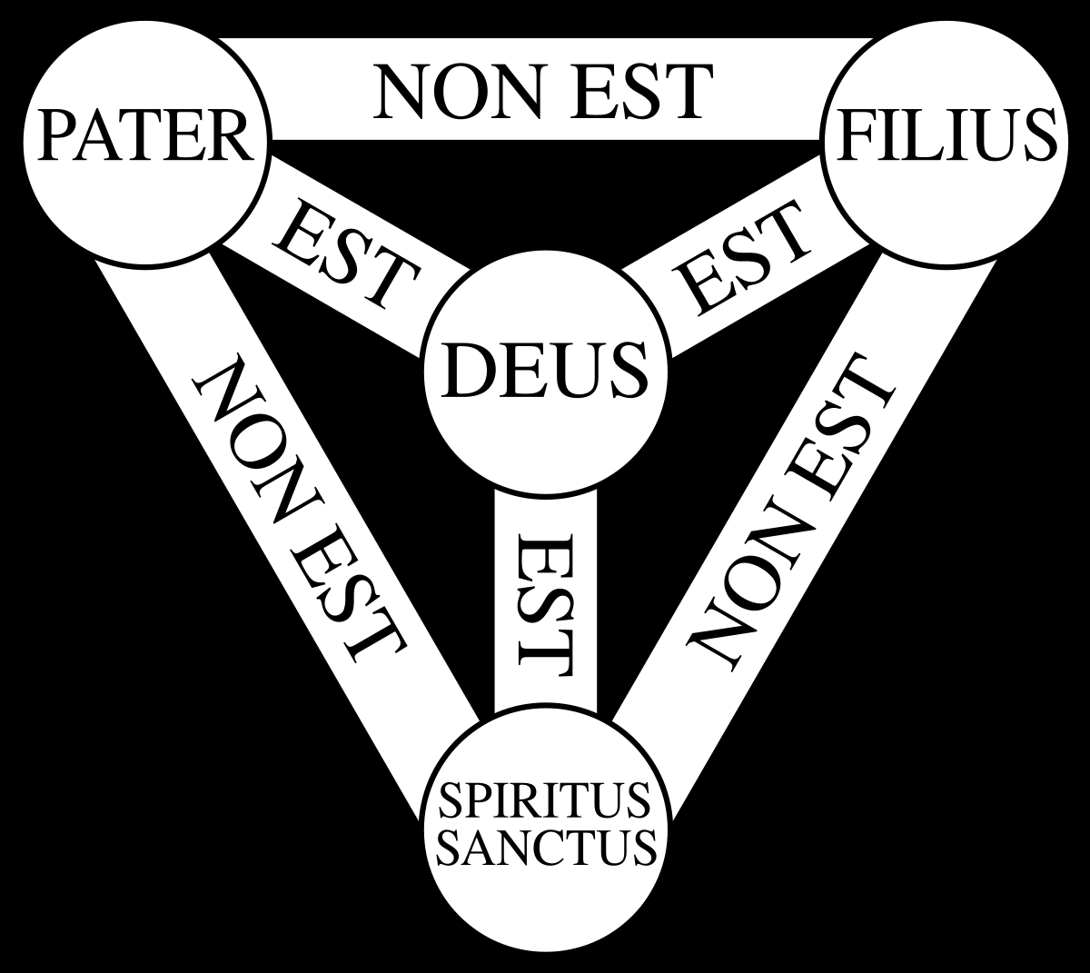
„And in every sphere, in the economy, as in politics, the capitalist religion declares a state of permanent crisis (…), which is, at the same time, a state of exception that has become normal, whose only possible outcome presents itself, precisely as in the Apocalypse, as „a new earth“.“

Slide 9
„That Christ is anarchic means, in the last instance, that in the modern West language, praxis and economy have no foundation in being.“
„Human action is no longer founded in being: for this reason it is free, which is to say, condemned to chance and uncertainty.“

Slide 10
„Anarchy is what becomes possible only when we grasp the anarchy of power.“

