Slide 1
Research Methods
ggplot2

Slide 2
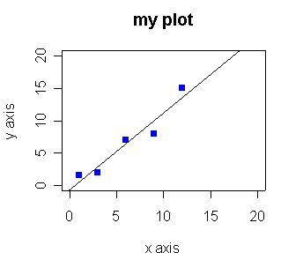
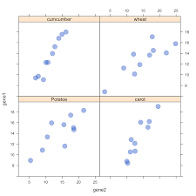
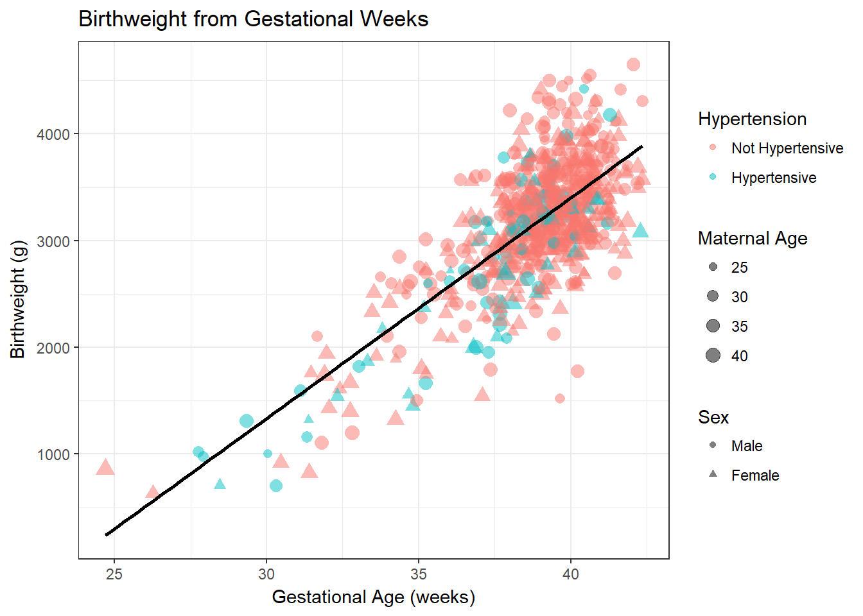
Data Visualisation
Multiple plotting libraries
Different ways how to draw some graphics in every software
Even within R
Base R – plot()
Lattice
Ggplot2 – ggplot()

Slide 3
Data Visualisation
Which plot?
Depends on the data
Different combinations of categorical and continuous variable
Number of dimensions

Slide 4
ggplot2
Grammar of graphics
Unified syntax for making different plots
Part of tidyverse
Works well with dplyr commands
Wide range of plots
Extendable for new types of plots (e.g. creation of maps, network diagrams,…)
Extendable for new themes
Every element of the plot is configurable

Slide 5
ggplot2
Syntax
Adding data to axes
Definition of plot
Definition of visual theme (fonts, labels,…)
Data %>%
ggplot(aes(x = var1, y = var2, col = var 3)) +
geom_point() +
theme_bw()

Slide 6
One variable continuous
Histogram geom_histogram()
Density plot geom_density()

Slide 7
Discrete vs continuous
Boxplot geom_boxplot()

Slide 8
Two or More Discrete Variables
Bar plot geom_bar()

Slide 9
Two Continuous Variables
Scatter plot geom_point()

