Slide 1
EMOTIONAL INTELLIGENCE

Slide 2
History of the concept of EQ
The term was first used by Daniel Goleman at a lecture in 1990 and later in his book (Emotional Intelligence) in 1995;
Cognitive abilities and academic intelligence (IQ - Intelligence Quotient) in the life of success involved only 20% ; the remaining 80% is constituted by EQ (Emotional Quotient);

Slide 3
IQ:

Slide 5
EQ:
is the skill to recognize different emotions in yourself and the world around you and to interpret and use these emotions to enhance your quality of life.
is a set of abilities that helps you manage your emotions and relate to others.
is the ability to recognize your emotions, understand what they're telling you and realize how your emotions affect people around you.
is the ability to understand and manage both your own emotions and those of the people around you.

Slide 6
IQ vs. EQ
‘Intelligence Quotient’ (IQ) is the measure most often used to determine how clever people are.
The most successful leaders tend to have an above average IQ, but this doesn’t make them successful. It’s another type of intelligence called ‘Emotional Intelligence’ or EQ.
EQ enables leaders to better manage the emotional content of the relationships they have and, as a result, they are more influential.
“The best leader is usually the most emotionally intelligent person in the team.”

Slide 7
IQ vs. EQ
THE BRAIN IS WIRED TO BE EMOTIONALLY INTELLIGENT:
Reptilian brain (controls very rudimentary functions e.g. breathing, swallowing and heartbeat)
Limbic brain (can be expressive and intuitive, but it doesn’t reason, isn’t logical, and doesn’t respond to our will)
Neo-cortex brain (the ability to control your actions in the face of strong emotions) - it’s the seat of your thinking, logic and reasoning.

Slide 9
The value of emotions
Emotions tell the truth about a situation or problem, before we can use logic to rationalize our response. They are our messengers.
Emotion comes from the Latin word: Motus Anima that literally means “The spirit that moves us.“
The most empowering decision we can make is to take responsibility for our feelings.
Taking responsibility for our actions involves examination of our motives.
Instead, we see that everything we do is a choice based on our needs, our beliefs, our values, our fears, and desires.
Virtually all of our actions are motivated by one of two basic emotions: fear or desire.

Slide 10
Characteristics of low/high EQ

Slide 11
The five (5) competencies of EQ

Slide 12
1) Self awareness
It must come first because if we don’t know ourselves and what we’re feeling, how can we possibly know or understand someone else and how they feel?
Self-awareness is about knowing what drives us and what we’re passionate about.
The more we know about ourselves, the better we are able to control and choose what kind of behaviours we’’ display in a work setting.
Without self-awareness, our emotions can blind us and guide us to do things or to become people we really don’t want to be.
If we are aware of our feelings and thoughts, we can choose how we will act or react in a given situation or to a certain person.
With this choice comes power - the kind of intrinsic power that no one can take away from us.

Slide 13
1) Self awareness
People with high emotional intelligence are usually very self-aware.
They understand their emotions, and because of this, they don't let their feelings rule them.
They're confident – because they trust their intuition and don't let their emotions get out of control.
They're also willing to take an honest look at themselves.
They know their strengths and weaknesses, and they work on these areas so they can perform better.

Slide 14
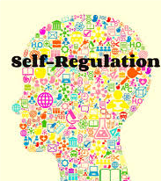
2) Self regulation
The second step is to regulate those feelings and manage them so they do more good than harm.
Our passions can be contagious and energize others, but our ranting and ravings can damage work relations beyond repair.
Checking those emotions is what self-regulation is all about. It’s giving the rational side time to temper our feelings when needed.
When we are angry, we cannot make good decisions and often react inappropriately by blowing an incident out of proportion - we lose our perspective.
By learning to manage our emotions, we become more adaptable and innovative in stressful situations.

Slide 15
2) Self regulation
Self-regulation helps us act intentionally rather than reactively.
Self-regulation helps us act deliberately and not destructively.
Self-Regulation is the ability to control emotions and impulses.
People who self-regulate typically don't allow themselves to become too angry or jealous, and they don't make impulsive, careless decisions - they think before they act.
Characteristics of self-regulation are thoughtfulness, comfort with change, integrity and the ability to say no.

Slide 16
Out of control emotions make smart people stupid – IQ:178; EQ: 0

Slide 17
3) Self motivation
The third step is to direct the power of our emotions towards a purpose that will motivate and inspire us.
Self-motivation is about visualizing the achievement of a goal and taking the necessary steps to get there.
Athletes use their emotions to psyche themselves up for competition.
The same technique is effective in the workplace to raise job performance.
“Self-motivated people can envision reaching the goal which gives meaning to the mundane.”
“Stand firm even when you are buffeted by events and emotions.”

Slide 18
3) Self motivation
The strongly self-motivated workers also accept change and are more flexible. New twists and unexpected turns don’t bend them out of shape.
They have better attitudes, take more initiative and do balanced risk taking. But most of all, self-motivated employees persist toward goals, despite obstacles and setbacks.
People with a high degree of emotional intelligence are usually motivated.
They're willing to defer immediate results for long-term success.
They're highly productive, love a challenge, and are very effective in whatever they do.

Slide 19
Empathy
Empathy is defined as an outwardly-looking approach to managing relationships that enables people to see from another person’s perspective.
It means responding to others appropriately with sensitivity and compassion.
Empathy begins with listening i.e. with the purpose to understand and respond and display sensitivity and concern.
“Nobody in life will listen to us unless they feel we have listened to them.”
A team leader, who is empathetic, listens and responds and naturally displays sensitivity and concern - this makes a connection with people.
It is important for team leaders to be attuned to different people’s needs and emotional responses as well as reading these cues.

Slide 20
Empathy
“Empathy is the glue that will bind the group together to work successfully.”
The ability to model empathy is the best way to motivate others.
Empathetic people are usually excellent at managing relationships, listening and relating to others.
They avoid stereotyping and judging too quickly and they live their lives in a very open, honest way.

Slide 21
Relationship/social skills
This fifth competency is about interacting with people successfully and being adept at managing emotions in others.
With heightened social skills, leaders are better communicators and better collaborators.
It's usually easy to talk to and like people with good social skills, another sign of high emotional intelligence.
Those with strong social skills are typically team players.
Rather than focus on their own success first, they help others develop and shine.
They can manage disputes, are excellent communicators, and are masters at building and maintaining relationships.

Slide 22
Summary of EQ competences

Slide 23
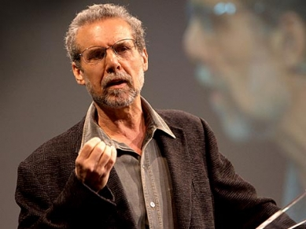
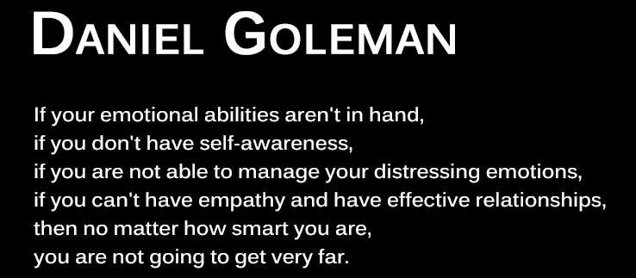
Emotional Intelligence Quiz
Test your emotional intelligence
Daniel Goleman introduces Emotional Intelligence watch

Slide 24
EQ Components I.
adaptability: flexibility and willingness to adapt to new conditions;
assertiveness: the ability to uphold their rights openly, honestly and without attacking others;
expression of emotions: the ability of communicating feelings to others;
managing the emotions of others: the ability to influence the feelings of others;
the perception of emotions in oneself and others: the ability to clearly perceive one's feelings and feelings of others;

Slide 25
EQ Components II.
emotional regulation: the ability to control your emotions;
low impulsiveness: deliberate action;
relationship skills: the ability to experience fulfilling interpersonal relationships;
self-esteem: awareness of its pros and cons, adequate self-confidence, integrated personality;
motivation: ability not to give up in obstacles;

Slide 26
EQ Components III.
social skills: ability to deal with other people;
stress management: the ability to withstand pressure and manage stress;
empathy as a personality trait: the ability to look at the situation through the eyes of another;
happiness as a feature of personality: cheerful mind and contentment with life;
optimism as a feature of personality: a relaxed perception of life, perception especially of the "bright aspects of life"

Slide 27
Thank you for your attention

Slide 28
Literatura
Goleman, D. Emoční inteligence, 1995.
Furnham, A. Psychologie. 2012

