Slide 1
POLITICAL SOCIOLOGY OF CENTRAL EUROPE
Catching up with the West
Lecture 2 (28 February 2019)

Slide 2
The idea of the developed West
the West as a leader of progress, modernization, economic and cultural development
hierarchy among cultures
an idea of the linear progress and evolution
a time gap between the West and the East

Slide 3
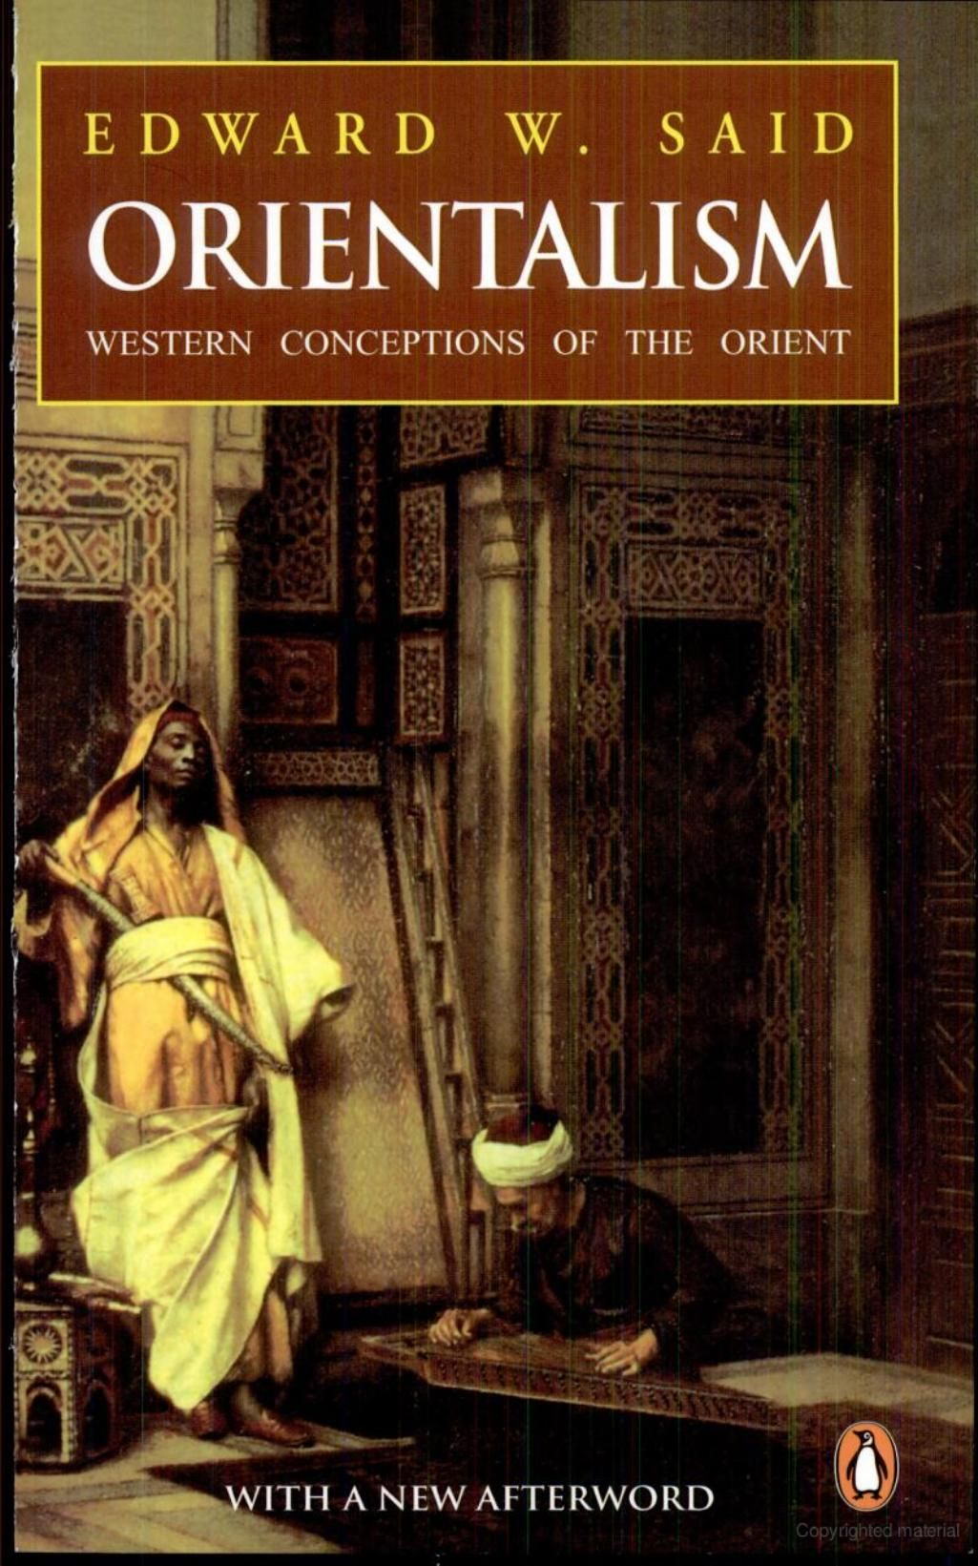
Orient vs. Occident
Edward Said: Orientalism (1978)
Europeans constructed the image of the East „Orient“ – based on the fragmented information, prejudices
a romanticized vision of Orient to justify colonial and imperialist intentions
Complementarity: „Occident“ (the West) – also an constructed image

Slide 4
„Time-zones“ of Europe (I.)
Ernest Gellner: Nationalism (1997)
„(I)n Europe, one can discern three or four time zones, rather like the world maps at airports indicating time differences in various ares.“ (p. 50)
France as an example for others
Zone I: „Atlantic coast“ GB, France, Spain, Portugal
state + culture (marriage); almost no impact of nationalism
Zone II: „the former Holy Roman Empire“ = Italy, Germany
both nations without a state
nationalism as unification

Slide 5
„Time-zones“ of Europe (II.)
Zone III: peripheries of empires = CEE
no nation (no high culture), no state
„It is when we move further east that the trouble really starts. In the second zone, nationalism could be benign and liberal; it had no inherent need to go nasty (even if in the end it did). In the third zone, on the other hand, violence and brutality seem to have been inscribed into the nature of the situation. The horror was not optional, it was predestined.“ (p. 54)
-> ethnic cleansing

Slide 6
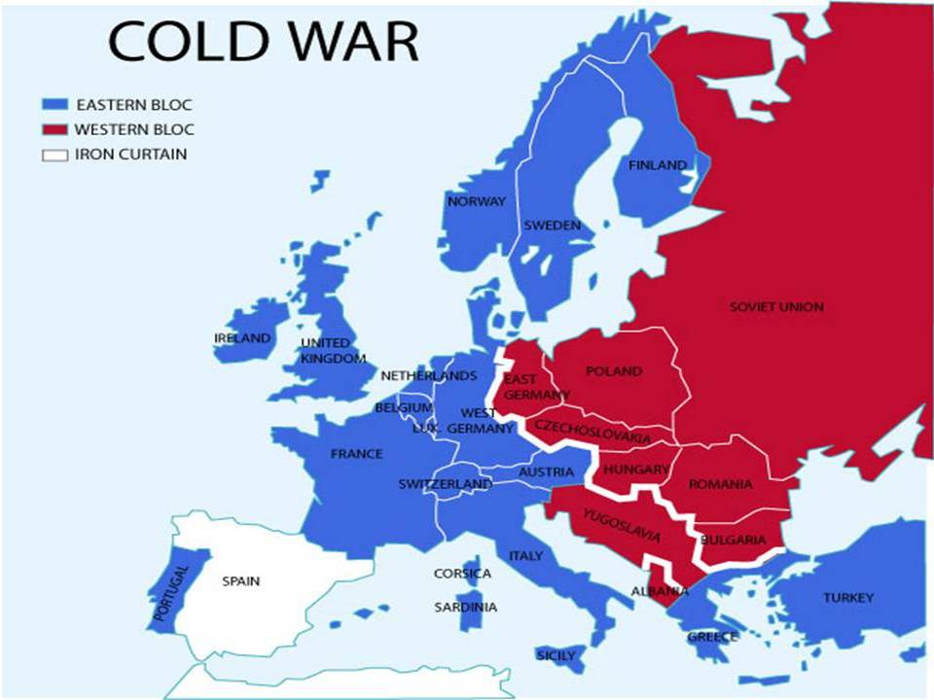

Slide 7
State socialism like the development project
state decides on the mode of development (types of industries)
state subordinates trade and fiscal policy to economic development
goal is to catch up with the West

Slide 8
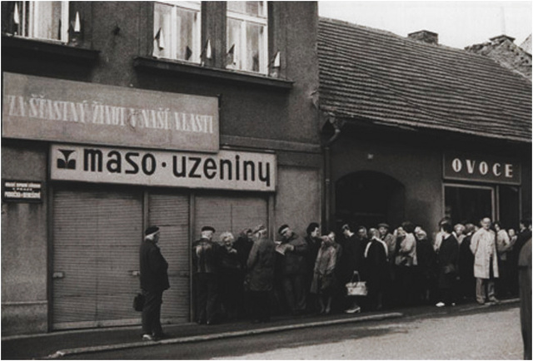
Shortages in CE in times of the Soviet Union

Slide 9
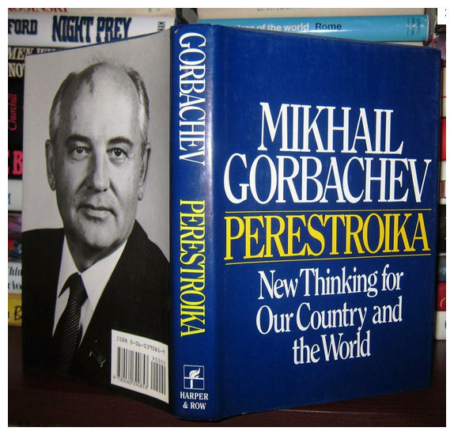
Perestroika
an idea of reformation within the Communist Party of the Soviet Union; run by Mikhail Gorbachev
alowing private ownership, partial decentralization, modified central planning, elections with several candidates
„glasnost“ = openness and transparency
democratization, not democracy

Slide 10
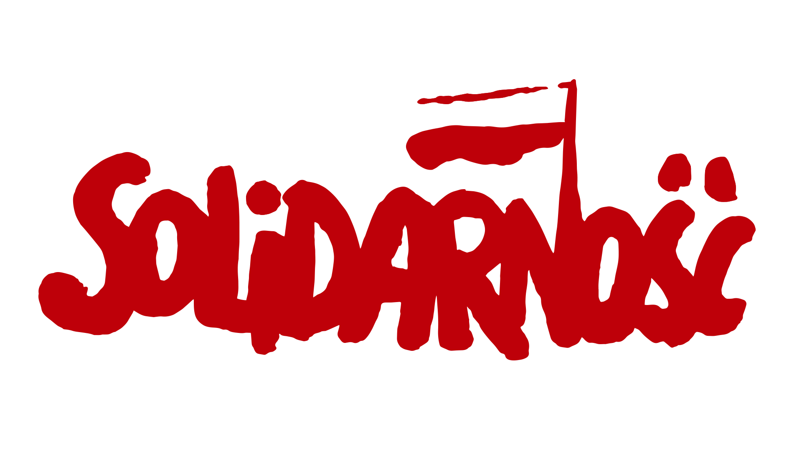
Solidarity Revolution in Poland
Solidarność = Polish trade union – „Independent Self-governing Labour Union ‚Solidarity‘“
a massive movement with 10 million members
main argument: workers‘ rights
lead by Lech Wałęsa
supported by the US and Pope John Paul II

Slide 11
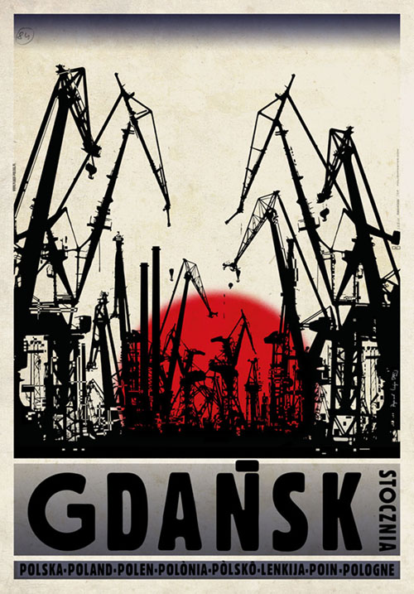
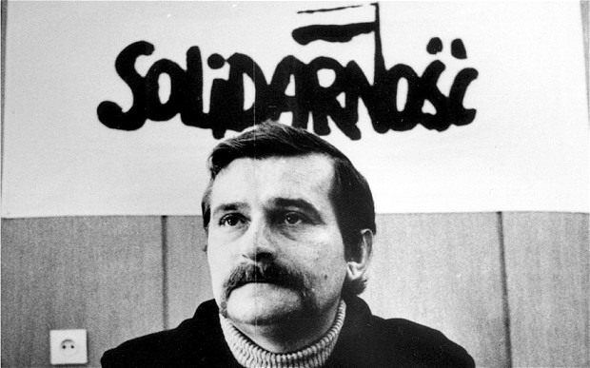
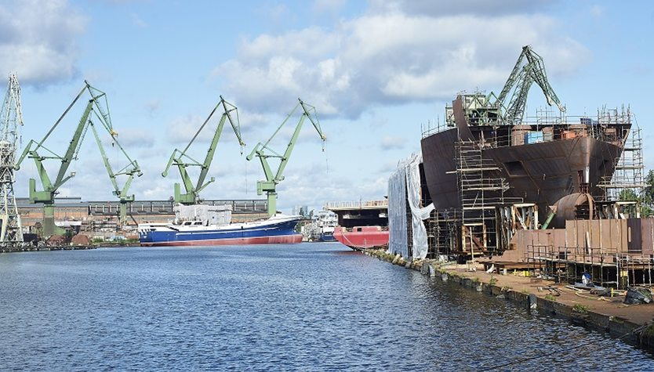

Slide 13
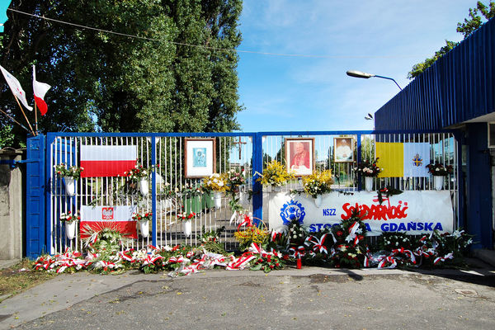

Slide 14
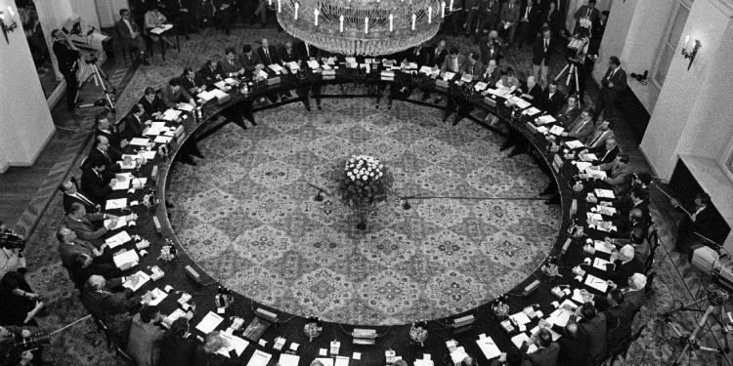
Polish Round Table Talks
February 1989

Slide 15
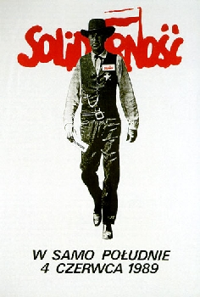
Polish semi-free elections 1989
June 1989

Slide 16
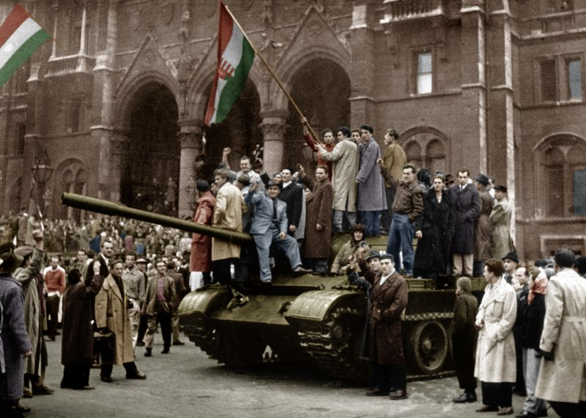
Negotiated revolution in Hungary
plurality of „new“ political subjects already in 1989
round table talkes, searching for a consensus (from March 1989)
23 October 1989 - proclamation of the Republic of Hungary
Árpád Göncz as a president

Slide 17
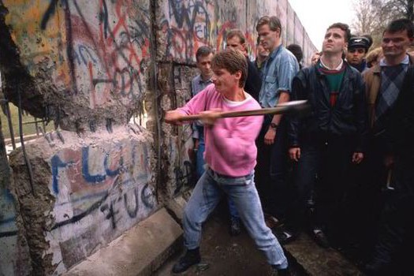
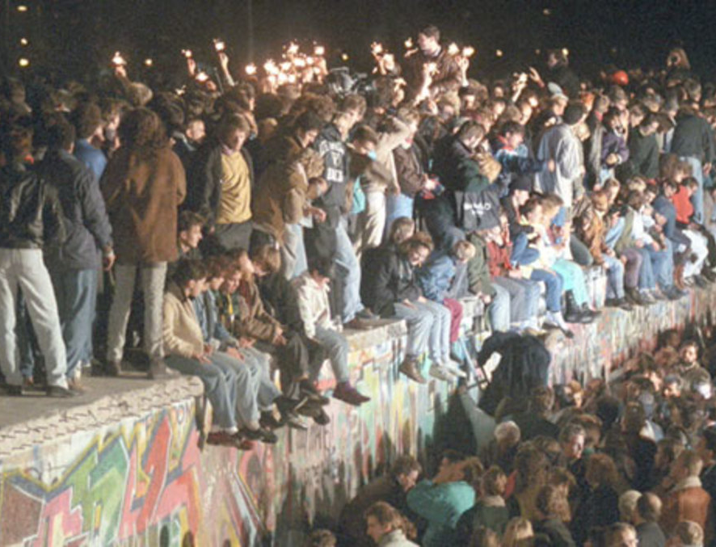
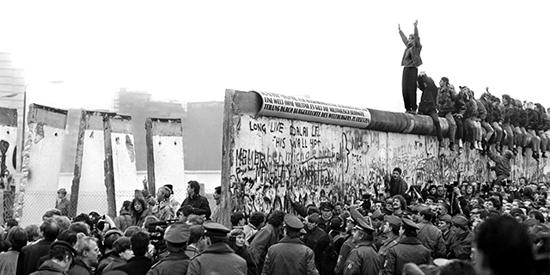
A chain reaction – Fall of the Berlin Wall
9 November 1989

Slide 18
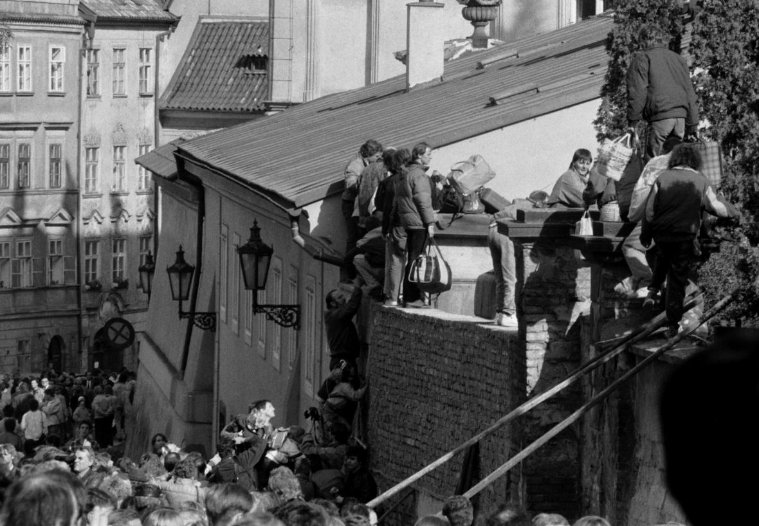
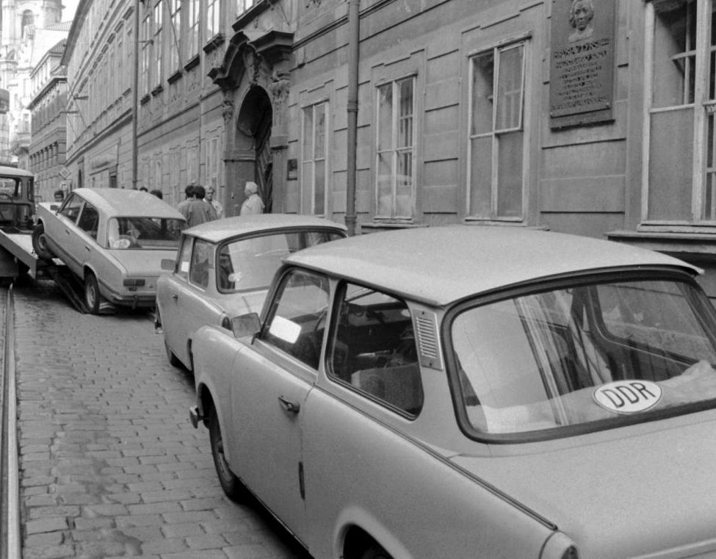
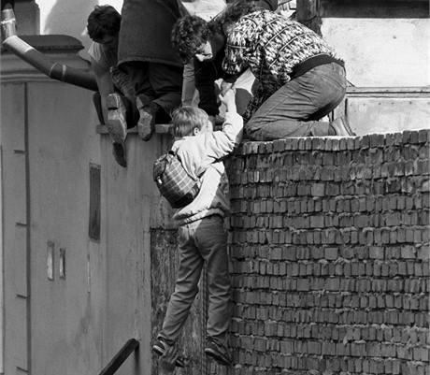
„East Germans Exodus“
https://www.radio.cz/en/section/curraffrs/german-embassy-marks-anniversary-of-1989-east-german-exodus

Slide 19
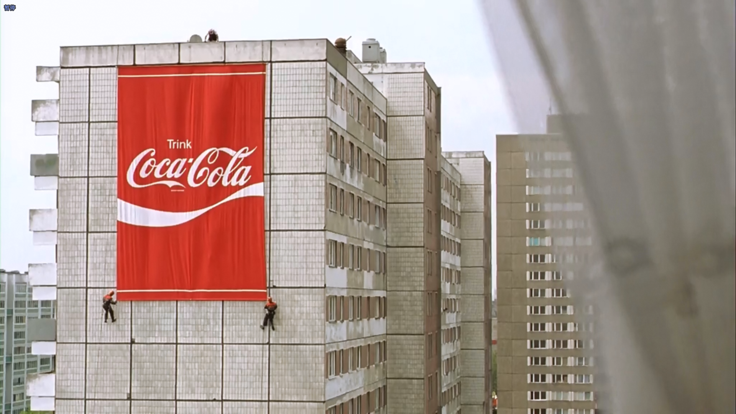
Ossie-Wessie difference/conflict
German unification 1990
called unification but in practice it was “annexation” of East Germany (GDR) by West Germany (FRG)
fifty years of separate sociality led to very different cultures and personalities

Slide 20
Wessie
used to consumerism
uses democracy
unemployment as threat
individual freedom, choice of lifestyles
Ossie
used to shortages and “making do”
had to use covert ways of realizing his/her interests, or emigrated
used to full employment
doesn’t understand competition
opposition was often about life style and values, not about overthrowing the regime

Slide 21
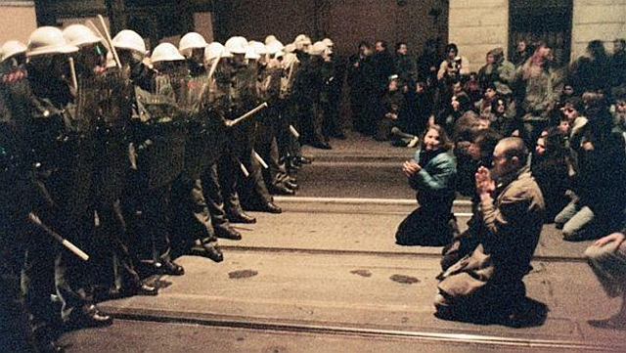
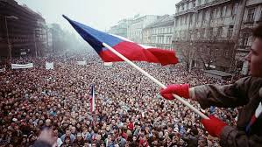
Velvet revolution in Czechoslovakia
from 17 November to 29 December 1989
a series of demonstrations against the regime
Václav Havel elected as a president
Civic Forum as a political platform -> new parties

Slide 22
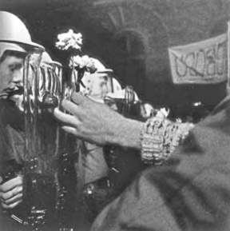
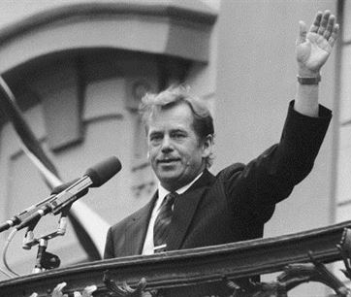
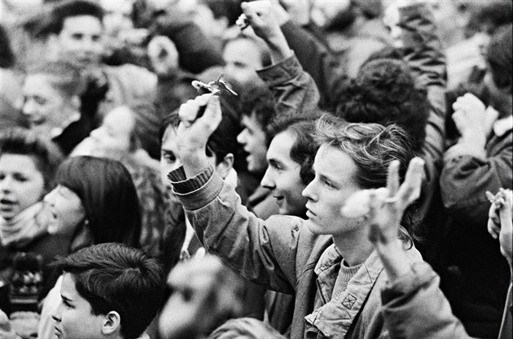
Velvet revolution in Czechoslovakia
https://www.youtube.com/watch?v=9qG5fxLmfAk

Slide 23
Return to the West?
Walesa in Congress
https://www.youtube.com/watch?v=vL6OBc-ca2w
https://youtu.be/7X5nCOXbQOo?t=175
Havel in Congress
https://youtu.be/b3tPguoWY-g?t=458

Slide 24
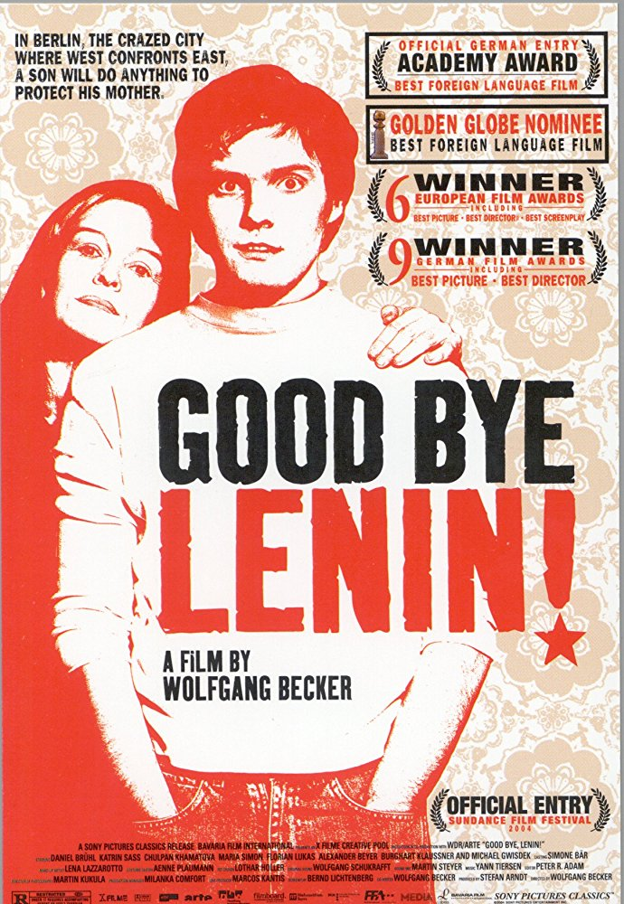
Movie tips
Good bye, Lenin!
https://www.imdb.com/title/tt0301357/
Wałęsa: Man Of Hope
https://www.imdb.com/title/tt2113820/

Slide 25
Fall of the Iron curtain
„(I)t takes six months to change a political regime, six years to change the economy and at least 60 years to change the society.“
Dahrendorf (1990) - three stages of transformation:
the hour of lawyers
- writing a new not-totalitarian constitution
= 6 months
the hour of economists and politicians
- implementing political and economic freedoms
= 6 years
3) the hour of citizens
- change of values and identity
= 60 years

