Slide 1
The Constitutional Sociology of Europe:
Politics, Law and Society
Paul blokker, PhD
Institute of Sociological studies, Charles University
28 February, 2017

Slide 2
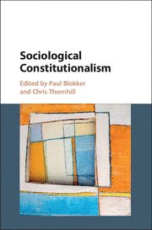
Constitutional Sociology
Introduction of myself
I am a political sociologist
PhD from the European University Institute, Florence
I have worked at the Universities of Amsterdam, Trento, Liverpool, Sussex, Syracuse, and Charles University
My main focus is on the sociology of democracy, constitutional sociology, socio-legal studies, democratic participation, European integration, qualitative methods (discourse analysis)
Why me?
Co-editor of volume “Constitutional Sociology”, with Chris Thornhill
Research project on “Constitutional Politics in Post-Westphalian Europe”
2
Notes:
2

Slide 3
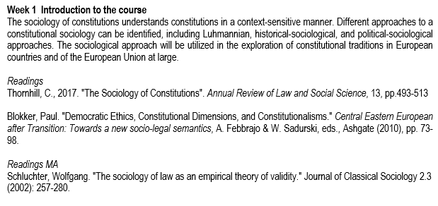
Readings
Constitutional Sociology

Slide 4
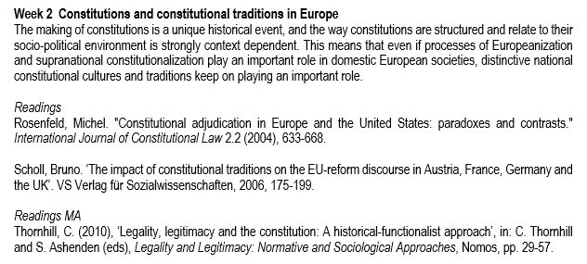
Readings
Constitutional Sociology

Slide 5
Objectives • To introduce the students to the sociology of constitutions; • To analyse the societal context in which constitutions operate; • To obtain knowledge of diverse traditions of constitutionalism in Europe; • To explore constitutional dimensions of the European integration project from a socio-legal angle; • To provide insights into the social operation of the law; • To explore the changing nature of constitutionalism from the perspective of social functions of constitutions, including axiological, integrative, and participatory functions; • To provide insight into the social embeddedness of rights and constitutional norms; • To analyse the challenges to constitutionalism (populism, participation);
Constitutional Sociology

Slide 6
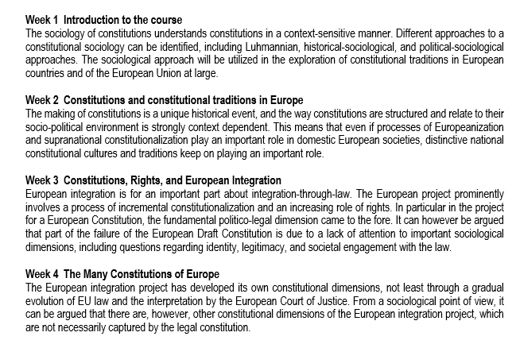
Course outline
Constitutional Sociology

Slide 7
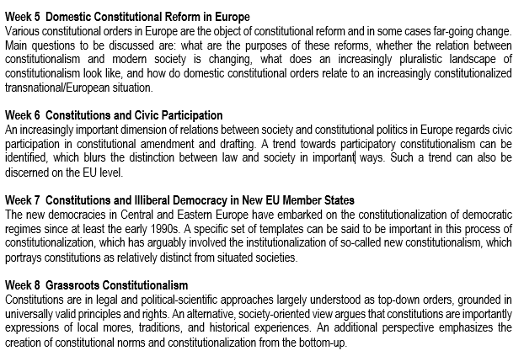
Course outline
Constitutional Sociology

Slide 8
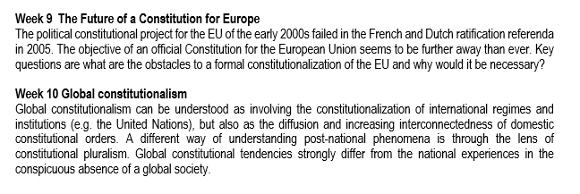
Course outline
Constitutional Sociology

Slide 9
Relevant literature - Blokker, P. and C. Thornhill (2017), Sociological Constitutionalism, Cambridge University Press. - Galligan, D. J., & Versteeg, M. (Eds.). (2013). Social and political foundations of Constitutions. Cambridge University Press. - Febbrajo, Alberto, and Giancarlo Corsi, eds. Sociology of Constitutions: A Paradoxical Perspective. Routledge, 2016.
Constitutional Sociology

Slide 10
Constitutional Sociology
Final Exam
-The student will be evaluated at the end of the course by means of a written essay, to be handed in at the end of the semester (exact date will be stipulated);
The written essay will be of a minimum of 2.000 words, and needs to contain a bibliography with at least 5 academic resources (MA: 3.000 words/10 resources).
10
Notes:
10

Slide 11
Introduction
Constitutional Sociology
What is a constitution?

Slide 12
Introduction
Constitutional Sociology
What does a constitution do?

Slide 13
Introduction
Constitutional Sociology
Are constitutions important?

Slide 14
The Sociology of Constitutions
Constitutional Sociology
Foundational. Constitutions as key dimension of the ‘constitution’/ ’foundation’ of modern societies or (political) communities and the legitimation of its core institutions (Constitution replacing God);
Societal. Constitutional norms are expressions of societal processes (of integration, differentiation, cohesion), in which ‘society’s legitimational ideas’ are condensed;
(Thornhill 2017: 495)

Slide 15
The Sociology of Constitutions
Constitutional Sociology
Constitutions are grounded in an ‘emotional address to citizenship and the ‘creation’/’constitution’ of citizens (legitimacy)’;
Constitutions are not self-standing, but exist in a complex socio-political-economic environment;
Constitutions are based on symbolic self-presentation and visibility (and invisibility);
(Schmidt 2012: 68)

Slide 16
The Sociology of Constitutions
Constitutional Sociology
Constitutions are not merely rational-legal texts, separated from society, and internally closed, to be interpreted by juridical actors;
Constitutions are also not merely the outcome of rational deliberation of political and legal actors;
Constitutions perform a range of social functions and the ‘embeddedness’ of constitutions depends on the extend to which they reverberate with social actors/subsystems;

Slide 17
The Sociology of Constitutions
Constitutional Sociology
A sociology of constitutions claims that constitutions can only be legitimate if constitutional norms are somehow embedded in social realities;
This is in stark contrast to rational-universalist ideas of constitutional law and human rights, which claim that legitimacy is the product of the rationalistic and universalist nature of constitutional design;

Slide 18
Interlude Classical sociology
Constitutional Sociology

Slide 19
Classical sociology
Constitutional Sociology
Durkheim
Societies possess a certain number of common ideas and sentiments;
Some of the common ideas and sentiments, referring to the practice of social life, are obligatory (maxims);
Some maxims are so important that institutions need to guarantee their observance and compliance (‘juridical formulas’);
(Schluchter 2002)

Slide 20
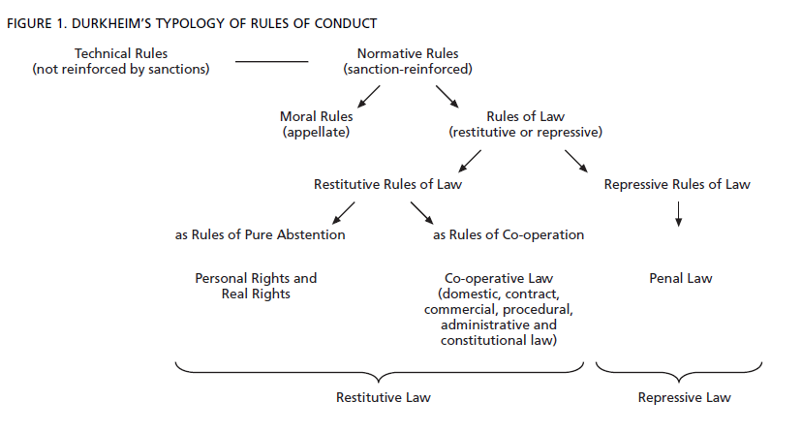
Constitutional Sociology

Slide 21
Classical sociology
Constitutional Sociology
Durkheim
For Durkheim, society and the law coincide, ‘strictly speaking, society is conceived as a system of law’ (Rechtssystem);
Law is the precondition of the constitution of social life;
(Schluchter 2002: 267)
For Durkheim, the rights-based constitutional state is the outcome of an evolutionary process
(Thornhill 2017: 497)

Slide 22
Classical sociology
Constitutional Sociology
Weber
Law is one, but not the, precondition for social life;
In Weber, there is an emphasis on formal rationalization, and hence the increasing importance of law in the social life of modern society. Procedural law is related to bureaucracy;
This means that there is a tension between the idea of justice, on the one hand, and the idea of legal certainty, on the other;
(Schluchter 2002)

Slide 23
Law and Legitimacy The division between the democratic state and the citizenry has been sociologically often understood – think of Weber – as a fragile relation based on different forms of legitimacy. A crucial role in relations of legitimacy is played by the law. Sociological, political, as well as legal accounts of the law often understand this relation in somewhat reductive terms, as one of the rational-procedural quality of the law, the ‘belief in the validity of legal statute and functional “competence” based on rationally created rules’ (Weber, Politics as a Vocation).
Constitutional Sociology

Slide 24
Law and Legitimacy The social imaginary most often related to (constitutional) law is one of rational mastery and neutral control. Different versions of the law´s legitimacy are formal-legal rationality and procedural rationality (Eder 1988). Formal rationality understands legitimacy as based on the idea that the law is 1) general; 2) abstract and well-defined, and 3) calculable (Eder 1988: 933). Procedural legitimacy rather puts emphasis on the ‘process of producing legal decisions - the legal practices as such’ (Eder 1988: 936).
Constitutional Sociology

Slide 25
Law and Legitimacy - But importantly for Weber, the rational-procedural basis of the law was not enough to invoke legitimacy, that is, widespread societal adherence to the law purely on the basis of its rational thrust; - Rather, value rationalities are need for the law to become ‘embedded’; - Also, legitimacy beyond rational-procedural legitimacy keep on playing an important role in modern society, in particular charisma;
Constitutional Sociology

Slide 26
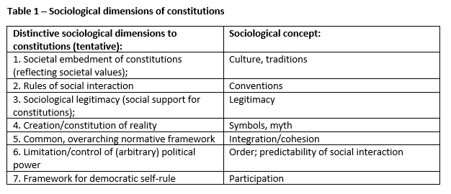
Classical sociology
Constitutional Sociology

Slide 27
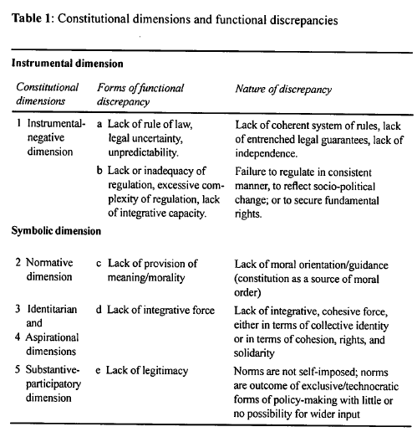
Classical sociology

Slide 28
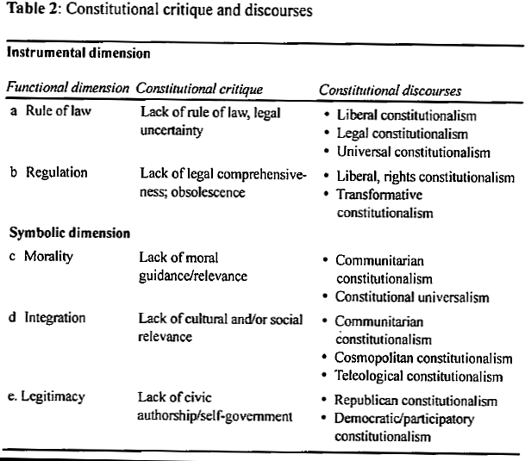
Classical sociology

Slide 29
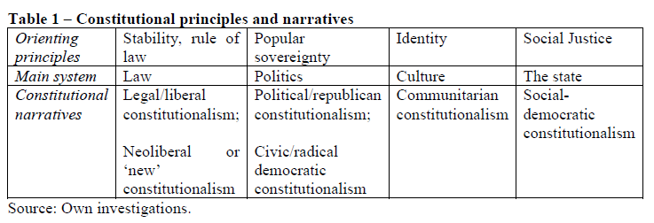
A Sociology of Constitutions

Slide 30
Constitutional sociology - An important distinction is between ‘facts’ and ‘norms’; - A story of modernization argues that facts increasingly correspond to norms (cf. Habermas) - A historical sociology of the modern state, however, indicates that modern constitutional democracy is not a linear, evolutionary story
Constitutional Sociology

Slide 31
Constitutional sociology - Constitutional sociology combines normative theory (‘ideal society’) with historical sociology (empirical investigation); - Legitimacy (Recht-fertigung/Just-ification) is a key dimension: is a state ‘just’ because it promotes universal principles (normative theory) or is it ‘just’ because its actions correspond to deep-seated cultural norms and conventions (historical sociology)?
Constitutional Sociology

Slide 32
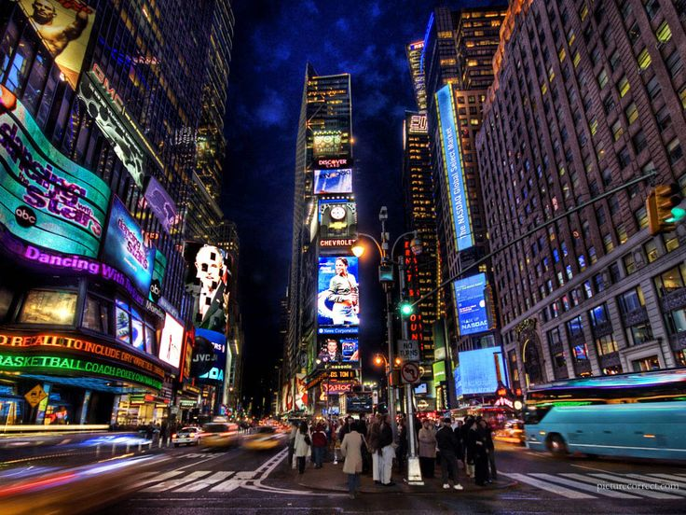
Societal acceleration

Slide 33
Societal acceleration - Constitutional acceleration has been defined as the ‘intensification of the recourse to revision to update the constitution’ (Palermo 2007); - Modern constitutions understood as ‘set in stone’, but increasingly they are subject to change;
Constitutional Sociology

Slide 34
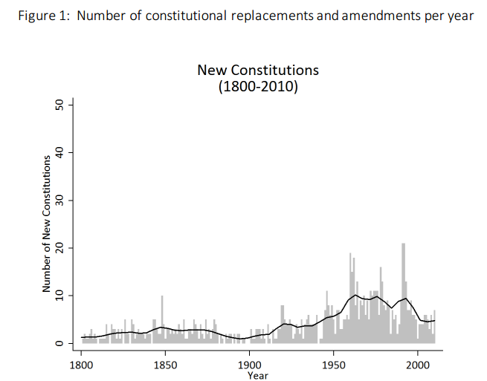
Societal acceleration

Slide 35
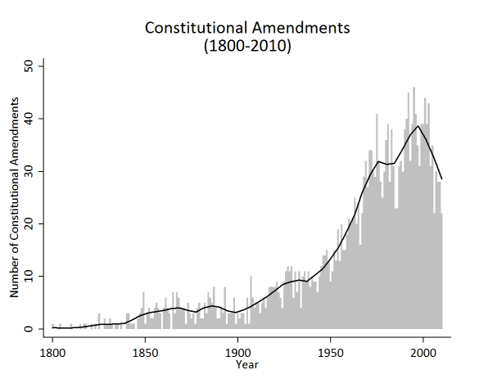
Societal acceleration

Slide 36
Societal acceleration - Constitutional acceleration as a reaction to a wider, societal form of acceleration or ‘high-speed society’ (Rosa and Scheuerman 2009); - In particular in relation to dynamics of globalization, modern societies are increasingly subject to phenomena of change, leading to increased perceptions of uncertainty and exposure to risk.
Constitutional Sociology

Slide 37
Societal acceleration - Prandini has defined social acceleration as an ‘increase in the decay rates of the reliability of experiences and expectations, and by the contraction of time spans definable as the present’ (Prandini 2013: 733).
Constitutional Sociology

Slide 38
Societal acceleration - Modern constitutions are attempts to freeze time, or to institutionalize and stabilize important characteristics of present society into the future (Prandini 2013); - High-speed society leads to an increased distance between (rapidly changing) society and institutionalized constitutional norms; - Modern constitutions are increasingly exposed to ‘constitutional obsolescence’ (Scheuerman 2002: 361).
Constitutional Sociology

Slide 39
Societal acceleration - The gap between the instituted and the to-be-instituted that results from relatively rigid constitutional frameworks that lag behind rapidly changing societal circumstances could be identified as constitutional anomie (Blokker 2010); - Constitutions seem to increasingly have difficulty in providing an integrative function (cf. Vorlaender 2017);
Constitutional Sociology

Slide 40
Introduction to a Sociology of Constitutions Examples
Constitutional Sociology

Slide 41
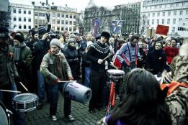
Introduction to a Sociology of Constitutions Example Iceland
Constitutional Sociology

Slide 42
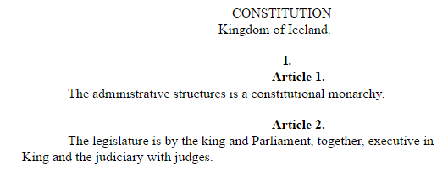
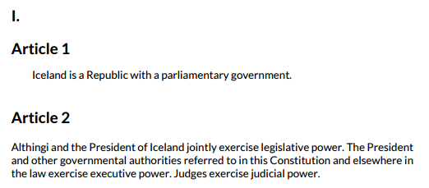
Example Iceland Icelandic Constitutions (1920 - 1944)
Constitutional Sociology

Slide 43
Example Iceland - The collapse of the financial system in Iceland in 2008 led to a deep political crisis - Intense protests in front of Althingi (the Parliament) led to the resignation of PM Geir H. Haarde and a call for new elections - One of the most drastic outcomes was the set-up of a Constitutional Council, made up of ‘ordinary citizens’, to reform the Icelandic Constitution
Constitutional Sociology

Slide 44
Example Iceland - Internationally, Iceland became well-known for its ‘crowd-sourced’ constitution-making process, in which the 25 citizens of the Constitutional Council interacted with the wider public through Facebook, Twitter, YouTube and e-mail; - The whole process encountered a lot of domestic resistance, however, by both the traditionally largest political parties, and others, skeptical of constitutional change;
Constitutional Sociology

Slide 45
Example Iceland
Constitutional Sociology

Slide 46
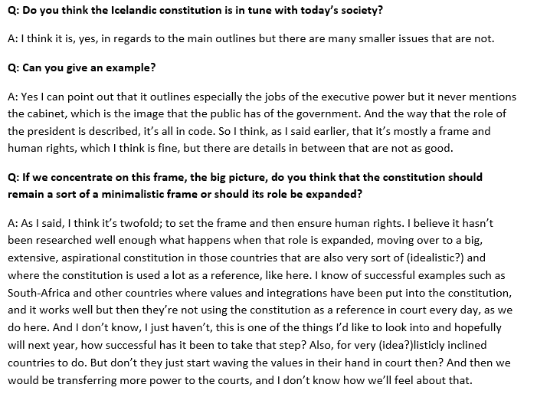
Example Iceland
Constitutional Sociology

Slide 47
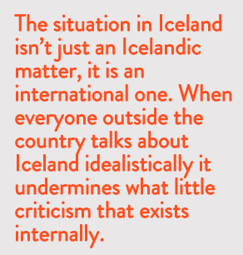
Example Iceland
Constitutional Sociology

Slide 48
Example Iceland - .
Constitutional Sociology
Icelandic Constitutional Reform Process
Financial Collapse 2008
Protests leading to resignation government early 2009
Election of 25-member Constitutional Council November 2010
Drafting new Icelandic Constitution Summer 2011
Referendum October 2012 on new Constitution
General elections April 2013: constitutional reform stalled
2013-2016: Parliamentary commission works on four constitutional issues
October 2016: General elections
October 2017: General elections

Slide 49
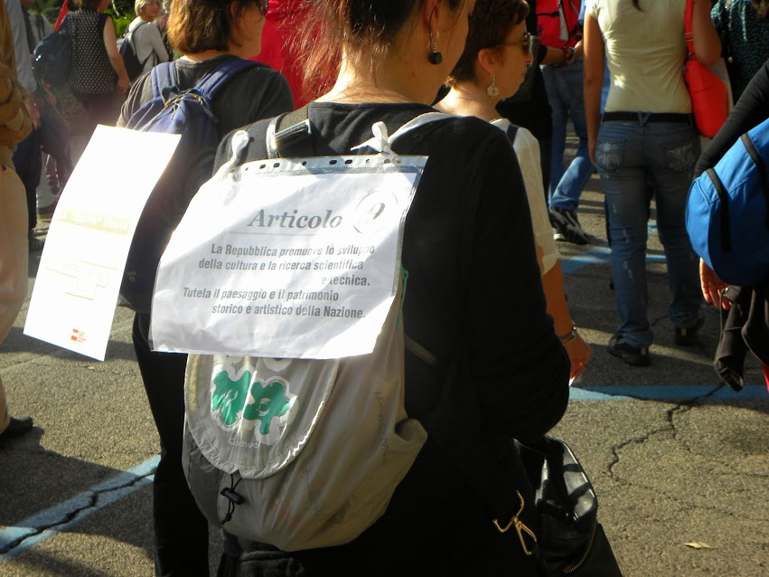
Introduction to a Sociology of Constitutions Example Italy
Constitutional Sociology

Slide 50
Example Italy - In 2013, a major constitutional reform started that was to modernize Italy and to streamline its politics and the economy: increase the governabilità of Italy; - The emphasis was on the reduction of the costs of politics (e.g., by abolishing the senate), and the clarification of relations between the central state and the regions;
Constitutional Sociology

Slide 51
Example Italy “The decades succeeding the constituent assembly [of 1948], our decades, the decades of our generations ,[lasting] until today, have demonstrated the need for an adaptation of the mechanism of institutional functioning, of its revision in the view of an ever increasing efficiency of democracy, [a democracy] which asks to be efficient, as a democracy incapable of providing adequate replies in a relevant and fast time frame belies a relevant part of its objectives” (Camera, 16-12-2014, 74).
Constitutional Sociology

Slide 52
Example Italy “The legislative proposal that is examined in the Parliament today does not do anything else than finalize that process of modernization of the institutions which we have been discussing for decades, welcoming solutions that are widely shared, not only by public opinion, but also by the majority of the academic world and, I allow myself to say, by the political history of the Italian left of the decades” (Fiano, Camera, 18-12-2014, 77).
Constitutional Sociology

Slide 53
Example Italy - One highly interesting dimension of the Italian reform was the emergence of constitutional resistance; - Various movements and associations criticized the reforms and called for the observance of constitutional norms rather than their reform or distortion; - Ultimately, on 4 December 2016, the government’s constitutional reform was rejected in a popular referendum.
Constitutional Sociology

Slide 54
Example Italy
Constitutional Sociology

Slide 55
3. A political sociology of constitutions
Constitutional Sociology
Political
Politicians, parties, experts
Societal
Advocacy groups, civil society associations , citizens
Judicial
Judges, (constitutional) lawyers

