Slide 1
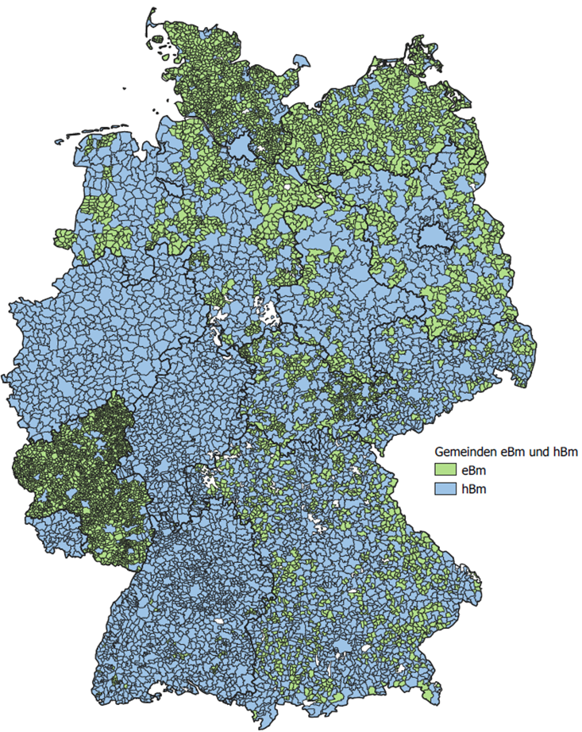
Introduction to Local Politics in Germany
Dr. David H. Gehne, Louisa Süß M.A.
15th May 2025, Prague

Slide 2
Outline
Political System Federal Republic of Germany
Municipalities within the Federal Republic of Germany
Relevance of local politics
Historical Development
Structure
Tasks
Finances
Stakeholders
Limitations of local self-government
Conclusion
Questions?

Slide 3
1. Political System Federal Republic of Germany

Slide 4
1.1 State Structure
Parliamentary democracy
two-tier federal state with Bund (federation) and 16 Länder (states)
Basic Law for the Federal Republic of Germany (Grundgesetz)
Started as provisional framework, today serves as constitution
Includes local self-government (Kommunale Selbstverwaltung, Art. 28 GG) following principle of subsidiarity
interplay within multi-level-governance: German cooperative federalism → policy interwovenness (Politikverflechtung) (Wollmann 2024, p. 10 referring to Scharpf et al. 1997)

Slide 5
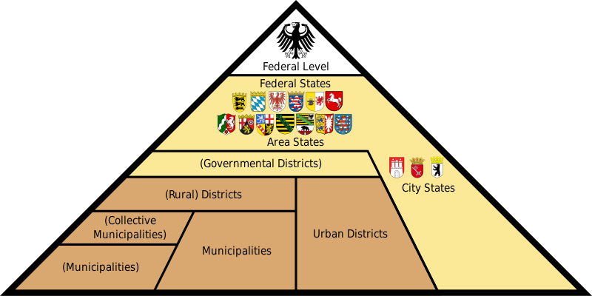
1.1 State Structure
Figure 1: Administrative Divisions of Germany
Source: Wikipedia, available at: https://en.wikipedia.org/wiki/File:Administrative_divisions_of_Germany.svg

Slide 6
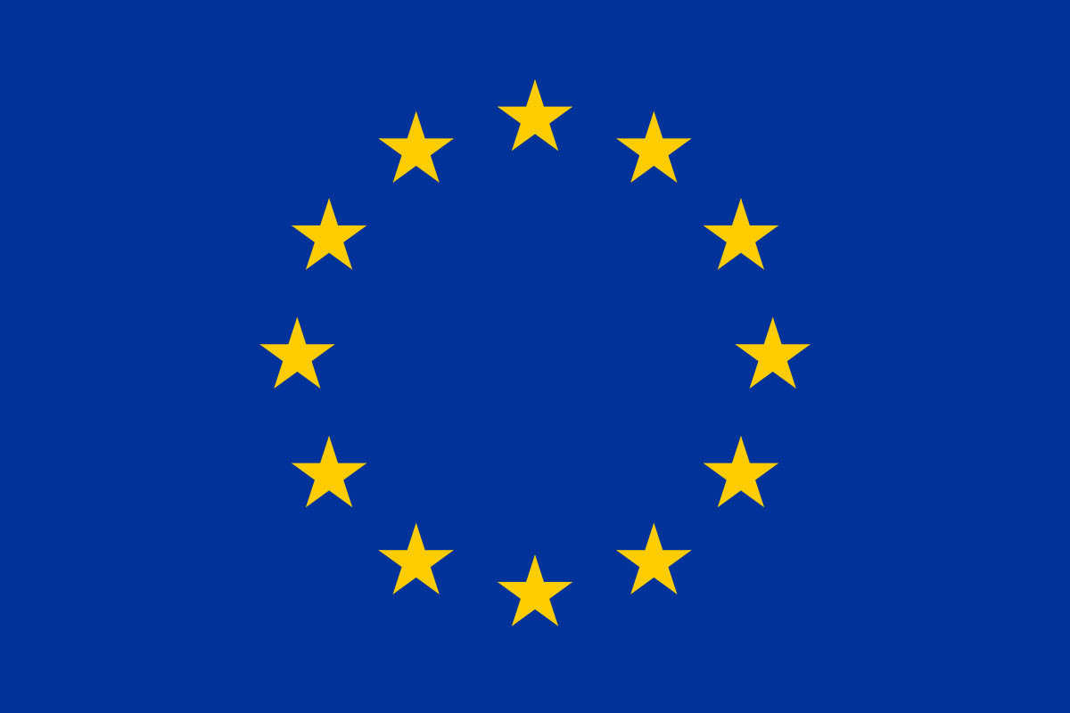
1.1 State Structure
Europeanisation
Lobbying
Local Government Associations
Council of the Regions (CoR)
Adaptations based on Wollmann 2024, p. 25ff.

Slide 7
1.1 State Structure
Länder more important than federal government for municipalities
Municipalities part of Länder (jurisdiction and supervision)
constitutions for local governments → legal status, tasks, institutional design of local government
‘creatures of the Länder‘ (Wollmann 2004, p. 109): founded, merged, re-organised, abolished by Länder legislation even without consent (Egner 2017, p. 160)
Local Autonomy Index (Ladner et al. 2016): 5th place out of 39 European countries, 11 indicators

Slide 8
2. Municipalities within the Federal Republic of Germany

Slide 9
2.1 Relevance of Local Politics
“School of Democracy“: democratic behaviour, political skills developed through compromising, cooperation, participation and decision-making
many interactions with citizens: high legitimacy
important policies decided
public infrastructure to support citizens: streets, public transport, kindergarten, schools, public spaces like parks, etc.
but: missing data (Wegschaider/Gross/Schmid 2023)

Slide 10
2.2 Historical Development
historic tradition from medieval times, Prussian reforms in 1808 until now
idea of local self-government closely linked to modern statehood
After WWII: different local government systems in occupational zones
Soviet zone (East Germany): unit of central state
French zone (RLP, Saarland): dualist system with weak mayor and strong council → ‘mayoral model‘
British zone (Lower-Saxony, NRW, Schleswig-Holstein): council manager system with strong council, politically neutral director and mayor for ceremonial purposes → ‘northern council model‘
US zone (Bavaria, Baden-Wurttemberg, Hesse): continued with traditional municipal codes; no intervention in design of local government → ‘Southern council model‘ and ‚‘magistrate model‘ (Egner 2017, p. 160)
After reunification (1990): discourse on democratic and management reforms → institutional changes in local government → ‘Southern model‘

Slide 11
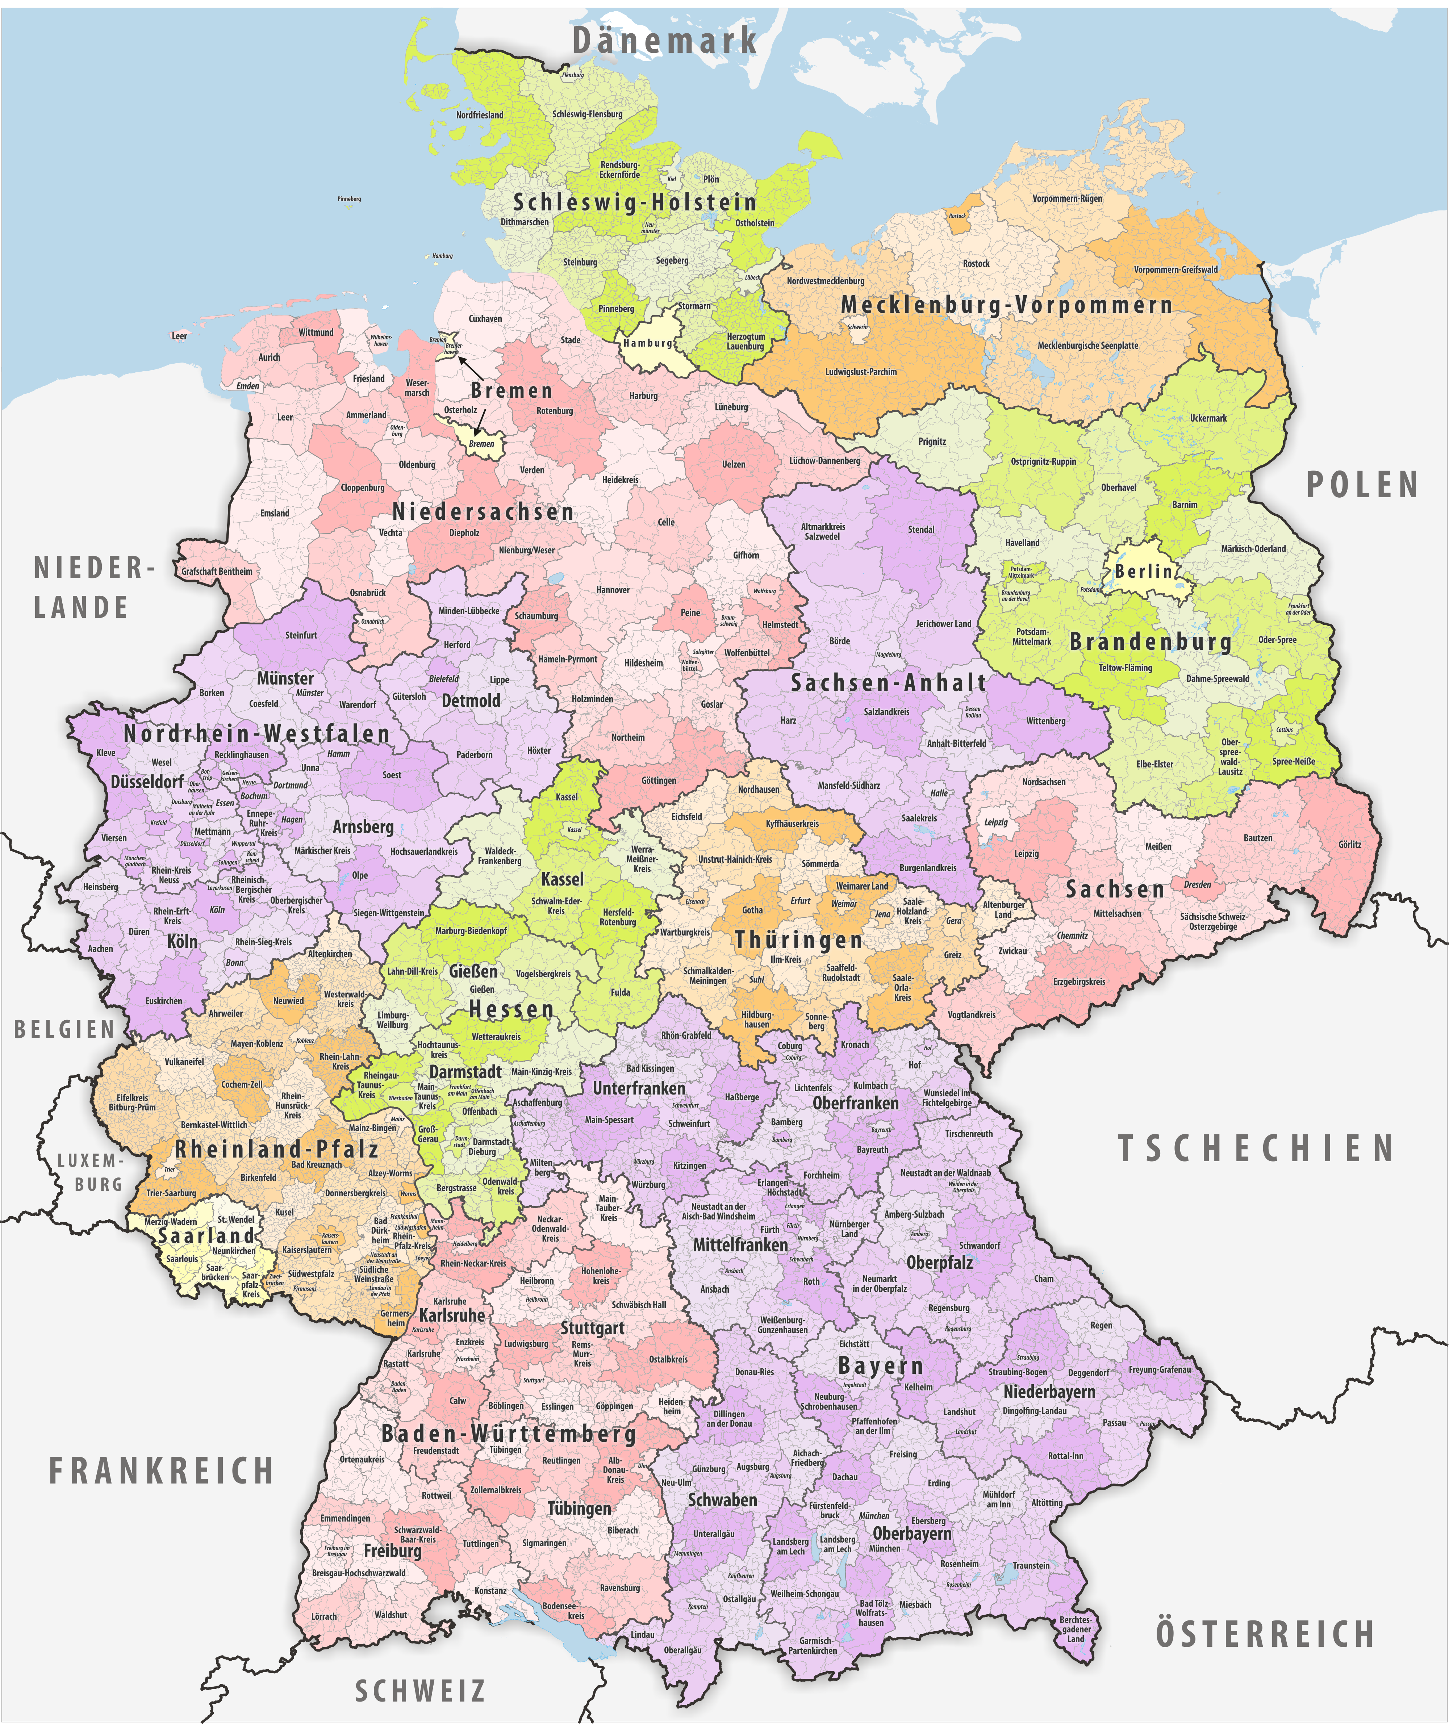
2.3 Structure: Heterogenous Setting
107 district-free cities
294 districts
10.800 municipalities
Figure 2: Districts in Germany
harmonisation of local constitutional law but differences persist
principle of self-government creates variety in municipalities
consociational and competitive democracy to describe varieties in decision making structures (Holtkamp 2008; Bogumil/ Holtkamp 2023)

Slide 12
2.3 Structure: Districts/ Municipalities
distinction: districts & municipalities important
district (Kreis):
not mentioned per se in Basic Law
dual nature: 1. association of municipalities 2. local authority with constitutional right to self-government
supra-local tasks: e.g. public transportation
supervision of municipalities
rual areas: administrative community as structure between municipality and district to perform administrative tasks (Amt, Verbandsgemeinde, etc.)

Slide 13
2.3 Structure: Districts/ Municipalities
urban areas: district-free city → singular nature
96% of Germany covered by districts, 60% of population
large variety in size:
district-free cities: Munich (1.5 million) to Zweibrücken (34.500)
district: Recklinghausen (620.000) to Lüchow-Dannenberg (49.000); usually 150.000-250.000; average 37 municipalities
amalgamation reforms in Hesse, North Rhine-Westphalia and Saarland 1970‘s; in Eastern Germany after reunification number reduced by 68%
Mecklenburg-Western Pomerania: only 6 districts since reform 2011
average 45.000 inhabitants in NRW, 1.8000 in Rhineland-Palatine per municipality (Vetter 2022)

Slide 14
2.4 Tasks
municipality is not a ‘state‘: no judiciary, legislative power limited, autonomy mediated/ limited, representing the executive branch of the federal state (Frenzel 2013, p. 98)
division of tasks follows the principle of universality: everything regarding local affairs
voluntary and mandatory self-government tasks (Wollmann 2024, p. 18)
traditional dual function:
Original task/ local self-administration affairs: municipalities can do it on their own
Delegated tasks/ instruction affairs: performed by municipalities on behalf of Land or federal law

Slide 15
2.4 Tasks
Quasi-sovereign rights: personnel, organisation, planning affairs, local taxes, spending
about 80% of administrative tasks (incl. EU legislation) executed by local authorities (Wollmann 2024, p. 7 referring to Rechlin 2004; Schmidt-Eichstädt 1999)
30% of public service personnel employed in local authorities
”front office for and of behalf of state government” (Frenzel 2013, p. 117): Execute most public services with direct contact to citizens (Bürgeramt; one-stop-shop) (Ruge/Ritgen 2021)
→ “political decentralization or State/Land functions or even of their ‘communalization/municipalization’” (Wollmann 2024, p. 21, emphasis in original)

Slide 16
2.4 Tasks
District | Municipality
Framework fire/ disaster protection | Equipment, facilities, maintenance fire departments
Secondary schools, vocational schools, adult education | Schools when district is not responsible
Supporting job seekers | Supply of public goods (water, electricity, gas, sewage)
Public health/ veterinary inspection | Infrastructure
district hospitals/ emergency & ambulance services | Kindergarten
Public transportation/ maintenance district roads | Cultural institutions (museum, library, parks, pools)
Youth welfare | Cemeteries/ funeral services
Administrative tasks (vehicle licensing, building supervisory authority, etc.) | Maintenance municipal roads
Waste disposal/ environment protection | Creating land-use and development plans
Integration refugees/ migrants | Administrative tasks (ID & civil status registration; Bürgeramt)
Economic development
General social welfare
Source: Ruge/ Ritgen 2021, p. 129f.; Fich 2011; own visualisation.

Slide 17
2.5 Finances
complex system
incomes vary, council can define some taxes/fees
financially dependent on state/ federal government
Figure 3: Municipal Finances
Taxes
own taxes (trade tax, property tax, dog licence fee)
Fees
financial duties to fulfil sovereign tasks
Grants
by state, federation, EU
often linked to projects
Credits
No profit
investments
share of federal/ state tax (parts of income tax, wage tax, sales tax)
co-financing necessary
Source: Fich 2011, Bogumil 2018; own visualisation.

Slide 18
2.6 Stakeholders
parties
mayor
council
citizens
Local media
Local admin-istration
corporation

Slide 19
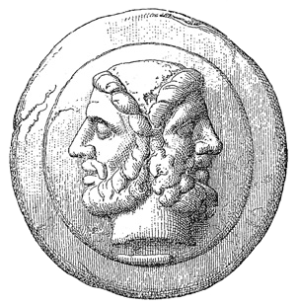
2.6 Stakeholders: Parties
Role of parties different: Länder, size, history/ culture
Fragmentation of party systems increased since 1990
parties Janus-faced (Lehmbruch 1972)
Independent lists (Wählergemeinschaften)
political experimental ground for new political parties (e.g. VOLT)
power position depending on election procedures (spread votes between lists: Kumulieren/Panaschieren)
influential for recruiting political elites (mayor, councillors, etc.)
quotas can increase share of marginalised groups (women, migrants, disabled, etc.)
share of females higher when Greens, Left and Social Democrats are successful

Slide 20
2.6 Stakeholders: Council
legislative body
→ not a „true“ parliament due to lack of legislative powers
committees and consulting advisory boards for foreigners & integration
elections in 9 Länder on the same day as European elections
following ideals of laymen principle and self-government
varieties in Länder
number of seats according to inhabitants and Land
different role of mayor in Länder: head of council, member/ not a member
directly elected by citizens for 5 years (Bavaria 6 years)

Slide 21
2.6 Stakeholders: Council
EU-passport, 16/18 years old, residency for certain time (3/6 months)
electoral systems of proportional representation but different approaches in the Länder: e.g. three votes in Lower Saxony and east German states; as many votes as seats in council in Hesse (Kumulieren und Panaschieren)
Methods to transfer votes into seats differ (d‘Hondt, Hare/Niemeyer, etc.)
Different turnout in Länder
lower than federal elections → second order election (Reif/Schmitt 1970)
Lower turnout in Eastern Germany
Institutional, cultural or political contexts vary → create path dependency
Underrepresentation of women: 30% in Hesse, 20% in Saxony (Vetter 2022)

Slide 22
2.6 Stakeholders: Mayor
value 9 on Mayoral Strength Index (Heinelt/Hlepas 2006)
60% German municipalities with voluntary mayor
only 10% female (4% NRW, 26% Thuringia (Vetter 2022))
directly elected by citizens in a two-round majority system
5 – 10 years
since 1990‘s; South Germany 1950‘s
requirements: EU-passport, age limits (18/30 to 67 in some Land)
responsibilities differ in Länder
execution council votes
head of administration
external representation

Slide 23
2.6 Stakeholders: Administration
executive: original and delegated tasks
variety of tasks, multifunctionality
executing council votes
between council, citizens, mayor and law → different interests, priorities
often underfunded
shortage of qualified employees, public service often not attractive

Slide 24
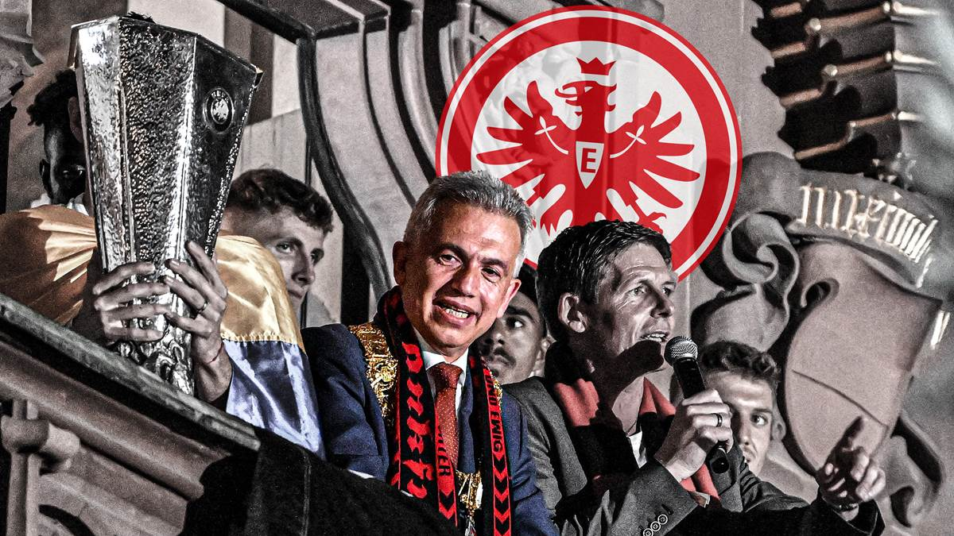
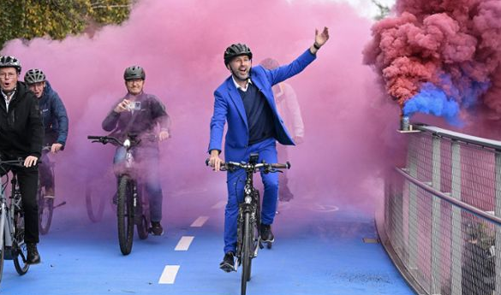
2.6 Stakeholders: Citizens
elect council/mayor/ district commissioner at the age of 16 or 18 with EU-passport
plebiscitary instruments to take binding decision in certain cases
to increase legitimacy and quality of decisions
two stages: 1. citizens‘ initiative 2. referendum
not on every matter possible
recall procedure in most Länder: Peter Feldmann Frankfurt; Boris Palmer Tübingen
high responsiveness: low hurdles to reach out to local politicians
clubs: important for social cohesion
but: low turn-out at local elections

Slide 25
2.6 Stakeholders: Local Media
important for communication
transmitter/ transfer between political arena and citizens
power factor: deciding what is newsworthy, promoting issues, criticism
struggling: decreasing audience → financial problems → wider territories to cover → less capacities
Social Media as alternative?

Slide 26
2.6 Stakeholders: Corporations
important factor for local politics due to income through taxes
need for space, infrastructure, workers, etc.
connections with local politicians: networking or lobbying?

Slide 27
2.7 Limitations of Local Self-government
interplay between many actors on different levels → pathdependencies
Law (Land, EU, etc.)
Europeanisation (Europe-wide tender, public contracting, economic development, etc.)
Financial situation/ budgetary consolidation/ rising prices
economic fluctuations → variations in income
fulfilling federal or Länder tasks
conflict in council → no majority
…

Slide 28
3. Conclusion
What‘s so special about local government and politics in Germany?

Slide 29
Concluding Remarks
structure of local politics in Germany is complex; varieties prevail despite homogenisation of constitutional outline of Länder
no sample solution for every municipality
interdependencies within multilevel Governance
self-government central and guaranteed by Grundgesetz but political reality shows limits to local autonomy
many crises unfold at the local level → pressure high
local politicians important stakeholders in political system but influence on higher tiers limited → decisions affect them but they have a limited say

Slide 30
4. Questions?

Slide 31
Literature
Bogumil, Jörg/ Gehne, David H./ Süß, Louisa Anna (2024): Ehrenamtliche Bürgermeister in Deutschland. Das unbekannte Wesen, Springer VS: Wiesbaden.
Bogumil, Jörg/ Holtkamp, Lars (2023): Kommunalpolitik und Kommunalverwaltung. Eine praxisorientierte Einführung, 2nd edition, Bundeszentrale für politische Bildung: Bonn.
Egner, Björn (2017): Directly Elected Mayors in Germany. Leadership and Institutional Context, in: David Sweeting (eds.): Directly Elected Mayors in Urban Governance. Impact and Practice, The Policy Press: Bristol, pp. 159-178.
Frenzel, Eike Michael (2013): Local Government in Germany. An Indispensable level of EU governance, in: Carlo Panara/ Michael Varney (eds.): Local Government in Europe. The ‚fourth level‘ in the EU multilayered system of Governance, Routledge: London, pp. 97-127.
Fich, Mathias (2011): Local Politics in Germany: Constitutional Basics, Problems and Current Developments, in: Reimund Seidelmann (eds.): The New Germany, Nomos: Baden-Baden, pp. 269-274.
Ruge, Kay/ Ritgen, Klaus (2021): Local Self-Government and Administration, in: Sabine Kuhlmann et al. (eds.): Public Administration in Germany, Palgrave Macmillan: Basingstoke, pp. 123-141.
Vetter, Angelika (2022): Germany. A Variety of Local Elections in a Federal System, in: Genzdwill, Kjaer, Steyvers (eds.): The Routledge Handbook of Local Elections and Voting in Europe, Routledge: London, pp. 126-139.
Wegschaider, Klaudia/ Gross, Martin/ Schmid, Sophia (2023): Studying politics at the local level in Germany: a tale of missing data, in: Zeitschrift für Vergleichende Politikwissenschaft.
Wollmann, Hellmut (2005): The Directly Elected Executive Mayor in German Local Government, in: R. Berg& N. Rao (eds.): Transforming Local Political Leadership, Palgrave Macmillan: London, pp. 29-41.
Wollmann, Hellmut (2024): Local Government and Governance in Germany. Challenges, Responses and Perspectives, Springer: Wiesbaden.

