Slide 1
Human Rights and Medicine 6
Zuzana Svobodová

Slide 2
What is the source of ethics?
Religious Answers
Secular Answers
The Divine Will
The Divine Law
Universal Sources
Relativist Answers
Natural Law
Hypo-thetical Contract
One´s Culture
Actual Social Contract
One´s Personal Preferences

Slide 3
Set of laws in the Middle Ages (Thomas Aq.)
Eternal law
Plan of God's providence
Divine law
The Old and New Testament
Human law
Written provisions derived from natural law, or concretizing natural law
Natural law
Man's participation in the eternal law through reason

Slide 4
The second main question of metaethics:
How do we know what is ethical?
Religious Answers
Secular Answers
Experience and Observation
Intuition
Social Agreement or Contract
Reason
Religious experience
Revelation
Religious tradition
Scriptures

Slide 6
Polymnia: Muse of rhetoric and eloquence
Period: Hellenistic
Date of creation/manufacture: 3rd c. BC; 2nd c. BC (-300 – -100)

Slide 7
Jan Patočka (1907-1977)
In January of 1977, Czech philosopher Jan Patočka became, together with international lawyer Jiří Hájek and playwright Václav Havel, one of three spokespersons of Charter 77: a loose, informal, open association of people with various shades of opinion, faiths and professions united by the will to strive individually and collectively for the respecting of civic and human rights in our own country and throughout the world.
Patočka’s Socratic perspective, brought by him to the emerging public space of our “parallel polis” of that time - a message for those who decided to stick to the unity between their inner and outer selves and thus to say no to the policies of “normalization” that had clear destructive effects on the citizens of socialist Czechoslovakia, on both their individual identities and their “collective” national soul.
In his last short texts - he died in March of 1977, exhausted by the permanent police interrogations and harassment he was exposed to after he had taken over his “office” - Patočka decided to bring, in his capacity as Charter 77’s spokesperson, “to everyone’s clear awareness” the “truths of which we are all in some sense aware“ and also came with his own philosophical definition of human rights:
The idea of human rights is nothing other than the conviction that even states, even societies as a whole, are subject to the sovereignty of moral sentiment: that they recognize something unconditional that is higher than they are, something that is binding even on them, sacred, inviolable, and that in their power to establish and maintain a rule of law, they seek to express this recognition.
Jan Patočka: Čím je, a čím není Charta 77. In : Češi I, p. 429. Translated as The Obligation to Resist Injustice. In: Erazim Kohák: Jan Patočka. Philosophy and Selected Writings, p. 341

Slide 8
What is the source of ethics?
Religious Answers
Secular Answers
The Divine Will
The Divine Law
Universal Sources
Relativist Answers
Natural Law
Hypo-thetical Contract
One´s Culture
Actual Social Contract
One´s Personal Preferences

Slide 9
Notes:
The Basic of Bioethics. ISBN 0-13-099161-9. (cover)

Slide 10
Human dignity
„the inherent human dignity“
Although the inherent human dignity, perceived by international lawyers as a fundamental material source both of constitutional and international law: this concept is presented in the human rights context “as a stark fact, without further definition of it, or any elaboration concerning its metaphysical basis or source?” And here is Glenn Hughes’s diagnosis:
This absence of definition and metaphysical contextualization, serves, obviously, an important political function. Human rights instruments must strive to appeal be convincing to governments and institutional leaders of all the nations of the globe and to persons of every worldview, secular or religious. If such document were to specify any metaphysical or religious source of human dignity, or define the essence of human dignity in too culturally-specific a manner, their effective appeal would be restricted and its universality undermined.
Glenn Hughes: Understanding the Principle of Inherent Human Dignity, in The Solidarity of the Shaken: Jan Patočka’s Legacy in the Modern World, Academica Press, Washington-London, 2019, p. 81

Slide 11
Human dignity
If dignity is given along with human existence, then it belongs to human beings essentially; and for something to belong to humans essentially, then it must be, by definition, something beyond all human particularities. The givenness of dignity presupposes, in other words, a human nature that transcends all differences of biology, locality, culture and history.
Op.cit., p. 88
the argument made by Jacques Maritain:
“A person possesses absolute dignity because he is in direct relationship with the absolute.”
Jacques Maritain: The Rights of Man and Natural Law, trans. Doris C. Anson (New York: Gordian Press, 1971), p. 4 (quoted also in Hughes, op. cit. p. 89)

Slide 12
Human dignity and human identity
Francis Fukuyama made in his book, Identity. The Dignity and the Politics of Resentment, an interesting and important contribution to our debate:
The basic problem of human identity “grows out of a distinction between one’s true inner self and an outer world of social rules and norms that does not adequately recognize that inner self’s worth or dignity”; it must be perceived as a fundamental difference between human dignity and human identity:
The inner self is the basis of human dignity, but the nature of that dignity (human identity) is variable and has changed over time.
Francis Fukuyama: Identity. The Dignity and the Politics of Resentment, Farrar, Strauss and Giroux, New York, 2018, p. 9, 10.

Slide 13
Human dignity and human identity
The teaching of ancient classical philosophers, namely of Plato (cf. his Republic or Phaedrus), according to which the human soul consists of three different parts, each of which is under the controls of its specific drive:
epithymia: appetitive part (our bodily desires, pleasures, comforts and satisfactions);
thymos: spirited or hot-blooded part (driven by emotions, falling in love, succumbing to anger);
logos: the logical part (human capacity of reasoning having logos and thus being mindful, i.e., under control of mind/spirit/nous).
The fundamental task of human being – a charioteer, motivated by its thymos – is this: to be in control of its chariot pulled by two winged horses, 1) one mortal representing its bodily appetites and 2) other immortal representing its reason.

Slide 14
Human dignity and human identity
Fukuyama argues that thymos is “the part of our soul that seeks recognition.” And he adds:
But while thymos is a universal aspect of human nature [dignity] that has always existed, the belief that each of us has an inner self that is worthy of respect, and that the surrounding society may be wrong in not recognizing it, it is a more recent phenomenon. So, while the concept of identity is rooted in thymos, it emerged only in modern times when it was combined with a notion of inner and outer self, and the radical view that the inner self was more valuable than the outer one. This was the product of both a shift in ideas about the self and the realities of societies that started to evolve rapidly under the pressure of economic change.”
Op. cit. p. 23-24

Slide 15
Human dignity and human identity
The process of modernization started in Europe in the period of Enlightenment, when human reason has been enthroned as the only relevant authority in human matters and the idea of human progress has been discovered and proclaimed as the principal guide of the whole human history.
Fukuyama, analysing this process, splits thymos into two parts, motivating in their own specific way the political behavior of modern human being: 1) on the one hand we are driven by our isothymia, “the demand to be respected on an equal basis with other people”; 2) on the other hand, what still remains with us, maybe in a new form, is the Greek traditional megalothymia, the maxim “ever to excel”, aein aristeuein, the wish to distinguish oneself from all others by being the “best” in one’s own words and deeds – in the Fukuyama’s words “the desire to be recognized as superior.”
Op.cit p. xiii

Slide 16
Human dignity and human identity
Contra Fukuyama:
the articulation of thymos by ancient classical philosophers, the final sentences of Plato’s Phaedrus. In the very end of conversation, Socrates offers the following prayer, demonstrating that the tension between the inner and outer self, our „inside“ (exothén) and „outside“ (endothén) was actually at the very center of Sokratic philosophical „anthropology“ and not only a modern invention:
Socrates: Beloved Pan, and all you other gods who haunt this place, give me beauty in the inward soul; and may the outward and inward man be at one. May I reckon the wise to be the wealthy, and may I have such a quantity of gold as a temperate man and he only can bear and carry.-Anything more? The prayer, I think, is enough for me.
Phaedrus: Ask the same for me, for friends should have all things in common.
Socrates: Let us go.
Plato: Phaedrus, 279b8-c3, transl. by Benjamin Jowett

Slide 17
Human personality
„Personality, from the perspective of Vedic literature, appears to be a combination of three gunas: sattva, rājas, and tamas.“
Srikanth N. Jois, Vijaykumar Vinu, Siddalingayya Hiremath, Kiran Kumar K. Salagame, Ramesh Moulya: Personality Types and Prānic Energy Perceptions: An Exploratory Study. In: Spirituality Studies 6-2 Fall 2020, p. 48, available at: https://www.spirituality-studies.org/dp-volume6-issue2-fall2020/48/

Slide 18
Charter of Fundamental Rights of the European Union
TITLE I – DIGNITY
Article 1 – Human dignity
Human dignity is inviolable. It must be respected and protected.
Article 2 – Right to life
1. Everyone has the right to life.
2. No one shall be condemned to the death penalty, or executed.
Article 3 – Right to the integrity of the person
1. Everyone has the right to respect for his or her physical and mental integrity.
2. In the fields of medicine and biology, the following must be respected in particular:
(a) the free and informed consent of the person concerned, according to the procedures laid down by law,;
(b) the prohibition of eugenic practices, in particular those aiming at the selection of persons;
(c) the prohibition on making the human body and its parts as such a source of financial gain,;
(d) the prohibition of the reproductive cloning of human beings.
Article 4 – Prohibition of torture and inhuman or degrading treatment or punishment
No one shall be subjected to torture or to inhuman or degrading treatment or punishment.
Article 5 – Prohibition of slavery and forced labour
1. No one shall be held in slavery or servitude.
2. No one shall be required to perform forced or compulsory labour.
3. Trafficking in human beings is prohibited.

Slide 20
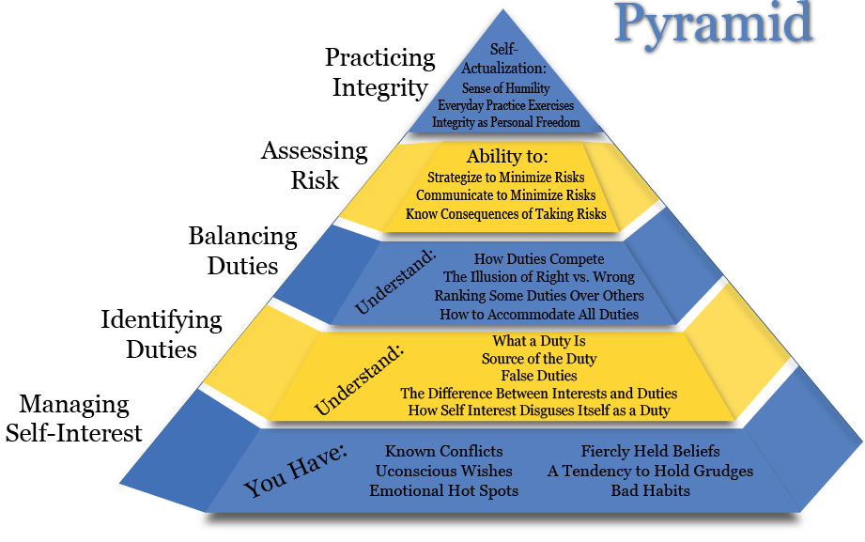
Notes:
http://integrityintensive.com/idm-model/

Slide 21
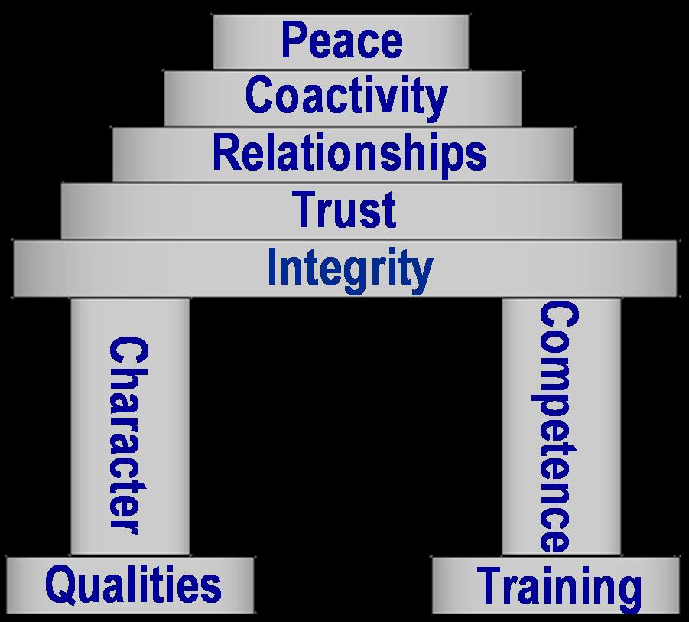
Notes:
https://policedynamics.files.wordpress.com/2010/11/twin-towers.jpg

Slide 22
Integrity
Integrity is the virtue of practicing what one believes is right.
To act without integrity, even occasionally, will leave others distrustful.
Integrity makes us whole, complete.
Can I be whole, complete?

Slide 23
Professional ethical framework

Slide 24
FAIR
Fairness
respect for Autonomy
Integrity
seeking the most beneficial and least harmful consequences, or Results

Slide 25
The Principles: Justice, Dignity
Physicians for Human Rights:
The Principle of Medical Neutrality:
https://youtu.be/PFHg3jjjsEM
Doctors Without Borders (MSF):
About Dr. Denis Mukwege (2013 Human Rights First Award):
https://youtu.be/VT5nsIAyCuI

Slide 26
Bibliography
Public Responsibility in Medicine and Research: People & Perspectives: George Annas - Human Rights: https://youtu.be/0L2NVFcYqkM
Islamic Bioethics: https://youtu.be/XykeF8sAd_o?feature=shared
Physicians for Human Rights: https://phr.org/

Slide 27
Bibliography
http://www.wma.net/en/20activities/20humanrights/index.html
http://www.wma.net/en/20activities/10ethics/index.html
http://www.unesco.org/new/en/social-and-human-sciences/themes/bioethics/
http://www.unesco.org/new/en/social-and-human-sciences/themes/bioethics/ethics-education-programme/
http://www.unesco.org/new/en/social-and-human-sciences/themes/bioethics/human-genome-and-human-rights/
Universal Declaration on Bioethics and Human Rights. 19 October 2005: http://unesdoc.unesco.org/images/0014/001428/142825e.pdf#page=80
WMA Declaration of Sydney on the Determination of Death and the Recovery of Organs:
http://www.wma.net/en/30publications/10policies/d2/index.html
http://www.wma.net/en/30publications/10policies/o3/
Bioethics and Human Dignity: http://www3.nd.edu/~undpress/excerpts/P01307-ex.pdf

Slide 28
Bibliography
Human Dignity and Bioethics: http://www.thenewatlantis.com/docLib/20091130_human_dignity.pdf
https://www.ncbi.nlm.nih.gov/pmc/articles/PMC300789/pdf/32701419.pdf
http://bmcmedethics.biomedcentral.com/articles/10.1186/1472-6939-7-2
About dignity: https://www.ncbi.nlm.nih.gov/pmc/articles/PMC300789/citedby/
Peel, Michael. “Human Rights and Medical Ethics.” Journal of the Royal Society of Medicine 98.4 (2005): 171–173. Print.
Mohanti, Bidhu K. “Ethics in Palliative Care.” Indian Journal of Palliative Care 15.2 (2009): 89–92. PMC. Web. 17 Feb. 2017.
Sharma, Himanshu et al. “End-of-Life Care: Indian Perspective.” Indian Journal of Psychiatry 55.Suppl 2 (2013): S293–S298. PMC. Web. 17 Feb. 2017.
https://www.amnesty.org/en/
https://www.hrw.org/

Slide 29
Bibliography
Links to study materials – also in „Vyuka“:
R. Rorty: On Human Rights
B. Schaefer: Foundations of HR
M. Macdonald: Natural Rights
T. Machula: Natural Law
R. A. Primus: Rights Theory and Practice
M. Poovery: Abortion and Death
HR_Justifications
United Nations_HR
Reproductive Rights
Gender
Sexual Orientation
Sexual Health
Disability

