Slide 1
Public Management for 21st Century
#7
May 7, 2018

Slide 2
HW feedback

Slide 3
Some good accountability for learning questions:
How do you know you do a good job?
What have you changed last week and why?
What do you want to change next week and why?
What help do you need from us?

Slide 4
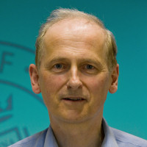
Reading reflections
Compulsory reading - Veselý, A. - Accountability in Central and Eastern Europe: concept and reality
Read part of Arnošt Veselý's article on Accountability - parts "The concept of accountability", "Accountability overload and professional disorientation" and "Accountability trap and accountability asymmetry".
Compulsory reading - Hood, C. (1991). A Public Management for all Seasons?
Read Hood, C. (1991). A Public Management for all Seasons? Public Administration, 69(1). (14 pp)
Compulsory reading - Perrin, B. (2015). Bringing accountability up to date with the realities of public sector management in the 21st century
Read Perrin, B. (2015). Bringing accountability up to date with the realities of public sector management in the 21st century: New View of Accountability. Canadian Public Administration 58(1)·March 2015. DOI: 10.1111/capa.12107 (17 pp)

Slide 5
Exercises
7-1
7-2

Slide 6
#6 Accountability: Paradigm shift from accountability overload to accountability for learning
Public organisations has to be accountable for their actions and meeting their purpose. Historically, different aspects of accountability were stressed: Honest and Fair (Focus on preventing distortion, bias and abuse of office and on proper procedures), Lean and Purposeful (Match narrowly defined tasks with resources (time and money) as tightly as possible, cutting any slack) and Robust, Resilient, Adaptive Being able to adapt rapidly to changing environments, to withstand shocks, to keep operating even in a crisis. These aspects are contradictory and when not balanced, problems emerge. Good way to maintain balance is to reframe all aspects of accountability by accountability for learning.

Slide 7
Definition of accountability
“The obligation of an individual or organization to account for its activities, accept responsibility for them, and to disclose the results in a transparent manner.”
http://www.businessdictionary.com/definition/accountability.html#ixzz3xamYU2Nf

Slide 8
account (v.) 1300, "to count, enumerate," from Old French aconter "to count, render account" (Modern French conter). Meaning "to reckon for money given or received, render a reckoning," from late 14c.; sense of "to explain" (c. 1710) is from notion of "answer for money held in trust." Transferred sense of "value" is from late 14c.
Two parts:
a) relational (from someone to someone): to whom?
b) substance: something of value is “to be reckoned for”: of what?
http://www.etymonline.com/index.php?term=account&allowed_in_frame=0

Slide 9
Accountability for what?

Slide 10
Different concepts of accountability
“honest and fair”:
focus is on preventing distortion, bias, abuse of office and inequity
proper discharge of duties in terms of procedures AND substance is of prime importance:
“how the job gets done” rather than just “getting the job done with the least possible input”
emanations:
process controls (rather than output)
words like transparency, prevention and detection of fraud, compliance with rules, etc. fit here

Slide 11
Accountability for what?

Slide 12
Different concepts of accountability
“lean and purposeful”:
match narrowly defined tasks and circumstances with resources (time and money) as tightly as possible, cutting any slack
it is very important to have “checkable” objectives that are not overlapping
hence the focus on outputs, ideally to be provided by independent departments
emanations:
words like effectiveness, efficiency, impact, value for money, achieving targets
approaches like payment by results, just in time delivery and zero based budgeting

Slide 13
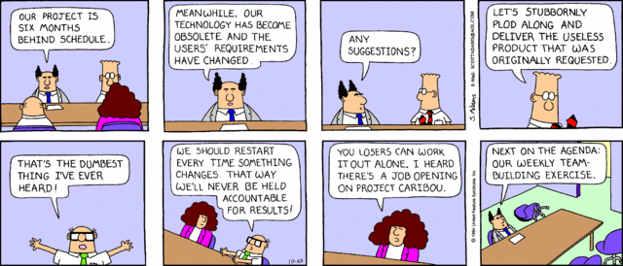
Accountability for what?

Slide 14
Different concepts of accountability
“robust, resilient, adaptive”:
focus is on:
being able to adapt rapidly to changing environments
to withstand shocks, to keep operating even under the most dire circumstances (e.g. in a crisis)
emanations:
back-up systems, maintaining adequate diversity to avoid widespread common failure (including in the social sense e.g. avoiding groupthink) and building in safety margins (e.g. in planning work or using materials)
words like diversity, empowerment, sustainability etc.

Slide 15
Hood (1991)
Notes:
Double bind: transparency vs fairness: transparency means explicit rules but fairness sometimes calls for deviating from the rules.

Slide 16
Your recap
What have you learnt during the course?

Slide 17
My recap

Slide 18
#1 The Environment: Paradigm shift from relatively stable and predictable to volatile, uncertain, complex and ambiguous world.
Most public policies implicitly assume the world is relatively stable and predictable. Patterns repeat. Causalities are known. We know what we are facing and we can agree with each other about it. V. U. C. A. world is different, determined by Volatility - Fast, unpredictable changes without clear patterns or trends; Uncertainty - Frequent disruptive changes where the past is not a very good predictor of the future; Complexity - Multiple, complex, intertwined technological, societal, geopolitical and ecological evolutions; and Ambiguity - Little clarity on what is real or true and difficult to predict the impact of action or initiatives. The environment is constantly changing. Not even with expertise we are able to analyze it towards the future.

Slide 21
#2 The People we Serve: Paradigm shift from selecting measures of human well-being from the point of view of policy-makers to understanding human development from the point of view of a diversity of citizens.
The purpose of any public service is positive change in the well-being of people and an expansion of their possibilities. These are the results we look for, not indicators or targets.

Slide 22
Functionings (what people value) are very diverse – each person is somehow different.
This establishes high diversity of needs.

Slide 23
Capability Approach
Succesful interventions are expanding the capabilities of individuals

Slide 24
Metric B
What we want to ‘measure’
Metric A
What we can ‘measure’

Slide 25
Problem of targets
"The more any quantitative social indicator (or even some qualitative indicator) is used for social decision-making, the more subject it will be to corruption pressures and the more apt it will be to distort and corrupt the social processes it is intended to monitor.“ Campbell‘s law
"When a measure becomes a target, it ceases to be a good measure.“ | „Any observed statistical regularity will tend to collapse once pressure is placed upon it for control purposes.“ Goodhart‘s law
By using targets as a tool for evidence-based policy-making we just create an environment of policy-based evidence-making.

Slide 26
#3 The Way of Management: Paradigm shift from products to services.
Public services are often managed in product manufacturing style. Production and consumption of products is separated in time and space and variety of products is relatively limited. But public services are services, not products. Each service is co-produced in interaction between user and provider and consumed at the moment of its provision. As people have different needs, this leads to enormous variety in demand on services. Thus, service provision should be managed in a way different from manufacturing in order to cope with the variety and complexity of demand.

Slide 27
A continuum of services…
Education
Human services (welfare, mental health, child protection, elderly care, chronic care…)
Criminal justice
Social housing
…
T
R
A
N
S
A
C
T
Drivers licence
License plates
Birth certificate
ID card
Child benefits
…
Emergency services
(police, hospital,…)
Housing repairs
Acute health care
…
R
E
L
A
T
E
What: Give what they want as quickly as possible (categorise-act)
What: Interpret/analyse what comes into the system and provide correct response at first point of contact (sense-act)
What: explore/discover the many ambiguous demands coming from the same user(s), over longer term engagement (act-sense)
How: Focus on understanding type and frequency of value demand, train against high frequency demand and put expertise on frontline; pull in expertise for low frequency demand
How: focus on understanding patterns of demand (e.g. using persona’s) and construct response flexibly (sequence/combination) with known elements
How: Focus on how to process demand right first time and frequency of errors caused by the system
Main issue: volitality of volume/change of demand
Main issues: correct interpretation of somewhat ambiguous / complex demand and volatity
Main issues: correct interpretation of highly ambiguous / complex demand, uncertainty and volatity

Slide 28
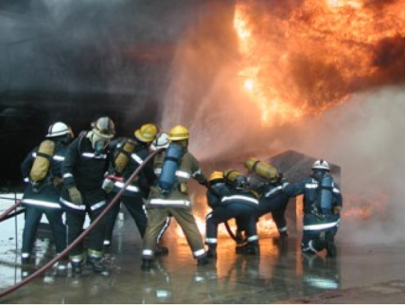
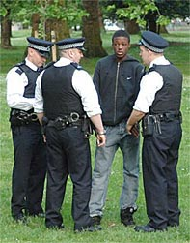
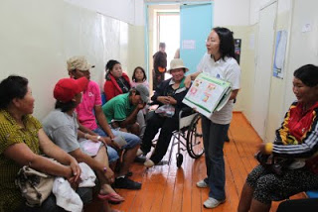
Where are the factories?
The public service is predominantly about… services!

Slide 29
Why services (including public) differ?
There is much higher variability of demand (every person in different).
As demands on services are very variable
It is difficult to set meaningful standards, guidelines are very detailed, but stil insufficient to cope with everything possible
It is difficult to quantify the quality of human interaction
Service is always co-produced in interaction between the client and provider in given time. To stock of services available.

Slide 30
Toyota Production System for services: Vanguard method
1
What is the purpose (in customer terms)?
6
Thinking
C
U
S
T
O
M
E
R
5
System Conditions
4
Flow : Value work + Waste
3
Capability of response
John Seddon is an occupational psychologist, researcher, professor, management thinker and leading global authority on change, specialising in the service industry. He has published five books. In his 2008 book, Systems Thinking in the Public Sector, he provided a criticism of the UK Government reform programme and advocated its replacement by systems thinking. Seddon won the first Management Innovation Prize for 'Reinventing Leadership' in October 2010. He conceived the Vanguard method.
2
Demand : Type + Frequency
What matters?

Slide 31
#4 The Nature of Public Organisations: Paradigm shift from simple tasks in complex organisations with top down hierarchies to complex tasks in simple organisations with self-steering
Hierarchical public organisations are complex and closed systems providing simple services. In a stable and predictible environment they can be effective and efficient. In reality they often fail to integrate services. Self-steering learning organisations are simple and open systems capable of producing complex services. Double-loop learning enables them to cope with the VUCA environment.

Slide 32
Take aways
Bureaucratic
Flexible
Max division of operations into simple tasks in separate units => complex structure, simple tasks
Regulation separated => regulation of service providers
Inside-out
Coersive or empirical-rational strategy for change (change team prepares the change).
As many operational task as possible together in one single team. => Simple structure, complex tasks.
Regulation integrated: service providers regulate in interaction with service users.
Outside-in
Normative re-education strategy for change (everybody experiments with perfection)

Slide 33
#5 Motivation of Staff: Paradigm shift from stress on external motivators to creating environment that keeps internalised motivation of people.
For most jobs (with exception of routine manual work) internalised motivation is more effective than externalised motivators (sticks and carrots, SMART goals). For internalised motivation people need autonomy to self-organise; mastery (possibility to do a good job) and relatedness to a higher purpose. Introducing external motivators ruins internalised motivation. Idea of SMART objectives is just a consultants’ folklore, not a concept backed by science to manage organisations or countries.

Slide 34
Flow is closely connected to intrinsic motivation
Intrinsic motivation is “the natural tendency manifest from birth to seek out challenges, novelty and opportunities to learn”.
This natural tendency is easily frustrated if there is no supportive environment for :
autonomy
mastery (feel effective)
relatedness/belonging/purpose
See works of Deci and Ryan on self-determination theory
Notes:
Close your eyes and think about the event (1 min)
Share in the groups the cases of your flow (5-9 min)
Try to find some commonalities (10 min)
Sharing with other groups (10 min)

Slide 35
#6 Accountability: Paradigm shift from accountability overload to accountability for learning
Public organisations has to be accountable for their actions and meeting their purpose. Historically, different aspects of accountability were stressed: Honest and Fair (Focus on preventing distortion, bias and abuse of office and on proper procedures), Lean and Purposeful (Match narrowly defined tasks with resources (time and money) as tightly as possible, cutting any slack) and Robust, Resilient, Adaptive Being able to adapt rapidly to changing environments, to withstand shocks, to keep operating even in a crisis. These aspects are contradictory and when not balanced, problems emerge. Good way to maintain balance is to reframe all aspects of accountability by accountability for learning.

Slide 36
End of topics

Slide 37
What you can do in next days
You can use two „jokers“ to
Submit a homework you have ignored
Submit a homework to get better score
Final deadline (hard) is 24h before your final discussion.
You can recap what we were speaking about
And if not registered yet, sign in for the final discussions (Via Moodle, not SIS)

Slide 38
Final group discussions
#1 – Friday, May 17, 9 am Room – 3018
1 place free
#2 – Friday, May 17, 10 am Room – 3018
FULL
#3 – Friday, May 17, 11 am Room – 3018
FULL
#4 – Monday, May 27, 9 am Room – 3019
3 places free
#5 – Monday, May 27, 10 am Room – 3019
1 place free
Jere? Elisabeth? Alexandre?

Slide 39
Reading beyond this course

Slide 40
How has the public service been dealing with all of this?

Slide 41
#7 Metagovernance: Paradigm shift from looking for best practice to thinking about our thinking about governance.
Meta-governance is “governance of governance“ and a process to achieve smart governance mixtures. It entails critical thinking about the daily practices (first order governance) and main modes of governance (second order governance – hierarchical, market- or network-based governance) as any form of governance can be problematic when taken too far.

Slide 42
Governance
“…the totality of interactions, in which government, other public bodies, private sector and civil society participate, aiming at solving societal problems or creating societal opportunities” (Meuleman, L. 2008, Public management and the metagovernance of hierarchies, networks and markets, p. 11)
So it concerns types of relationships among actors. These are influenced by their institutions (organisations, values, norms, procedures,…)

Slide 43
Governance
First order: problem solving and opportunity creation of actors= focus of most research => concrete solutions
Public administration: “the implementation of public policy, largely by the executive branch”*
Public management: “influencing of common activities in the public domain or by public sector organisations and public managers” (Meuleman, p. 76, 2008)
Second order: looks at institutions (e.g. culture) = how they determine what governance modes emerge and are organised, recognises three main governance styles – hierarchy, market, network
Third order: meta-governance: “governance of governance” by “designing and managing sound combinations of… governance” (Meuleman, p. 68, 2008)
*http://dictionary.reference.com

Slide 44
Three types of second order governance and accountability
Hierarchy
Honest and fair
Market
Lean and purposeful
Network
Robust, adaptive, resilient

Slide 45
All forms of governance can be problematic when taken too far!

Slide 46
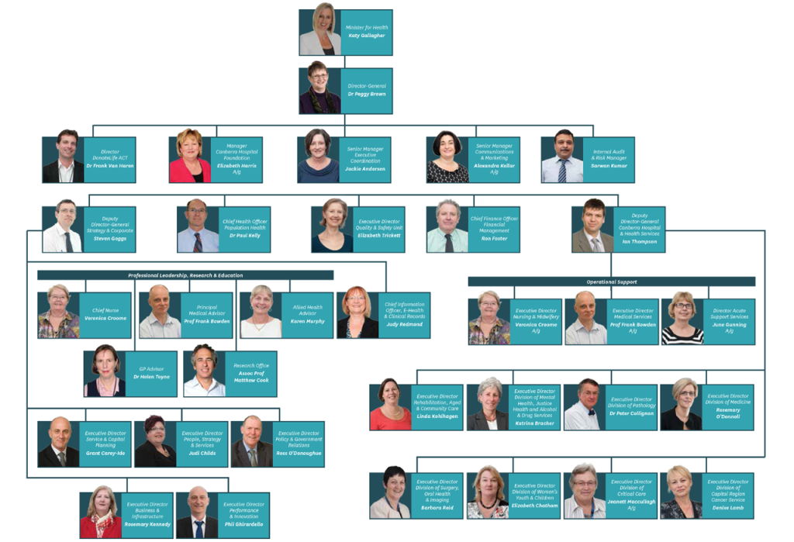
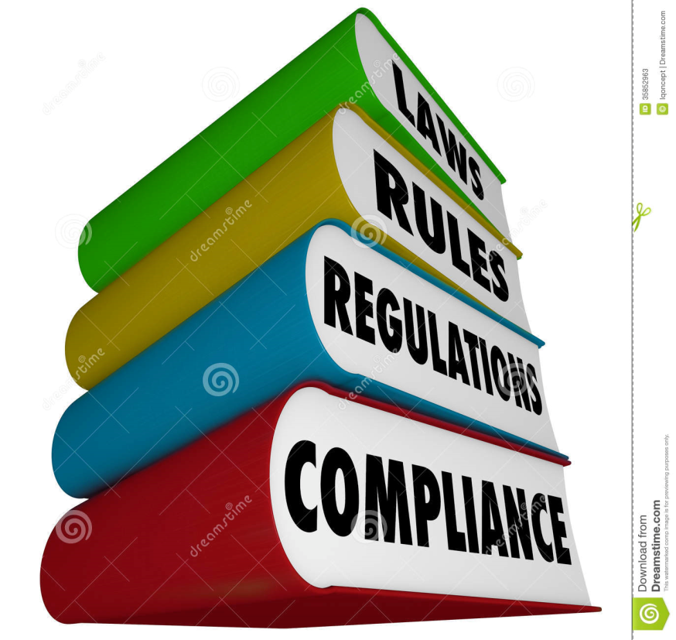
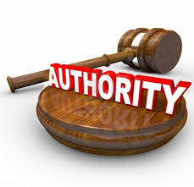
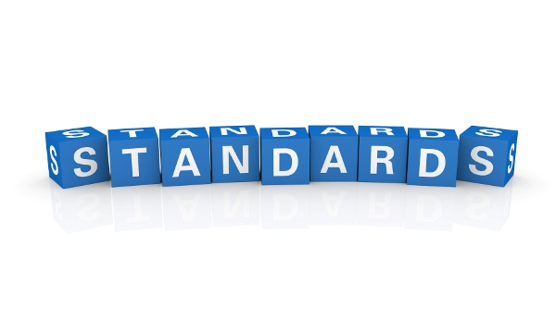
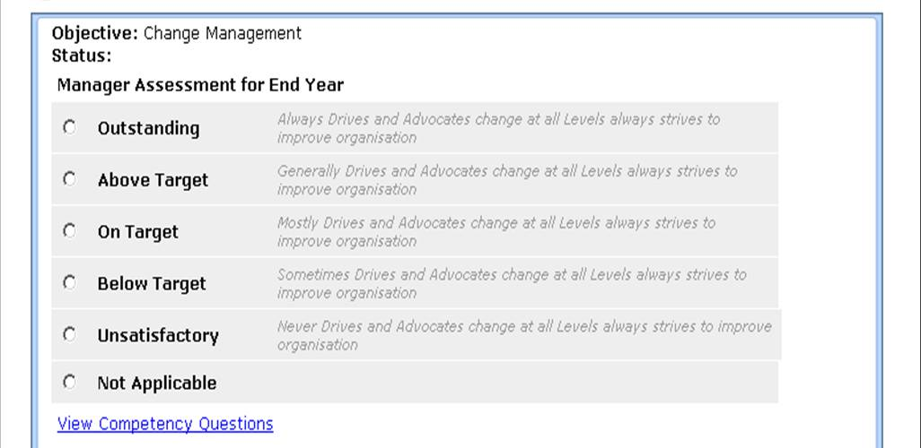

Slide 47
When hierarchical governance goes too far…

Slide 48
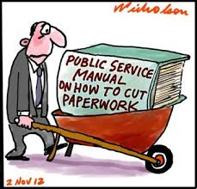
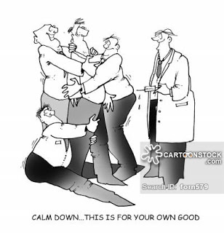
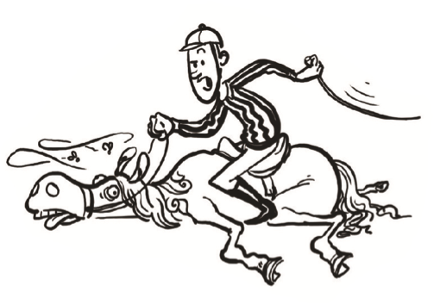

Slide 49
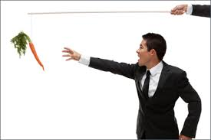
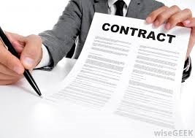

Slide 50
When market governance goes too far…

Slide 51
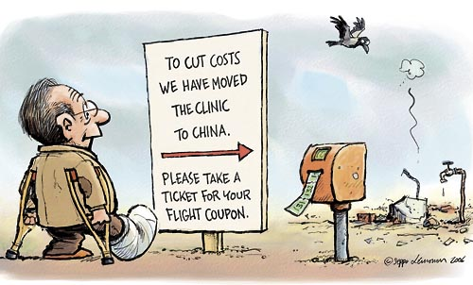
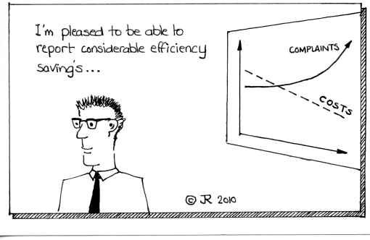
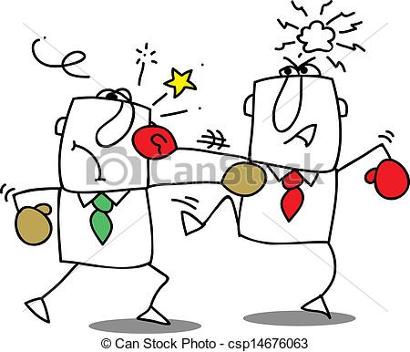
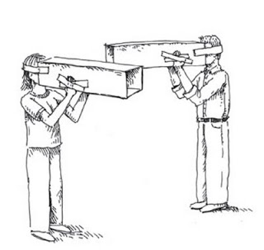
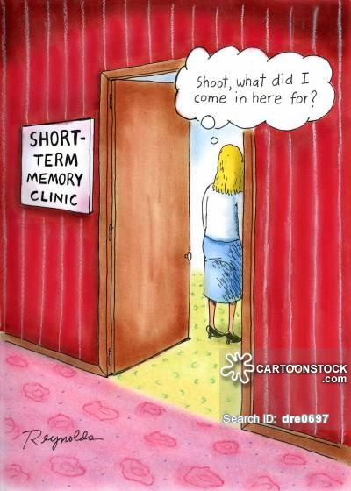
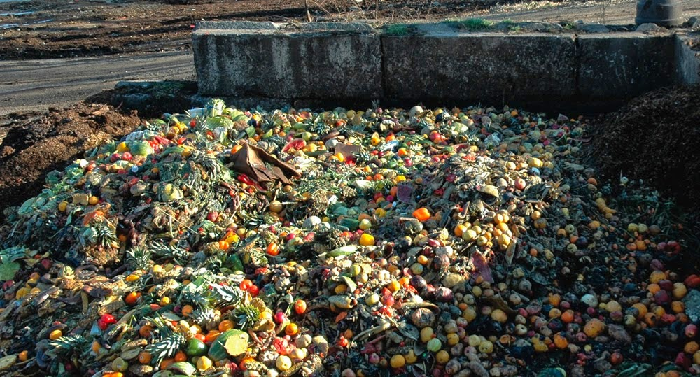

Slide 52
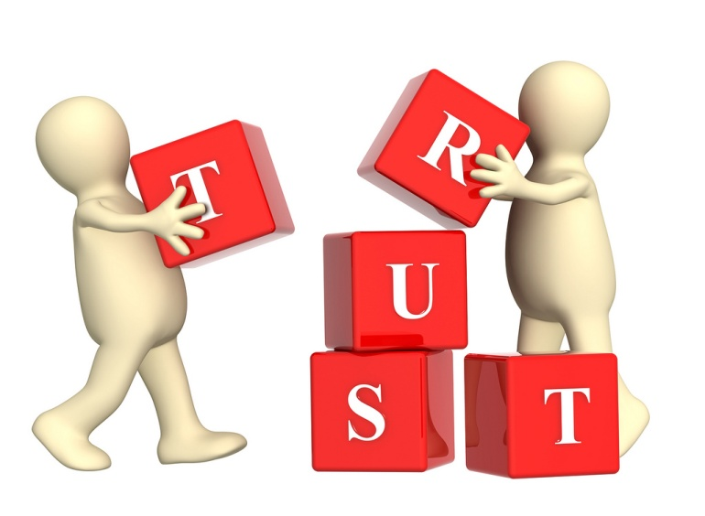

Slide 53
When network governance goes too far…

Slide 54
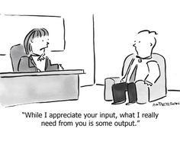
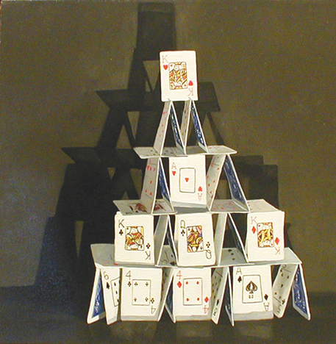
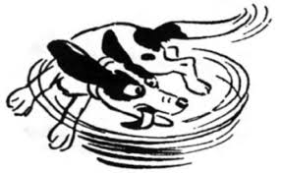
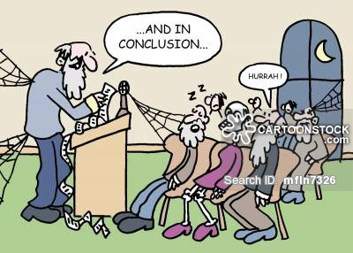

Slide 55
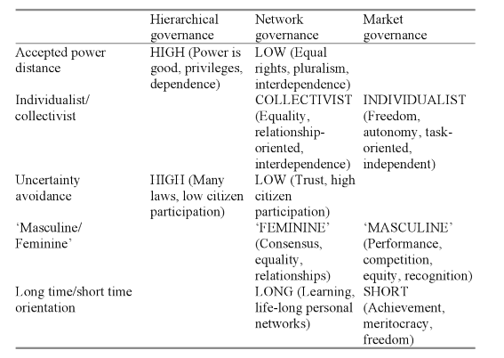
Culture and governance
Germany, France
Netherlands, Scandinavia
US, UK, Australia
Meuleman 2008

Slide 56
Culture and governance
Different countries will be better / worse at solving different kinds of problems
Germany, France
Netherlands, Scandinavia
US, UK, Australia
Meuleman 2008

Slide 57
How have these “modes” of governance manifested themselves over time?

Slide 58
Different models for the public sector
In the old days, there was the absolute and often arbtirary power of hereditary kings/queens
Weberian “bureacracy” replaced this “arbitrariness” but was criticised for lack of efficiency (1950-1980)
Next came “New Public Management”, heavily supported by the OECD…(1980-95)
…but fallen into discredit…
…with many different “rival” concepts of governance fighting for attention since then. under the banner of New Public Governance (1995-…)

Slide 59
….”most reform programmes (of the UK, NL, D, EC, OECD for example) have in common that they stimulate network governance as well as market governance and on top restore elements of hierarchical governance that are considered to have become too weak, such as control and accountability procedures” (p. 294)
p. 43

Slide 60
….”most reform programmes (of the UK, NL, D, EC, OECD for example) have in common that they stimulate network governance as well as market governance and on top restore elements of hierarchical governance that are considered to have become too weak, such as control and accountability procedures” (p. 294)
Given the potential for conflict between governance modes as well as synergies, reform programmes would do best to explicitly adress these interactions
p. 43

Slide 61
No succession but rather hybridisation
Hierarchy is still going strong:
Evidenced by ongoing battles against ”over-regulation”
Also sometimes sensible as hierarchy still good at dealing with acute crisis, disaster and security (send in the army…) and useful for some tasks (e.g. administering salaries should be reliable and not “entrepreneurial”)
Yet market and network thinking mix with what are still essentially bureacracies:
Sometimes disguising as market and network governance
Often new tools facilitate network governance within a hierarchical setting
Meuleman 2008

Slide 62
Meta-governance
a process to achieve smart governance mixtures!
Governance mixture is situational:
Different even in countries with similar development of democratic institutions and for the same policy problem
Usually the preferred mode is tried first and if unsuccesful , others are tried
Not possible to copy first order approaches from Germany to Netherlands; even between cities and regions and within them there are differences (Meuleman, 2008, p. 237) e.g. individualistic Amsterdam (market) versus “all hands on deck” Rotterdam (network) and within Amsterdam young Morrocans are sensitive rather to hierarchy
Concerns both internal (between policy units, ministries, levels, support units, … ) and external (relative to politicians and other actors) aspects
Internal metagovernance may be prerequisite to external
Meuleman 2008

Slide 63
Meta-governance
Concerns public management in all its aspects:
Business management: result oriented, coordinated, efficient “enteprise”; linked to market governance
Organisation management: professionals operating in complex environments; linked to network governance
Policy management: organising and influencing policy making processes to ,address societal problems; linked to network governance
Political management: influencing poltical agenda setting and decision-making , linked to all modes
Can be done by a line manager, project manager, process manager,…
Meuleman 2008

Slide 64
The police force: metagovernance in action
When working on “wicked problems” they require discretion and flexibility to actively problem solve in a variety of cooperation types with others
Also need to work efficiently
…and exercise hierarchy (law and order)
Meuleman 2008

Slide 65
Meta-governors
Key characteristics of succesful meta-governors:
I. Willingness:
Highly motivated / drive, believe what they do makes a difference
Willing to be unorthodox (change the rules that limit or push the boundaries)
Mindfulness:
Learning by doing
Regular challenging of one’s own assumptions by taking a hard look at reality, seeing weak signals
Courage to make mistakes
Tenacity
II. Discretion:
Act on all levels with all involved parties…
…with discretion regarding rules, values, tasks, …
…which can be informally, using ‘dirt roads’ without constantly having to ask for permission…
linked to an overall policy objective
Meuleman 2008

Slide 66
Meta-governors
III. Capability:
Typically highly educated, well trained, at least five years experience in line or project management jobs
Ability to take multiple perspectives, not to get stuck in one preferred mode of governance, supported by empathy
Reflexivity: understanding that knowing about a system changes the system (e.g. reflecting why a specific mode of governance dominates, rather than another)
Recognition of complexity and variety:
deliberate cultivation of a flexible repertoire of responses (requisite variety)
dealing well with unexpected events
Self-reflexive irony (recognition of likelihood of failure but proceeding as if success will happen)
Casting: putting the right people in the right places, although this will be constrained (e.g. administrators don’t get to choose their politicians)
Meuleman 2008

Slide 67
Back to accountability
the three aspects of accountability and governance modes that support them may conflict so a more general definition of accountability is required from meta-governance perspective:
“programs should be accountable for demonstrating that they ask the difficult questions, that they explicitly identify problems and limitations as well as what is going well, that they have in place appropriate monitoring systems, and that they carry out evaluations looking at challenging questions and issues” (Burt Perrin)
“the way people give an account of what they have done and why, rather than describing in a more limited way if they have hit a target or not” (Chris Mowles)

Slide 68
Back to accountability
This is accountability for learning in terms of continuously “thinking about our thinking” and using that to move forwards, which is what meta-governance aims to do!
the three aspects of accountability and governance modes that support them may conflict so a more general definition of accountability is required from meta-governance perspective:
“programs should be accountable for demonstrating that they ask the difficult questions, that they explicitly identify problems and limitations as well as what is going well, that they have in place appropriate monitoring systems, and that they carry out evaluations looking at challenging questions and issues” (Burt Perrin)
“the way people give an account of what they have done and why, rather than describing in a more limited way if they have hit a target or not” (Chris Mowles)
NOT a “major” reform and then rest in peace!

Slide 69
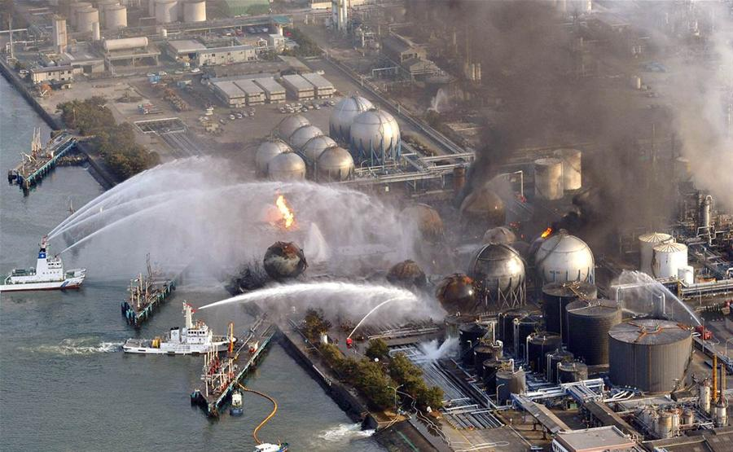
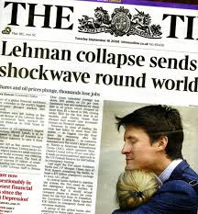
What happens if we do not go for balance?
Private sector examples of overemphasising lean and purposeful (facilitated by public policy) with wider repercussions

Slide 70
Fukushima
In 2002, the government of Japan revealed that TEPCO, the company behind the plant, was guilty of false reporting in routine governmental inspection of its nuclear plants and systematic concealment of safety incidents
In 2007, the company announced that an internal investigation had revealed a large number of unreported incidents. These included an unexpected unit criticality in 1978 and additional systematic false reporting, which had not been uncovered during the 2002 inquiry.
Along with scandals at other Japanese electric companies, this failure to ensure corporate compliance resulted in strong public criticism of Japan's electric power industry and the nation's nuclear energy policy. However, the company made no effort to identify those responsible.
Also, in 2007, TEPCO was already forced to shut the Kashiwazaki-Kariwa Nuclear Power Plant after an earthquake had hit Japan. The Fukushima disaster displaced 50,000 households in the evacuation zone because of leaks of radioactive materials into the air, soil and sea.

Slide 71
What happens if we do not go for balance?
On July 31, 2012, TEPCO was substantially nationalized by receiving a capital injection of US$12.5bn from the Nuclear Damage Liability Facilitation Fund, a government-backed support body. The total cost of the disaster was estimated at $100bn in May 2012.
Before the disaster happened, TEPCO had no problem demonstrating its accountability in terms of lean and purposeful (in this case, profit oriented)
In 2010, TEPCO had reported an operating income of ¥399.6 billion
Of course, this came at the expense of the other two dimensions of accountability:
“honest and fair“: covering up and misrepresenting earlier mistakes that endangered safety
“robust, resilient and adaptive”: here, even after an earlier earthquake had led to disrupting another powerplant, someone must have calculated that the probability of an earthquake triggered tsunami engulfing a nuclear powerplant at Japan’s coast was too low to want to incur the costs of back-up systems and a sea-wall
It was just not efficient…

Slide 72
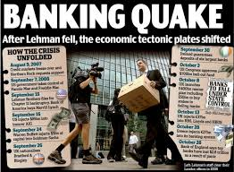
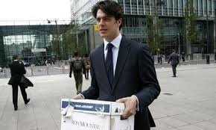
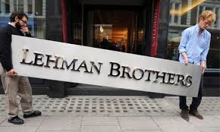
there are strong parallels with the collapse of Lehman Brothers
it was the trigger of the global financial crisis that is still affecting us today
this was an organization that was ALSO hitting its, strongly incentivized, performance targets:
Lehman reported record profits every year from 2005 to 2007
In 2007, the firm reported a net income of a record $4.2 billion on revenue of $19.3 billion
In February 2007, the stock reached a record $86.18, giving Lehman a market capitalization of close to $60 billion.
On Monday September 15, 2008, Lehman declared bankruptcy.

Slide 73
Three types of governance
Hierarchical: “authority” is everything
Top down decision-making
Strict internal and external procedures for accountability
Hierarchical organisation structure
Emphasis on project management (breaking a whole into independent parts and then addressing the parts) as opposed to processes
Strong preference for legal measures and standardisation
Advantage: quick decisions and clear lines of responsibility: useful for crisis management (e.g. disasters) and for clear and well-defined issues
Meuleman 2008

Slide 74
Three types of governance
Market governance: efficiency (cost) rules
Decentralisation, deregulation and autonomy (eg. Agencies)
Managerial competence of staff instead of policy-making
Competition instead of cooperation, incl. via benchmarking
Contractualising relations
Outputs instead of outcome
Advantage: focus on empowerment and individual responsibility which is good for supporting efficiency
Meuleman 2008

Slide 75
Three types of governance
Network governance: “trust” is everything
Policy is the result of complex interactions between a variety of actors, hence not entirely predictable:
“management of complex networks, consisting of many different actors from the national, regional and local government, from political groups and from societal groups (pressure, action, and interest groups, societal institutions, private and business organisations)” (p. 31-2)
A form of horizontal coordination manifesting as
Interactive policy-making
Informal use of networks such as expertise networks
Covenants (gentlemen’s agreements, mutual promises)…
Offering advantages of learning and innovation in an ever-changing environment, dealing with “wicked issues”
Focus on content, not power with highly professional participants with maximum freedom
Works well in knowledge-rich environments as they have superior information processing capabilities and are also more flexible and adaptable due to loose coupling and openess to information
Meuleman 2008

Slide 76
Three types of governance
Requires:
Trust: Collective action is only possible, if trust in the reliability of each member to act in a co-operative way can be guaranteed; cheating will destroy the cooperation
Durability: To produce trust, to avoid cheating, continuous (or as a minimum repeated) interaction between same actors is necessary, therefore, networks have to be stable constellations of actors at least to a certain extent and over a recognizable time period.
Strategic Dependency: continuous interaction between formally independent and voluntary participating actors leads to “strategic dependency” due to shared production of common goods; egoistic behaviour risks future support of partners and hence does not occur
Institutionalisation: especially for balancing power disparities between members network rules have to be developed (modalities of participation, the process of decision-making, the distribution of commonly produced benefits)
Empathy (ability to understand the interests of other and act accordingly)
Power (ability to influence others)
Meuleman 2008

Slide 77
Three types of governance
However also weak points:
Instable: prone to desintegrate or to convert into a formal organisation
Not very efficient
Openess can pose threat to trust (which requires some form of closure)
Can threaten democracy as a form of decision-making (representative democracy), although it is compatible with democracy as a societal value (as in direct democracy)
People with more links than others (hubs) play an important role:
facilitate speed of communication but if they disappear, networks can break into isolated pieces
this also establishes a hierarchy as they have an advantage
no commonly accepted selection procedures: risk is that priviliged actors decrease the participation of others compared to classic representative democracy
Meuleman 2008

Slide 78
Three types of governance
Various forms of network governance:
participatory; (interactive policy-making):
individual and collective participation of state and non-state actors in policy-making and implementation
includes “nodal governance” for co-production of public services through partnerships or “nodes” of state agencies, business and NGOs
community:
Governments appeal to citizens to form communities to look after their own affairs (e.g. safety)
deliberative governance:
Anti-statist: focuses on societal processes of deliberation
reflexive governance:
Learning is the central issue rather than how actors interact: approach to governance and the governers should be open to influence by their environment
Includes “adaptive governance”:
Design policies in such a way they can adapt to a range of anticipated nd unanticipated conditions
Collaborative, flexible and learning based issue management across scales
Meuleman 2008

Slide 79
Hybrids
Oligopolies:
Self-interest (market)
But actors also realise interdependency hence behave with empathy and moderation (network)
Public private partnerships:
Bargaining (market)
Persuasion (network)
Chain management
Interdependency in a chain (market)
But only functional (hierarchy)
Open method of coordination
Benchmarking, target setting, peer reviewing (market)
Linking a variety of actors in joint determination of policy (network)
Self-regulation / organisation:
Individual autonomy (market)
Regulated self-regulation (hierarchy)
Voluntary cooperation and trust (network)
Bazaar/Wikipedia model:
Co-creation (network)
Individual autonomy (market)
Meuleman 2008

Slide 80
Meta-governors
Meta-governors need to:
Be able to “see” hierarchy, networks and market elements as building stones
Understand tensions and conflicts between them (resolve paradoxes –resolving apprent contradictions- and dilemma’s –choosing between 2 unsatisfactory situations)
Design mixtures that work well in a certain context and switch when needed
When they are public administrators they need to connect their work with the metagovernance tasks of politicians
Leadership without dominance
Meuleman 2008

Slide 81
Meta-governors
Discretion
Freedom to act according to what one deems of value, from multiple stakeholder perspectives
Decide for innovative learning experiences
Willing to be unorthodox
Understanding ambiguity of rules as opportunity
Willingness
Capability
Open to reflexive learning
Multi-perspective
ability
Meuleman, 2008, p. 266

Slide 82
Supporting meta-governors
Increase:
I. Willingness:
Select the right people who are willing
Reward reflexive attitudes
Make shared objective of policy process clear
II. Discretion: jump into the grey zone of discretion because of the opportunities, rather than run away from it due to fear
Create short cuts in the organisation (e.g. direct lines to senior management)
Give trust to managers that they will not cross sound lines of accountability and legitimacy and consider mistakes as investment in learning
Meuleman 2008

Slide 83
Supporting meta-governors
Inform “hierarchical” units such as legal, finance, HRM of the level of discretion given to a manager
Allow flexible use of budgets (e.g. multiplier money to break deadlocks)
Internal code for dealing with external actors, especially regarding making agreements
Make clear what exactly must be decided by politicians
Meuleman 2008

