Slide 1
„The Cinderella Syndrome“

Slide 2
„The Cinderella Syndrome“
What is it?
How does it work?
Where can you find it?

Slide 3
„The Cinderella Syndrome“
What is it?
How does it work?
Where can you find it?
Which kind of worldview does it represent?

Slide 4
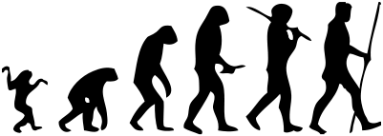
„The Cinderella Syndrome“
Barash, D. and N:
Madame Bovary´s Ovaries:
A Darwinian Look at Literature (2005)

Slide 5
Literary Darwinism
„The Cinderella Syndrome“
Barash, D. and N:
Madame Bovary´s Ovaries:
A Darwinian Look at Literature (2005)
Notes:
TADY Ukázat celej powerpoint Cinderella Syndrome. Pak ZPÁTKY SEM. Vysvětlit Madame Bovary. Pak

Slide 6
Literary Darwinism
Evolutionary Biology
Evolutionary Psychology

Slide 7
Literary Darwinism
Evolutionary Biology
Evolutionary Psychology
Richard Dawkins: Selfish Gene (1976)
Matt Ridley: Origins of Virtue (1996)
Notes:
So we already know that the stepmother is oppressing Cinderella because she wants to promote her own offspring = because she promotes her own genes. To understand not only the purpose of this kind of behaviour, but also the reason = the cause of it, the ground of it, you need to understand fully the mechanisms of evolutionary theory -)

Slide 8
What is Darwinism?

Slide 9
Darwinism
Darwinism - the theory of biological evolution stating that all species of organisms arise and develop through the natural selection of small, inherited variations that increase the individual's ability to compete, survive, and reproduce
Notes:
Any negative connotations?

Slide 10
Natural selection:

Slide 11
Natural selection:
how it works?

Slide 12
Natural selection:
how it works?

Slide 13
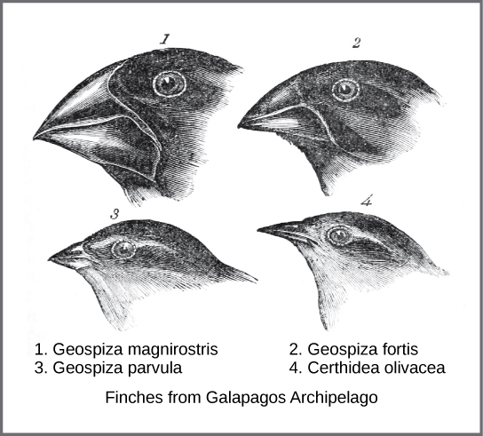
Natural selection:
how it works?
Adaptation - modifications made in response to environment to help organism survive and better reproduce.
Notes:
Example: finches beaks, giraffes neck
PŘIPODOTKONOUT paralelu s evolucí pohádek: the good ones survived, the bad ones dossapeared

Slide 14
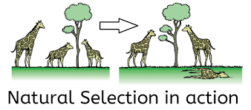
Natural and Sexual Selection
Natural selection: organisms better adapted to their environment survive. („a struggle for existence“)

Slide 15
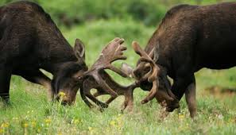
Natural and Sexual Selection
Natural selection: organisms better adapted to their environment survive. („a struggle for existence“)
Subtype: Sexual selection: organisms of the same sex compete for mates to reproduce („struggle for a mate“).

Slide 16
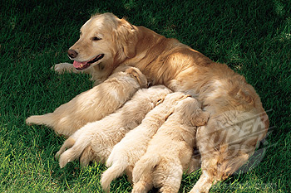
Natural and Sexual Selection
Reproductive success
Fitness – a measure of reproductive succes = how well an organism is able to reproduce in its environment
- contributionto the gene pool of the next generation
Survival of the fittest - survival of the form that will leave the most copies of itself in successive generations.

Slide 17
Natural selection :
how it works?
There is:
variation in traits
different survival rate (see natural selection)
The organisms with more advatageous traits (better adapted to the environment) survive.
different reproduction rate (see sexual selection)
The organisms with more advatageous traits (better adapted to the environment) reproduce more.
heredity
The offsprings of the surviving and reproducing individuals have the same traits.
Notes:
The more advantageous trait allows the organism to have more offspring, and thus becomes more common in the population. If this process continues, eventually, all individuals have this trait.

Slide 18
Natural selection :
how it works?
Why are the stepmothers cruel, then?

Slide 19
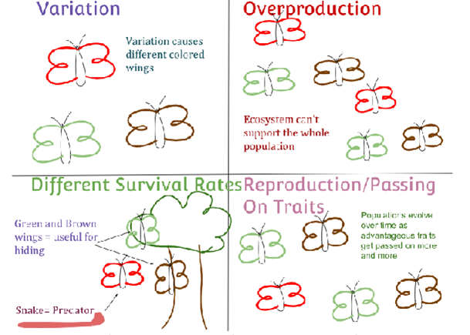
Natural selection :
how it works?
Why are the stepmothers cruel, then?

Slide 20
Natural selection :
how it works?
Why are the stepmothers cruel, then?
The good ones became extinct.

Slide 21
Natural selection :
how it works?
But why are they cruel even without having their own children?
Notes:
1. Snowhite 2. Hansel and Grethel

Slide 22
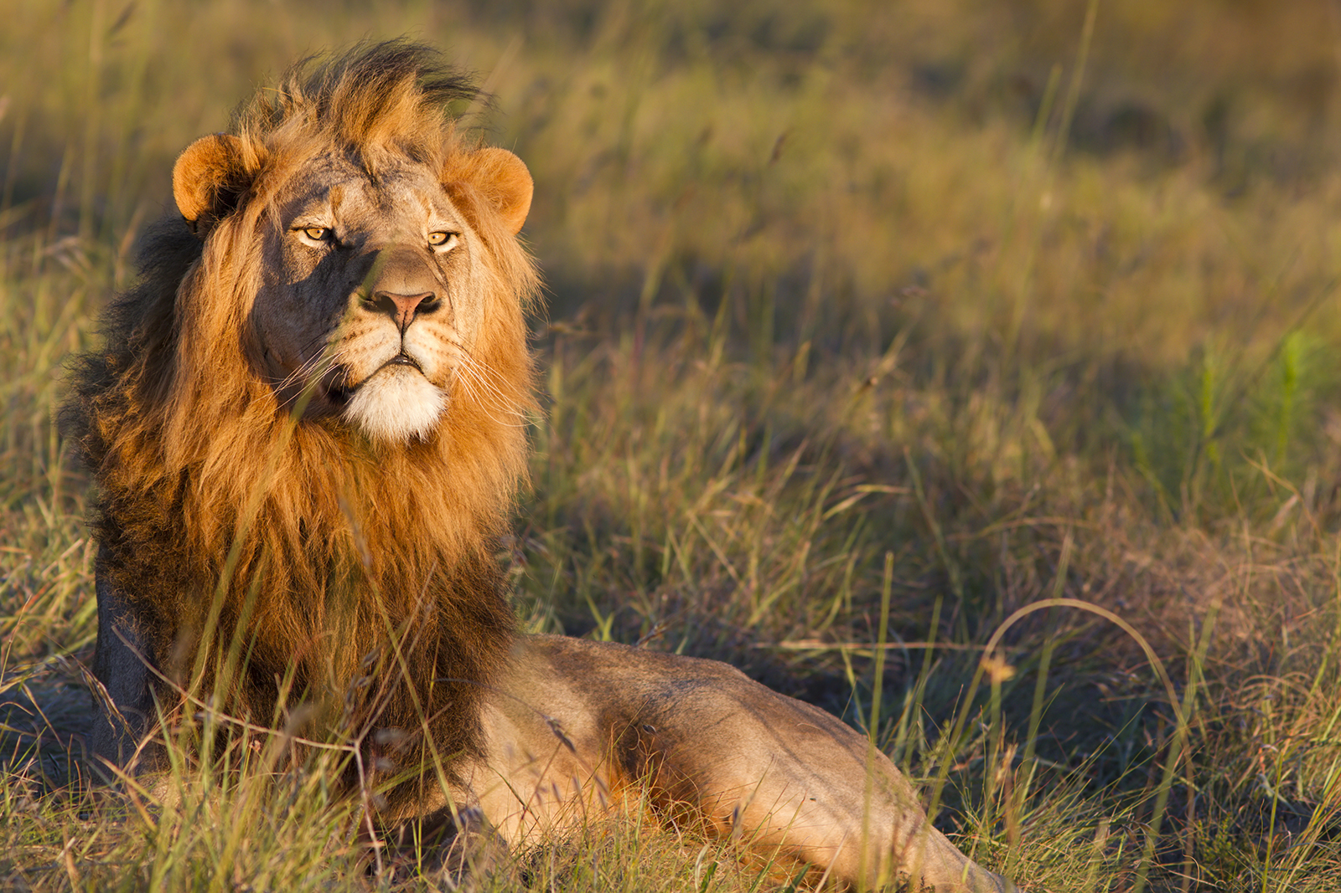
Natural selection :
how it works?
But why are they cruel even without having their own children?
Infanticide – an intentional killing of infants by a mature member of species

Slide 23
Natural selection :
how it works?
But why are they cruel even without having their own children?
Infanticide – an intentional killing of infants by a mature member of species
Reasons:
care for a youngster prevents the mother from next reproduction (Snowhite case)

Slide 24
Natural selection :
how it works?
But why are they cruel even without having their own children?
Infanticide – an intentional killing of infants by a mature member of species
Reasons:
care for a youngster prevents the mother from next reproduction (Snowhite case)
evolutionary, an adult is more valuable than an infant (Hansel and Grethel case)

Slide 25
Other fairytale motifs – other strategies to spread one´s genes:
Beeing a gene („a selfish gene“), what do you aim for?

Slide 26
Other fairytale motifs – other strategies to spread one´s genes:
Beeing a gene („a selfish gene“), what do you aim for?
3. protect other vehicles bearing your genes!

Slide 27
Other fairytale motifs – other strategies to spread one´s genes:
Beeing a gene („a selfish gene“), what do you aim for?
1. protect your vehicle!
3. protect other vehicles bearing your genes!

Slide 28
Other fairytale motifs – other strategies to spread one´s genes:
Beeing a gene („a selfish gene“), what do you aim for?
1. protect your vehicle!
2. make copies of yourself!
3. protect other vehicles bearing your genes!

Slide 29
Other fairytale motifs – other strategies to spread one´s genes:
Make copies of yourself = Reproduce

Slide 30
Other fairytale motifs – other strategies to spread one´s genes:
Make copies of yourself = Reproduce
With whom?!?

Slide 31
Other fairytale motifs – other strategies to spread one´s genes:
Make copies of yourself = Reproduce
With whom?!?
- What mate should I choose?
- How should he/she look like?

Slide 32
How do the most desirable men look like? Who is typical fairytale/mythogical hero?

Slide 33
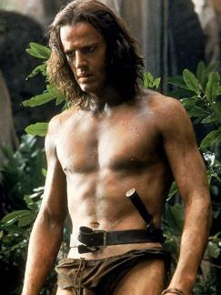
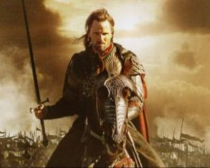
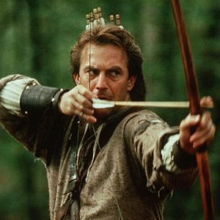
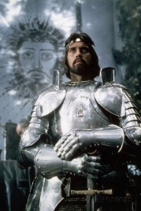
How do the most desirable men look like? Who is typical fairytale/mythogical hero?
handsome, strong, brave, resistant, active
powerfull, wealthy

Slide 34
How do the most desirable men look like? Who is typical fairytale/mythogical hero?
handsome, strong, brave, resistant, active
powerfull, wealthy
= promise
of the highest reproductive succes

Slide 35
How do the most desirable women look like? Who is a typical fairytale/mythogical heroine?

Slide 36
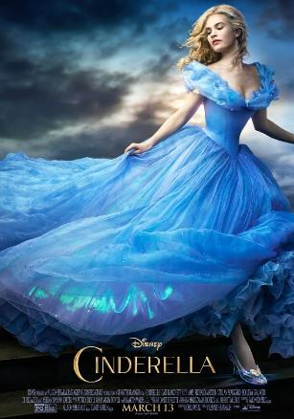
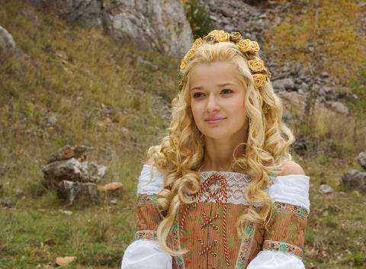
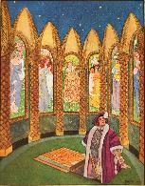
How do the most desirable women look like? Who is a typical fairytale/mythogical heroine?
beautiful

Slide 37
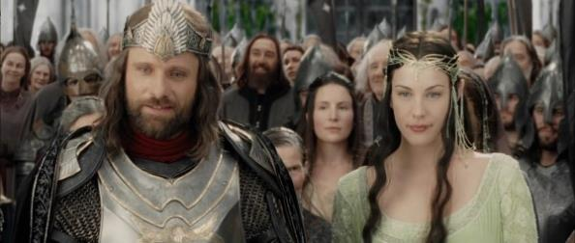
Typical fairytale/mythogical heros and heroines
Gottschall, Wilson: The Literary Animal, 2005:
„model of a physically fit hero striving for physically attractive female is really a central motif of fairytales across all cultures, not just product of patriarchal approach of western society“

Slide 38
Typical fairytale/mythogical heros and heroines
Gottschall, Wilson: The Literary Animal, 2005:
„model of a physically fit hero striving for physically attractive female is really a central motif of fairytales across all cultures, not just product of patriarchal approach of western society“
Where is ethic? Where is moral?

Slide 39
Typical fairytale/mythogical heroine
beautiful

Slide 40
Typical fairytale/mythogical heroine
beautiful
What does it mean “beautiful”?

Slide 41
The most universal signs
of physical attractivity

Slide 42
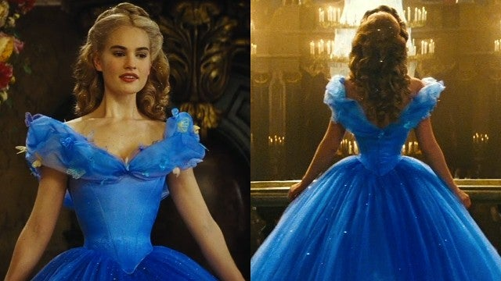
The most universal signs
of physical attractivity

Slide 43
The most universal signs
of physical attractivity
waist-hips ratio
blond hair

Slide 44
The most universal signs
of physical attractivity
waist-hips ratio
blond hair
signs of attractivity = indications of good fitness (fertility)

Slide 45
Typical male vs. female strategy of reproduction

Slide 46
Typical male vs. female strategy of reproduction
Aiming for quantity vs. aiming for quality
Notes:
Of course: big simplification, the whole thing is more complicated: men also seek for quality! (implied by the signs described above). But at the same time, there is the difference: men need the best female just to reproduce, women need the best male to be provided and protected during the reproduction. So, that´s why the „quality“ means something else for males and for females -)

Slide 47
Typical male vs. female strategy of reproduction
Aiming for quantity vs. aiming for quality
But what does it mean „quality“?

Slide 48
Typical male vs. female strategy of reproduction
Aiming for quantity vs. aiming for quality
But what does it mean „quality“?
for males
for females
Notes:
- for males: physical beauty = good fitness = fertility
- for females - capability to take care of her and the youngsters (to get enough food – speaking both about animals and human society, at least most of the history), also willingness to stay with them, not to leave them (moral integrity – speaking about human society rather than animals I guess) – BUT AGAIN, for females IT IS MORE COMPLICATED -)

Slide 49
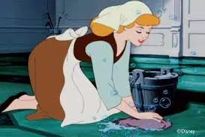
Female strategies of reproduction
Cinderella´s strategy

Slide 50
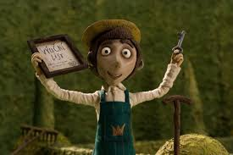
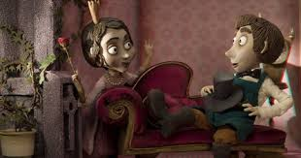
Female strategies of reproduction
Cinderella´s strategy
Clever princess/Reason and Luck strategy
Notes:
Overally: FT show very aptly many of the mechanisms and patterns described by evolutionary biologists and psychologists…-)

Slide 51
Any counterarguments?

Slide 52
Any counterarguments?
Altruism?

Slide 53
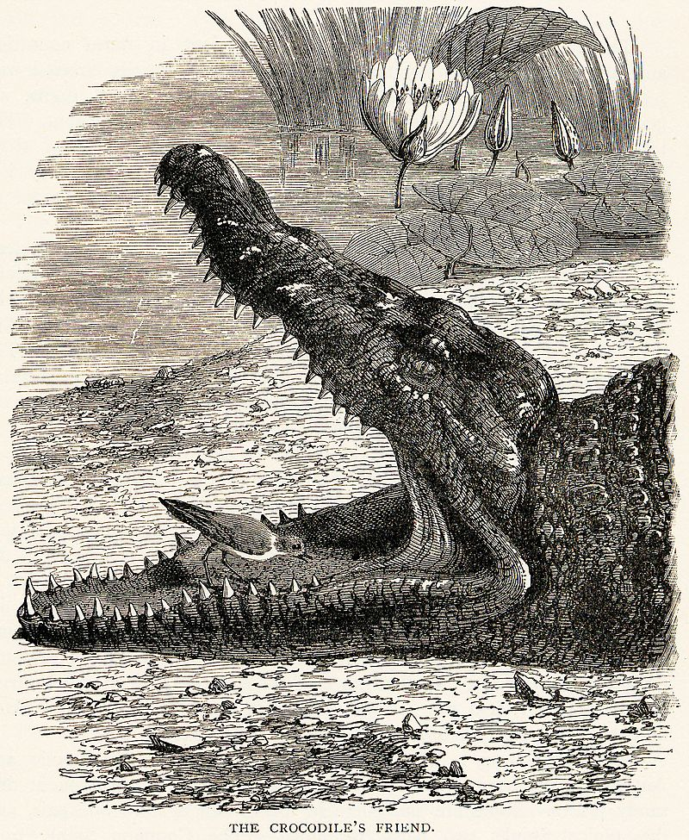
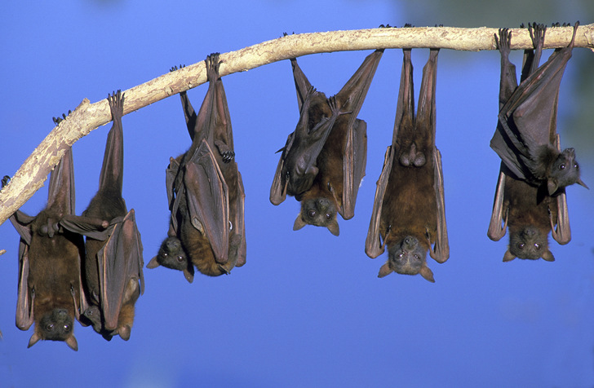
Any counterarguments?
Altruism?
Reciprocal altruism
- a behavior whereby an organism acts in a manner that temporarily reduces its fitness while increasing another organism's fitness.
(Examples - cleaning symbiosis, sharing meat)
- „help and you will be helped - in long term it pays off!

Slide 54
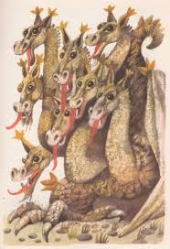
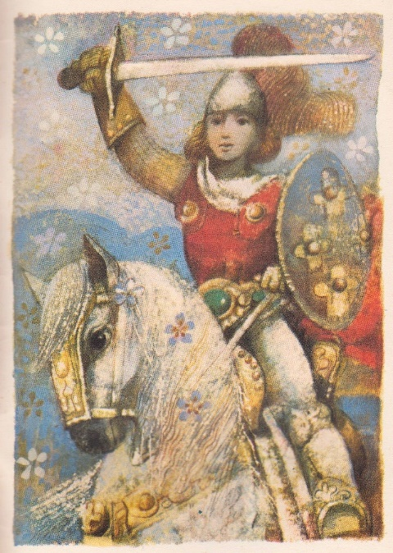
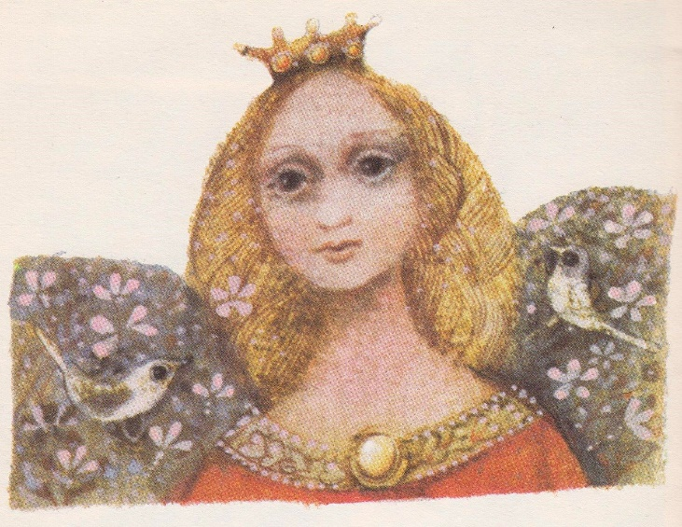
Any counterarguments?
Altruism?
Reciprocal altruism
- a behavior whereby an organism acts in a manner that temporarily reduces its fitness while increasing another organism's fitness.
(Examples - cleaning symbiosis, sharing meat)
- „help and you will be helped - in long term it pays off!
Altruism for prestige
- to have prestige (good reputation) can in long terms pay off (increase one´s fitness)

Slide 55
Literary Darwinism
What if I am not…?
Notes:
Let´s go back to the question posed last time by the feminist criticists…

Slide 56
Literary Darwinism
What if I am not…?
You fail: you will not reproduce, your genes disappear…

