Slide 1
Restoration drama
Soňa Nováková

Slide 2
WHEN
WHERE
For WHOM
WHAT
WHY
HOW

Slide 3
WHEN? Restoration
After Interregnum
1660 restoration of monarchy
Charles II
1660 – 1688 (Glorious Revolution)
In literature extends at least until 1700

Slide 4
An Ordinance of both Houses, for the suppressing of Stage-Playes 2 September 1642
… whereas publike Sports doe not well agree with publike Calamities, not publike Stage-playes with the Seasons of Humiliation, this being an Exercise of sad and pious solemnity, and the other being Spectacles of pleasure, too commonly expressing lacivious Mirth and Levitie: It is therefore thought fit, and Ordained by the Lords and Commons in this Parliament Assembled, that while these sad Causes and set times of Humiliation doe continue, publike Stage-playes shall cease, and bee forborne. Instead of which are recommended to the people of this Land, the profitable and seasonable Considerations of Repentance, Reconciliation, and peace with God, which probably may produce outward peace and prosperity, and bring againe Times of Joy and Gladness to these Nations.

Slide 5
The Weekly Intelligencer 11-18 September 1655
This Day proved Tragical to the Players at the Red Bull, their acting being against an Act f Parliament, the Soldiers secured the persons of some of them who were upon the Stage, and in the Tyrin-house, they seized also upon their cloaths in which they acted, a great part whereof was very rich, it never fared worse with the spectators then at this present, for those who had monies payed their five shillings apeece, those who had none to satisfie their forfeits, did leave their Cloaks behind them, the Tragedy of the Actors, and the Spectators, was the Comedy of the soldiers.

Slide 6
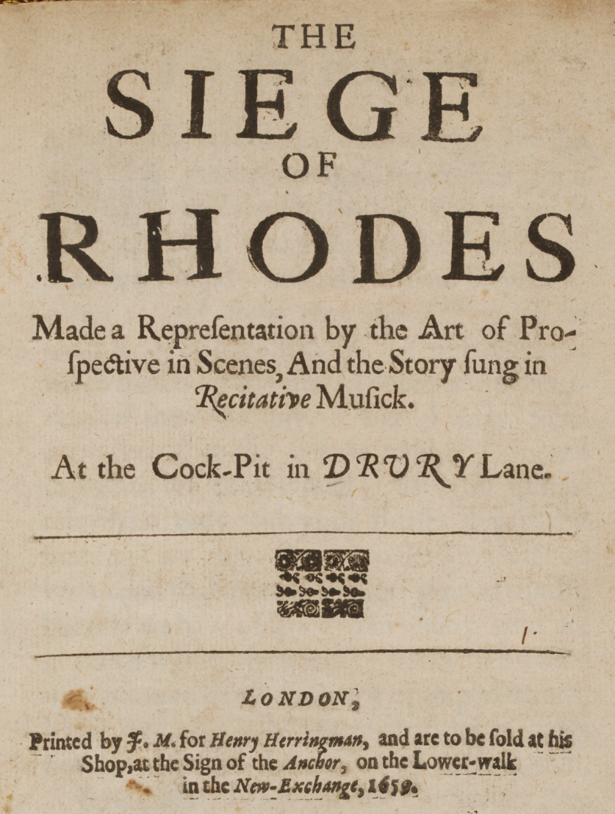
William Davenant (1608-68)
1656
First opera?
Rutland House
1659 Cockpit
1661 Lincoln Inn’s Field
Influence on
Restoration theatre
and drama

Slide 7
Charles II (1660-1685) The Merry Monarch

Slide 8
WHERE ? and for WHOM?
1660 – two companies chartered:
The King’s Company: Thomas Killigrew, at the Theatre Royal at Drury Lane
The Duke’s Company: William Davenant, the Duke’s Theatre
1682 – United Company
1695 – again two companies (actors break away from UC, led by Thomas Betterton)

Slide 9
Women actresses
Breeches parts
E.g. Nell Gwynn
Ellen Barry
Anne Bracegirdle

Slide 10
The Restoration theatre

Slide 11
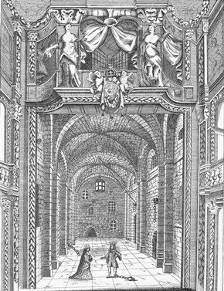
The Restoration Theatre
Proscenium arch
Forestage – apron (thrust)
Scenic stage – sliding
scenery
Perspective/Vista stage
Boxes, galleries, pit

Slide 12
Interactive theatre
Sir Goeorge Etherege: The Man of Mode (Prologue)

Slide 13
Prologue to The Man of Mode (continued)
‘Tis by your follies that we players thrive,
As the physicians by diseases live.
And as each year some new distemper reigns,
Whose friendly poison helps to increase their gains,
So, among you, there starts up every day,
Some new unheard of fool for us to play.
Then for your own sakes, be not too severe,
Nor what you all admire at home, damn here.
Since each is fond of his own ugly face,
Why should you, when we hold it, break the glass?

Slide 14
Samuel Pepys, Diary
February 18, 1667. Thence away, and with my wife by coach to the Duke of York’s play-house, expecting a new play, and so stayed not more than other people, but to the King’s house, to “The Mayd’s Tragedy”, but vexed all the while with two talking ladies , and Sir Charles Sedley, yet pleased to hear their discourse, he being a stranger. And one of the ladies would, and did sit her mask on, all the play, and, being exceedingly witty as ever I heard woman, did talk most pleasantly with him; but was, I believe, a virtuous woman, and of quality. He would fain know who

Slide 15
she was, but she would not tell, yet did give him many pleasant hints of her knowledge of him, by that means setting his brains at work to find out who she was, and did give him leave to use all means to find out who she was, but pulling off her mask. He was mighty witty, and she also making sport with him very inoffensively, that a more pleasant rencontre I never heard. But by that means lost the pleasure of the play wholly, to which now and then Sir Charles Sedley’s exceptions against both words and pronouncing were very pretty. So home and to the office, did much business, then home, to supper, and to bed.

Slide 16
WHAT ?
Heroic drama
In verse
Lofty style, high rhetorics, long speeches, sudden plot reversals, historical topics
Exotic locations
Love x duty
1660s: themes about legitimate authority
Roger Boyle, Earl of Orrery: Henry the Fifth
Until 1675 mostly in heroic couplets
John Dryden: The Conquest of Granada (1670)

Slide 17
Heroic drama
John Dryden: All for Love, or The World Well Lost (1678), in blankverse
John Dryden, Aurengzebe (1675):
When I consider life, ‘tis all a cheat;
Yet fooled with hope, men favour the deceit;
Trust on, and think tomorrow will repay.
Tomorrow’s falser than the former day;
Lies worse, and while it says we shall be blest
With some new joys, cuts off what we possessed. (IV.i.)

Slide 18
Heroic drama
Nathaniel Lee
Thomas Otway
Venice Preserved (1682), blank verse
Jaffier
Belvidera
Priuli
1670 etc. - themes deal with anxiety over succession

Slide 19
Comedies of manners
Dryden: “Gentlemen will be entertained with the follies of each other.”
Sexual intrique
Follies
Elegance of language, epigrams, wit, repartee
Prose

Slide 20
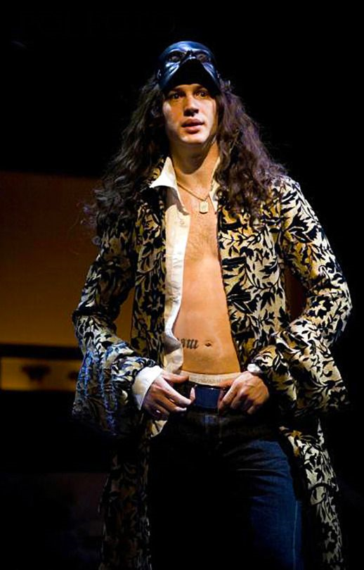
WHO ?
Sir George Etherege (1635-1691)
1664 The Comical Revenge or Love in
a Tub
1676 The Man of Mode, or Sir Fopling
Flutter
Sir Fopling X Dorimant
Loveit, Belinda, Harriet
the GALLANT X the FOP
Inner X outer
Royal Society – plurality of worlds

Slide 21
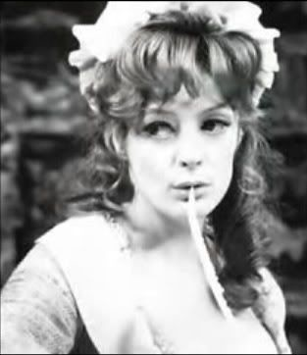
William Wycherley (1640-1716)
Cynical satire
The Plain Dealer (1676) based on Le Misanthrope
The Country Wife (1675)

Slide 22
Second generation
John Vanbrugh (1664-1726)
architect
The Relapse
George Farquhar (1678-1707)
William Congreve (1670-1729)
Incognita (1692)
Love for Love (1695)
The Way of the World (1700)

Slide 23
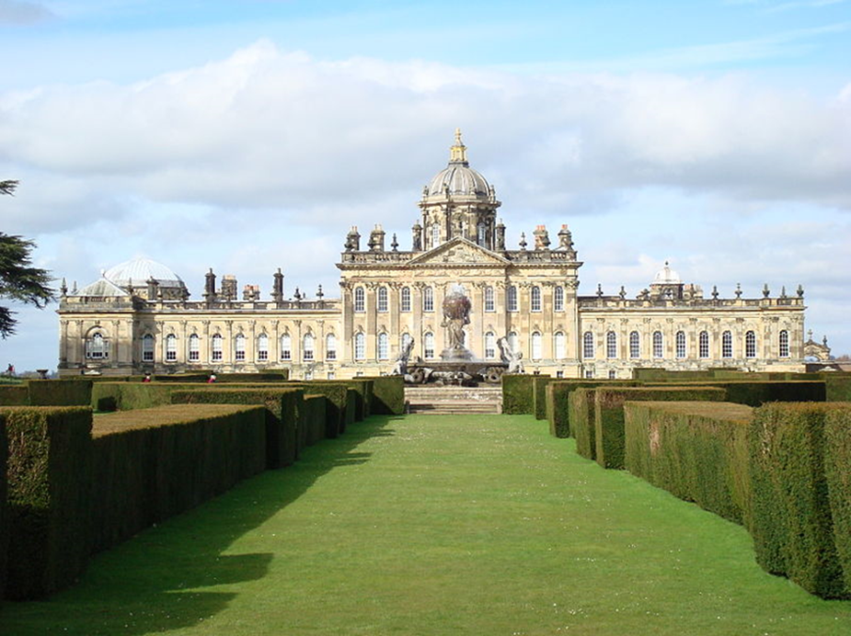
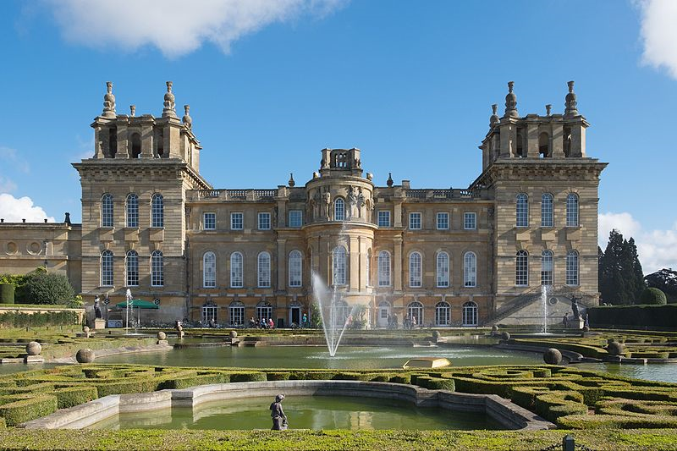

Slide 24
WHY ?
The aims of the comedy of manners
Satire
Compare with comedies of humours
Human weakness, sin – scorned
X deficiency in accomplishments – laughed at
Harsh mockery
X genial laughter

Slide 25
HOW?
Aims and tools
Characterization – type names (e.g. Valentine, Angellica, Alithea, Sir Samson Legend, Mr Foresight, Mr Tattle, Mrs Frail etc.) X Volpone
Contrasts: hero X Puritanical characters
X pretenders to wit (fops)
X heroine

Slide 26
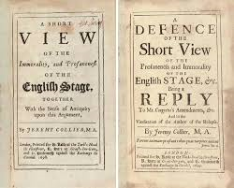
HOW ? – and backlash!
Setting
Landed gentry, rich merchants
Variety
Jeremy Collier, A Short View of the Immorality and Profaneness of the English Stage (1698)

Slide 27
Aphra Behn (1640-1689)

Slide 28
Aphra Behn 1st professional woman writer
“They charge [The Lucky Chance] with the old never failing Scandal – That ‘tis not fit for the Ladys: As if (if it were as they falsely give it out) the Ladys were oblig’d to hear Indicencys only from their Pens and Plays.”
The Rover, or the Banished Cavaliers (1677)
Oroonoko, or the Royal Slave (1688)
“Here lies a proof that wit can never be
Defense enough against mortality” (epitaph)
Virginia Woolf: “All women together ought to let flowers fall upon the tomb of Aphra Behn, for it was she who earned them the right to speak their minds.”

Slide 29
Timetable
1642 – Civil War; theatres closed
1660 – Restoration of the Stuart monarchy; two companies chartered
1660-1685 – Charles II
1664 – Etherege, Love in a Tub
1665 – Plague
1666 – Great fire
1678 – Dryden, Essay on Dramatic Poesy
1670 – Dryden, The Conquest of Granada
1675 – Wycherley, The Country Wife
1676 – Etherege, The Man of Mode
1677 – Behn, The Rover
1685-1688 - James II
1688 – Behn, Oroonoko
1688-1702 – William III and Mary
1695 – Congreve, Love for Love
1698 – Collier, A Short View of the Immorality and Profaneness of the English Stage
1700 – Congreve, The Way of the World

