Slide 1
Land Art Project
CREATIVE TASK 2: INSTRUCTIONS

Slide 2
Land Art Project
Go to a park or woods and create a land art project. You can work individually, in pairs or in groups of max. 3 students.
Take 2 photos of your art in the middle of the nature (one with everybody who was making it and one detailed photo of your piece of art) and upload it to Moodle by 27th November. You can send more pictures if you would like to.
The following photos might help and inspire you. However, I prefer if you come with something new and original. When you walk in a park or forest, try to look at details carefully and study them from various perspectives. Try to discover uncommon and new connections. It might help you to create something really original☺.

Slide 3
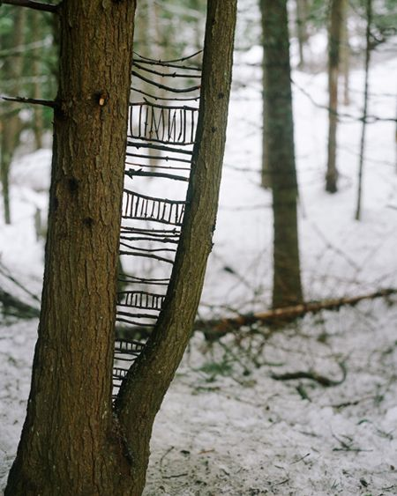

Slide 4
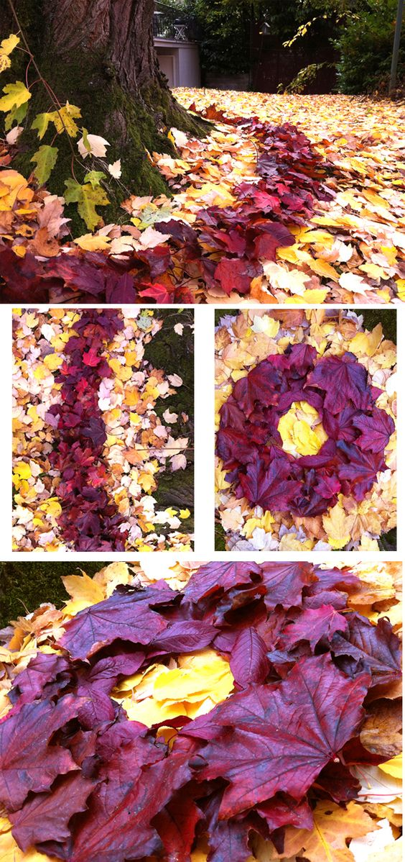
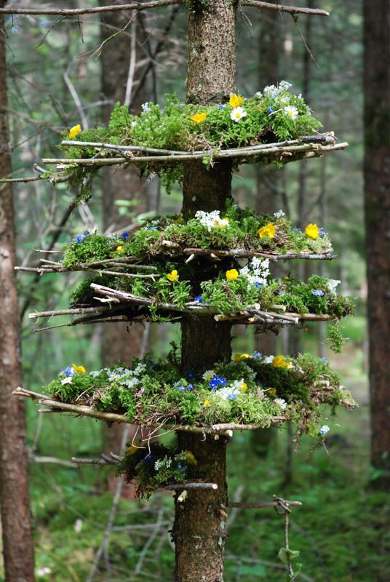

Slide 5
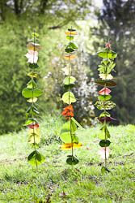

Slide 6
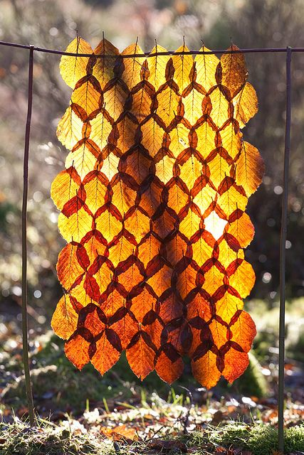
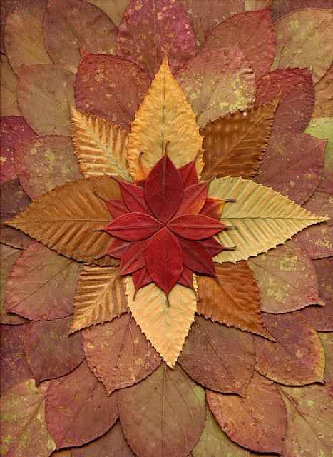

Slide 7
Creativity is not just about making art, however,
art may help you to unlock, discover and release
your creative potencial!

