Slide 1
Care of the Soul: In Antiquity and Today 2 The seeking for personality and integrity in different cultures
Zuzana Svobodová, Adhip Rawal

Slide 2
Basic information
In SIS: CVOL0376
Title: Care of the Soul: In Antiquity and Today
Guaranteed by: Department of Medical Ethics and Humanities, Third Faculty of Medicine, Charles University
Points, E-Credits: 5
Guarantor: doc. PhDr. Zuzana Svobodová, Ph.D.: zuzana.svobodova@lf3.cuni.cz
Annotation: The care of the soul is a phenomenon of cultivation, of human culture. The course focuses on the exemplifications of care of the soul from the earliest times of mankind to the present day. From the ancient times, examples of material culture with symbols and signs will be presented, and their interpretation will be based on different methodological principles. Course participants will also seek their own interpretive approaches within the expression of the human possibility, which is the care of the soul. The course is taught in tandem with Dr. Adhip Rawal from the University of Sussex School of Psychology, alongside the course supervisor.
Course completion requirements: Students upload written text, 4-6 pages (1800-2700 words). The content of the written work: Students will choose a short text/picture/movie/… describing the process of caring for the soul and write an interpretation.
Literature to the course at: https://www.citacepro.com/slozka/bpKEWhZf

Slide 3
Basic information
Syllabus:
Examples of the oldest remains of material culture, their symbols and interpretations.
The seeking for personality and integrity in different cultures.
Critical periods in life, examples of ritualization and symbolic expressions.
Theatre as a manifestation of care of the soul.
Spa as an expression of care for a good and beautiful life.
Learning resources - Moodle: https://dl1.cuni.cz/course/view.php?id=16377
MS Teams: https://teams.microsoft.com/l/team/19%3aW70bEVcamrlLOG6V9FgovqmNVQo-Wf8uff3vIal8ZGw1%40thread.tacv2/conversations?groupId=2b9b36ce-8617-449e-b3dd-9cc70566e7ec&tenantId=e09276da-f934-4086-bf08-8816a20414a2
Schedule for the winter semester 2024–2025:
October 22, 18-19:30
November 5, 18-19:30
November 19, 18-19:30
December 10, 18-19:30
January 7, 18-19:30
In these days and hours (at least 3 of them), connect to:
https://teams.microsoft.com/l/meetup-join/19%3aW70bEVcamrlLOG6V9FgovqmNVQo-Wf8uff3vIal8ZGw1%40thread.tacv2/1718882985968?context=%7b%22Tid%22%3a%22e09276da-f934-4086-bf08-8816a20414a2%22%2c%22Oid%22%3a%22da59b418-9bdf-4c0e-b401-2e81c8f22ed6%22%7d
Minimal requirements, prerequisites, conditions for selection and enrolment of students: Students can use the internet for MS Teams video meetings, have English as a spoken language - minimum level: B1 - "Can understand the main points of clear standard input on familiar matters regularly encountered in work, school, leisure, etc. Can deal with most situations likely to arise whilst travelling in an area where the language is spoken. Can produce simple connected text on topics which are familiar or of personal interest. Can describe experiences and events, dreams, hopes & ambitions and briefly give reasons and explanations for opinions and plans."

Slide 4
Treppenrede: Afterthought:
Why?
For thinking from more perspectives/points of view/angles on manifestations of the soul
To identify the needs of the soul
Trying to describe the different ways in which the soul manifests
Thinking more about how was described differences in the manifestations of the soul

Slide 5
Interpretations? Why? Who? How? When?

Slide 6
Introduction to the art of interpretation

Slide 7
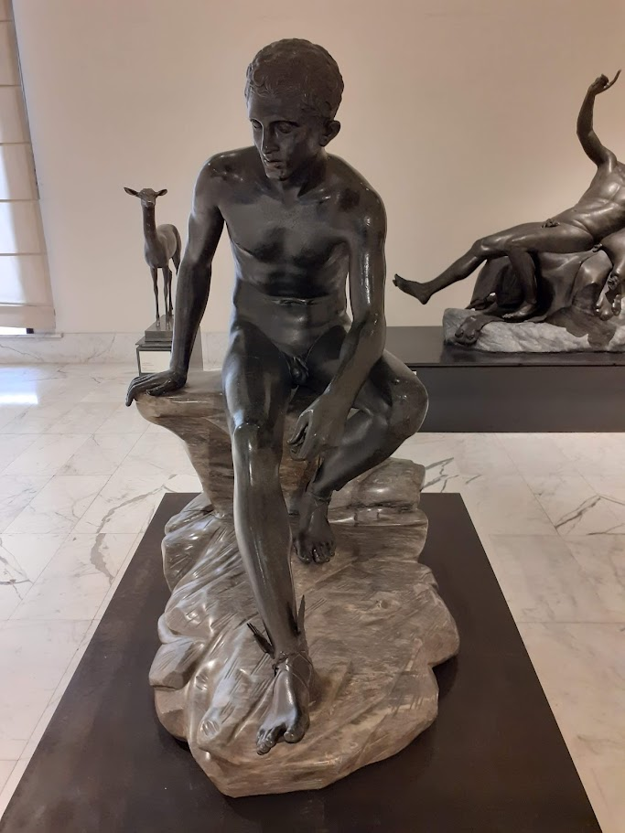

Slide 8
Text comprehension and reader’s interpretation
perception – understanding – comprehension – interpretation
perception – comprehension – interpretation
perception as a psychological process (?)
comprehension – a paradigm for cognition, a non-verbal process, insight through the analysis of the verbal form; the ability to perceive the meaning of a text
interpretation – a verbalized stage (explanation, critical analysis, ...; interpretation as explanation)

Slide 9
Approaches to text comprehension
logical-linguistic (observation of a principal pragmatic-semantic postulate of argumentation)
systemic-semiotic (a sign as a cultural phenomenon; inter-cultural communication; an infinite interpretation of signs; signification of sign actuality)
cognitive (speculative theorization)
psycholinguistic (re-construction of text projection)
psycho-poetic
the theory of games
idioethnic strategies
…

Slide 10
Approaches to textual interpretation
structural-semiotic (genre, form; text representation as a coherent whole of interrelated elements, patterns etc.) / cf. Aristotle: form, material (the formal cause, the material cause)
content / cf. Aristotle: Gr. arche, telos (the efficient cause, and the final cause)
“For we do not think that we know a thing until we are acquainted with its primary conditions or first principles” (Aristotle, Physics 184a13)
meaning, significance, value (evaluation), importance, relevance, ...
sense, purpose
(potential) infinity of textual interpretation, impossibility of two identical textual interpretations, openness to multiple interpretations
freedom and the possibility of self-expression to/of the interpreter
appropriateness (adequacy), adequateness to reality, trueness and completeness of demonstrated phenomena, exactness (verification, veracity; considering limits of scientific exactness), clarity (clearness, lucidity, brightness, distinctness), transparency, integrity, relevance (relatability to the text, context, ...), originality, deepness (interpretable “rigid” or “flexible” text), ...
textual imagery (symbol, metaphor, allusion)

Slide 11
Man is in need of a symbolic life…but we have no symbolic life…only the symbolic life can express the need of the soul – the daily need of the soul, mind you! And because people have no such thing, they can never step out of the mill – this awful, grinding, banal life in which they are “nothing but” – Jung (1954)
Notes:
Student voice: Everything about reality seems to be built perfectly in contradiction with every natural part of human existence. Oshun's verdict? We must be living on a prison planet and when we die we will return to our heart’s desire.

Slide 12
Motivation(s) for the course

Slide 13
Care as:
connection (people and nature, culture and nature)
L. cultura / care
soul / Gr. psyche, L. anima / principle of life / movement

Slide 14
Symbols
signs
power
language(s)
meaning(s)
interpretation(s)

Slide 15
Symbols in your mind

Slide 16
„Sleeping Lady“, 3600-2500 BC, Malta
young sleeping hunter, Patras

Slide 17
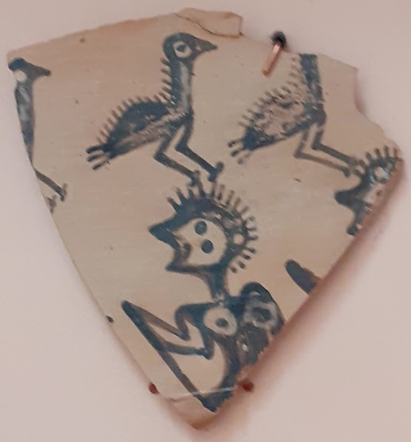
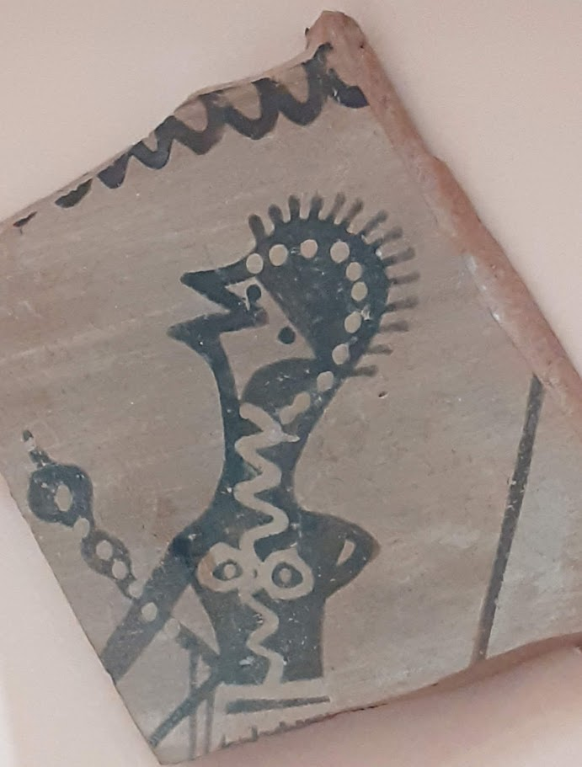

Slide 18
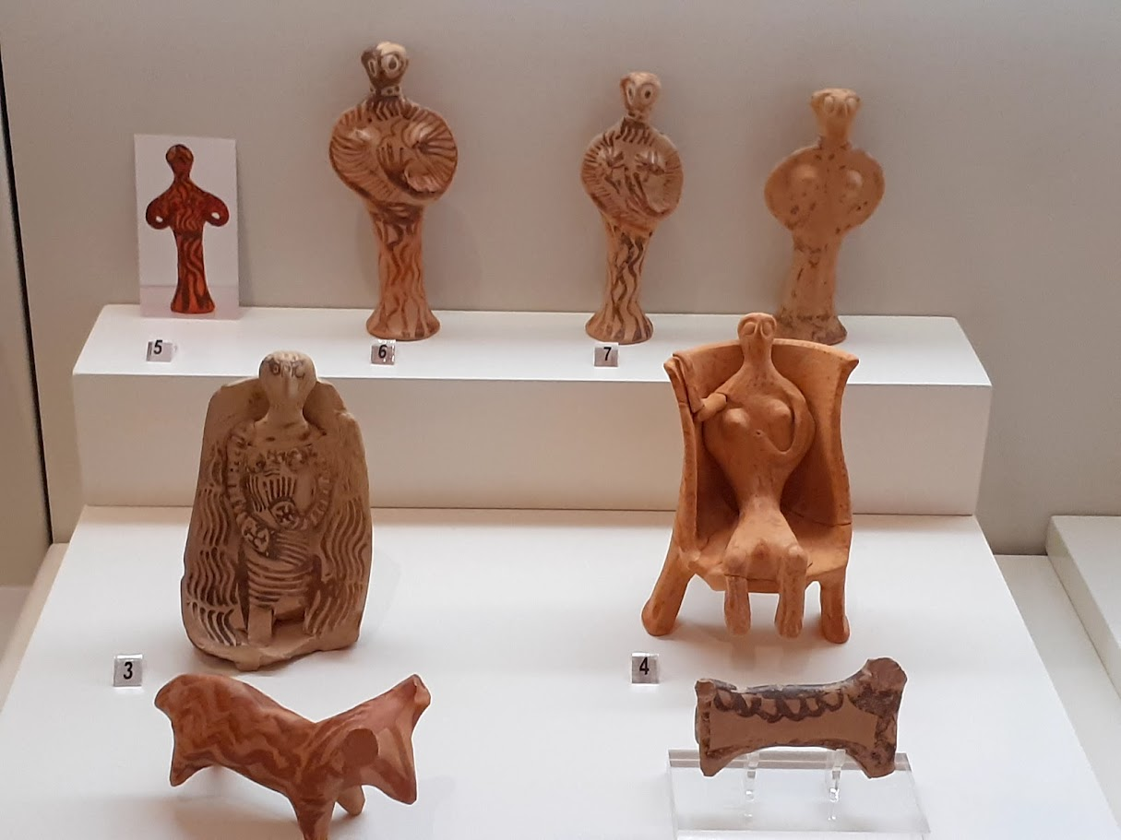

Slide 19
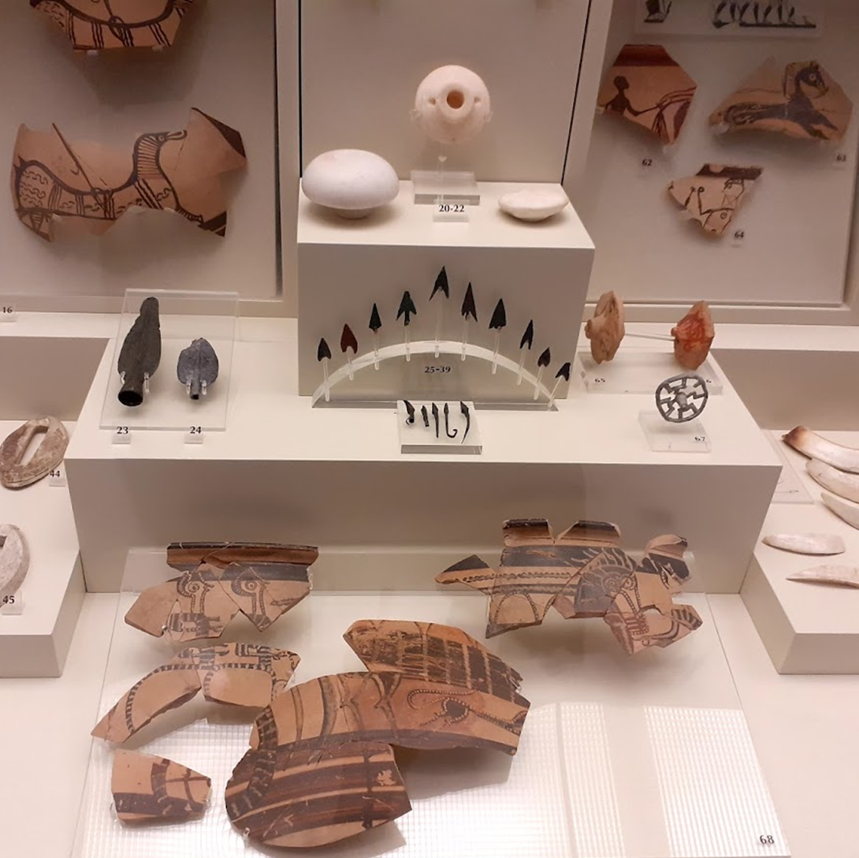

Slide 20
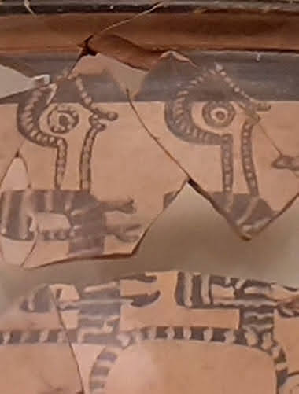
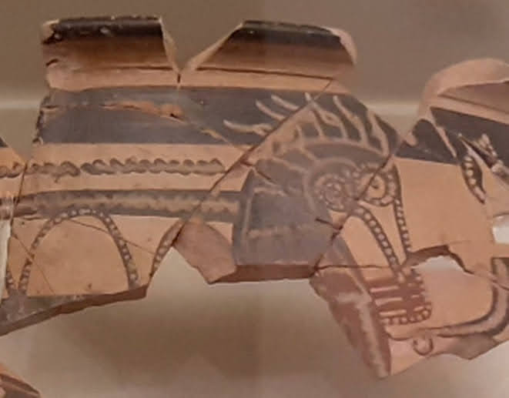

Slide 21
Wolf-head
Pelican

Slide 22
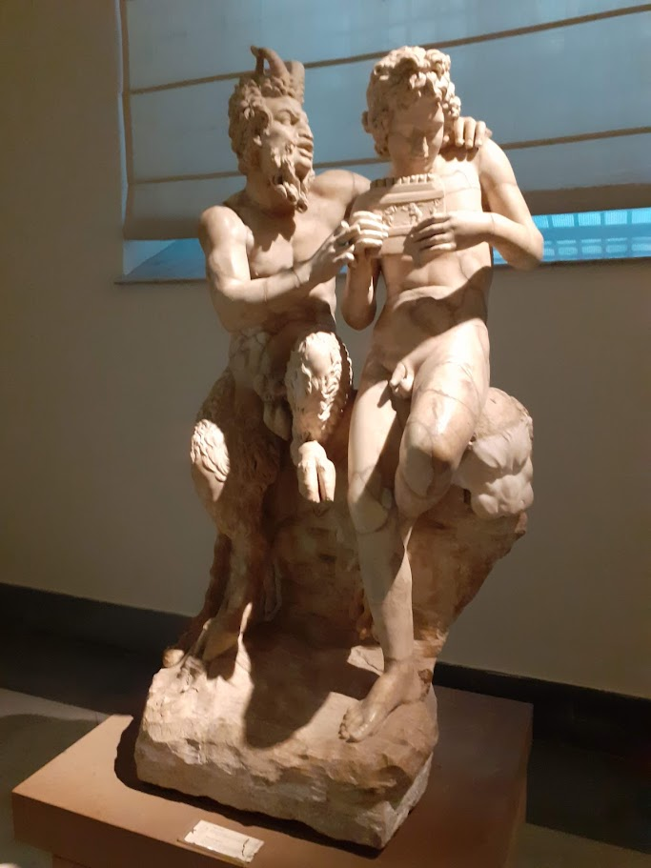
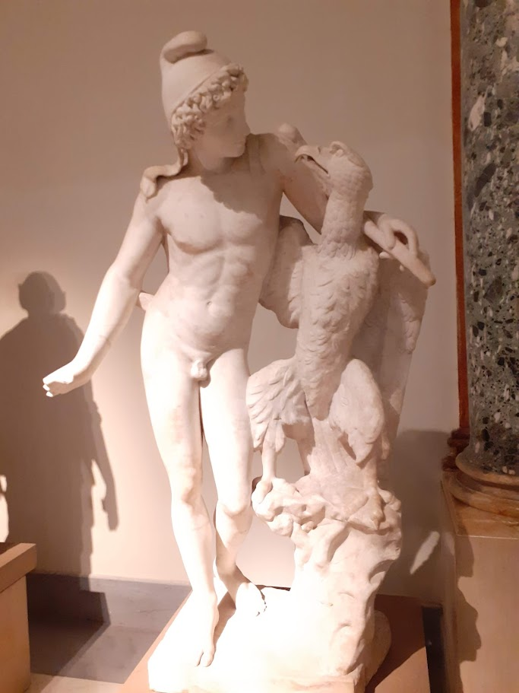
Ganymedes with eagle, 4th AD
??? Vulture
Freud – da Vinci´s dream
Pan and Daphne

Slide 23
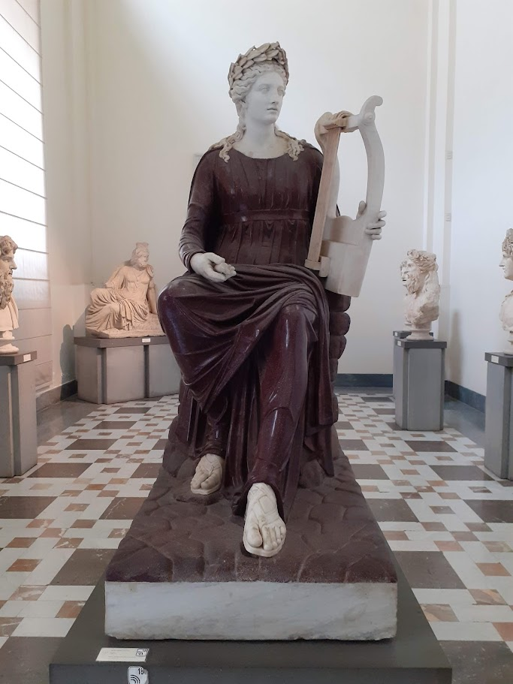
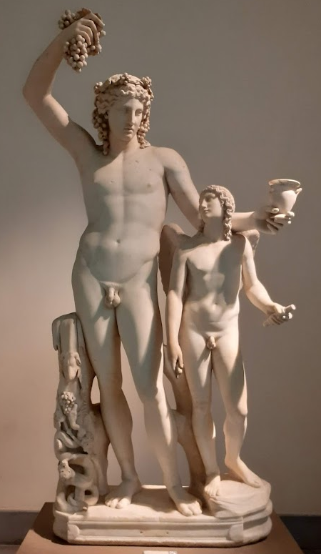
Apollo, 2nd century (AD); after to a model from the 4th century BC; from Rome, in Naples from 1805
Dionysus, 2nd AD, reworking from 4th BC
Dionysus and Eros, 2nd c AD
Dionysus, Athena, Satyr, 500-490 BC

Slide 24
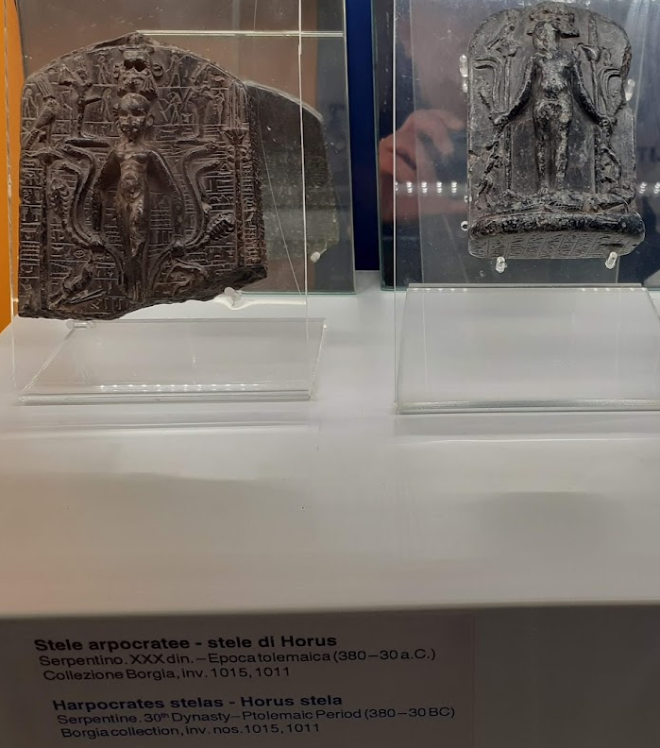
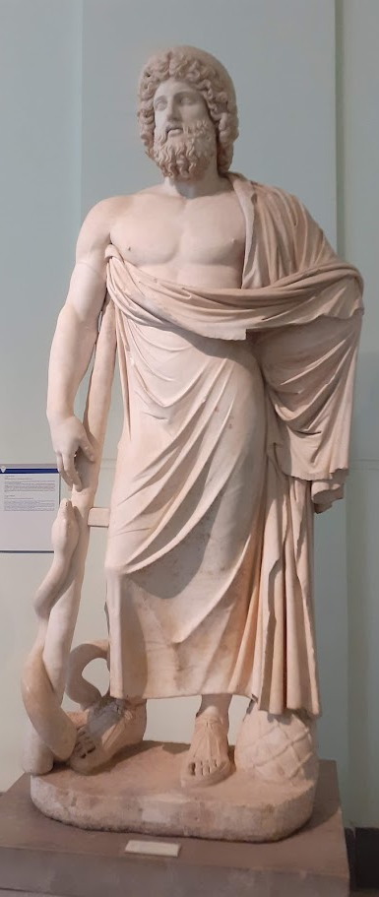
Asclepius, 2nd c AD, after an original from 4th c BC

Slide 25
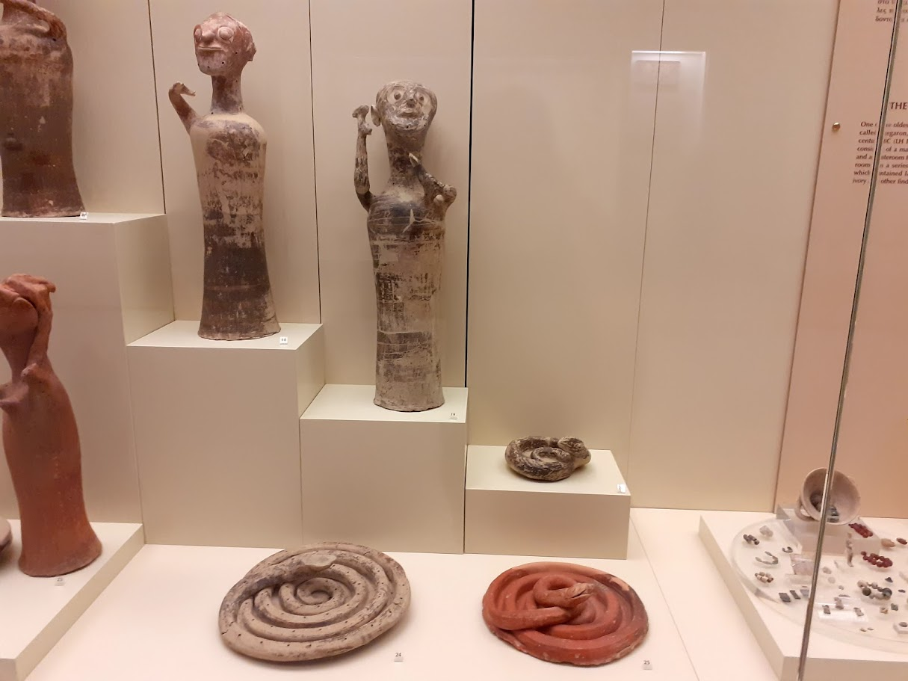
Mycenae

Slide 26
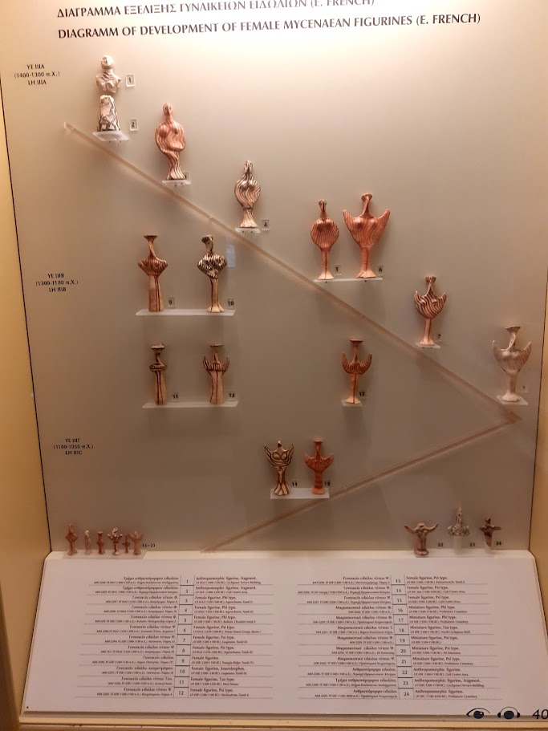
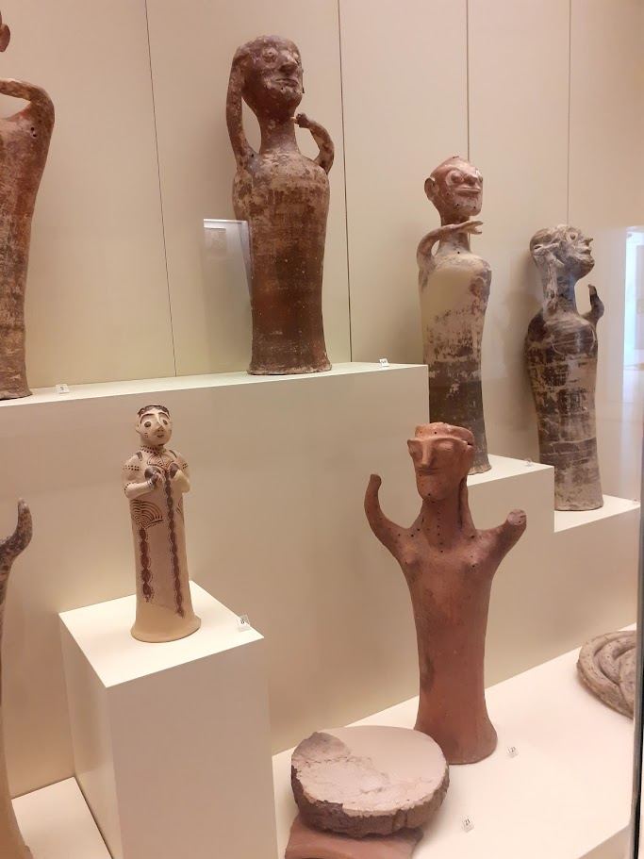

Slide 27
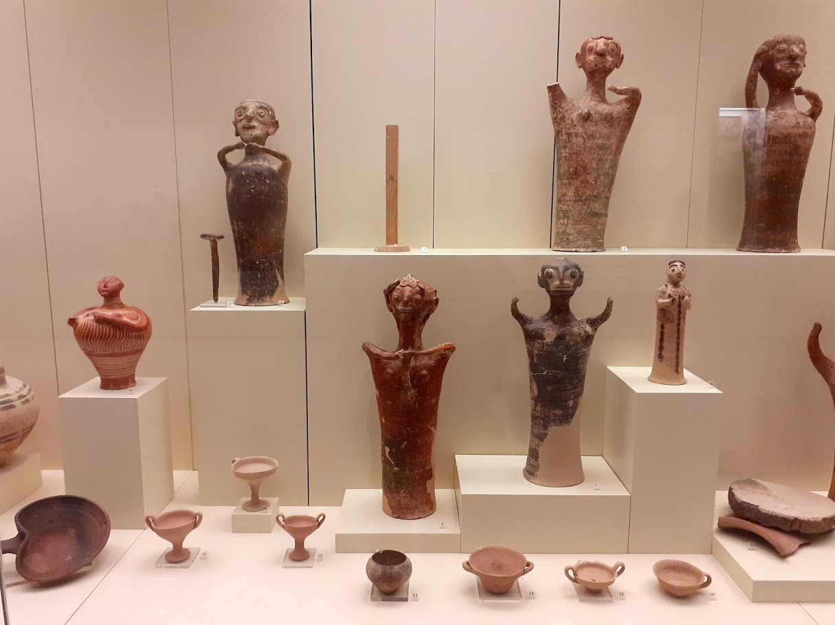

Slide 28
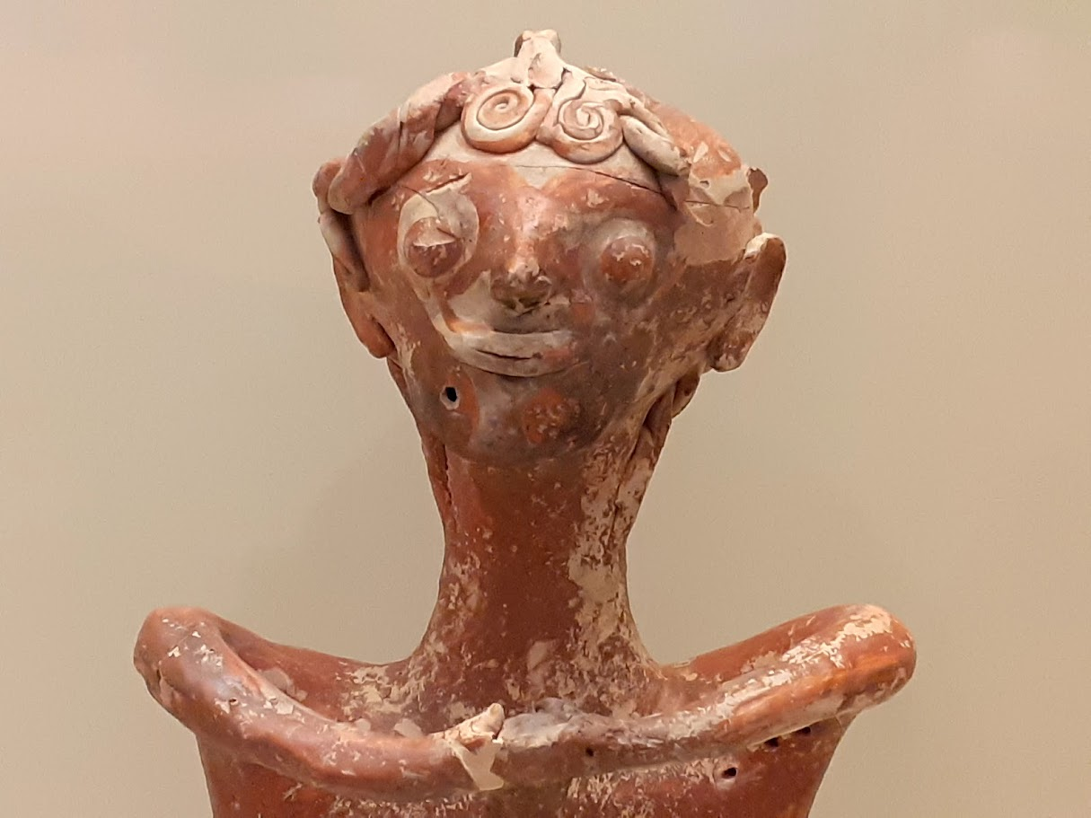

Slide 29
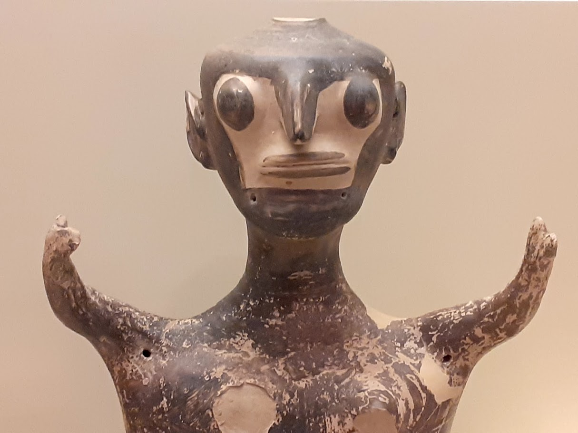

Slide 31
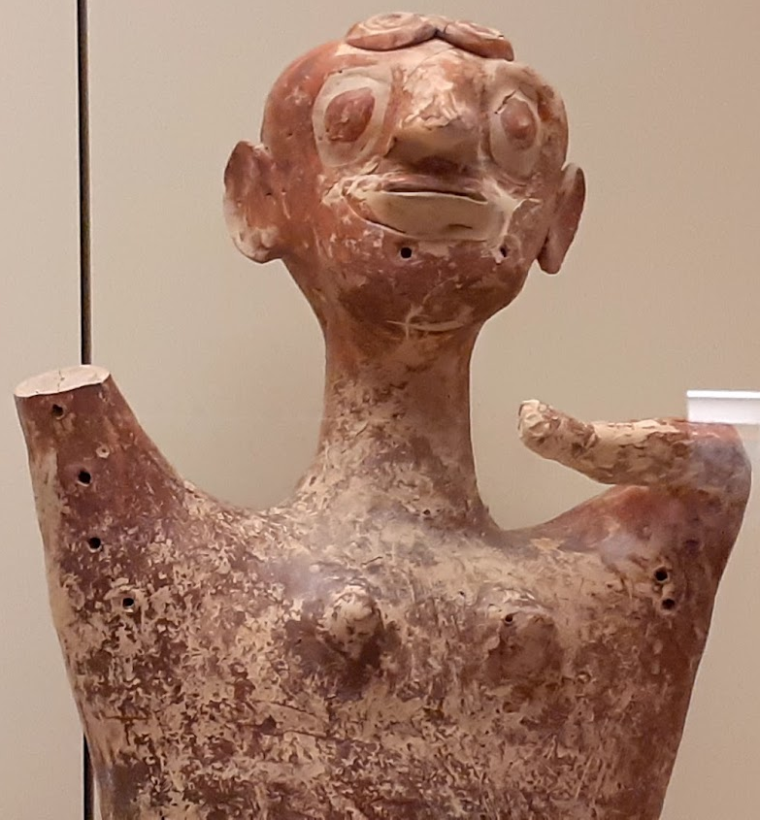
1250-1180 BC, Mycenae

Slide 32
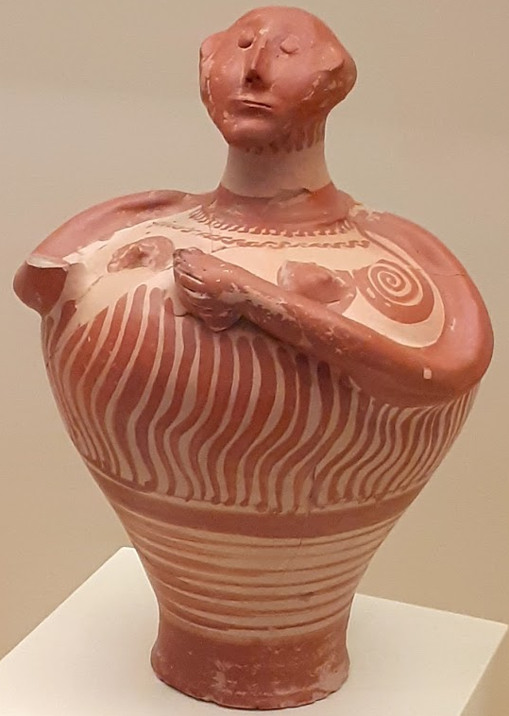

Slide 34
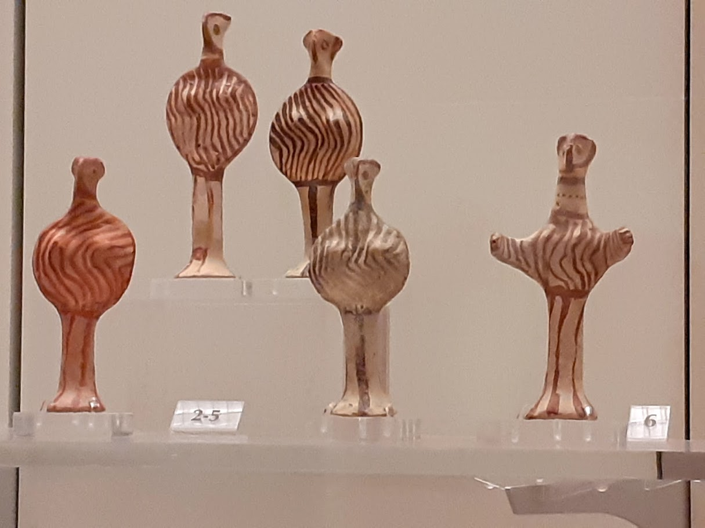
1300-1180 BC

Slide 36
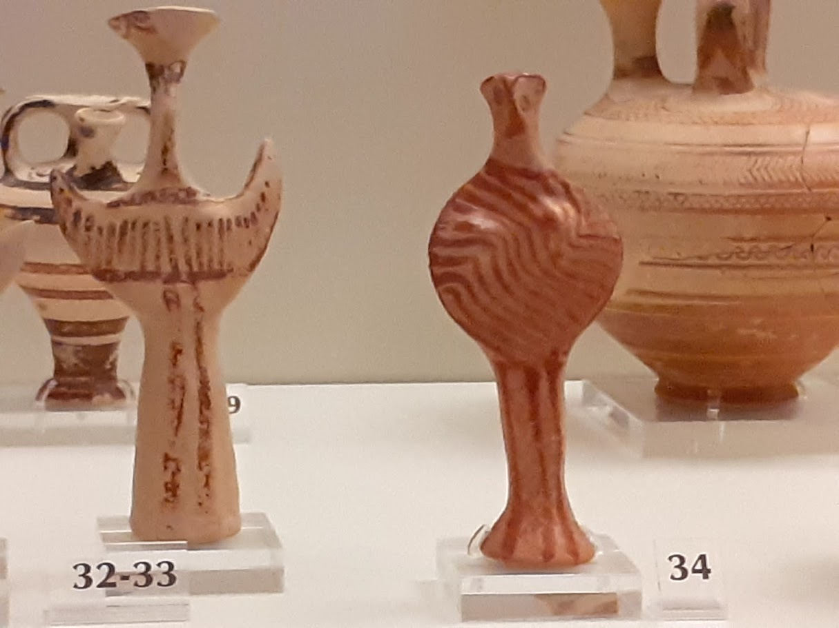

Slide 39
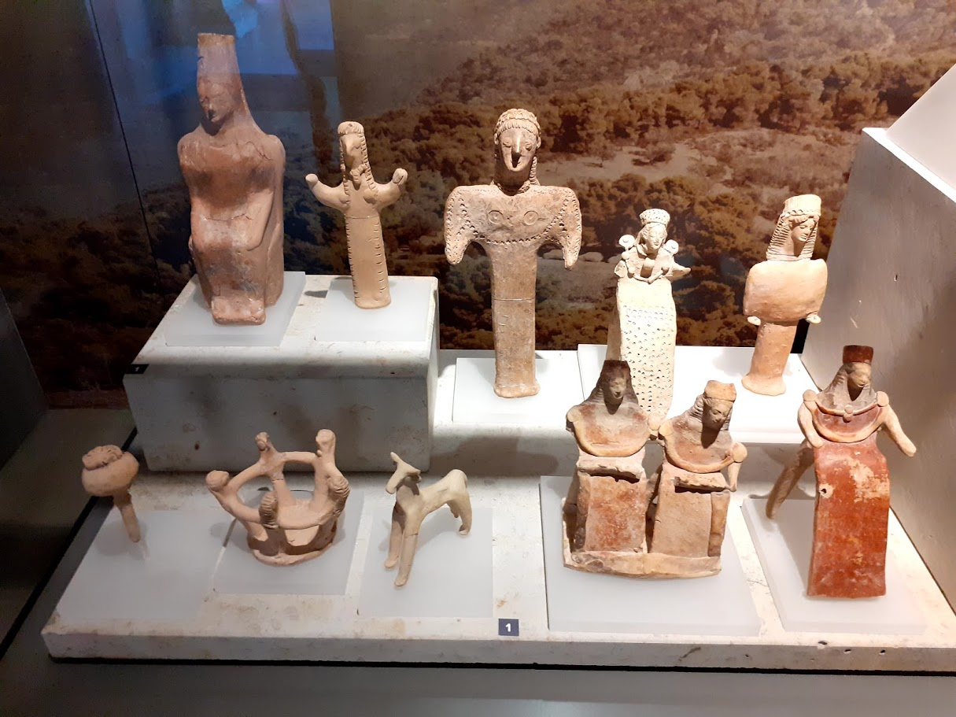
Corinth

Slide 40
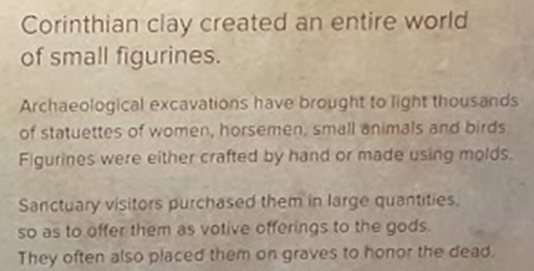

Slide 41
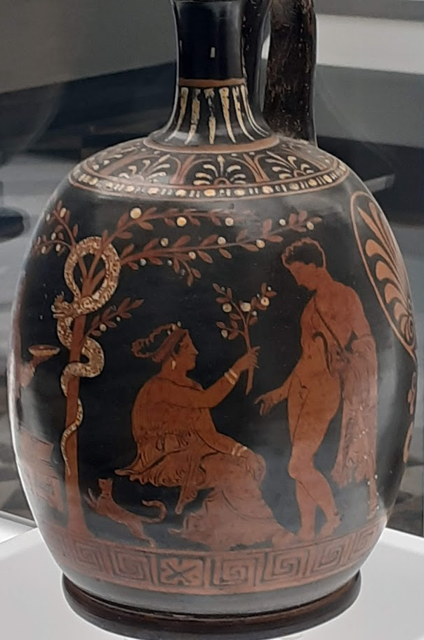
Naples

Slide 42
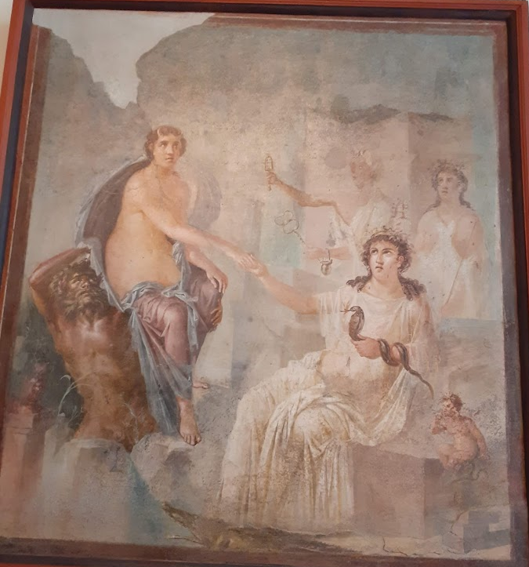
Pompei
(Arch. mus. in Naples)

Slide 43
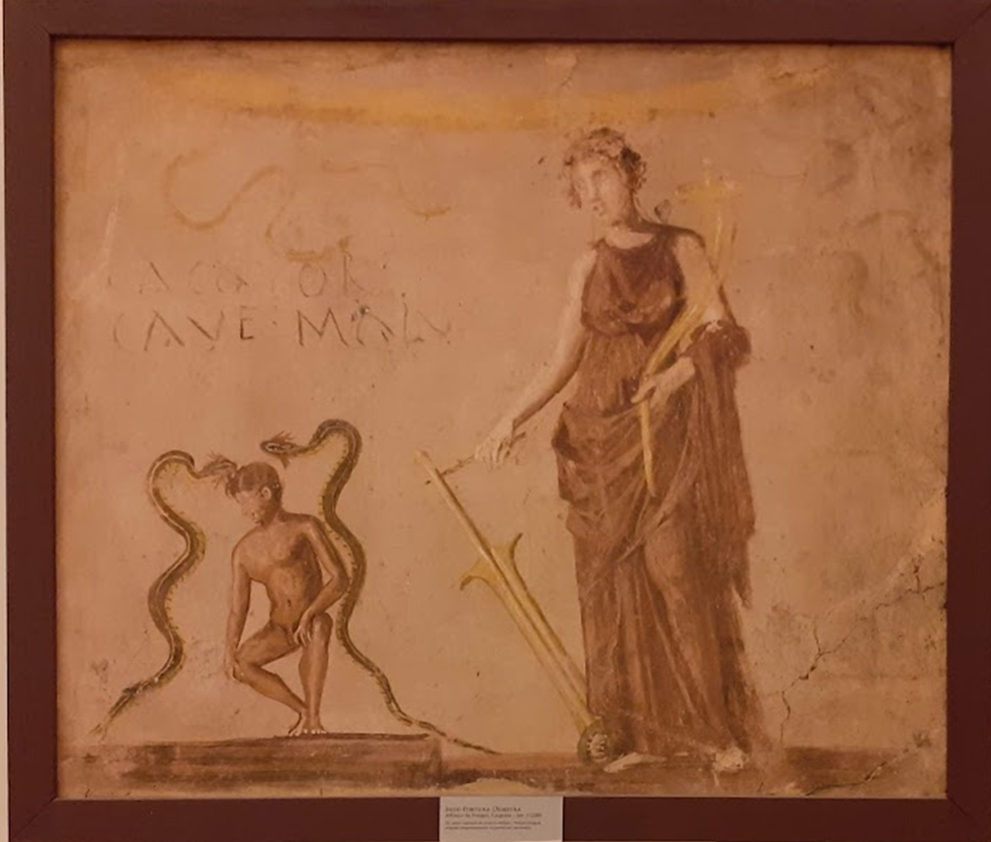

Slide 46
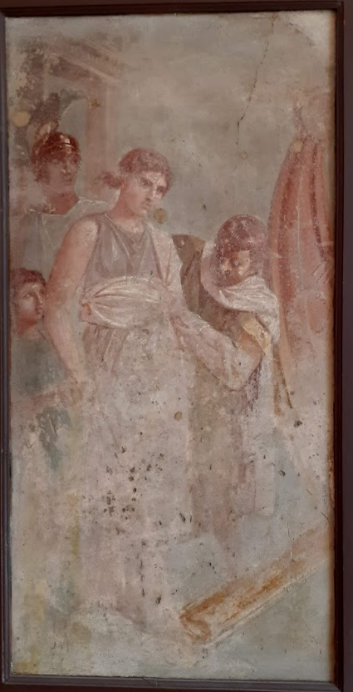
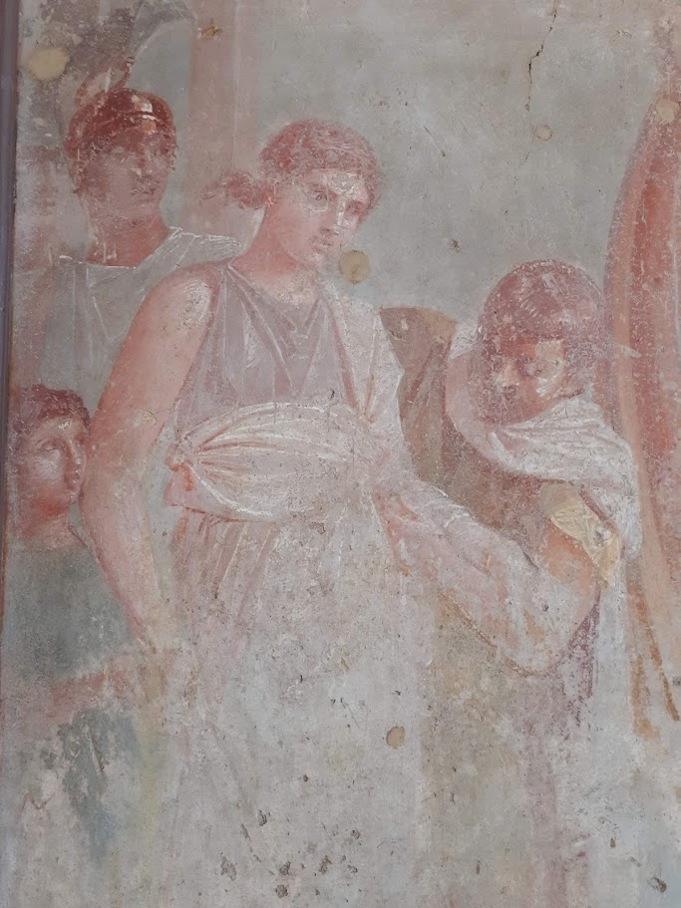
45-79 AD
Elena ?
Departure for Troy / bording on a ship
The first step

Slide 47
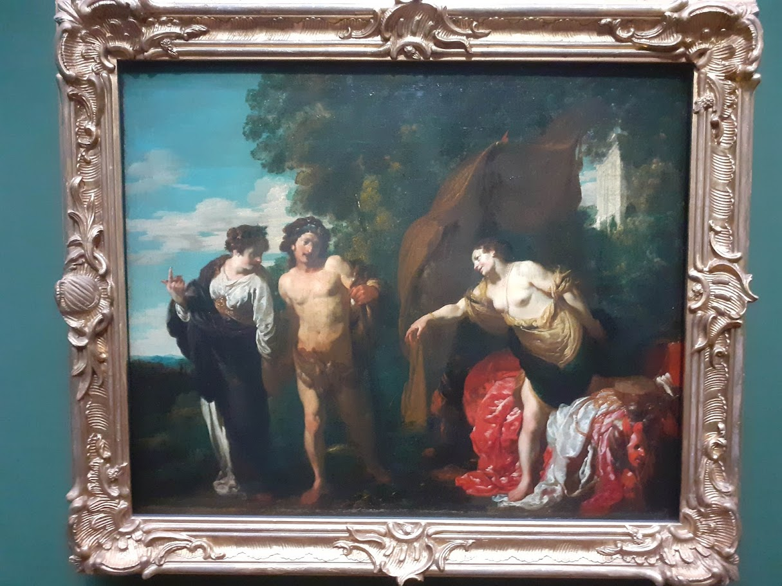
Hercules at the crossroads, 1625
Dresden
Johann Liss (1597-1631)

Slide 48
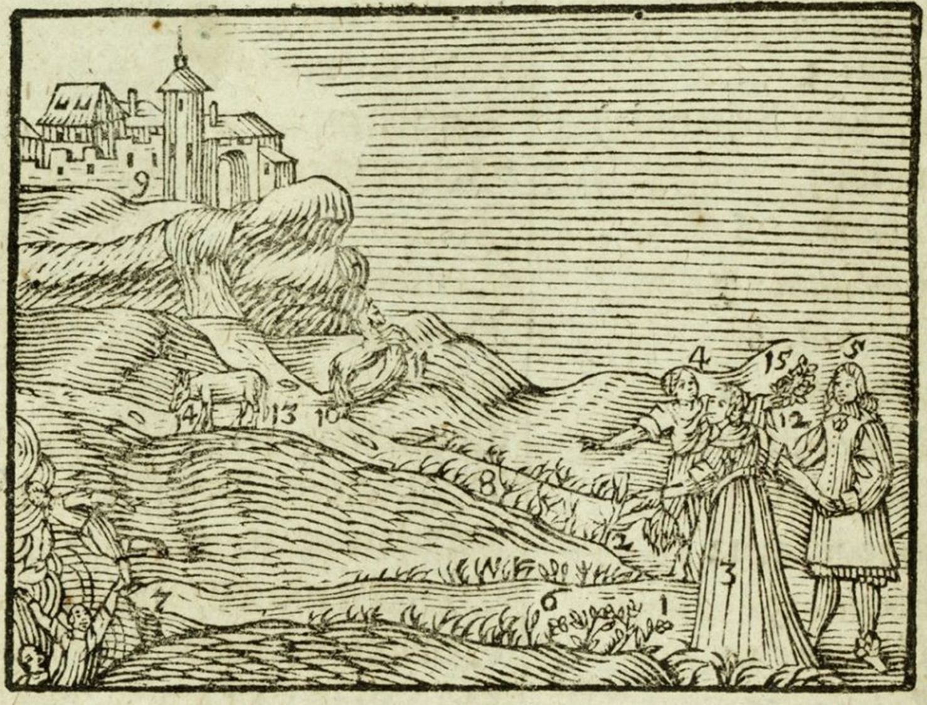
Comenius, Orbis sensualium pictus, 1658

Slide 49
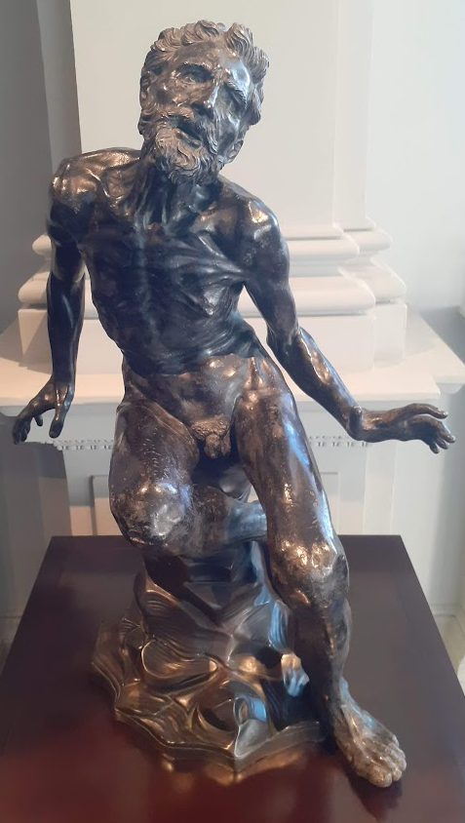
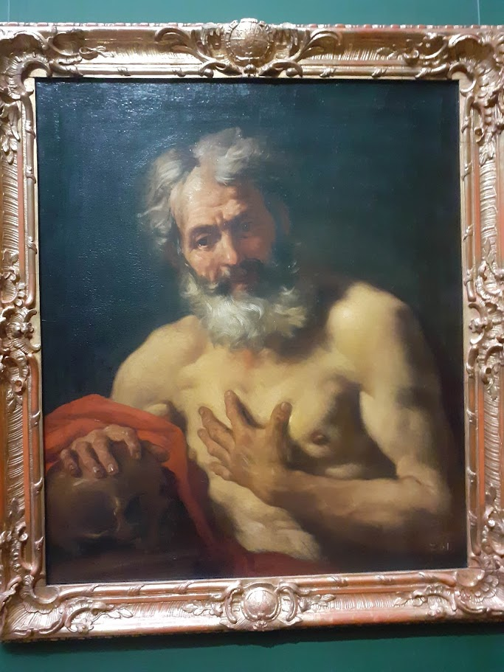
Hieronymus / Saint Jerome. Daniel Seiter (1647-1708), 1680/90
searching, seeking, decision making
Saint Jerome(?) ZV3628 Dresden

Slide 50
Abraham´s sacrifice, 1529/30, Andrea del Sarto (1486-1530)

Slide 51
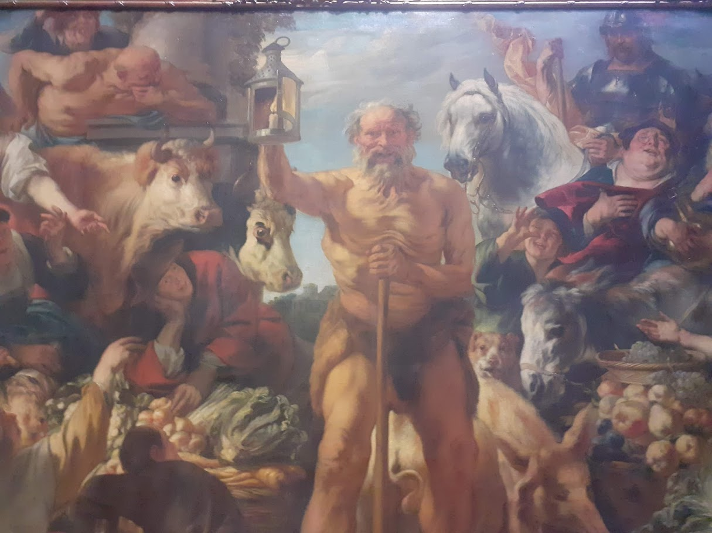
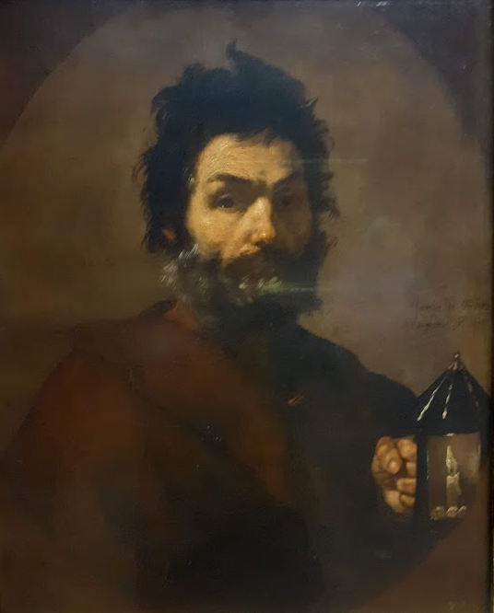
Diogenes with a lantern searching for a true human being on the market place, 1642, Jacob Jordaens (1593-1678)
Diogenes, 1637, Jusepe de Ribera (1591-1652)

Slide 52
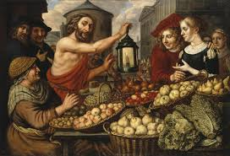
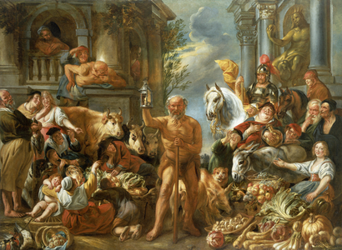
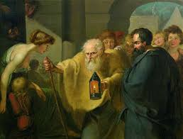
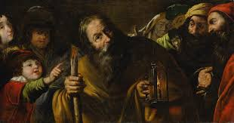

Slide 53
Searching for…
“For my whole heart,
which is guilty of stealing glances at her,
longs for that form to become a person.”
Thomas Mann: Die vertauschten Köpfe - Eine indische Legende, 1940

Slide 54
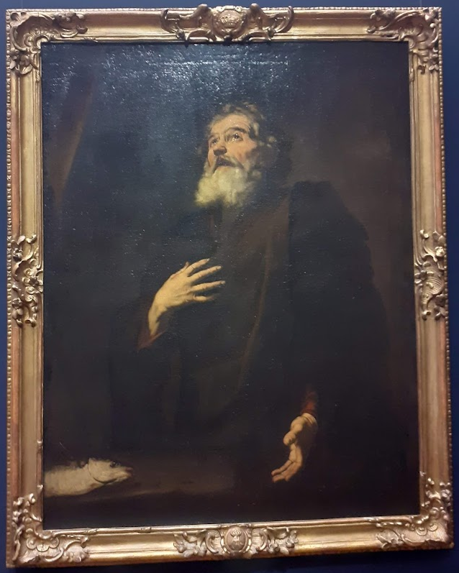
Saint Andrew
„Protokletos“ – „the first called“

Slide 55
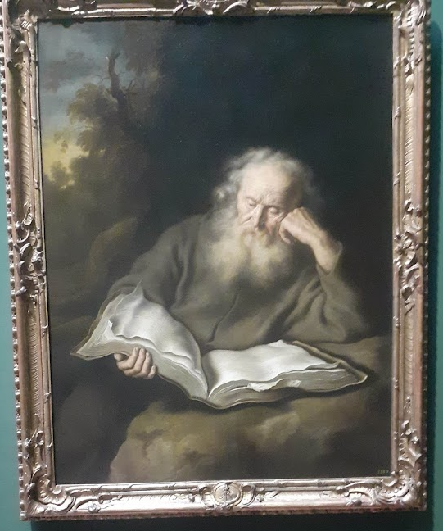
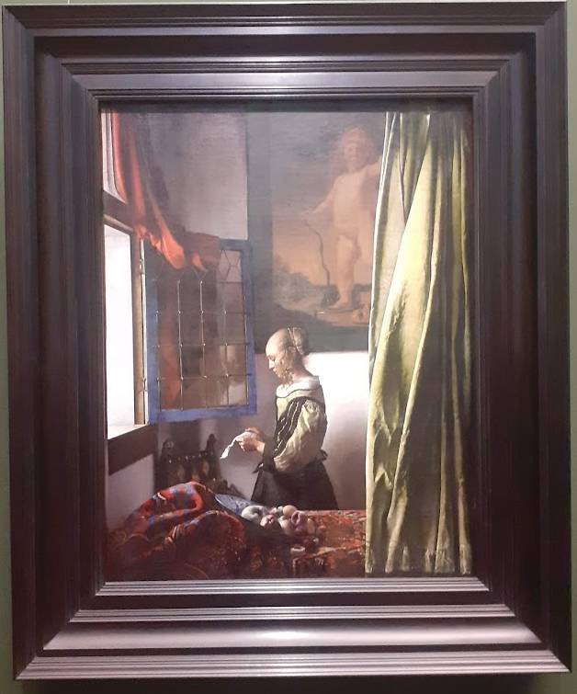

Slide 57
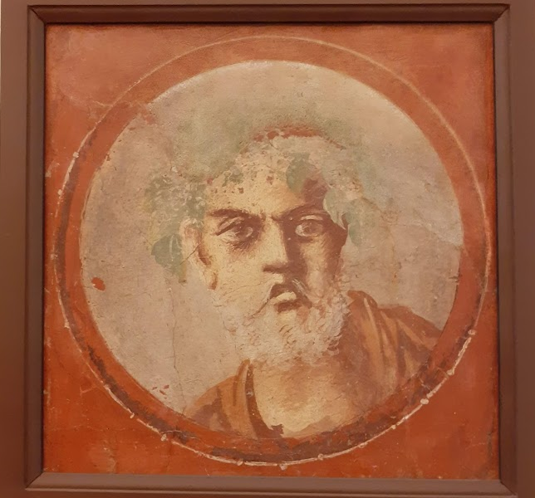

Slide 58
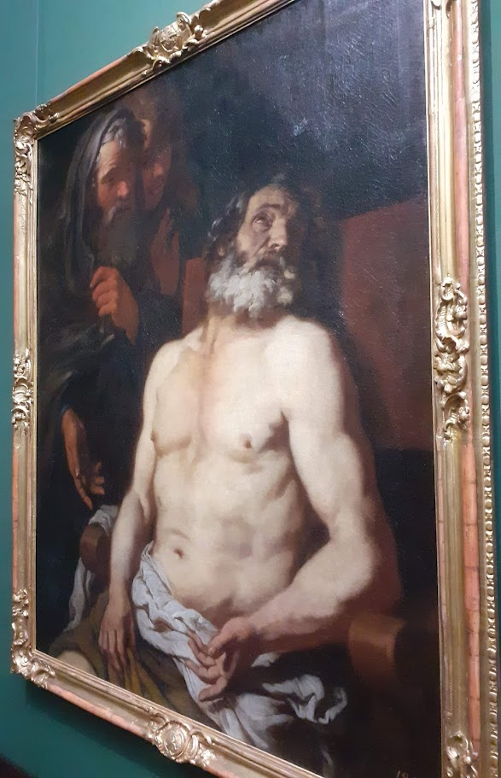
Job/Hiob with „friends“

Slide 59
Is something calling us?
“There is an inner voice, trying to speak to you, calm down, listen to your heart, this is the right thing for you to do” (Fromm, 1956)
The clouds preceded us.
There was a muddy centre before we breathed.
There was a myth before the myth began.
Venerable and articulate and complete.
- Wallace Stevens

Slide 60
Notes:
Ella Fitzgerald. 1965.

Slide 61
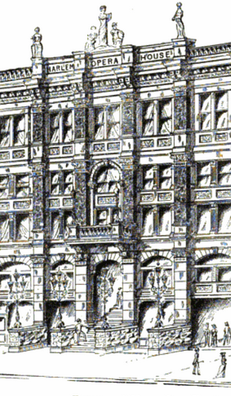
November 21st, 1934
“The next contestant is a young lady named Ella Fitzgerald…Miss Fitzgerald here is gonna dance for us…Hold it, hold it. Now what’s your problem, honey?...
Correction, folks. Miss Fitzgerald has changed her mind. She’s not gonna dance, she’s gonna sing”
“It was a bet…we just put our names in…we never thought we’d get the call” - Ella
Notes:
She got the call

Slide 62
Es muss sein
My father had plenty of books, and…one day when I was eight years old curiosity moved me to take down a little black book lettered on its spine “Kant’s Theory of Ethics.”…as I began reading it, my small form wedged between the bookcase and the table, I was attacked by a strange succession of emotions. First came an intense excitement. I felt that things of the highest importance were being said about matters of the utmost urgency: things which at all costs I must understand. Then, with a wave of indignation, came the discovery that I could not understand them. Disgraceful to confess, here was a book whose words were English and whose sentences were grammatical, but whose meanings baffled me. Then, third and last, came the strangest emotion of all. I felt that the contents of this book, although I could not understand it, where somehow my business: a matter personal to myself, or rather to some future self of my own…there was no desire in it; I did not, in any natural sense of the word, ‘want’ to master the Kantian ethics when I should be old enough; but I felt as if a veil had been lifted and my destiny revealed.
There came upon me by degrees, after this, a sense of being burdened with a task whose nature I could not define except by saying, “I must think.” What I was to think about I did not know; and when, obeying this command, I fell silent and absent-minded…There were no particular questions that I asked myself; there were no special objects upon which I directed my mind; there was only a formless and aimless intellectual disturbance, as if I were wrestling with a fog…I know now that the problems of my life’s work were taking, deep down inside me, their first embryonic shape.
- R.G. Collingwood (1939)
Notes:
English philosopher, R.G. Collingwood (1889-1943)

Slide 63
Psychological Integrity
Sensory data
Bodily changes
Affect
Holistic Meanings
Specific meanings
Thoughts & images
Two types of human knowing represent qualitatively different meanings
Conceptual mind is characterised by a certain narrowness
Holistic mind: Embraces implicit & explicit dimensions of experience
Layers of reality can be felt in and derived from the body → Content, valuing
Ancient idea: ‘Diaphragm’ (phren=mind) → Location of contemplation
Adapted from Barnard, P. J., & Teasdale, J. D. (1991). Interacting cognitive subsystems: a systemic approach to cognitive-affective interaction and change. Cognition and Emotion, 5, 1–39.

Slide 64
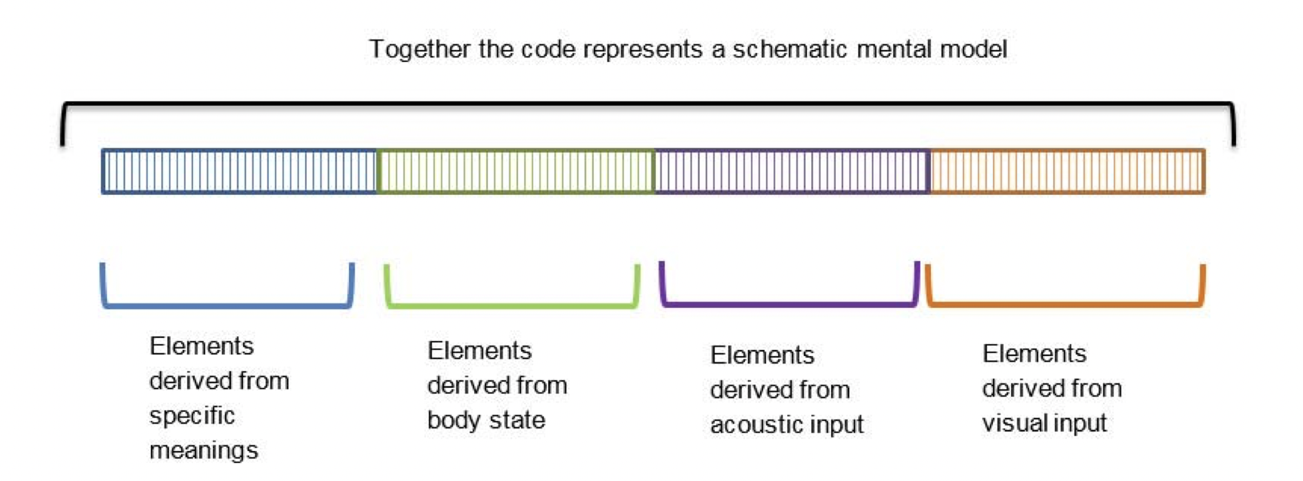
Sensory data
Bodily changes
Ways of knowing
Holistic meanings
Specific meanings
“…high level Implicational meanings cannot be communicated by single sentences. Traditionally, such meanings have been communicated by poems, parables and stories…A poem conveys ‘holistic’ meanings…with appropriate direct sensory contributions from the sounds of the words, the rhythms and metres of the whole, and from the visual imagery elicited.” (Teasdale, 1993, p. 345)
Thoughts & images
‘Scholarliness alone is not enough; there is a knowledge of the heart that gives deeper insight.
The knowledge of the heart is in no book and is not to be found in the mouth of any teacher,
but grows out of you like the green seed from the dark earth.’
(Jung, The Red Book, p. 233).

Slide 65
Feelings bring forward dimensions of soul which we are to embody, but they need to be re-cognized
“I go to the attic of my childhood home to find a black box. I put my hand in and feel the quivering, warm body of my pet bird. I cry because I have forgotten him and left him alone to die. I am afraid of what I may see when I take him out of the box, but I do so. As my tears fall over his tiny skeletal body, he turns into a tiny baby, and says ‘I only wanted to sing my song’.”
There is sacredness of tears, there are not the mark of weakness, but of power. They speak more eloquently than ten thousand tongues. They are the messengers of overwhelming grief, of deep contrition and of unspeakable love – Washington Irving
Notes:
The heart’s longings

