Slide 1
Therapy through Art

Slide 2
Table of contents
01
What Is Therapeutic about Art?
02
What Therapeutic Techniques Are There?
03
04
Artists & Therapy
Our Projects

Slide 3
Therapy through Art

Slide 4
What Is Therapeutic about Art?
When and How Can Art Help You?
Disconnecting from your phone and other devices
Reconnecting with your hands and body
Alternative ways to express your emotions freely
Understanding your feelings, coping with loss or trauma, gratitude and forgiving, calming down...
Common mental disorders
Mood disorders
Schizophrenia, dementia
It Is Free and Anybody Can Do It!

Slide 5
02
What Art Therapy Exercises Are There?

Slide 6
Art Therapy Exercises
Journaling
Emotions as Colors
Mind Flow
Music Therapy
3-D Art
Collaging
Writing and drawing your daily struggles
A mood-board or a diary of your emotions
Drawing of everything that is on your mind
Letting your favorite song lead your art
Sculpting and "getting your hands dirty"
Glueing down photos and cut-outs
A Few Examples Out of Many...

Slide 7
The Process of Your Exercise
Motivation
Creating
1
Form
3
Outcome
What is your motivation to create? What do you want to address?
2
Sit down to create and restrict anything from interrupting you.
4
How do you want to express it? Pick an art form.
Decide what to do with your finished work.
To keep it or destroy it?

Slide 8
03
Artists & Their Own Therapy

Slide 9
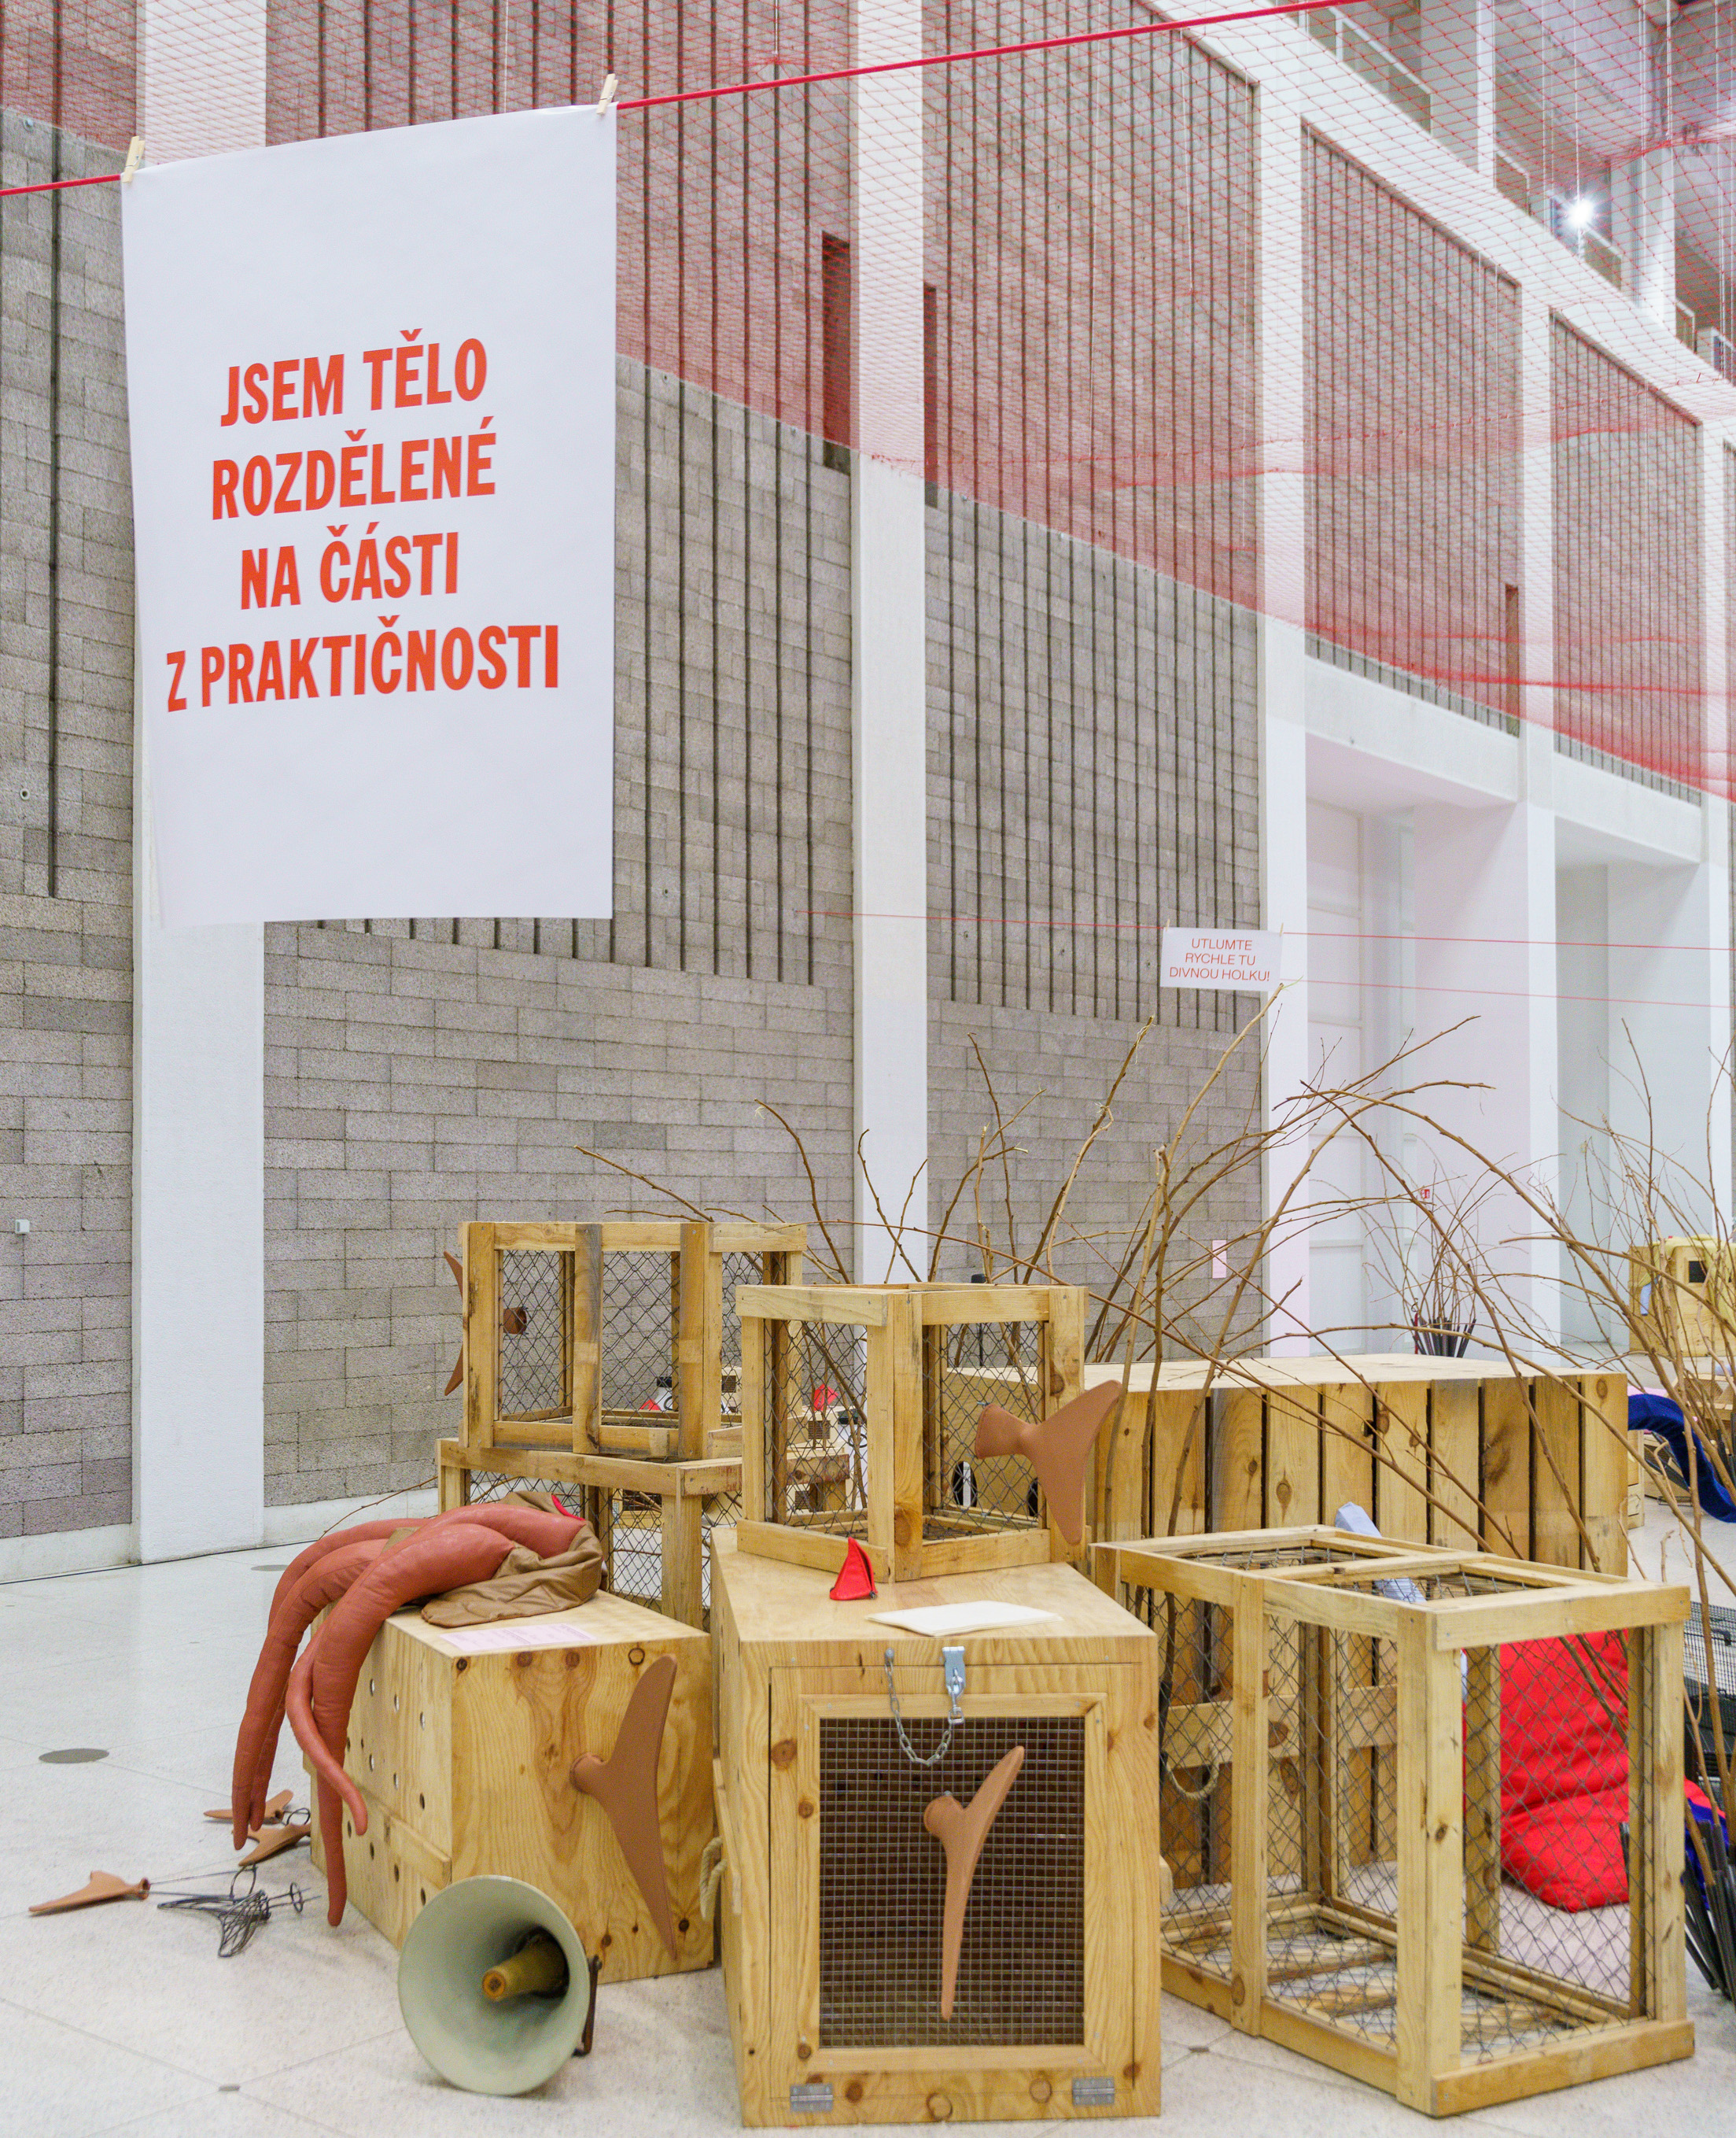
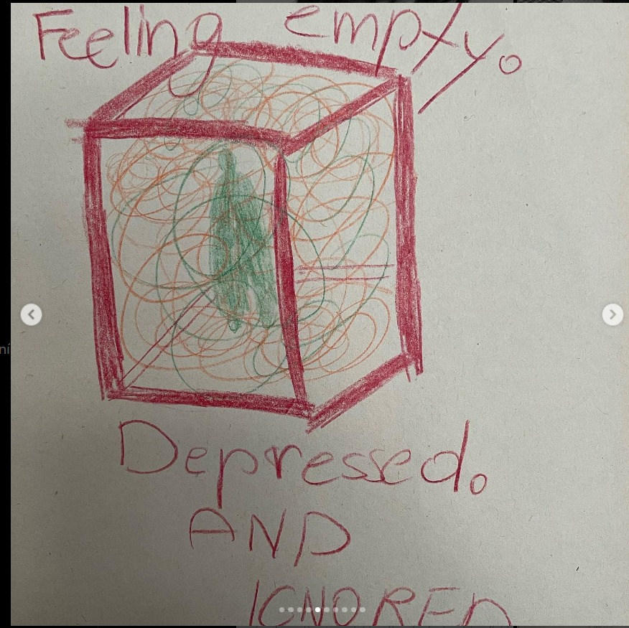
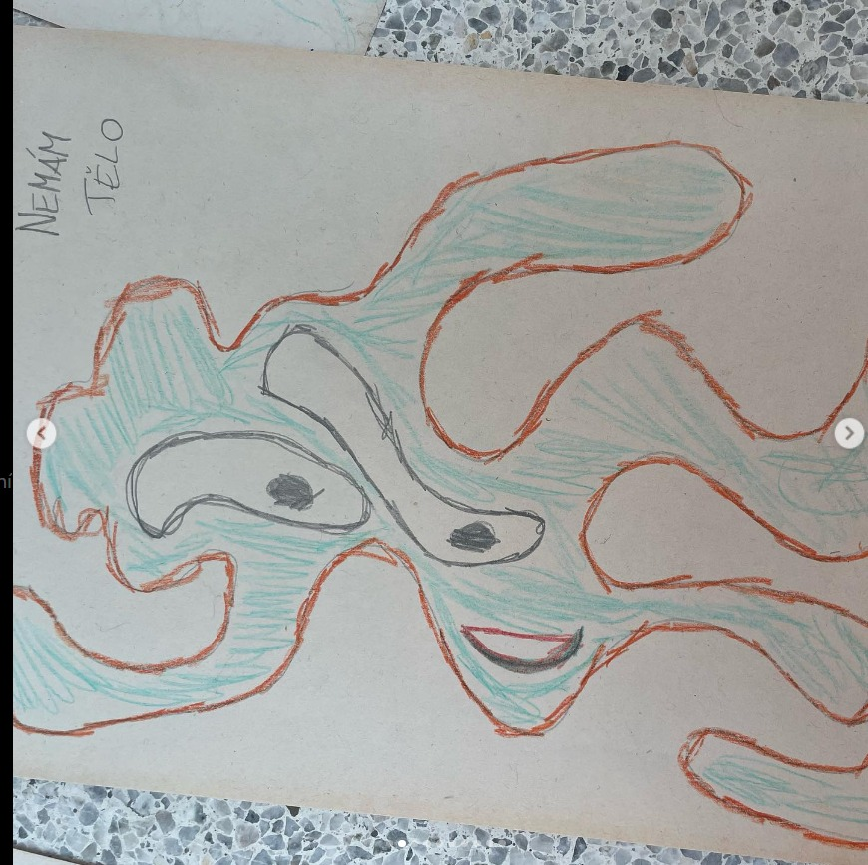
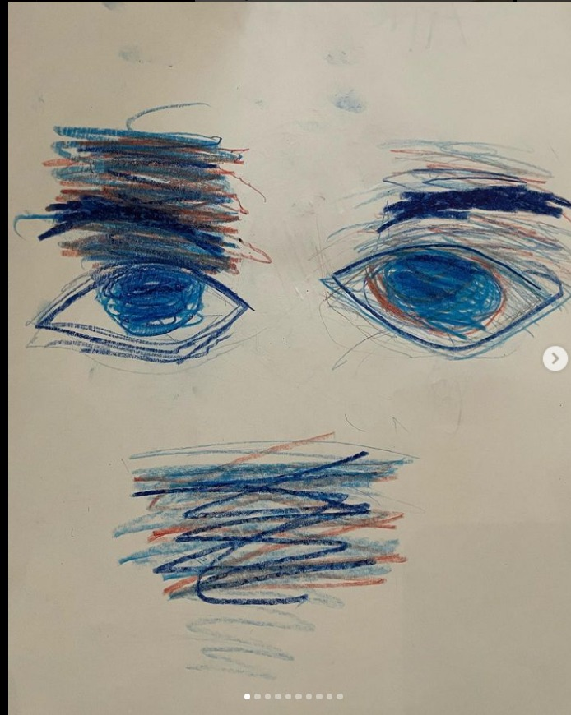
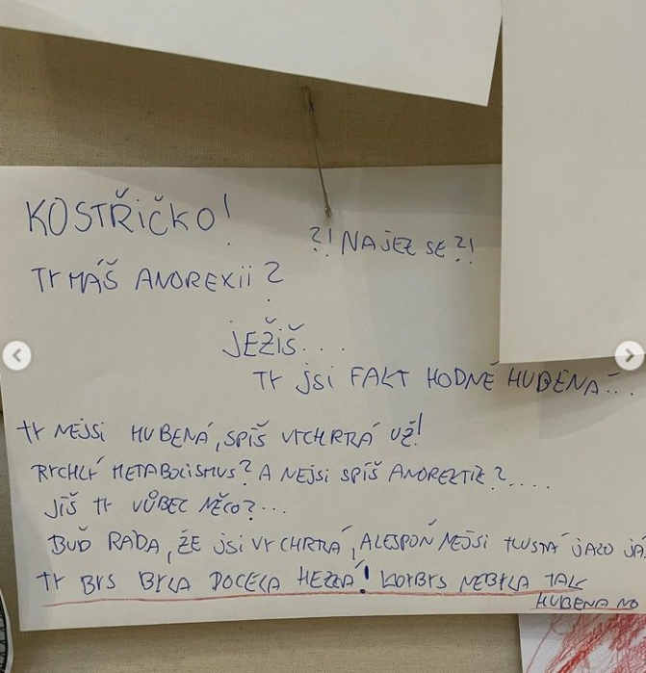
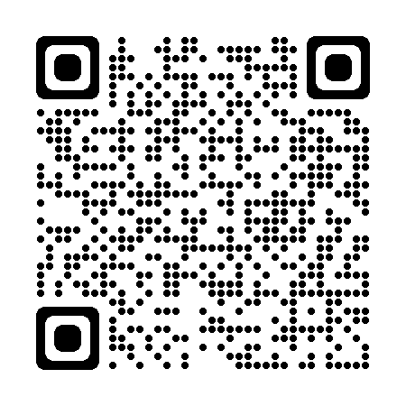
Eva Kotátková - Moje telo není ostrov
ˇ
ˇ

Slide 10
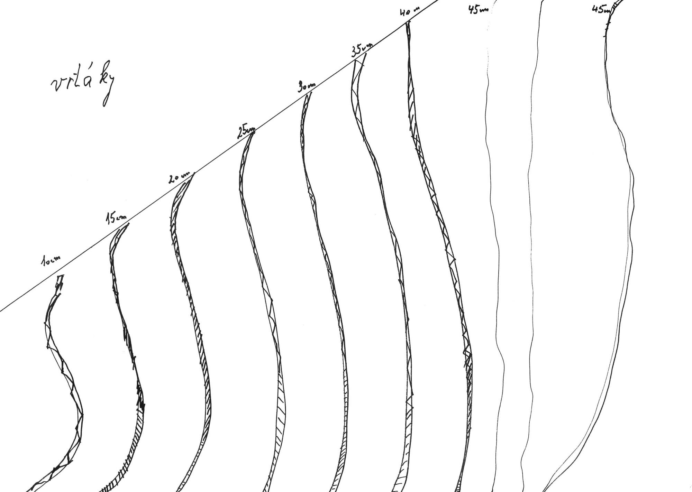
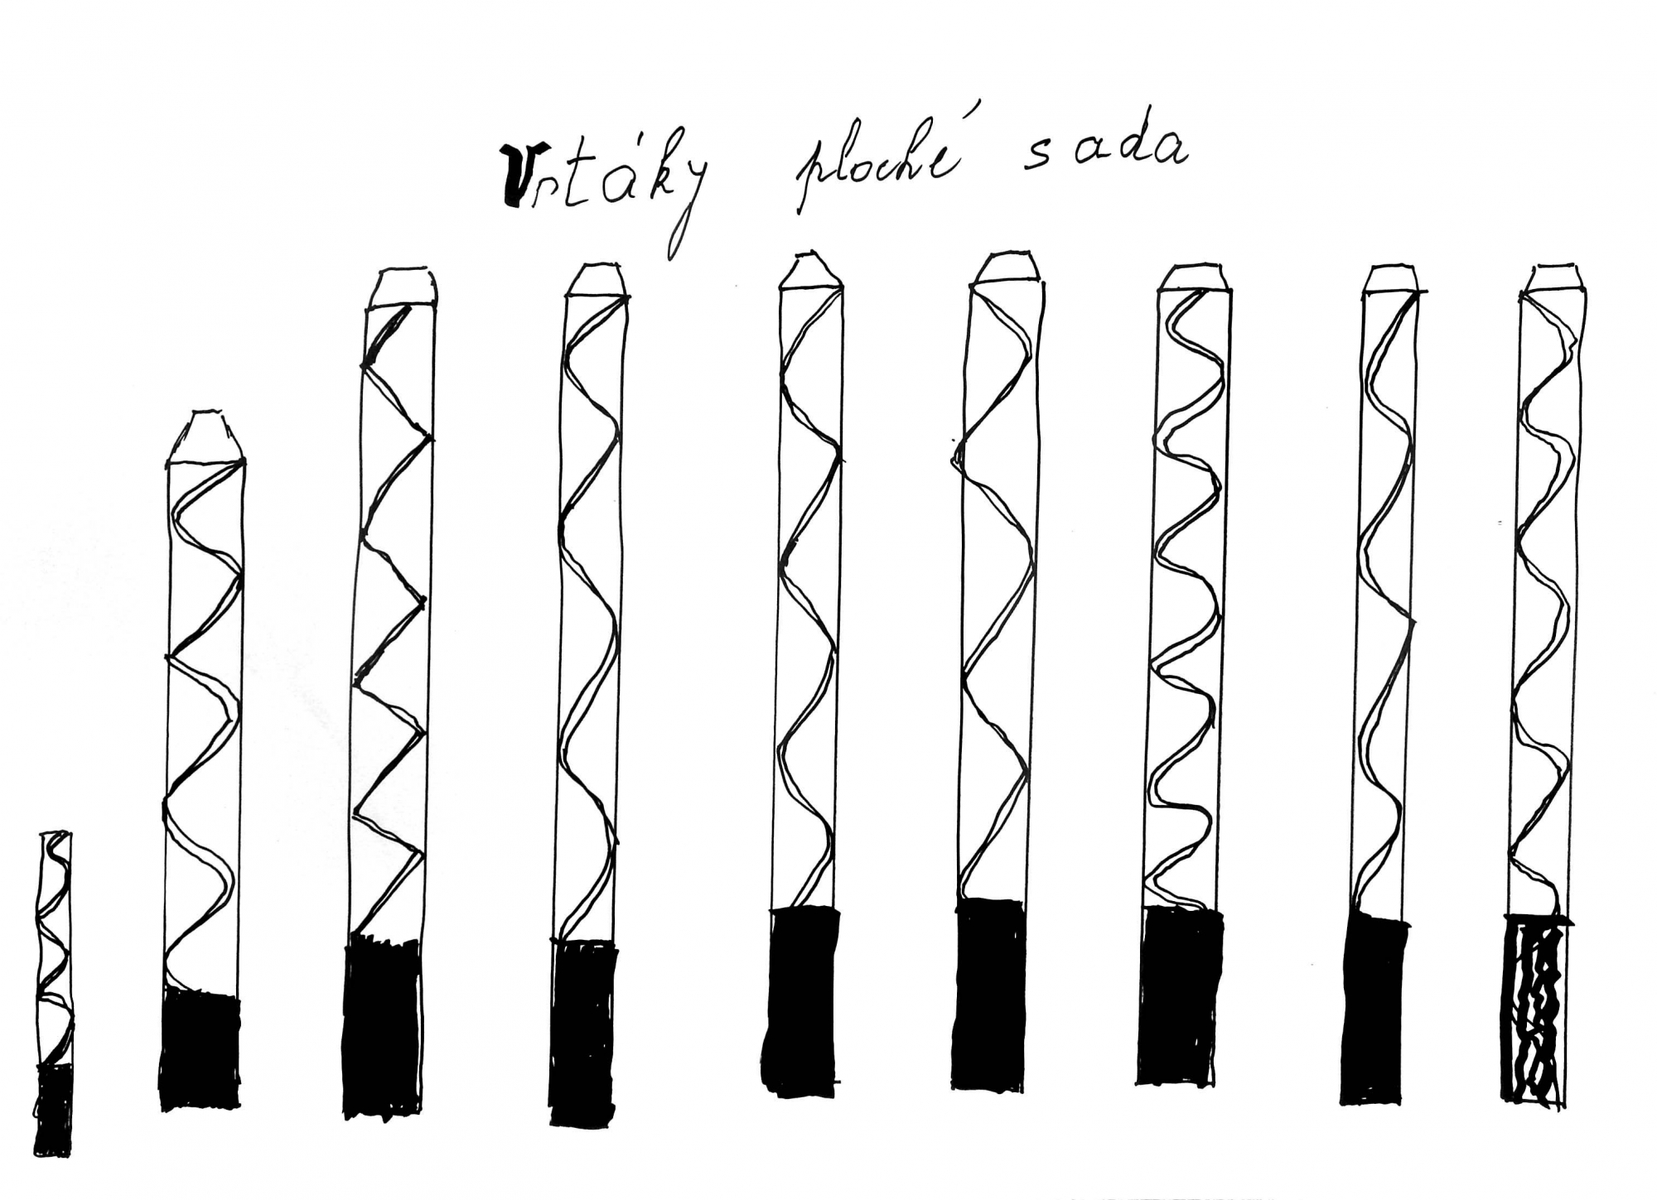
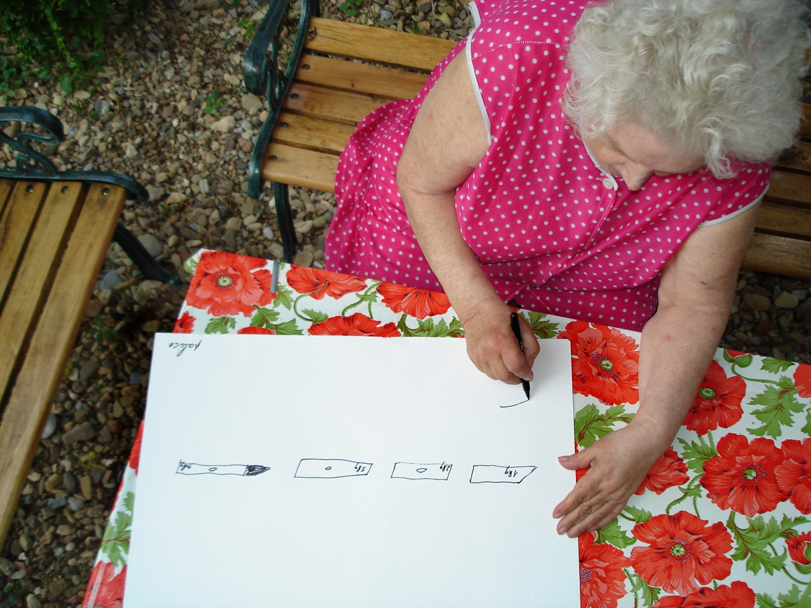
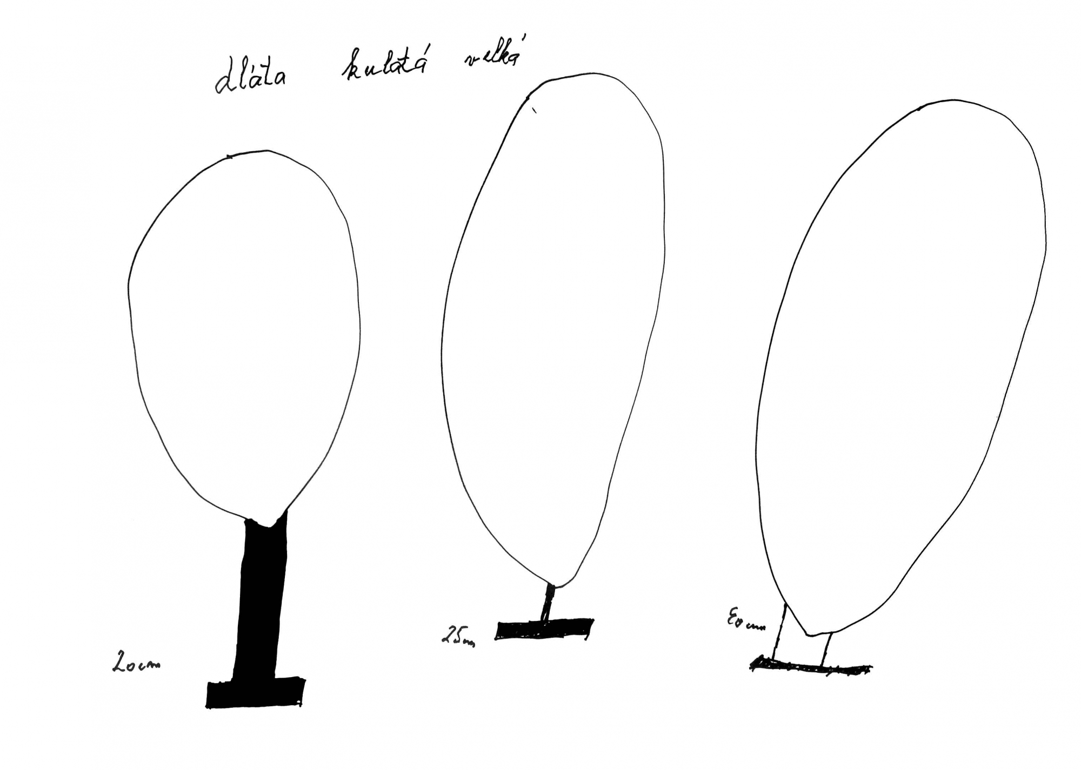
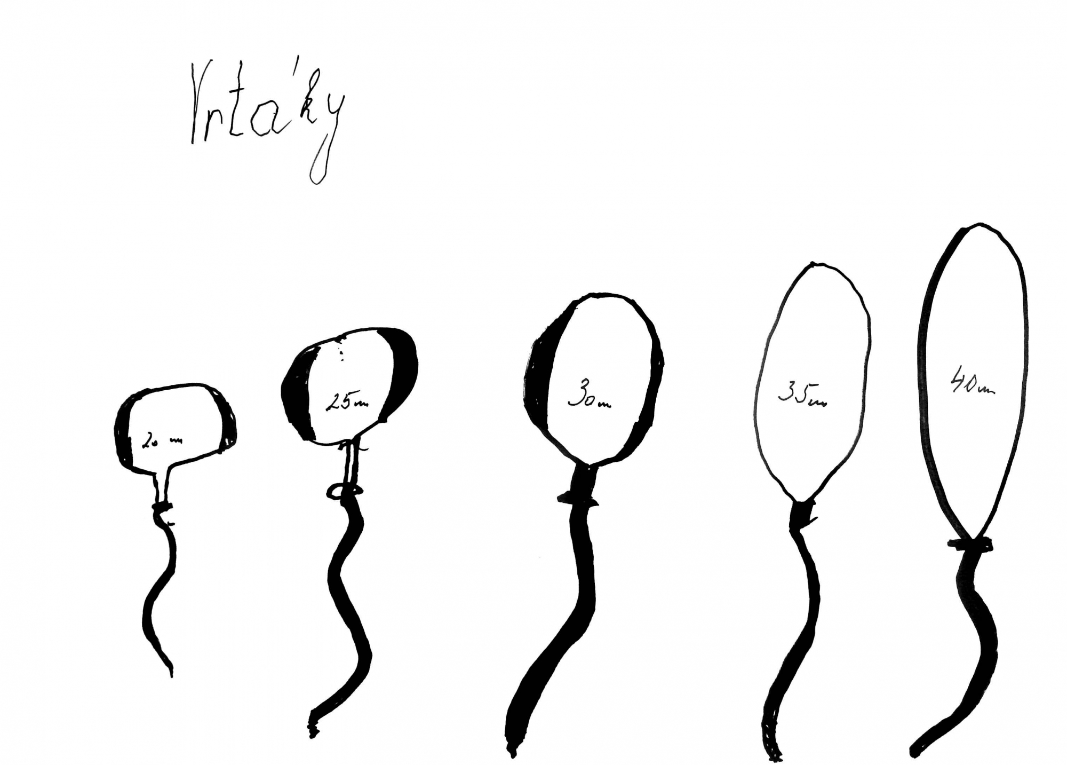
Katerina - It Doesn't Matter Šedá
ˇ

Slide 11
04 Our Projects

Slide 12
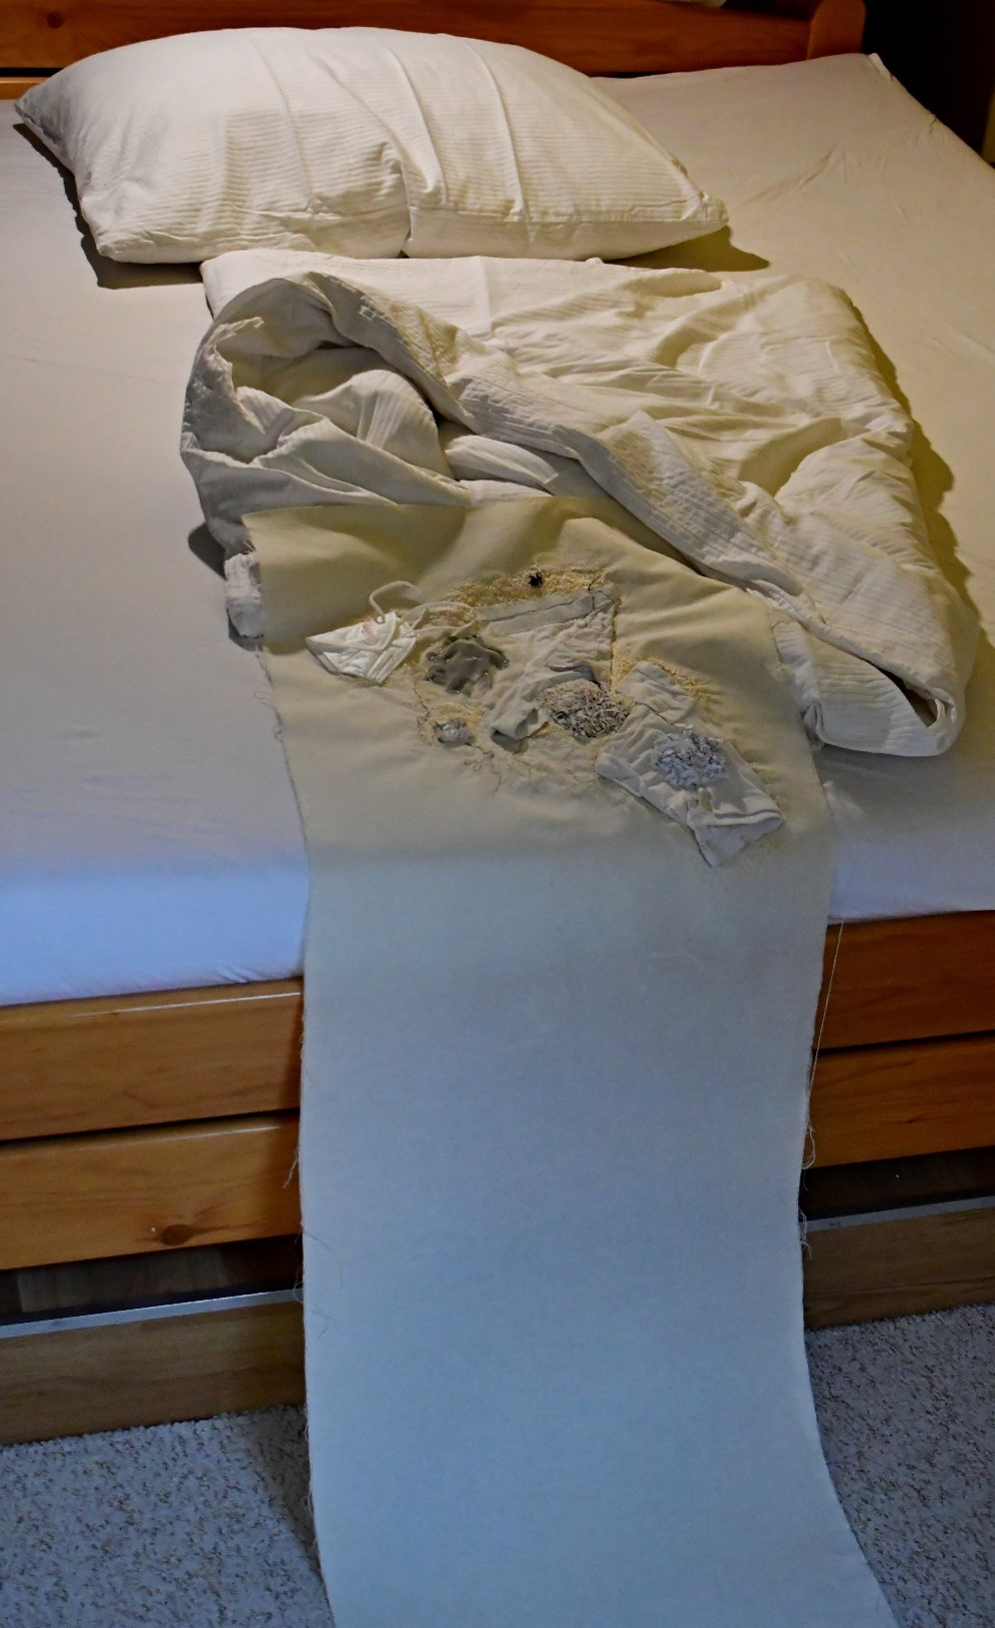
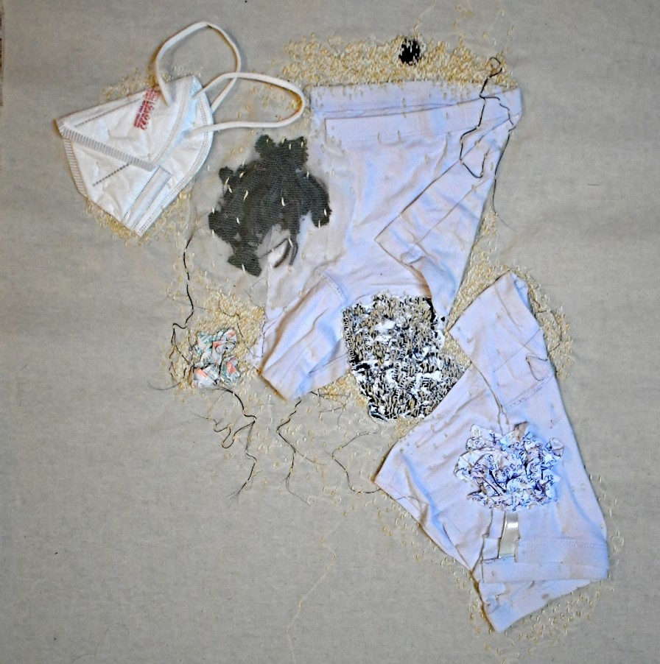
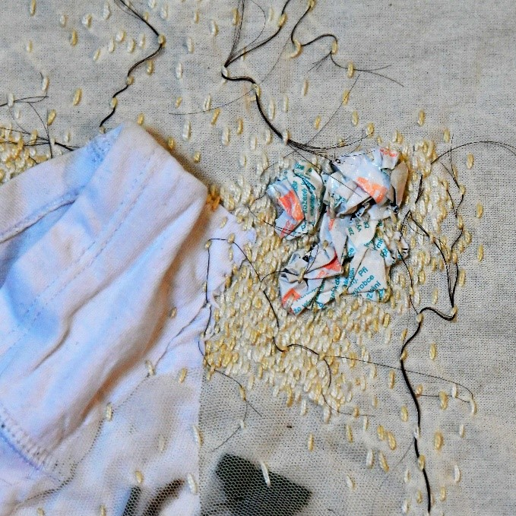
Alenka
Citlivost

Slide 13
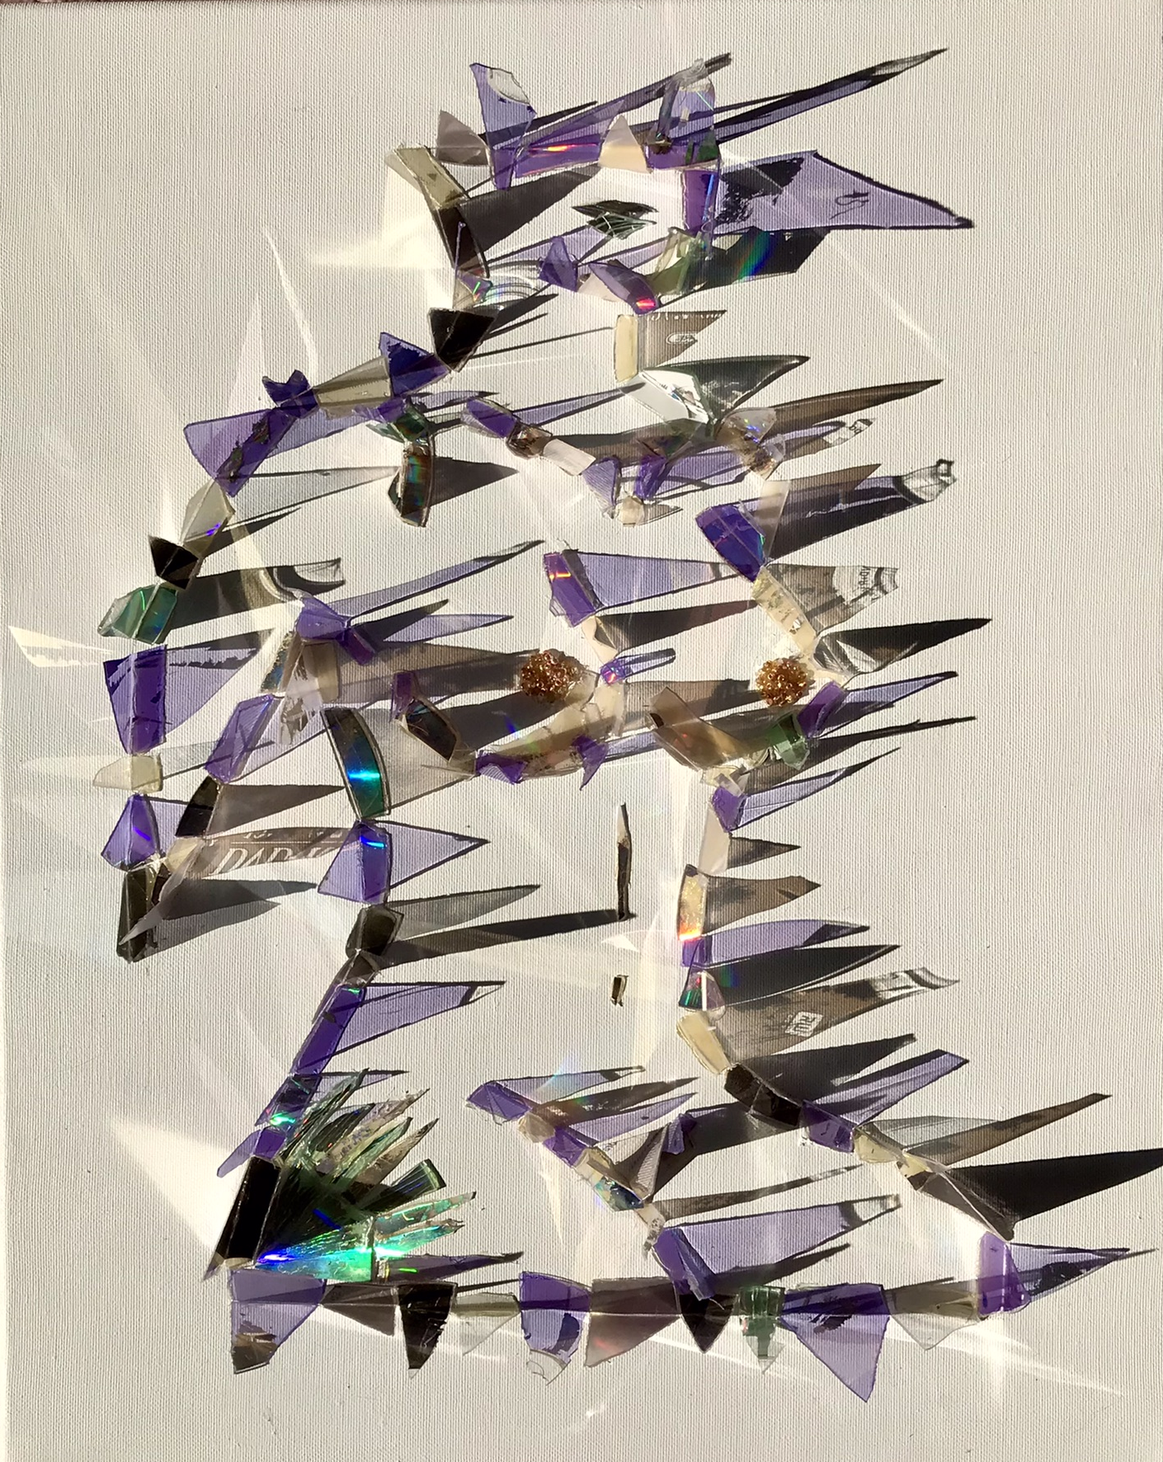
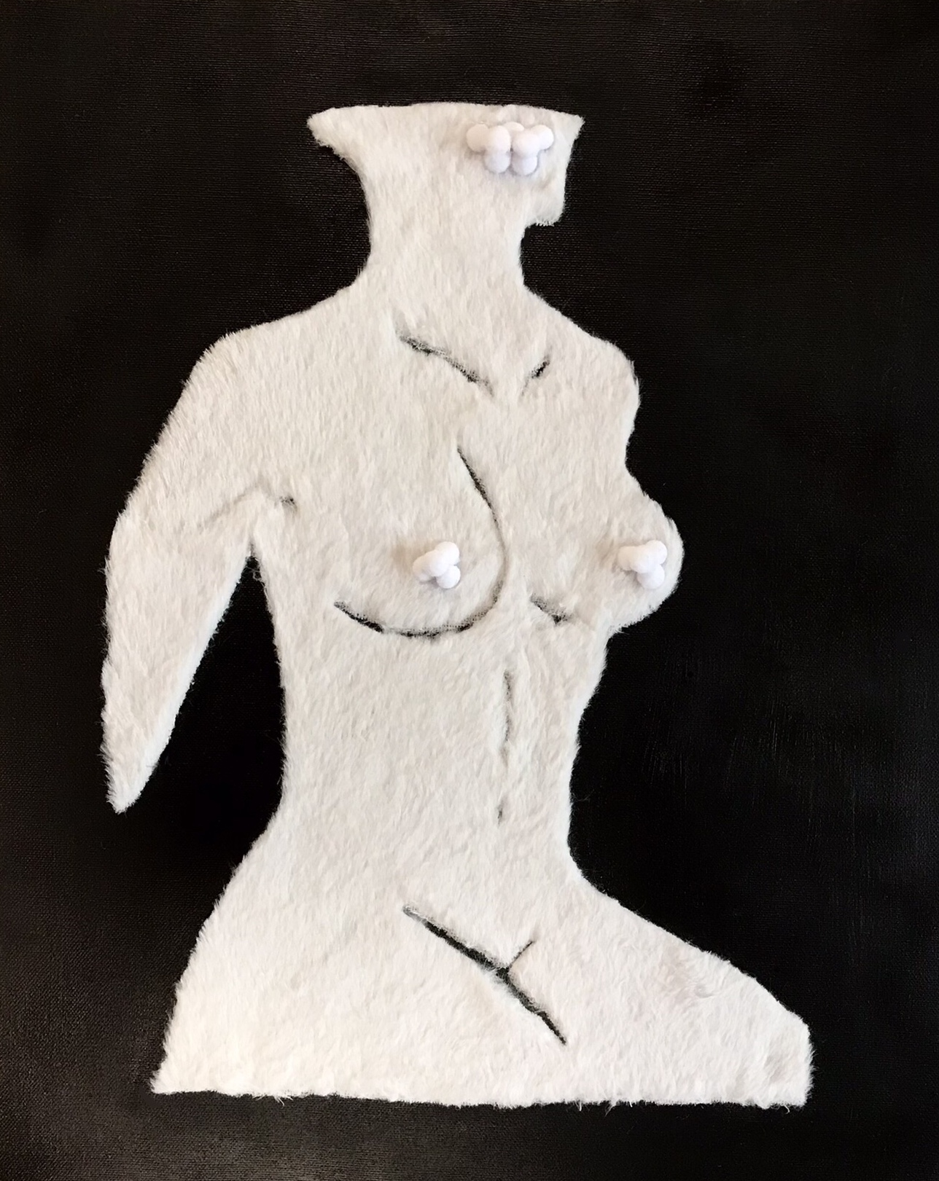
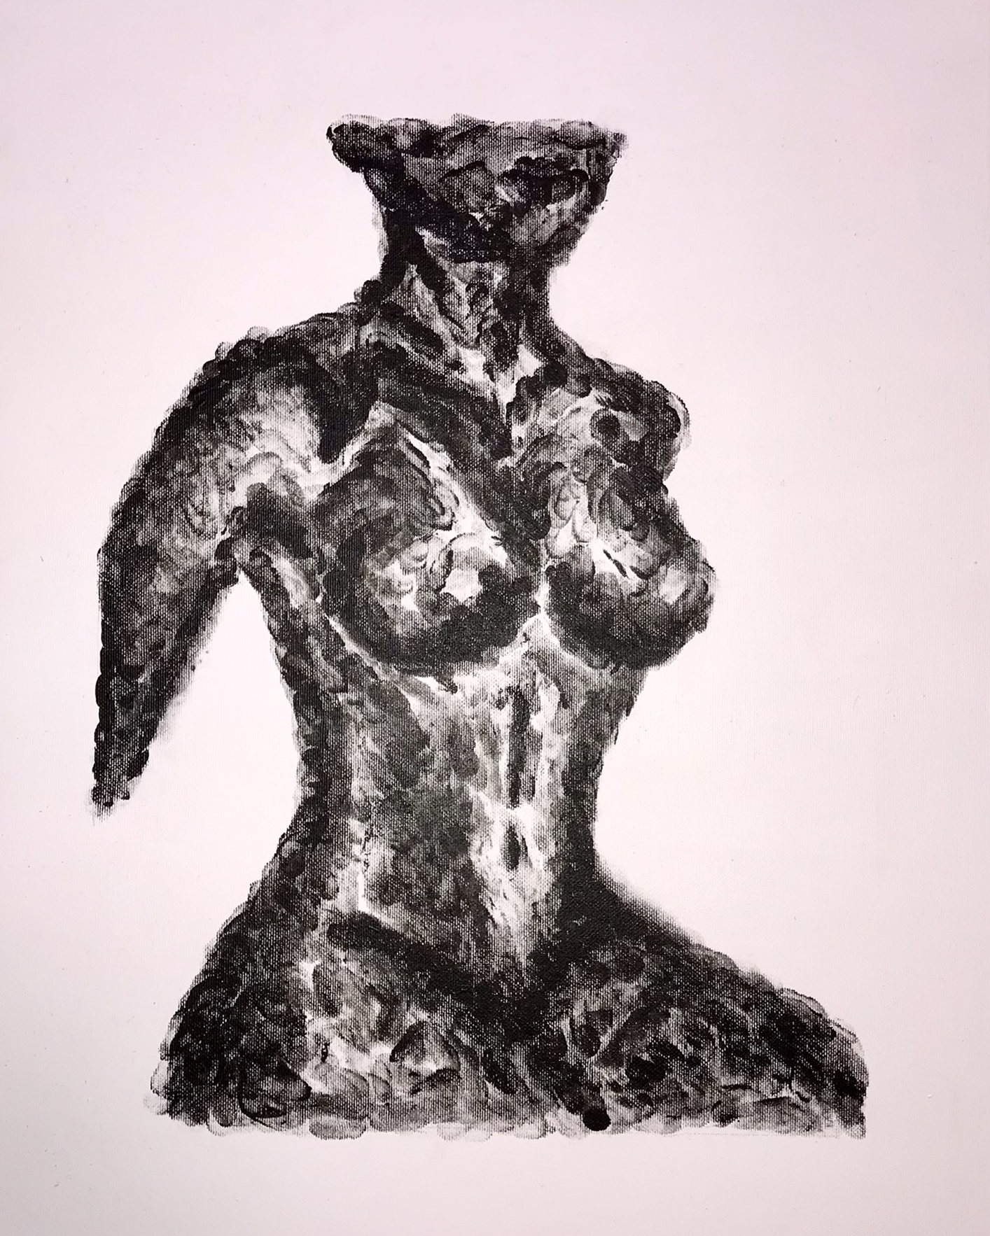
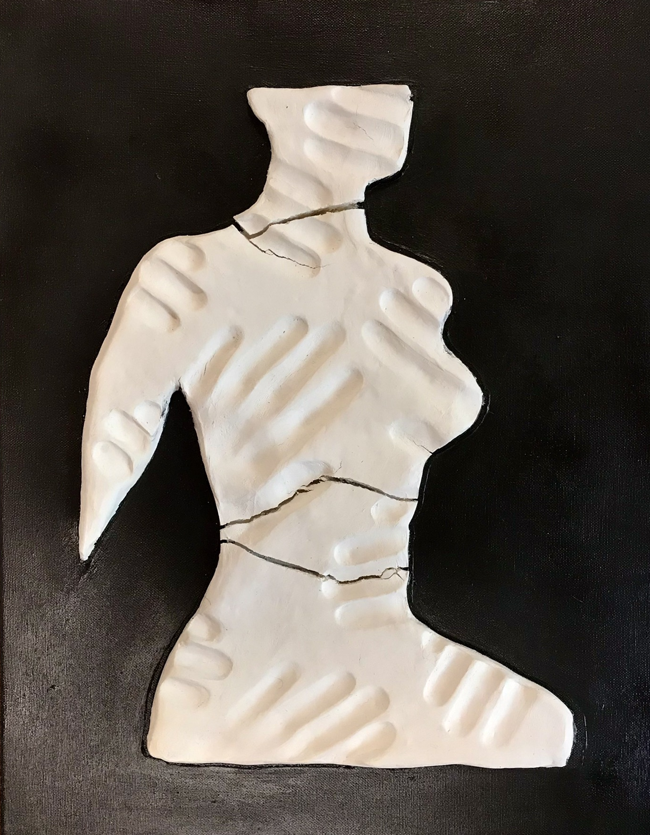
Kací Dotyk aneb Prosíme, nedotýkejte se vystavených exponátů
ˇ

Slide 14
Thank You for Your Attention

Slide 15
Resources
https://www.ncbi.nlm.nih.gov/pmc/articles/PMC9472646/
https://intuitivecreativity.typepad.com/expressiveartinspirations/100-art-therapy-exercises.html
Umělkyně Eva Koťátková: Někdo přece musí mluvit i za zvířata nebo stromy — ČT art — Česká televize (ceskatelevize.cz)
Official Website Kateřina Šedá (katerinaseda.cz)
https://intuitivecreativity.typepad.com/expressiveartinspirations/100-art-therapy-exercises.html

