Slide 1
Vybraná témata dějin německy mluvících zemí po roce 1945
JMB247 Seminář k dějinám NMZ
PhDr. Michal Dimitrov, Ph.D.

Slide 2
11. seminář – 29. 4. 2025
Migrační krize v Německu:
„Wir schaffen das!“
Oder doch nicht?
prezentace: Jan Pačes

Slide 3
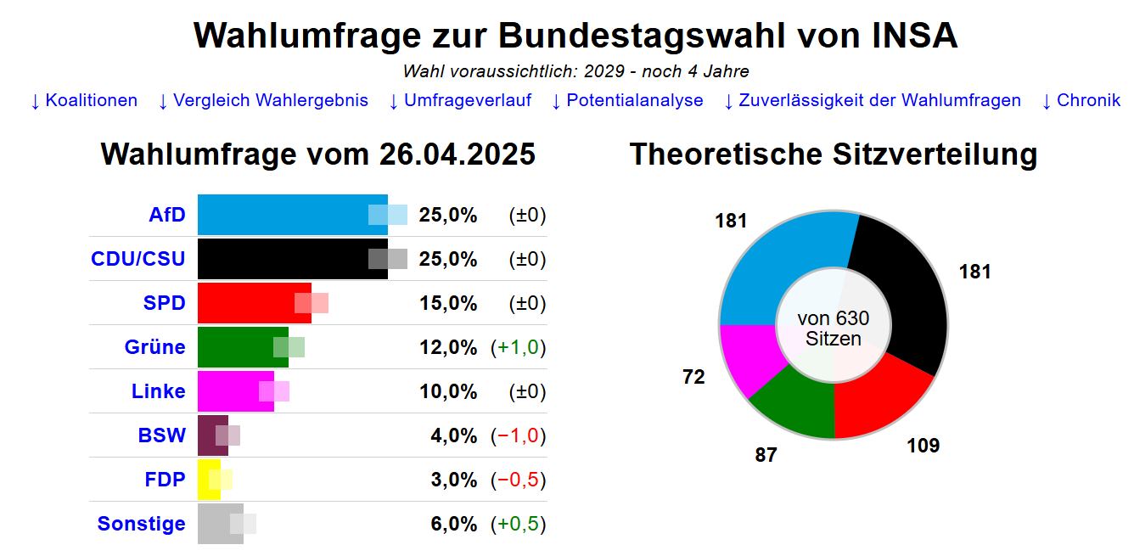
Kdyby v sobotu byly volby do Spokového sněmu…

Slide 4
Hlavní trasy migrace v roce 2015

Slide 5
Migrační saldo v Německu (1950-2020)

Slide 6
Jak se
z „uprchlické krize“
stala
„migrační krize“
?

Slide 7
Motto
„Migration is about more than influxes of people; it is also about influxes of images, emotions, and arguments.“
(Ivan Krastev)

Slide 8
Prezentace
Migrační krize v Německu
Jan Pačes

Slide 9
Text na přípravu
Inken Rommel, „We are the People.“ Refugee–Crisis and the Drag Effects of Social Habitus“, in Historical Social Research / Historische Sozialforschung 42 (4) 2017, 133-154.

Slide 10
Otázky k textu Rommelové (1)
1) Vysvětlete koncept „drag-effect of habitus“ Norberta Eliase a související pojmy „social habitus“?
2) Jaká je hypotéza autorky – jakým způsobem ji testuje?
3) Jak pracuje s pojmem „New Right“? (Co je „Old Right“)?
4) Jak se vyvíjela politická strategie Alternative für Deutschland? (témata, ideologie…)
5) Jaký je rozdíl mezi Alternative für Deutschland a PEGIDA – proč PEGIDA nakonec nebyla úspěšná?

Slide 11
Otázky k textu Rommelové (2)
7) Jaký je obsah pojmu „We are the people!“ („Wir sind das Volk“)?
8) Kolik procent obyvatel v citovaném výzkumu z roku 2016 souhlasila s tvrzením, „society is beiing inflitrated by muslims“?
9) Co znamená pojem „Lügenpresse“?
10) Interpretujte Tab. 1 („Dividing lines“)
11) Jak autorka vysvětluje různorodou kompozici tzv. „New Right“?
12) Vůči komu/čemu se vymezuje „Conservative Revolution“?

Slide 12
Štěpné linie v otázce migrace

Slide 13
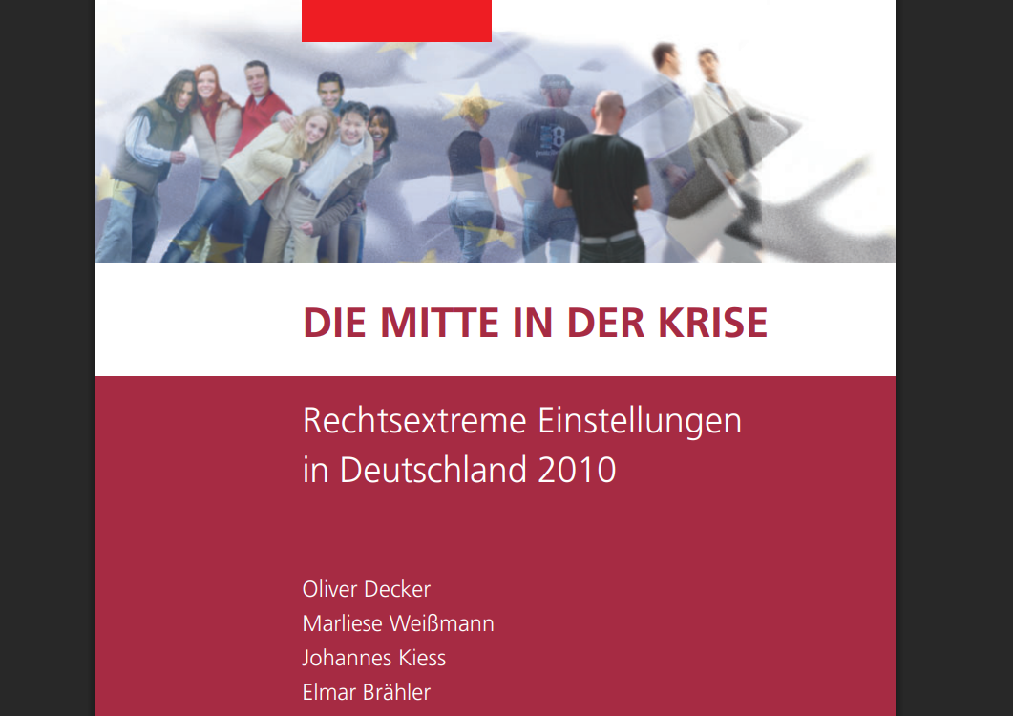
Střední třída v krizi (Studie FES, 2010)

Slide 14
Transformace strachu do odmítnutí
The transformation of fear into rejection can be attributed to a loss of trust in the ability to control national institutions, missing information, or successful propaganda about a refugee crisis. (Zick 2016, 215, translation I. R.)
Politicians and journalists should therefore not take part in heating up the mis- trust within society, but maintain a distanced perspective on real problems.
(Inken von Rommel, p. 152)

Slide 15
„Migration as a New Revolution“ (Krastev)
„People no longer dream of the future. Instead, they dream of other places. In this connected world, migration—unlike the utopias sold by twentieth-century demagogues— genuinely offers instant and radical change. It requires no ideology, no leader, and no political movement. It requires no change of government, only a change of geography. The absence of collective dreams makes migration the natural choice of the new radical. To change your life you do not need a political party—you only need a boat. With social inequality rising and social mobility stagnating in many countries around the world, it is easier to cross national borders than it is to cross class barriers.“

Slide 16
„Winners“ vs. „Losers“
„The media are full of stories about people who have found themselves in a totally foreign world, not because they moved but because others moved to them.“
(Krastev)

Slide 17
Budapest, September 3, 2015
Thousands of refugees, including hundreds of children, wait in limbo at Budapest’s Keleti train station on Thursday night
The Guardian, 3. Sept 2015
https://www.theguardian.com/world/2015/sep/03/hungary-train-diverts-refugees-back-to-camp

Slide 18
Hungarian-Serbian Border, September 17, 2015
Refugees trapped in Serbia attempt to storm Hungarian border
The Guardian, 17. Sept 2015
https://www.theguardian.com/world/video/2015/sep/17/refugees-trapped-in-serbia-attempt-to-storm-hungarian-border-video

Slide 19
European Migrant/Refugee Crisis since 2015
a period beginning in 2015
when rising numbers of people arrived in the EU
travelling across the Mediterranean Sea of through Southeast Europe
these people included asylum seekers, but also economic migrants and some hostile agents, including Islamic State militants disguised as refugees or migrants
most of the migrants came from Muslim-majority countries (Western Asia, South Asia and Africa)
over the Mediterranean Sea – from January 2015 to March 2016
TOP 3: Syrian (46,7 %), Afghan (20,9 %) and Iraqi (9,4 %)
over 1.2 million first-time asylum applications in 2015 (+112 % to 2014)
4 states (Germany, Hungary, Sweden and Austria) received around two-thirds of the EU's asylum applications in 2015

Slide 20
Notes:
Asylum applications in EU and EFTA states between 1 January and 30 June 2015, according to EUROSTAT data

Slide 21
First Time Asylum Applicants 2008-2016

Slide 22
Merkel and a common responsibility
June 2015:
”[…] the pan-European responsibility does not end at the sea rescue. Also in reference to reception of refugees solidarity between the Member States should be self-evident. It cannot be that three-quarters of all asylum seekers are received from only five Member States of the European Union. All Member States have the responsibility to participate in accepting refugees at an appropriate level. Solidarity and responsibility must go hand in hand . […]”

Slide 23
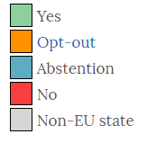
Relocation of 120,000 refugees (vote Sept 22, 2015)

Slide 24
Reactions of CEE states to the quota system:
Czech Interior Minister Chovanec on Twitter: "Common sense lost today.“
Czech Government's Secretary for European Affairs Prouza: “If two or three thousand people who do not want to be here are forced into Czech Republic, it is fair to assume that they will leave anyway. The quotas are unfair to the refugees, we can't just move them here and there like a cattle."
Slovak Prime Minister Fico threatening legal action over EU's mandatory migrant quotas at European Court of Justice in Luxembourg; Slovakia will accept only Christians (lack of mosques in Slovakia); “I will never allow a single Muslim immigrant under a quota system

Slide 25
Reactions of CEE states to the quota system:
Hungarian Prime Minister Orbán: "tens of millions of migrants could come to Europe“, „EU’s first duty is to protect its member states’ citizens“
Poland's European affairs minister designate Konrad Szymański: „No possibility of enacting the EU refugee relocation scheme (…) "We'll accept [refugees only] if we have security guarantees.“ (November 2015)
Jaroslaw Kaczyński: Newcomers may bring disease.

Slide 26
Angela Merkel and the refugee crisis
„The fundamental right to asylum for political persecuted people knows no limit; the same goes for the refugees coming from the hell of a civil war to us.“
Angela Merkel, September 11, 2015)
„If we now have to start apologizing for showing a friendly face in response to emergency situations, then that's not my country.“
(Angela Merkel, September 11, 2015)

Slide 27
Merkel: „Wir schaffen das.“
”I say simply : Germany is a strong country. We should approach things with this motif: we have done so much – we will manage this! [...] The federal government will do everything in its power - together with other countries, together with the municipalities […].” (Merkel, 31 August 2015.)
”[…] We have to accept large numbers of people and given they have a right to stay, we should integrate them in our countries. We should here remind us of our fundamental values, guided by the Article 1 of our Basic Law: human dignity shall be inviolable.” (Merkel, 11 September 2015.)

Slide 28
No Accident?
local version of the popular revolt against globalization
roots in history, demography, and the twists of postcommunist transitions
(Ivan Krastev)
how much ethnic and religious identities matter despite almost three decades of European integration

Slide 29
CEE and their experience with multicultural society
Western Europe
attitudes towards rest of the world shaped by colonialism and its emotional legacy
Central and Eastern Europe
states were born from the disintegration of empires and the outbreaks of ethnic cleansing that went with it
defensive nationalism
CEE do not share the West European Post-Colonial-Complex

Slide 30
Poland 1937

Slide 31
Czechoslovakia 1930

Slide 32
Slovakia 1910

Slide 33
Slovakia 2011

Slide 34
Hungary 1919
Notes:
Kingdom of Hungary lost 72% of its land and 3.3 million people of Hungarian ethnicity.

Slide 35
Ethnicity of Visegrád Countries Today
Czech Republic – 95 % Czechs (etnically and linguistically)
Slovak Republic – 80,7 % Slovaks
Poland – 98 % Poles
Hungary – cca 95 % Hungarians

Slide 36
Foreign-Born Population in Europe (2015)
Notes:
https://jakubmarian.com/wp-content/uploads/2015/07/immigrants-europe.jpg

Slide 37
The Fear of Ethnic Disappearance
small nations
nationhood defined by language, culture, and often religion
historical experience – divided and ruled by the big ones (Germany, Russia, Austria…), „victims“
aging society
emmigration (Poland)
arrival of (young) migrants
exit from history
existential melancholy

Slide 38
„Winners“ and „Losers“ of Transition after 1989
CEE could import Western political institutions, but not the social identities that support them („democracy without democrats“)
tension between cosmopolitanism (Havel, Michnik) and nationalism (Klaus, Zeman, Kaczyński, Orbán)
displacement of the border between left and right by the border between internationalists and nativists
cleavage „city“ vs. „country“
deeply rooted mistrust of the cosmopolitan mindset

Slide 39
„Winners“ and „Losers“ of Transition after 1989
consensus disappears (identity of the postcommunist voter) - desire to find a place in the new order of freedom and democracy withers
economic crisis, no economic growth anymore (x Poland)
rise of unequality („rich“ and „poor“)
still poorer than Western Europeans = feeling as a second class EU-citizens
everything being decided in Brussels (budget, migration policy) – loss of power of a common citizen
lack of selfconfidence
“transformative power” of the EU declines (CEE became members of the EU), EU = „tool of market globalization“
in the CEE region, post-1989 liberalism meant “democracy, markets, and European integration” = all in crisis now
migration crisis = cultural identity has taken center stage.

Slide 40
West-East Divide in Europe Again?
CEE countries:
1) departure from the rule of law as the foundation of liberal democracy
2) a recourse to nationalism as the principal source of political legitimation, complete with hardened identity politics. In the context of a major crisis of migration into Europe, these features have reopened an East-West divide within the EU.

Slide 41
Illiberal Democracies in CEE
Europe: the rise of populist nationalism
only in CEE reach power (x FRA, NED, GER, AUT…)
regression of democracy in Europe
hegemony of a democratically elected ultramajoritarian and illiberal party
majoritarian regimes in which the majority has turned the state into its own private possession
seek a strong executive power and see checks and balances, constitutional courts, and other presumably politically neutral institutions as imposing undue constraints on the sovereignty of the people

Slide 42
Illiberal Democracies in CEE
Hungary 2010 - Viktor Orbán’s Fidesz party wins a two-thirds constitutional majority in the National Assembly
undermining the separation of powers, the independence of the judiciary (Constitutional Court) and the freedom of the public media
Slovakia 2012 – Robert Fico´s SMĚR gets 83 seats out of 150 in the National Assembly
Fico = „the Orbán of the Left“
Poland 2015 – victory of Jarosław Kaczyński’s PiS (Law and Justice) party in the October 2015 election
similar way as Orbán
Czech Republic – 2017 ? (Babiš + Communists?)
government during the migration crisis – „refugees not welcome“

Slide 43
Illiberal Democracies in Hungary and Poland
support for Orbán and Kaczyński
mix of economic nationalism and social welfarism
compassionate conservatism
concern for those whom the transition to the market has left behind
protection of the „true Hungarians“, „true Poles“
„the people“ vs. „the elites“
the right-versus-left divide has been replaced by a split between national conservatives and pro-European liberals
in the context of a major migration crisis, it is a „culture war“ (Rupnik)—rather than the economy— that has weakened liberalism and facilitated the slide toward “illiberal democracy”

Slide 44
Migrační krize – Německo vs. Visegrád?
TEXT:
Jacques Rupnik, „Surging Illiberalism in the East“, in Journal of Democracy, Volume 27, Number 4, October 2016, pp. 77-87 (Article) Published by Johns Hopkins University Press https://doi.org/10.1353/jod.2016.0064

Slide 45
Seminář 6. 5. 2025
Text na přípravu:
Miriam Solera Ureña, „The dependence of Germany on Russian gas: analysis and prospects in the context of the current Ukrainian crisis“, in Comillas Journal of International Relations, Vol. 2, No. 4 (September-December 2015), pp. 52–72.
Prezentace:
Matyáš Bechný

