Slide 1
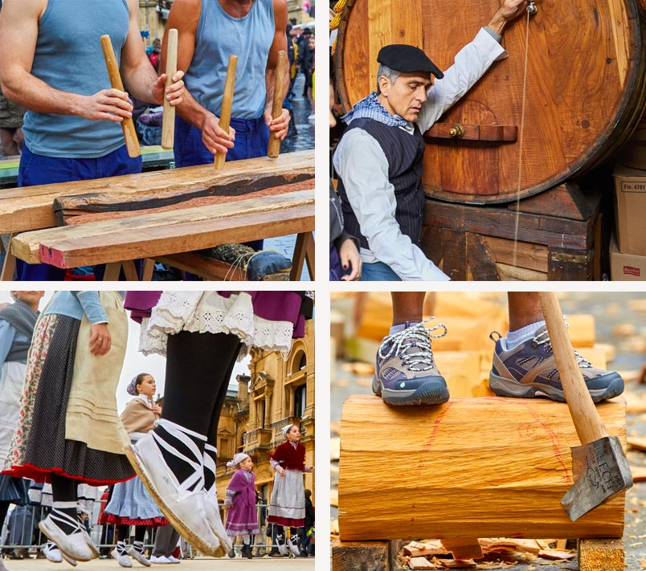
EUSKAL JAIAK BASQUE POPULAR FESTIVALS

Slide 2
BASQUE POPULAR FESTIVALS
MAIN FESTIVALS IN BASQUE CITIES:
San Fermines- Iruña / Pamplona – Navarre
La Blanca - Vitoria / Gasteiz - Alava
Aste Nagusia / Big week- Donostia / San Sebastian - Gipuzkoa
Aste Nagusia / Big week in Bilbao - Vizcay
Baiona festival - Lapurdi -- Iparralde / French Basque Country

Slide 3
SAN FERMIN FESTIVAL- 7 JULIO – IRUÑA/PAMPLONA
https://www.youtube.com/watch?v=60Q-urFem7Q
From July 6 to July 14
TXUPINAZOA
THE RUNNING OF THE BALLS
8:00 AM
2-3 min
875 m
Txupinazo in 2013
https://www.youtube.com/watch?v=vHUKC6suQos

Slide 5
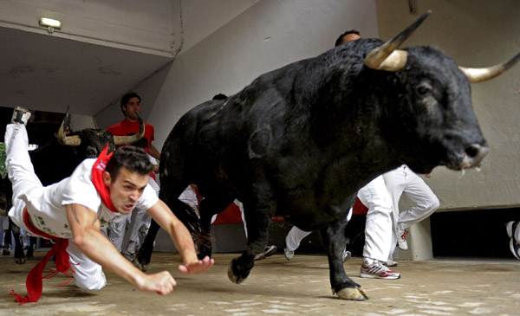

Slide 6
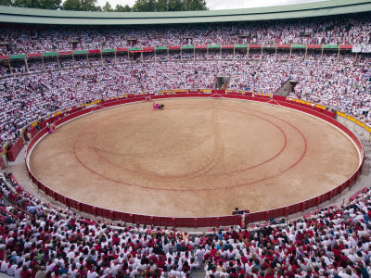
BULLFIGHTING IN THE AFTERNOON

Slide 7
THE RUNNING OF THE BULLS
The running of the bulls was born from the need to move the bulls from the outside of the city to the Plaza de Toros.
With runners it has been celebrated since 1880.
https://www.youtube.com/watch?v=5psHhu6rSxA

Slide 8
CLOTHING

Slide 9
PEÑAS

Slide 10
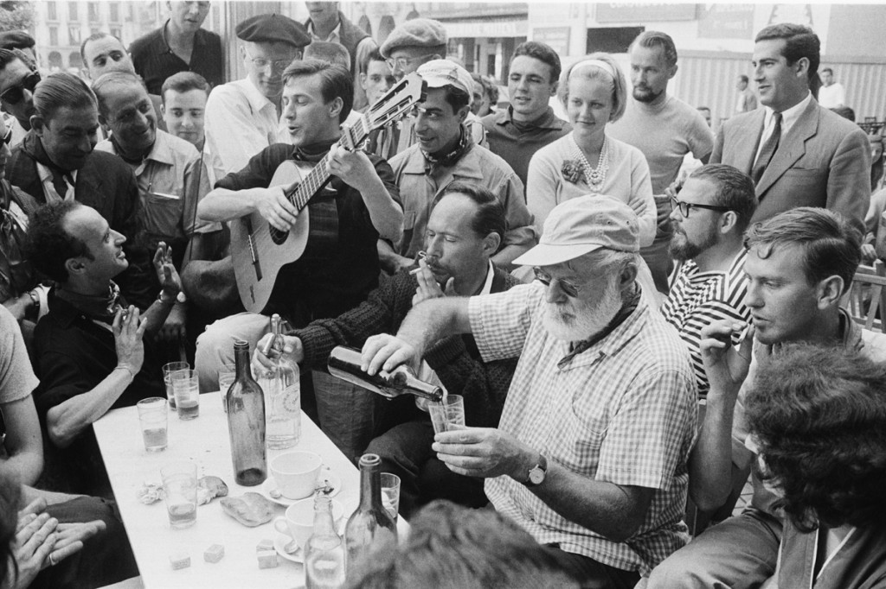
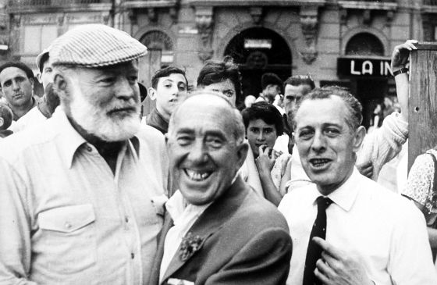
ERNEST HEMINGWAY

Slide 12
IS IT A BASQUE FESTIVAL? OLENTZERO AND SAN FERMIN CHANT
https://www.youtube.com/results?search_query=olentzero+joan+zaigu
https://www.youtube.com/watch?v=tQAU_S1WlAM

Slide 13
ASTE NAGUSIA – BIG WEEK IN BILBAO
3rd week of August. It lasts 9 days
MARIJAIA
Txupinazo
Gargantua
Txoznak
Music festivals, rural sports, fireworks,bertsolariak, gastronomic competitions ETC.
More tan 500 events take place during Aste Nagusia in BIlbao

Slide 14
MARIJAIA from 1978
https://www.youtube.com/watch?v=N_JAUeU6VkQ&t=62s
Txupinazoa: https://www.youtube.com/watch?v=rjYFgsenPss

Slide 15
Gargantua- Swallows boys and girls
Notes:
Es un tobogan que se traga a los niños

Slide 16
TXOZNAK

Slide 17
CLOTHING

Slide 18
ASTE NAGUSIA / BIG WEEK IN DONOSTIA/SS
The patron is the Virgen de Asunción
Week of August 15
CAÑONAZO
https://www.youtube.com/watch?v=QOTxJR8Xm6k
The axis of the festivities: fireworks
There is not a main symbol / protagonist
Music festivals, concerts
Gastronomic competitions, fairs
Shows more for tourism rather than locals
https://www.youtube.com/watch?v=Z-Mj0ETf8BU
Pirates from the post to La Concha beach
https://www.youtube.com/watch?v=ApBDG3AnJIQ
Aste nagusia is not as popula as in Bilbao or Gasteiz

Slide 19
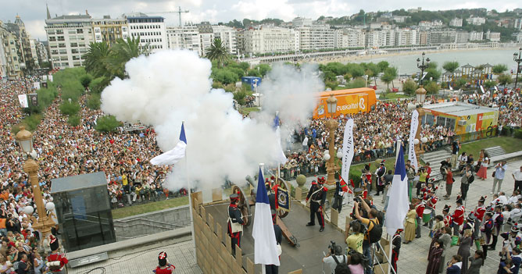
CAÑONAZO - DONOSTIA

Slide 20
FESTIVALS OF AMA ZURIA– VITORIA/GASTEIZ
Virgen Blanca, patron saint of Vitoria / Gasteiz,
from August 4 to 9
CELEDÓN since 1957
https://www.youtube.com/watch?v=96SJA1QjTOw
"The day of the blouse" and the Blouses
https://www.youtube.com/watch?v=mRRbvdG34ng
Choznas, rural sports exhibitions, music festivals
Few tourists
https://www.youtube.com/watch?v=96SJA1QjTOw

Slide 21
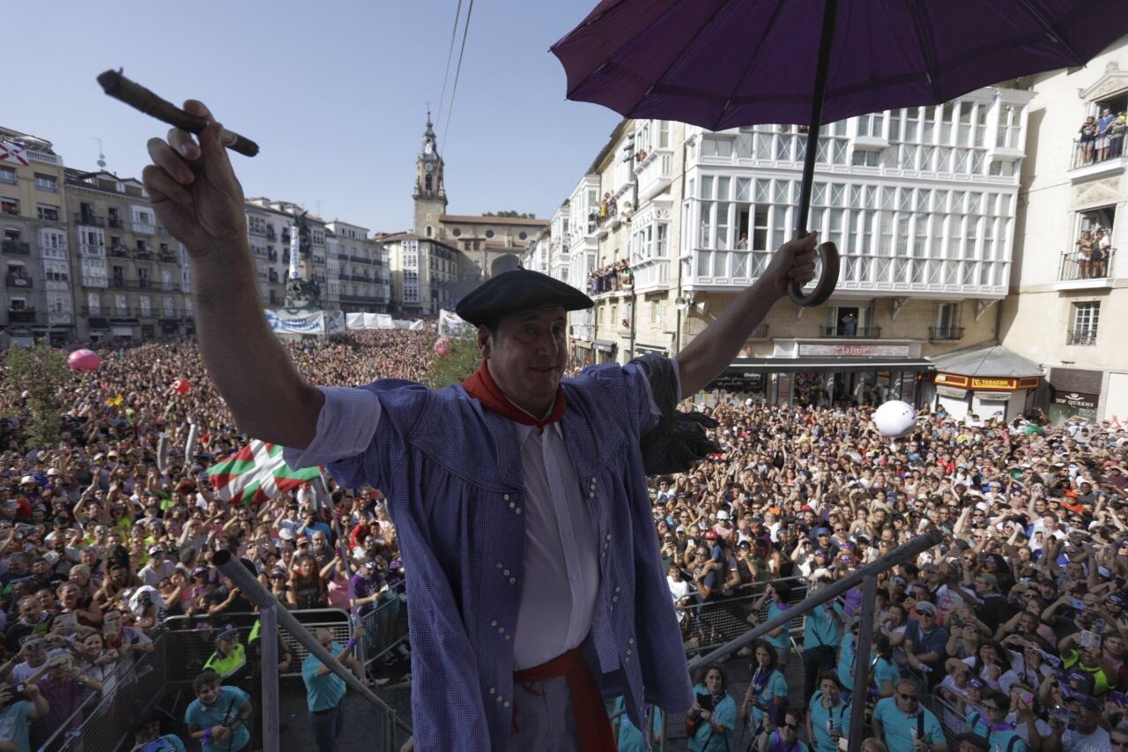
CELEDÓN - Symbol of the villager native of Alava

Slide 22
Fêtes de Bayonne in Lapurdi – FRENCH BASQUE COUNTRY
5 days at the end of July
Lion King on the balcony of the town hall throw the 3 keys to the city, one key for each neighborhood
1 million people every year
Red scarf like in San Fermin
https://www.naiz.eus/es/info/noticia/20180725/el-rey-leon-despierta-a-baiona-y-desata-la-fiesta

